Slide 1
Basic First Responder Training for Incidents Involving Grain Storage and Handling Facilities
Unit 3: Rescue Equipment
This material was produced under grant number SH-22307-11 from the Occupational Safety and Health Administration, U.S. Department of Labor. It does not necessarily reflect the views or policies of the U.S. Department of Labor, nor does mention of trade names, commercial products, or organizations imply endorsement by the U.S. Government.

Slide 2
Purpose
Discuss the importance in preplanning for emergencies at grain storage and handling facilities
Describe the type of rescue equipment that is needed and potential hazards associated with it’s use
Demonstrate the use of grain restraint systems

Slide 3
Pre Planning
It is unlikely that any one fire/rescue team will have all the equipment, or skills, necessary to conduct a successful rescue from a grain storage or handling operation.
Consequently:
Pre-planning is essential
Mutual-aid agreements need to be in place
The location of key resources need to be identified
Lot’s of support is needed- working cooperatively

Slide 4
Before an Emergency Occurs
Identify available resources – both public and private
Identify the type of grain storage and handling facilities in the area
  Flour mill
  Distilleries
  Feed mill
  Elevator
  Ethanol plants
Get with local facility owners and tour their operations
Get with farmers and tour their facilities
Contribute to prevention/safety efforts

Slide 5
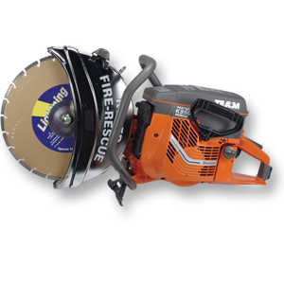
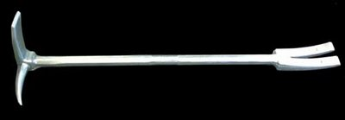
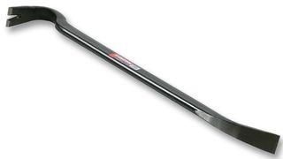
Becoming Familiar with Grain Storage and Handling Facilities will Help Identify the Rescue Equipment Needed at the Scene
Hooligan Tool or Pry Bar
K12 Rescue Saw with Abrasive Blade

Slide 6
Basic Rescue Equipment That Has Been Found Helpful at the Scene
Portable generators
Portable lighting system
Back boards
High angle rescue equipment
Communication

Slide 7
Cutting Tools
Rescue K12
Reciprocating saw
Torch
Angle Grinder
Air Chisel

Slide 8
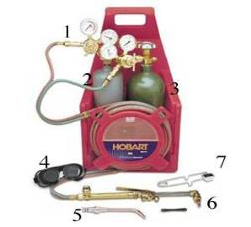
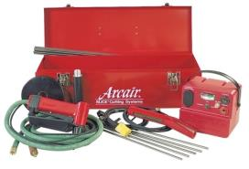
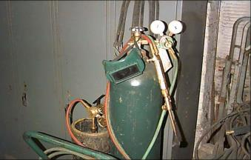
Various Cutting Tools
Portable Slice Pack
Portable Oxygen/Acetylene Torch
Wheeled Oxygen/Acetylene Torch

Slide 9

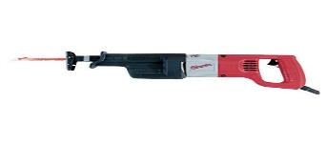
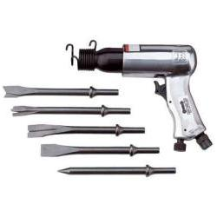
Various Cutting Tools
Battery Operated Saws All
110 Volt Saws All
Air Chisel

Slide 10
Hazards Associated with Cutting Tools
Flying debris
Contact with sharp edges and tool blades
Respiratory hazards from airborne dust and fumes
High sound levels

Slide 11
Risk of Fire/Explosion
Corn and most other grains have a relatively high ignition temperature
Many cutting tools generate sufficient heat to cause ignition
When cutting a charged line should be in place to extinguish any ignited material
There has been concern over ignition of grain dust
However, there is no documentation of a grain dust explosion ever occurring during a rescue attempt

Slide 12
Grain Bin Rescue Attempt with K-12 Rescue Saw

Slide 13
Grain Retaining System
A wide range of items have been used to build coffer dams.
Back boards
Plywood sheets (max. of 24” wide strips)
Barrels with ends cut out
Garbage cans
Metal roofing
Commercially available grain rescue tubes

Slide 14
Grain Retaining Devices and Rescue Tubes
Prevents the victim from being buried deeper
Allows rescuers the ability to remove the grain from within the tube, freeing the victim
The grain must be removed from around the victim rather than the victim removed from the grain

Slide 15
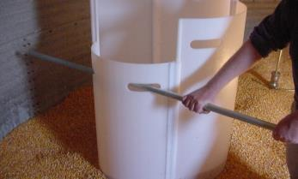
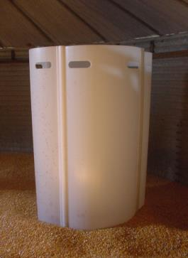
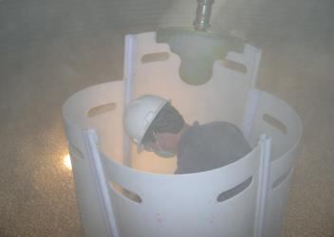
Liberty Rescue Tube

Slide 16
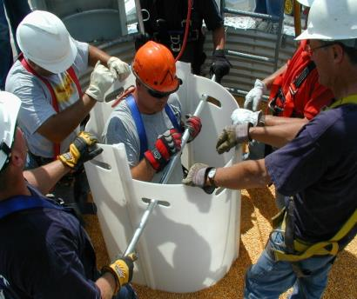
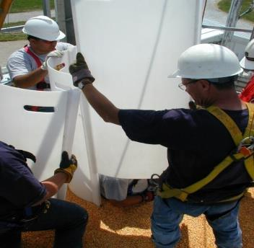
Liberty Rescue Tube

Slide 17
Grain Moving Equipment
In a typical rescue thousands of bushels of grain might have to be removed to access a victim. In addition to a large number of first responders, equipment to move grain will be essential.
This includes:
  Large grain shovels
  Portable grain auger
  Grain vacuum machines
  Front end or skid steer loader, pay loaders
  Grain trucks

Slide 18
Overhead Lift Point
If rescuers need to be lowered into the structure approved anchor points or overhead lift points will be needed, along with trained personnel to use them. This could include:
  Ladder or boom fire truck
  Tripod with manlift

Slide 19
Anchor Points
Most farm and feed lot grain storage operations do not contain approved anchor points that meet the load capacity specified in the federal confined space entry standards.
Since these facilities are exempt from compliance with either the grain handling or confined space entry standards they were not constructed to meet the standards.
If necessary, alternative anchor points for both fall protection and confined space entry will need to be configured.

Slide 20
Grain Vacuum Equipment
There has been an increased use of grain vacuum equipment in grain rescues
This equipment is found at most commercial grain storage facilities and on some larger farms
This equipment can move 1,000-2,000 bushels per hour of continuous use

Slide 21
Grain Vacuum Equipment Hazards
Presents the risk of first responder entrapment
Generates large amounts of dust

