Slide 1
Basic First Responder Training for Incidents Involving Grain Storage and Handling Facilities
Unit 2: Confined Spaces in Agriculture
This material was produced under grant number SH-22307-11 from the Occupational Safety and Health Administration, U.S. Department of Labor. It does not necessarily reflect the views or policies of the U.S. Department of Labor, nor does mention of trade names, commercial products, or organizations imply endorsement by the U.S. Government.

Slide 2
Purpose
Identify the types of confined spaces found in agricultural settings
Identify the risks related to agricultural confined spaces
Identify the grain handling and confined space entry standards
Explain the difference between OSHA exempt and non-exempt grain storage and handling facilities
Identify work practices that reduce the risk of grain-related injuries

Slide 3
Confined Space – OSHA Definition
A Confined Space:
      is large enough for an employee to enter fully and perform assigned work
      has a limited or restricted means of entry or exit
      is not designed for continuous employee occupancy

Slide 4
Permit Required Confined Space OSHA Definition
A Permit-Required Confined Space – has one or more of the following:
      Contains or has the potential to contain a hazardous atmosphere
      Contains a material with the potential to engulf someone
      Has an internal configuration that might cause an entrant to be trapped or asphyxiated by inwardly converging walls or by a floor that slopes downward and tapers to a smaller cross section
      Contains any other recognized serious safety or health concerns

Slide 5
Definitions
Flowable agricultural material – free flowing agricultural crops or material including grain.
Engulfment – events in which an individual is submerged, i.e. fully buried in agricultural flowable material, such as corn, small grains, or feed.
Entrapment – used in a broader way to describe events in which an individual is trapped, possibly due to engulfment, inside a structure considered in a confined space such as a silo, bin, grain transport vehicle, outdoor pile, or bunker silo, where self extrication is not possible.

Slide 6
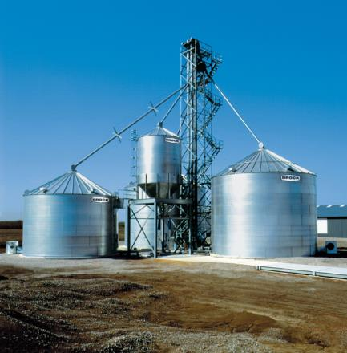
Confined Space in Agriculture
Confined Space Examples:
        Grain Bin
        Silo
        Manure Pit
        Hopper
        Storage Tank
        Other_________

Slide 7
Hazards Related to Agricultural Confined Spaces
Asphyxiation due to exposure to toxic environments
  Carbon Dioxide
  Methane
  Hydrogen Sulfide (manure)
  Ammonia (manure)
  Smoke/Carbon monoxide (fires)
Suffocation due to oxygen limited environments
Entrapments requiring extrication from flowable agricultural materials
Engulfments – fully buried in flowable agricultural material
Entanglements
Falls
Respiratory distress due to exposure to dust and microtoxins
Burns from fires and explosions

Slide 8
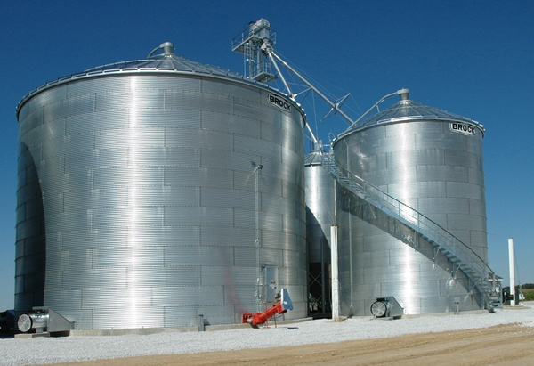
Large Scale Commercial Grain Operation

Slide 9
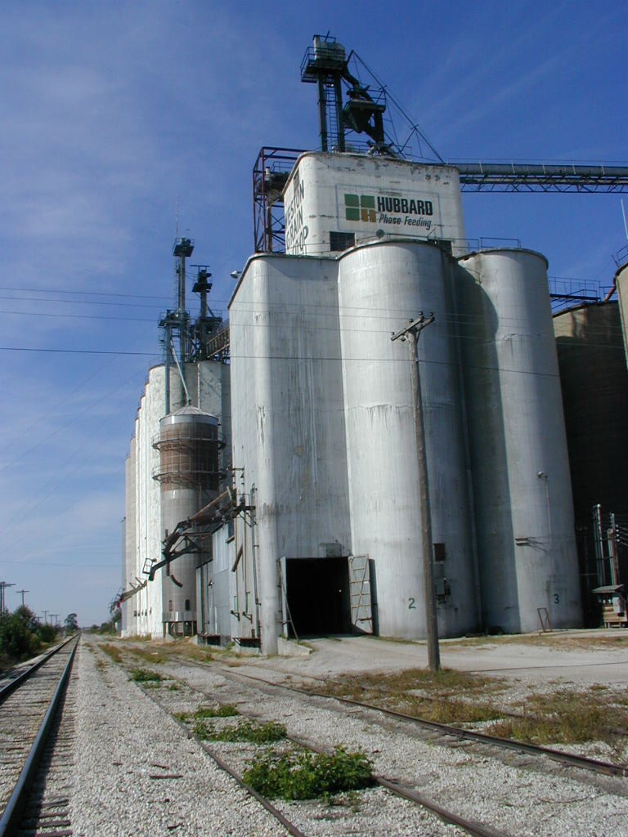
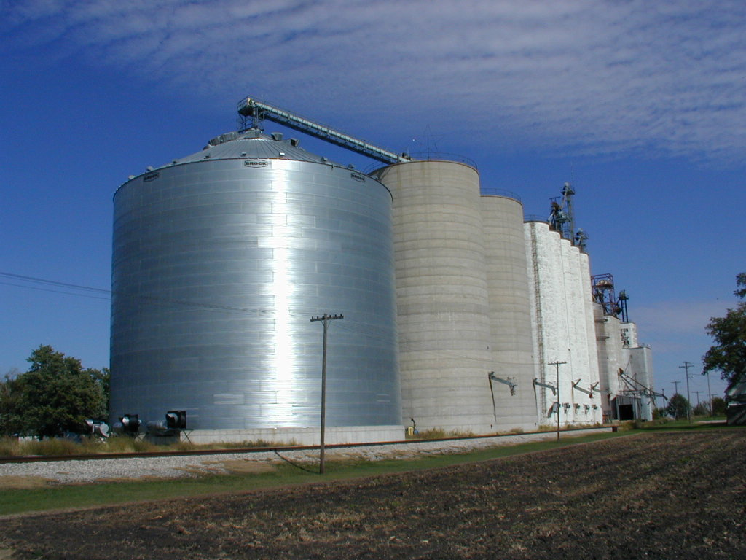
Commercial Elevators

Slide 10
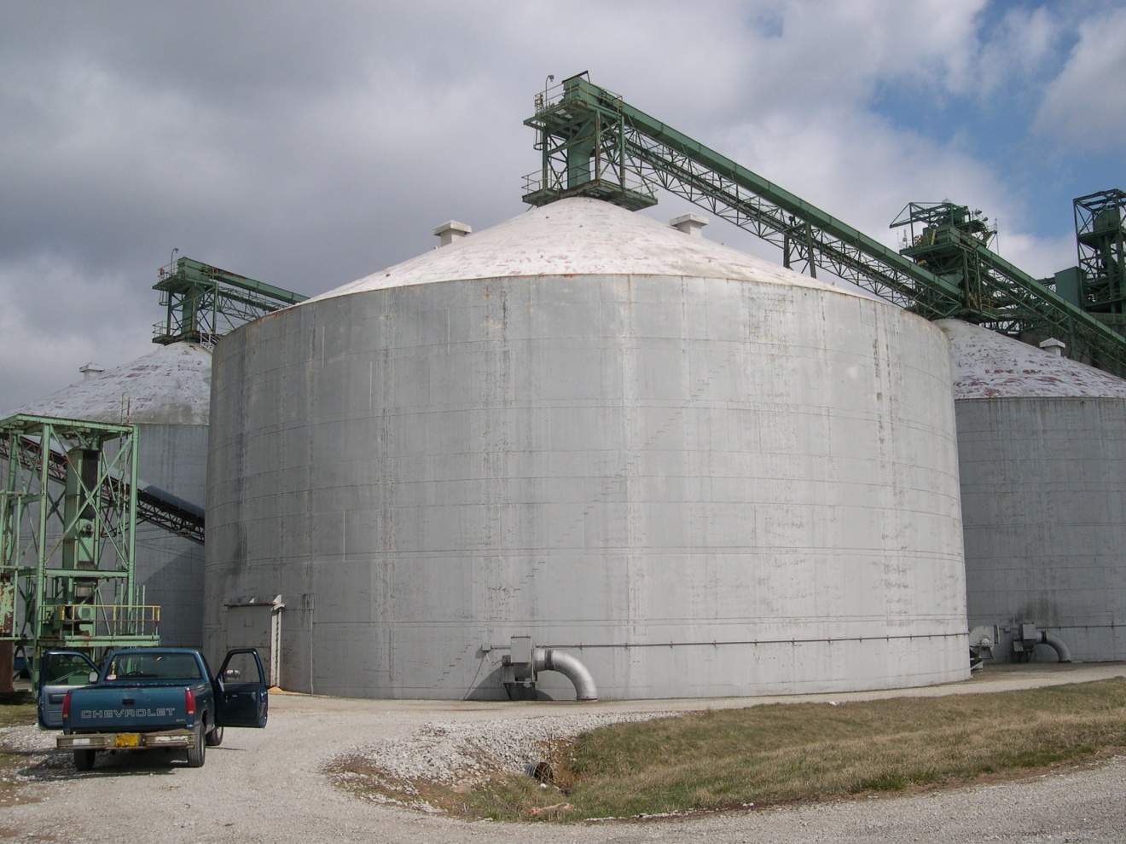
Large Grain Storage Tanks

Slide 11
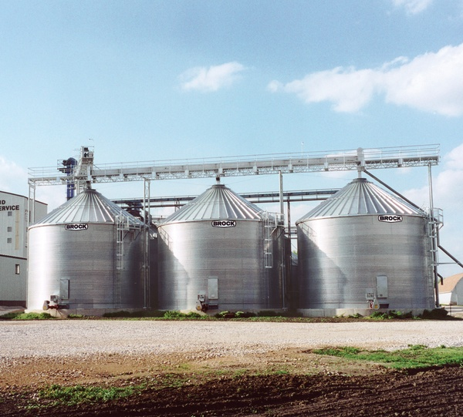
Commercial Seed Corn Operation

Slide 12
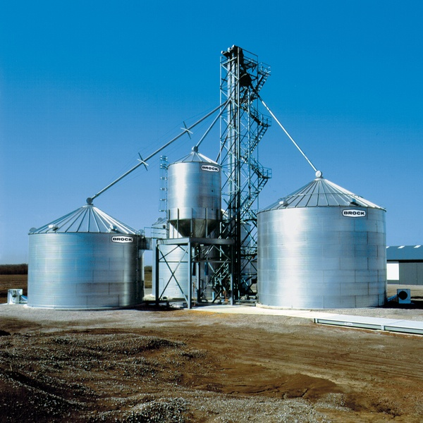
Farm Grain Storage and Grain Leg Operation

Slide 13
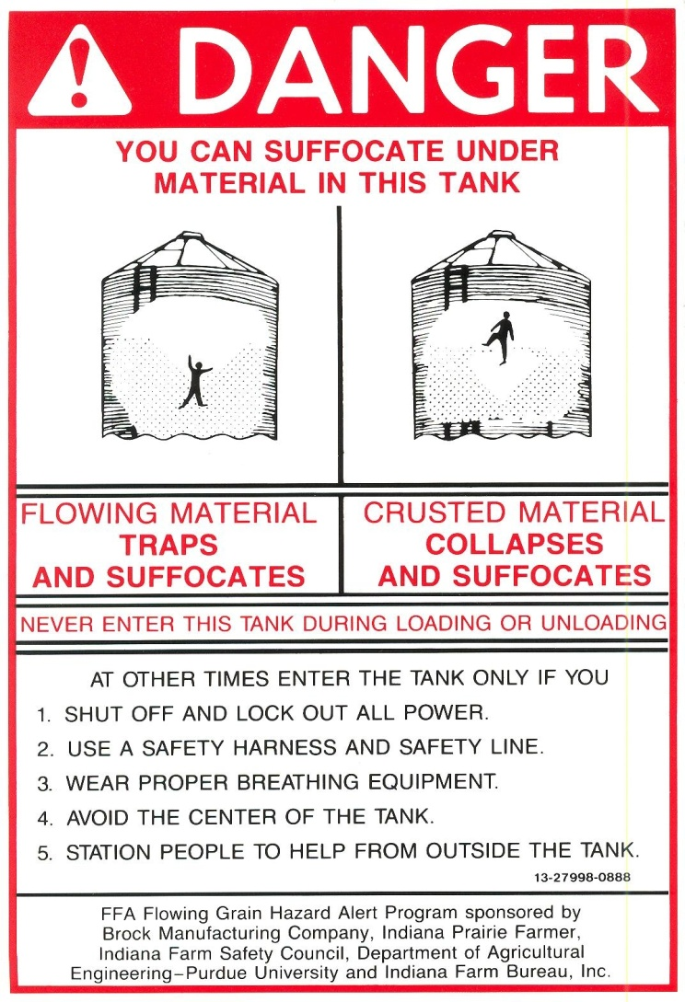
Grain Bin Warning Label

Slide 14
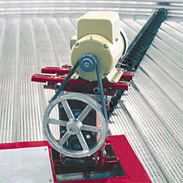
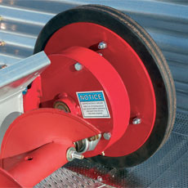
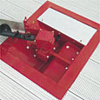
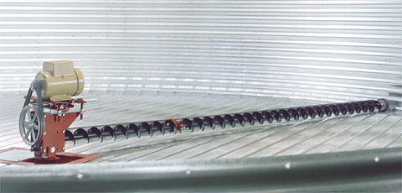
Grain Bin Sweep Auger for Unloading Grain

Slide 15
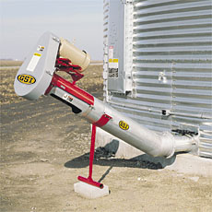
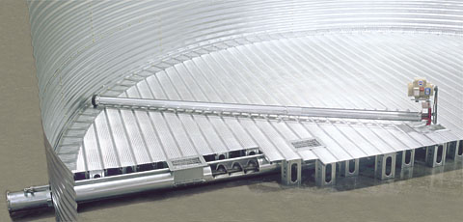
Bin Unloading
Equipment
Pictures from: Grain Systems Inc.

Slide 16
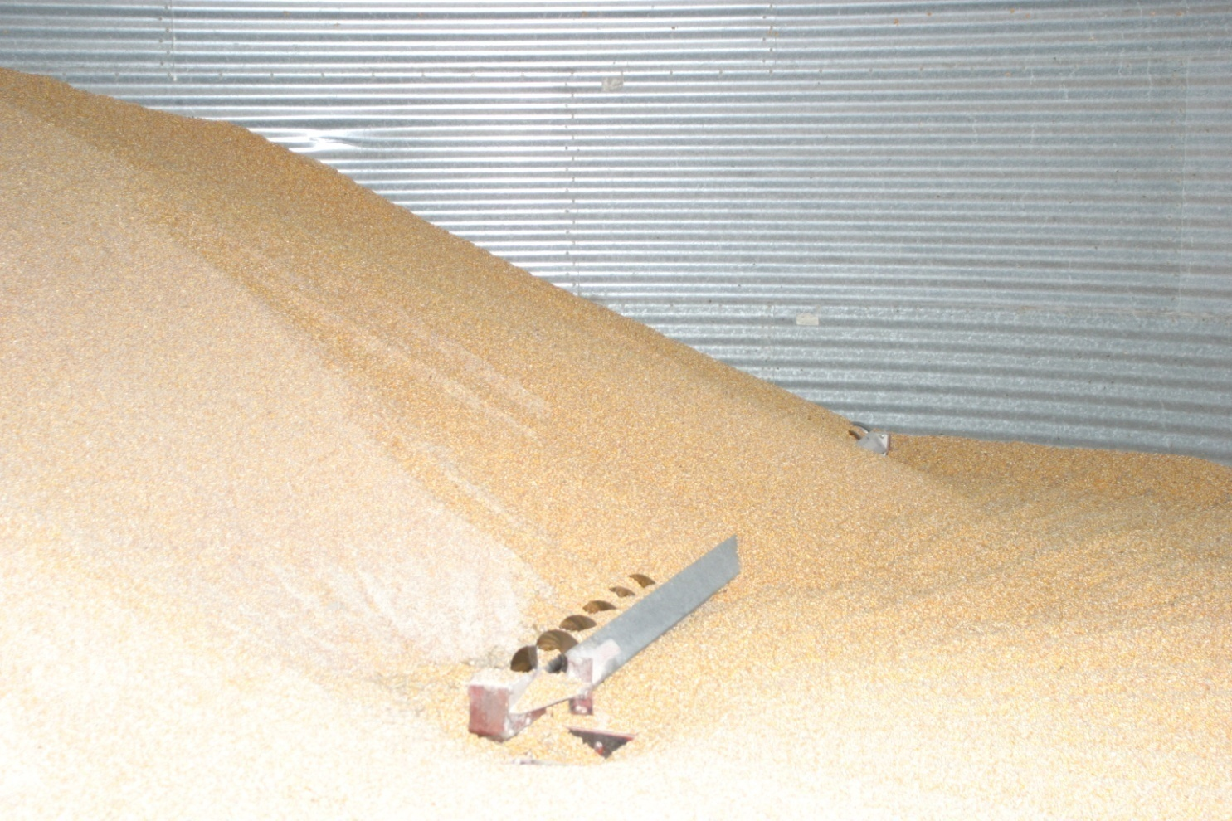
A Look Inside a Small Bin

Slide 17
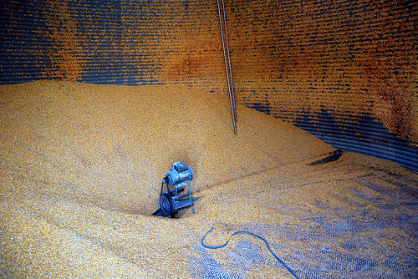
Out of Condition Grain Caked to the Side of a Grain Bin

Slide 18
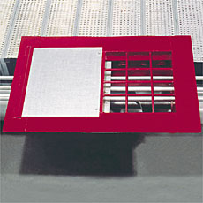
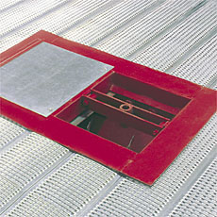
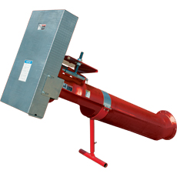
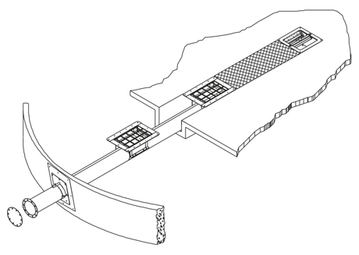
Grain Bin Unloading Auger

Slide 19
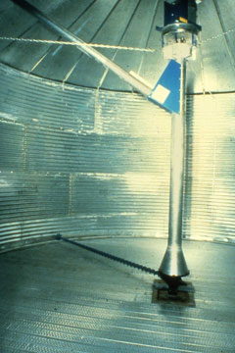
Grain Bin Transfer Auger

Slide 20
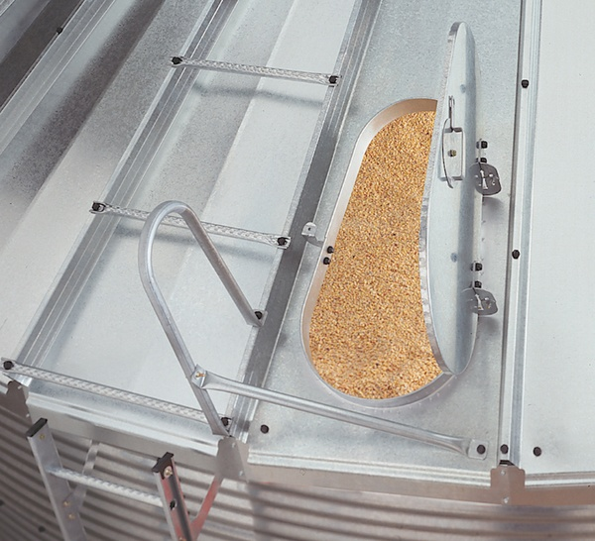
Grain Bin Roof Entry Door

Slide 21
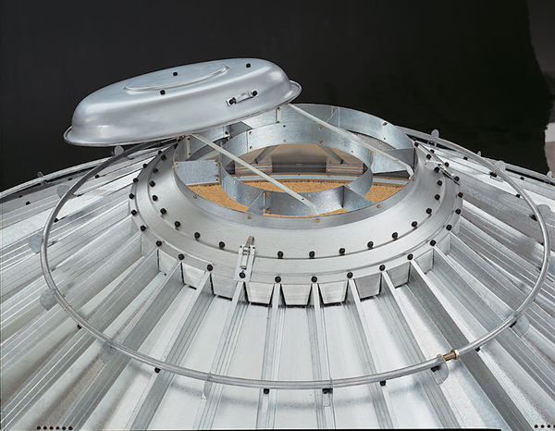
Grain Bin Filling Opening – Top of Bin

Slide 22
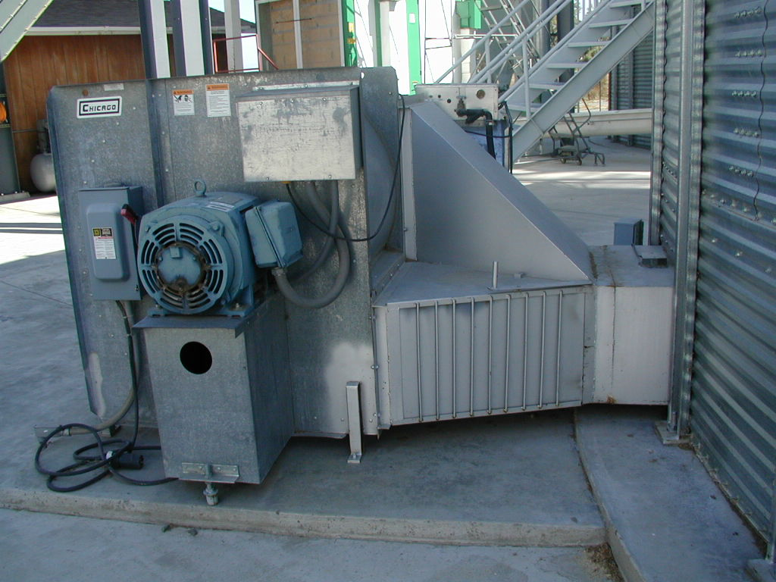
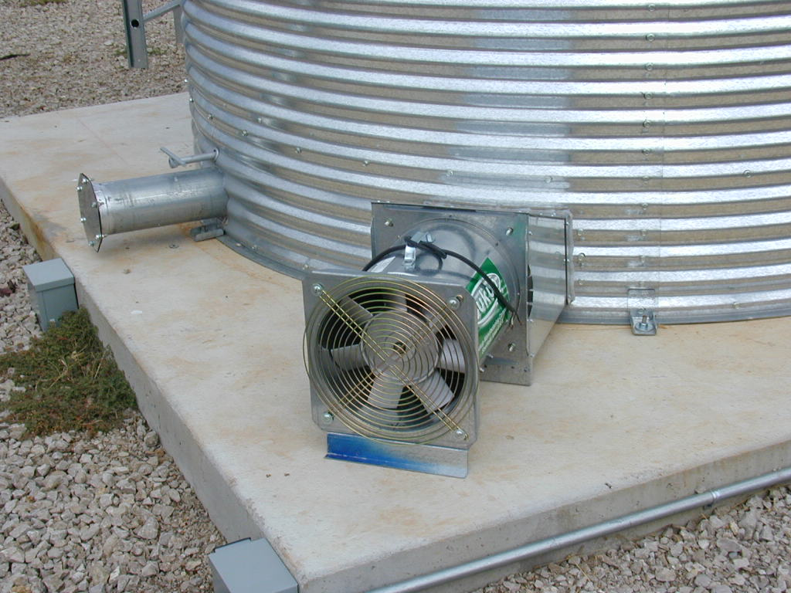
Aeration Equipment

Slide 23
Agriculture Confined Spaces Are
Generally Exempt from OSHA Compliance
OSHA 1910.146 Permit-required confined space
“This section does not apply to Agriculture”
OSHA 1910.272 Grain Handling Facilities
The standard contains requirements for new and existing grain handling facilities. The standard does not apply to seed plants which handle and prepare seeds for planting of future crops, nor to on-farm storage or feed lots.

Slide 24
Exempt vs. Non-Exempt Facilities
The OSHA grain handling and confined space entry standards currently exempt from compliance farms and feed lots.
Consequently, over half of the grain storage capacity in the U.S. is exempt from OSHA compliance.
Historically about 70% of all documented grain-related entrapments have occurred in exempt facilities.

Slide 25
Non-Exempt Facilities Must Have
Confined space entry permit system
Appropriate confined space entry equipment
  Lifeline and harnesses
  Air monitoring equipment
  Communication system
Emergency action plan
Documented training

Slide 26
Paid and Volunteer Response
“Both responding to confined spaces in agriculture is complex”
Volunteer & Paid responders, Need to comply with OSHA Standards
Volunteer responders to non-exempt facilities must still follow all OSHA Confined Space Rules
Volunteer Fire Dept. are public sector employers In. Code “36-8-12-2”
Paid responders to non-exempt facilities must follow all OSHA Confined Space Rules
Preplanning among response agency’s are essential for complex incidents

Slide 27
Preventing Emergencies in Confined Spaces in Agriculture
Grain Handling Safety Precautions
    Stay out of grain bins, wagons, and grain trucks when unloading equipment is running
    If you have to enter the bin, remember to lock out and tag out unloading auger
    Children should not be allowed to play in or around grain bins, wagons, or truck beds
    Ladders should be installed inside grain bins to provide an emergency exit.
    Paint brightly colored stripes just above ladders to make them easier to find in a dusty bin

Slide 28
Stay near the outer wall of the bin and keep walking slow and stop if the grain should start to flow.
Have another person, preferably two people, outside the bin who can help if you become entrapped. These people should be trained in rescue procedures.
Grain fines and dust may cause difficulty in breathing. Anyone working in a grain bin, especially for the purpose of cleaning the bin, should wear an appropriate dust filter or filter respirator.

Slide 29
    Don’t enter a bin with auto unloading equipment without locking out the control circuit
    Be cautious working with grain that is “out-of-condition”
    Dangers are mold, blocked flow, cavities, crusting, and grain avalanches
    Beware of steep piles of grain
    Never work alone !!!!

Slide 30
Respiratory Hazards
Small amount of spoiled grain can produce millions of tiny mold spores which easily can become airborne
Airborne mold spores can be inhaled through nose and mouth
Irritating sensitive lung tissue
In some cases can cause reactions so severe that hospitalization is necessary
Farmers without respiratory protection in moldy grain are especially vulnerable to mold reactions

Slide 31

Respiratory Hazards
This condition applies to truckers, scale operators, and dumping operators at an elevator
If exposed to high concentrations of mold spores, change clothing to avoid bringing the mold spores home and exposing family members
If you become ill after exposure to mold spores, seek medical attention

Slide 32
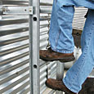
Preventing Falls
The more frequently a farmer climbs into a bin to complete the unloading process, the greater the risk of falling
With the greater level of storage problems many more injuries from slips, falls, around bins and transport equipment are possible
The potential for falls can be reduced by:
    Install appropriate ladders inside and outside
    Avoid using portable ladders

Slide 33
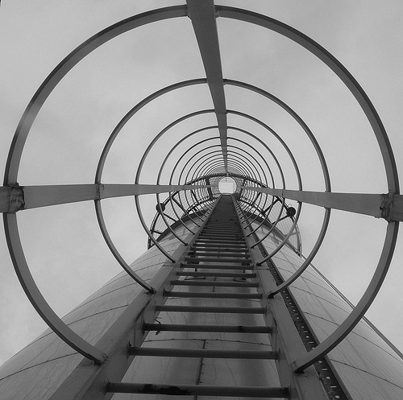
Preventing Falls
    Install resting platforms at top of each ladder to ease the transfer onto bin roof or into the bin
    Install ladder cages on all ladders over 30’ tall
    Keep shoes clear of mud
    If conditions are icy, delay access if possible
    Installing access ladders on trucks and using roll tarps will reduce the need to climb on trucks

