Slide 1
ERGONOMICS
School of Continuing Education
& Professional Development
Miami Dade College North Campus
OSHA - Susan Harwood Training Grant

Slide 2
Disclaimer
DISCLAIMER: This material was produced under grant number SH 208 32–SH–0 from the Occupational Safety and Health Administration, U.S. Department of Labor. It does not necessarily reflect the views or policies of the U. S. Department of Labor, nor does mention of trade names, commercial products, or organizations imply endorsement by the U. S. Government. The U.S. Government does not warrant or assume any legal liability or responsibility for the accuracy, completeness, or usefulness of any information, apparatus, product, or process disclosed. COPYRIGHT INFORMATION: This material is the copyrighted property of Miami Dade College. By federal regulation, OSHA reserves a license to use and disseminate such material for the purpose of promoting safety and health in the workplace. Miami Dade College hereby authorizes employers and workplace safety and health professionals to use this material, distributed by or through OSHA, in their workplaces or practices in accordance with the guidance contained in the material. To this end, permission is granted to use such copyrighted material solely for non-commercial, instructional, personal, or scholarly purposes. The material may be used and incorporated into other workplace safety and health programs on the condition that no fee may be charged for the subsequent use of the material. Use of the material for any other purpose, particularly commercial use, without the prior, express written permission of the copyright owner/s is prohibited. Furthermore, any modification to the material is prohibited without the prior, express written permission of the copyright owners.
OSHA - Susan Harwood Training Grant

Slide 3
Class Overview
Definition of Ergonomics
OSHA Guidelines
Ergonomics Stressors
Common Ergonomic Injuries
Recommended Solutions

Slide 4
Definition of Ergonomics
Ergonomics –(er-ge-na-miks)–n. Greek term for “the laws of work.”
The science of adapting workstations, tools, equipment and job techniques to be compatible with human anatomy and physiology to reduce the risk of Musculoskeletal Disorder injuries due to Ergonomic Stressors.
In other words, “fit the job to the person” rather than the “person to the job.”

Slide 5
Defining Musculoskeletal Disorder
Injuries caused by repeated physical trauma or exposure to a specific body part, such as the back, hand, wrist, or forearm
Also called repetitive strain injuries, repetitive motion disorders, overuse syndrome and Cumulative Trauma Disorders (CTDs)
Caused by Ergonomic Stressors

Slide 6
Common MSDs
Back Injuries
Neck Injuries
Lower Extremities Injuries
Hand Arm Vibration Syndrome
Carpal Tunnel Syndrome

Slide 7
OSHA Guidelines
Focuses on industries and employers with known high injury and illness rates related to ergonomic hazards.
Coordinates inspections with a legal strategy designed to target prosecutable ergonomic violations.
Serious ergonomics hazards will be addressed using Section 5(a)(1) of the OSH Act, often referred to as the General Duty Clause.

Slide 8
The General Duty Clause
The General Duty Clause describes the employer's obligation to "furnish to each of his employees employment and a place of employment which are free from recognized hazards that are causing or are likely to cause death or serious physical harm to his employees." This clause from the OSH Act is utilized to cite serious hazards where no specific OSHA standard exists to address the hazard, as is the case with ergonomic stressors.
When OSHA uses the General Duty Clause to cite an employer, OSHA must demonstrate that:
1) The employer failed to keep the workplace free of a hazard to which employees were exposed.
2) The hazard was causing or likely to cause death or serious physical harm.
3) The hazard was recognized.
4) A feasible means of abatement for that hazard exists.

Slide 9
Current Ergonomics Guidelines
Beverage Distribution
Shipyards
Poultry Processing Plants
Retail Grocery Stores
Nursing Homes
Meatpacking Plants

Slide 10
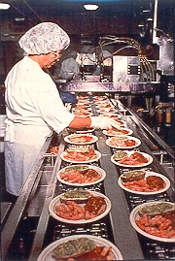
Workplace Stressors
Repetitive Motion
Assembly Line
Lifting
Climbing
Painting
Typing
Tool Operations

Slide 11
Workplace Stressors
Vibration
Grinders
Sanders
Drills
Chisels
Chainsaws
Jackhammers
Riveters

Slide 12
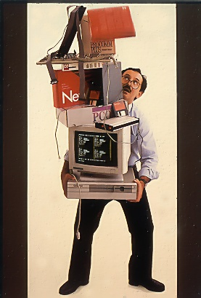
Workplace Stressors
Excessive Force
Lifting
Pushing
Pulling
Moving Heavy Objects

Slide 13
Workplace Stressors
Awkward Position
Reaching under
low Shelves
Holding object far away from your body
Painting ceilings

Slide 14
Conditions Aggravate with:
Age
Stress
Physical Conditioning

Slide 15
AVERAGE AGE OF ALL U.S. WORKERS

Slide 16
Our Reaction to Stress
Our bodies first reaction to stress, either
physical or emotional, is muscle tension
(Fight or Flight Syndrome)
A tense muscle is a tight muscle
Tight muscles are much more
susceptible to strains and sprains

Slide 17
Physical Conditioning
Lack Of Exercise
Poor Nutrition
Poor Sleep
Generally Unhealthy Lifestyle Habits

Slide 18
The Costs of Injuries
Direct
Diagnosis
Surgery
Rehab
Indirect
Turnover
Absenteeism Due to Unreported Injuries
Ongoing Benefit Costs
Overtime used to Cover Lost/Restricted Days
Morale
Product Damage
Bureaucratic Costs of Injury/Claims Handling
Accident Reporting
Accident Investigation
Case Management

Slide 19
SO HOW DO WE PREVENT THESE INJURIES?

Slide 20
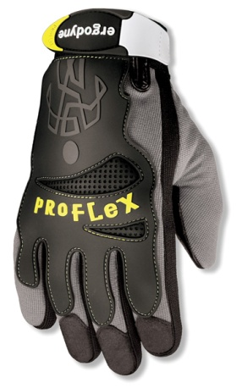
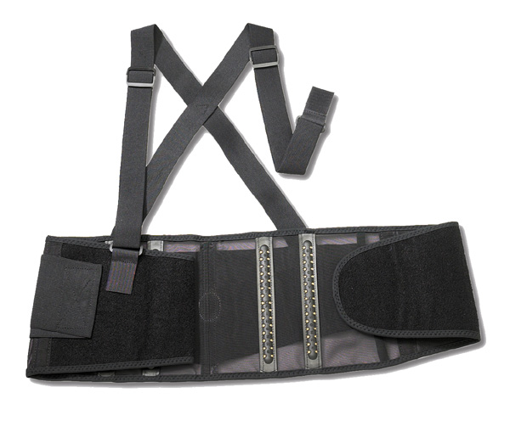
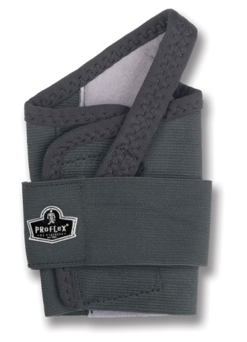
PERSONAL PROTECTIVE EQUIPMENT (PPE)
Clothing or devices worn to help isolate a person from
direct exposure to a hazardous material or situation.
Back Supports
Anti-Vibration Gloves
Wrist Supports
Wraps & Sleeves

Slide 21
BACK INJURIES

Slide 22
DID YOU KNKOW…
The back is the most frequently injured body part. Once injured, the risk of recurrence doubles
Low back injuries represent over 90 percent of all injury claims
Second only to the common cold in terms of lost work days
Back pain cost American businesses an estimated $30 billion each year
Four out of every five people will experience back pain in their lifetimes

Slide 23
YOUR BACK
The purpose of the back is to support the upper body, protect your spinal cord and allow flexibility
Most of the stress when lifting and bending is absorbed by the lower back. To take some pressure away from the spine, your abdominal and back muscles contract to give added
support
For example, when you lift a load, your abdomen and back muscles help equalize the effort so the entire weight is not transmitted to the spine, but is absorbed in the abdominal cavity. This is called intra-abdominal pressure.

Slide 24
CAUSES OF BACK INJURY
Improper lifting techniques
Overexertion
Poor posture
Medical factors (age, other disabilities, etc.)
Slips and falls
Excessive weight
Lack of exercise
Stress
Heavy purses and briefcases

Slide 25
SYMPTONS OF BACK INJURY
Pain
Stiffness
Numbness in the legs
Limited ability to sit or stand
Muscle weakness, spasms and strains
Decreased range of motion

Slide 26
PROPER LIFTING TECHNIQUES
Squat to lift and lower
Do not bend at the waist
Keep you back straight while
bending over
Keep the weight as close to you as
possible
Bow your back in and raise up with your
head first
If you must turn, turn with your feet, not
your body
Never jerk or twist!
Put the weight down by keeping your low
back bowed in
Keep you feet apart, staggered if possible
Wear shoes with non-slip soles

Slide 27
BACK INJURY CONTROL
PPE (Personal Protective Equipment)
Wear a flexible back support for additional lower back and abdominal support
Back supports also serve as useful reminders to lift properly

Slide 28
THE BACK SUPPORT

Slide 29
WHAT IS A BACK SUPPORT?
The back support is a control measure designed to reduce the risk of back injuries. It provides support to the lower back and abdomen by some of stress away from these areas

Slide 30
WHAT WILL THE BACK SUPPORT DO FOR YOU?
Two things: it will support your lower back and abdomen and it will remind you to use proper lifting techniques
The back support provides lower back and abdominal support when you lift. By tightening the back support you enhance your body’s intra-abdominal pressure and move the stress away from your spine
The back support reminds you to use proper lifting techniques. Every time you tighten the two-stage closure you are telling your body it is time to lift. This action reminds you to think about the Eight Commandments of Lifting, making lifting easier and safer

Slide 31
WHAT THE BACK SUPPORT WON’T DO FOR YOU?
It won’t cure an existing back problem
It won’t make you a body builder
If you continue to lift large, heavy and bulky objects you have an increased likelihood of injuring yourself

Slide 32
BACK SUPPORT DEMO
How To Put on Back Support:
Loosen suspenders and slip on the back support.
Grasp each end of the waistband. Stretch the right end with hook-and-loop fastener across the left and attach (approximately 4-6 inches [10-15 cm] of overlap). The upper edge of the waistband should be just below the navel. Fasten the outer elastic bands at your side.
Adjust suspenders for a comfortable fit. For maximum effectiveness, the back support must be properly positioned.
Before lifting, grasp the outer elastic bands and pull forward as far possible. Secure bands in a comfortable position.
Loosen when finished with lifting task

Slide 33
UPPER EXTREMITY INJURIES

Slide 34
UPPER EXTREMITY INJURIES
Hand-Arm Vibration Syndrome
Carpal Tunnel Syndrome (CTS)

Slide 35
HAND-ARM VIBRATION SYNDROME (HAVS)
Chronic disorder that can develop when the hand is subjected to repeated and prolonged exposure to vibration
Most often the damage to the blood vessels, nerves and muscles is irreversible
Half of the 1.5 million American workers who use vibrating tools will develop some form of HAVS (NIOSH)
5% of the general population suffers from HAVS
Other term: White Finger

Slide 36
H.A.V.S. SYMPTOMS AND RISK FACTORS
Symptoms
Tingling or numbness in fingers and palm
Spasms in fingers
Blanching of the fingers
Risk Factors
Repeated and prolonged exposure to hand-held vibrating tools
Improper tool use
Forceful tool grip
Aggravated by
Temperature - Cold
Damp environment
Smoking

Slide 37
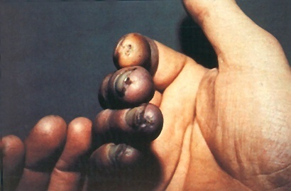

Slide 38
H.A.V.S. CONTROL
PPE
Wear full-fingered, certified anti-vibration gloves to reduce exposure to vibration

Slide 39
DEMONSTRATION

Slide 40
CARPAL TUNNEL SYNDROME

Slide 41
CARPAL TUNNEL SYNDROME
Damage to the hands and wrist is one of the fastest growing categories of worker’s compensation claims
Wrist injuries accounted for more than half of all MSDs
Five million American workers suffer from repetitive stress injuries to the wrist

Slide 42
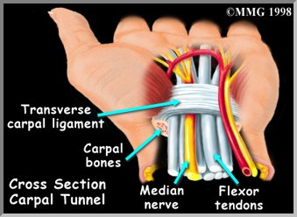
CARPAL TUNNEL SYNDROME (CTS)
Occurs when the median nerve running through a passage in the wrist up to the hand is compressed and inflamed.

Slide 43
CARPAL TUNNEL SYNDROME
Causes
Repetition
Sustained exertions
Awkward wrist and
positions
Symptoms
Tingling and
Pain in the hand and
numbness
wrist
Muscle atrophy at base
of thumb

Slide 44
CARPAL TUNNEL SYNDROME CONTROL
PPE
Use a flexible wrist support to encourage neutral wrist posture and limit wrist movements to help reduce the strain and pressure

Slide 45
DEMONSTRATION

Slide 46
KEY BENEFITS OF GOOD ERGONOMICS
Reduced worker’s
compensation costs
Reduced absenteeism
Increased
productivity
Increased morale
Increased work
quality

Slide 47
QUESTIONS?

Slide 48
THANK YOU!

