Slide 1
Forklift Safety
“This material was produced under grant number SH-22300-11-60-F-17 from the Occupational Safety and Health Administration, U.S. Department of Labor. It does not necessarily reflect the views or policies of the US Department of Labor, nor does mention of trade names, commercial products, or organization imply endorsement by the U.S. Government.””

Slide 2
Presentation Objectives
Define Powered Industrial Trucks (PIT)
Discuss the Benefits of Forklift Training
Discuss the Different Types of Forklifts
Discuss Forklift Training Requirements
Discuss Why is Forklift Training Important

Slide 3
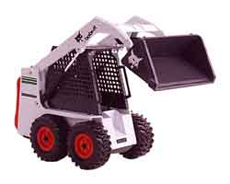
PIT Definition
An industrial vehicle that carries, pushes, pulls, stacks or tiers loads.
Include fork trucks, platform lift trucks, motorized hand trucks, and other specialized industrial trucks powered by electric motors or internal combustion engines.
Excludes vehicles that are used for earth-moving or over the road hauling and compressed air or nonflammable compressed gas-operated industrial trucks

Slide 4
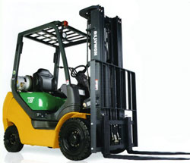
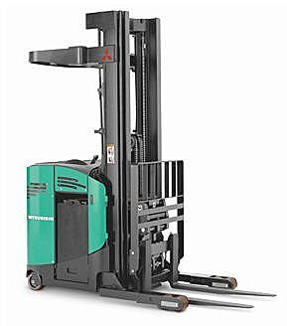
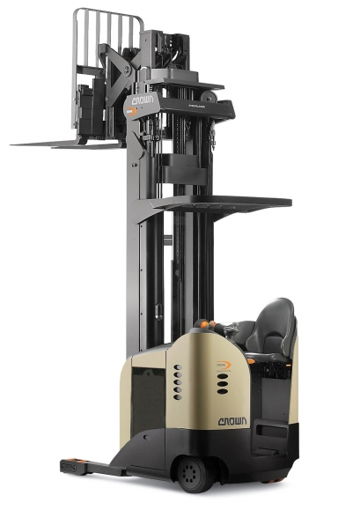
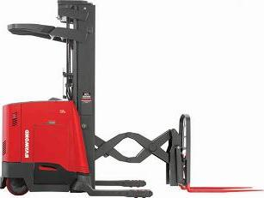
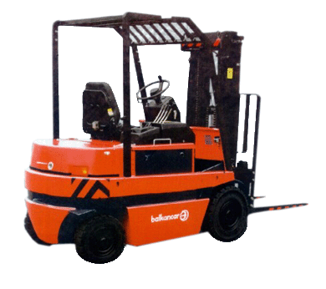
Notes:
Instructor will communicate that these photos are simply illustrating the types of trucks/vehicles we are referring to in our discussion today.
Detailed reference to the specific ITA Classes of trucks is covered in later slides of this presentation.

Slide 5
Benefits of Forklift Training:
REDUCES ACCIDENTS
by teaching correct methods of avoiding accidents
REDUCES PRODUCT DAMAGE
by teaching best load handling techniques
REDUCES EQUIPMENT DAMAGE
by giving instruction in correct operation and handling
REDUCES LOST TIME
by reducing accidents, and unplanned work stoppages

Slide 6
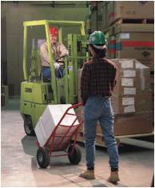
Benefits of Forklift Training (Cont.):
INCREASES OPERATOR CONFIDENCE
by showing correct methods of operation
INCREASE PRODUCTIVITY
by increasing operator skills
INCREASES EMPLOYEE MORALE
by showing management’s concern for employee health
INCREASES COMPLIANCE
by ensuring compliance with the OSHA Forklift Standard, 1910.178

Slide 7
Benefits of Forklift Training (Cont.):
INCREASES EQUIPMENT LIFE
by ensuring that forklifts are:
Properly operated
Properly maintained in accordance with manufacturers recommendations
Inspected for damage daily and prior to use
Taken out of service if damaged and until repaired

Slide 8
Classes of Commonly-Used Powered Industrial Trucks*
The Industrial Truck Association has placed powered industrial trucks into 7 classes.
Class I - Electric motor rider trucks
Class II - Electric motor narrow aisle trucks
Class III - Electric motor hand trucks or hand/rider trucks
Class IV - Internal combustion engine trucks (solid/cushion tires)
Class V - Internal combustion engine trucks (pneumatic tires)
Class VI - Electric and internal combustion engine tractors
Class VII - Rough terrain forklift trucks
Note that this classification refers to commonly-used vehicles and does not include all powered industrial trucks covered by the OSHA standard.

Slide 9
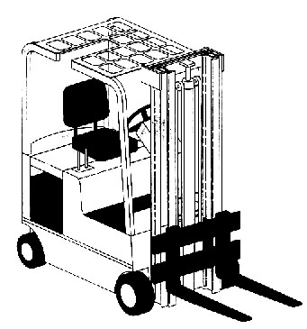
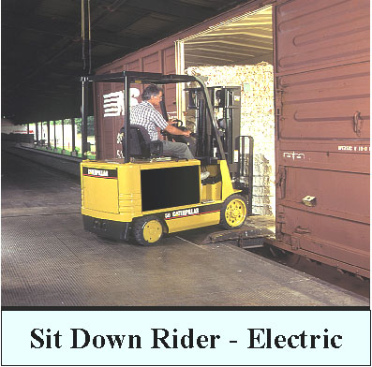
Class I - Electric Motor Rider Trucks
Notes:
Instructor will discuss the typical use and work environment these trucks can be found.

Slide 10
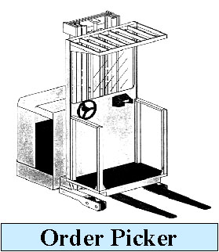
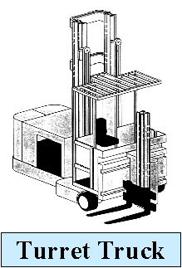
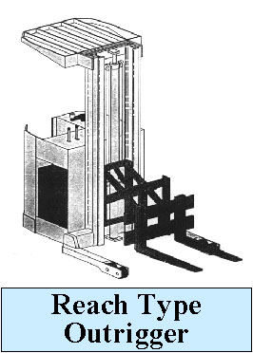
Class II - Electric Motor Narrow Aisle Trucks
Notes:
Instructor will discuss the typical use and work environment these trucks can be found.

Slide 11
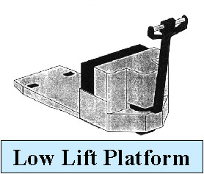
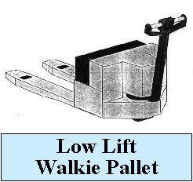
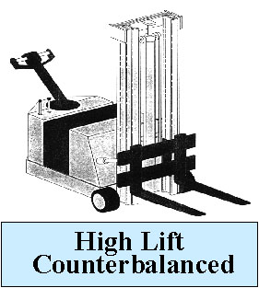
Class III - Electric Motor Hand or Hand/Rider Trucks
Notes:
Instructor will discuss the typical use and work environment these trucks can be found.

Slide 12
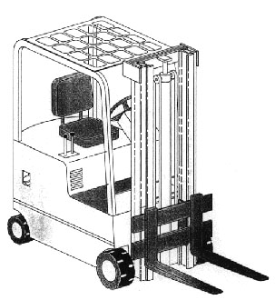
Class IV - Internal Combustion Engine Trucks - Cushion (Solid) Tires
Fork, counterbalanced (cushion/solid tires)
Notes:
Instructor will discuss the typical use and work environment these trucks can be found.

Slide 13
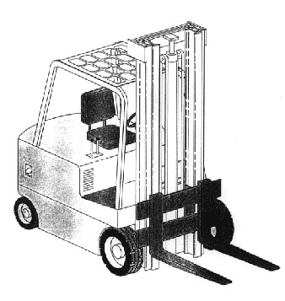
Class V - Internal Combustion Engine Trucks - Pneumatic Tires
Fork, counterbalanced (pneumatic tires)
Notes:
Instructor will discuss the typical use and work environment these trucks can be found.

Slide 14
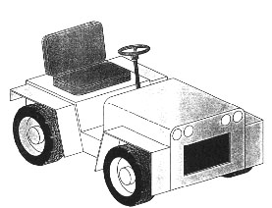
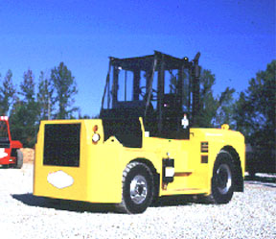
Class VI - Electric & Internal Combustion Engine Tractors
Sit-down rider
Notes:
Instructor will discuss the typical use and work environment these trucks can be found.

Slide 15
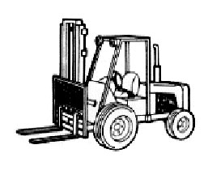
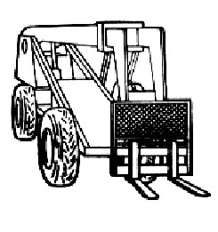
Class VII - Rough Terrain Forklift Trucks
Straight-mast forklift
Extended-reach forklift
Notes:
Instructor will discuss the typical use and work environment these trucks can be found.

Slide 16
Training Requirements Employer & Operator Responsibilities

Slide 17
Employer Responsibilities
Provide employees with training and evaluation once every three years, after a near-miss or an accident, and if an employee has been observed operating a forklift in an unsafe manner (i.e., horseplay)
Employer is to document and certify that employee has been trained and evaluated on forklift operations. The certification records need to be maintained including a copy of the test, the training provided, and evaluation of the driving.
Enforce forklift safety rules – does the employer have a disciplinary policy?
Enforce forklift inspections to check on damage and remove from service until repaired

Slide 18
Operator Responsibilities
Operate a forklift in a safe manner
Inspect PIT for damage prior to use
Report damage to supervisor & take out of service until repaired
Know the load capacity for the forklift you are operating
Use only factory-approved forklift attachments on the forklift
Never lift employees with your forklift
Have zero tolerance for horseplay
Drive within employer-specified speed limits
Never leave your forklift unattended
Engage the brakes prior to dismounting
Honk your horn when in a blind spot
Never drive with a load blocking your vision
Know your surroundings & hazards in your work area

Slide 19
OSHA Code: 29 CFR 1910.178 Code of Federal Regulations
OSHA Final Rule
Effective March 1, 1999
mandates a training program that bases the amount and type of training required on:
the operator’s prior knowledge and skill,
the types of equipment the operator will be operating,
the hazards present in the workplace, and
the operator’s demonstrated ability to operate a forklift safely
Refresher Training is required if:
the operator is involved in an accident or near-miss,
the operator has been observed to be unsafe,
evaluation indicates need for additional training,
changes in the workplace affect safe forklift operation, or
the operator is assigned to a different type of truck.

Slide 20
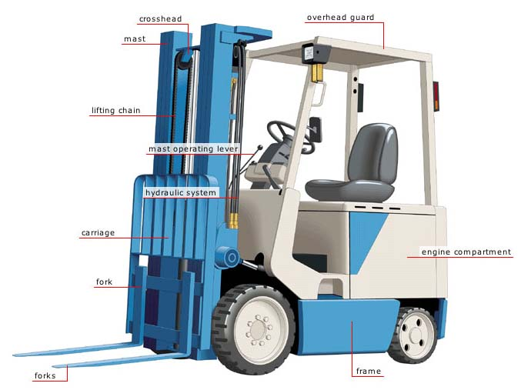
OSHA Code: 29 CFR 1910.178 Code of Federal Regulations
Evaluations of each operator’s performance are required:
as part of the initial and refresher training and at least once every three years.
Training must consist of a combination of:
1. Formal Instruction
2. Practical Training
3. Evaluation

Slide 21
OSHA Code: 29 CFR 1910.178 NOTE:
Employers must conduct an evaluation of the effectiveness of the forklift training by conducting an evaluation of the operator’s driving performance and/or ability after the in-class and practical training has been conducted.
Notes:
Note:
[Employers often miss this key point.
They conduct in-class training, which may include a test, they conduct practical training,
but they fail to conduct and document the evaluation of the operator’s ability to operate the forklift in a safe manner.]

Slide 22
Why Is Forklift Training Important?

Slide 23
Powered industrial truck accidents cause approximately 100 fatalities and 36,340 serious injuries in general industry and construction annually.
It is estimated that 20 - 25% of the accidents are, at least in part, caused by inadequate training.
Since a large percentage of accidents and fatalities were due to operator inexperience, OSHA mandated that operators must be trained and competent.

Slide 24
Source: Bureau of Labor Statistics,
Job Related Fatalities Involving Forklifts
(p) Preliminary Data, Report Finalized Apr/2010

Slide 25
Source: Bureau of Labor Statistics,
Job Related Fatalities Involving Forklifts
(p) Preliminary Data, Report Finalized Apr/2010

Slide 26
Refueling or Recharging
Park in designated recharging/refueling area
Ensure adequate ventilation
Don’t smoke
No open flames, sparks, or electric arcs nearby
Have fire extinguisher nearby
Use proper personal protective equipment
Always check lines, wires, hoses for leaks
Notes:
Instructor will review each of these and detail potential hazards, best practices, Do’s/Don’t as they are discussed;
soliciting audience participation whenever possible.

Slide 27
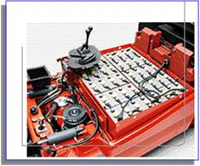
Recharging Electric Trucks
Wear splash proof goggles and protective clothing
Check electrolyte level before charging
Keep tools and metallic objects away from battery top
Do not pour water into acid –
add acid to water.
Watch for spilled materials
Ensure battery is secure
Notes:
Instructor will review each of these and detail potential hazards, best practices, Do’s/Don’t as they are discussed;
soliciting audience participation whenever possible.

Slide 28
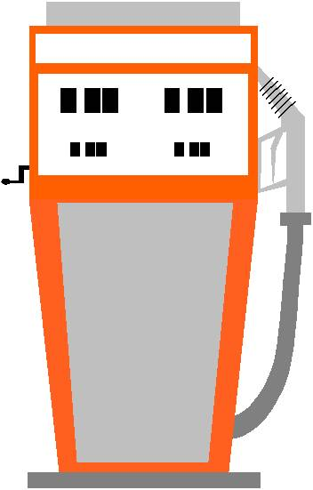
Refueling Gas or Diesel Trucks
Turn off ignition and lights
Make contact between spout and fill pipe before pouring
Check for leaks
Clean up any spills
If a container must be used, make sure
it is an approved container
Notes:
Instructor will review each of these and detail potential hazards, best practices, Do’s/Don’t as they are discussed;
soliciting audience participation whenever possible.

Slide 29
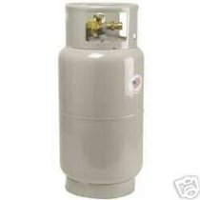
Refueling Liquid Propane Trucks
Shut valve; let engine run until it stalls
Turn off ignition and lights
Check for leaks and damage to connections
Wear protective clothing
Remove empty tank and store it
Install new tank securely
Notes:
Instructor will review each of these and detail potential hazards, best practices, Do’s/Don’t as they are discussed;
soliciting audience participation whenever possible.

Slide 30
THANK YOU!

