Slide 1
Fall Protection for the Construction Industry
Train the Trainer
Hispanic Contractors Association
de San Antonio/OSHA
Susan Harwood Training Grant
SH-22298-11-60-F-48
Prepared by SHORM Consulting
Notes:
Instruct students to read the disclaimer.

Slide 2
Disclaimer
This material was produced under grant SH-22298-11-60-F-48 from the Occupational Safety and Health Administration, U.S. Department of Labor. It does not necessarily reflect the views or policies of the U.S. Department of Labor, nor does the mention of trade names, commercial products, or organizations imply endorsement by the U.S. Government.
Notes:
Instruct students to read the disclaimer.

Slide 3



WELCOME/BIENVENIDOS
IMPORTANT ITEMS:
Notes:
Introduction:
In case of emergency/evacuation routes, exit doors, mustering areas
Cell phone use, silent or vibrate; take, make calls outside of classroom; no texting allowed.
Restroom locations and breaks.
Time for questions, during, after, when?

Slide 4

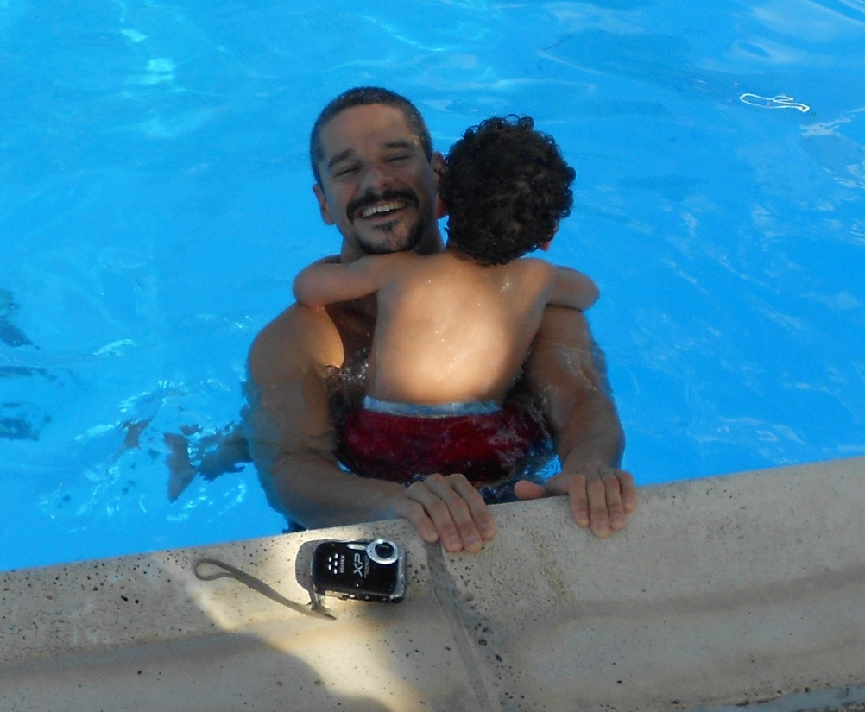
WHO ARE THESE TRAINERS?
WHO ME?
NO, YOU!
Notes:
Introduce the trainers:
Samuel Cantu & Rafael Llera

Slide 5

TRAIN THE TRAINER? HOW?
Notes:
Inform the student trainers the type of class, purpose and how will it be conducted. Informal, student participation, etc. Make sure the trainers know that this is not the actual Fall Protection Class, that it will be a 6 hour class. Usually a TTT class like this one, will run at least for 1 or 2 days. So not covered in detail. At the end of the class, student trainers will receive their certificate and a memory stick with the actual PPT from the grant, in English and Spanish and all kinds of training materials and safety plans related to fall protection.
At this point let each class participant introduce themselves, name, company they work for, type of work and industry and what is their role in the company.
Only move to the next slide after all classroom participants have introduced themselves.

Slide 6

TRAINERS NEED:
TO GRAB STUDENTS ATTENTION!
Notes:
Indicated to class, that one very important element of teaching, training, is to make sure the audience or students are paying attention and that you as a trainer need to find ways of achieving this.

Slide 7
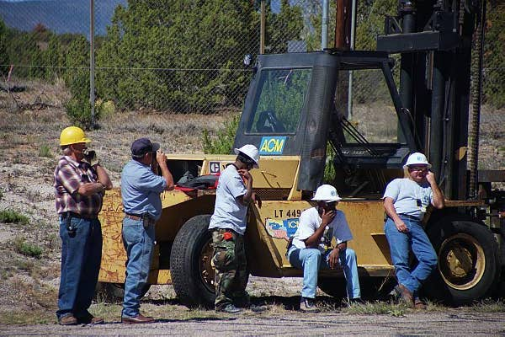
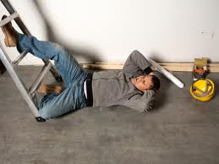
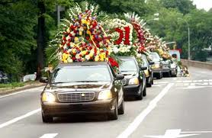
IF THEY DON’T, THEN:
Notes:
If the students or employees are not attentive, this can bring serious communication problems, it can make your audience or employees loose interest in the topic, it can lead to future accidents due to lack of knowledge or it can even cause a fatality at work.

Slide 8

SO WHY ARE YOU HERE?
Write down 3 things:
Why are you here?
What about fall protection?
The first thing that comes up when you think about falls
Notes:
Ask the trainers to answer these 3 questions on the board. After all are done, you should have a good description of your class and it’s interest towards fall protection. Leave the slide here until all trainers are finished, then start a discussion using their answers. As the discussion progresses, write on the board any critical elements of fall protection that came up during the discussion. This will serve as a teaching element through the class. It will help identify weak areas of knowledge and strong areas of your audience.
After the trainers are done writing in the board, you can show slides 9, 10, & 11, if necessary as additional points to discuss the importance of fall protection.

Slide 9
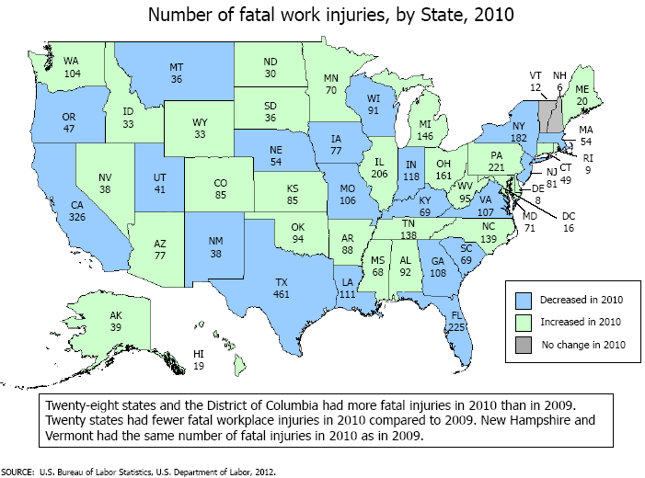
SO WHY ARE YOU HERE?
Notes:
Texas has the highest number of fatal work injuries for 2010.

Slide 10
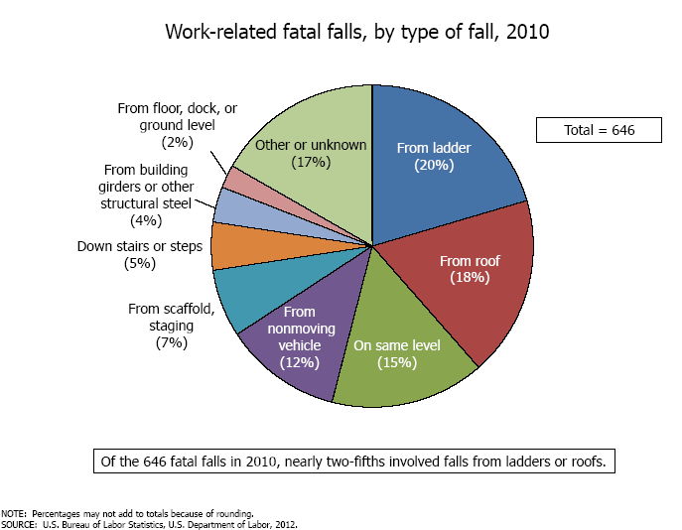
SO WHY ARE YOU HERE?
264 deaths by falls in Construction ; out of 774 total Industry fatalities. 2010.
Notes:
For the year 2010 a total of 646 deaths occurred from falls. Out of those, 264 were related to the Construction Industry. Total construction industry fatalities were 774, were Discuss the graph.

Slide 11
SO WHY ARE YOU HERE?
NUMBERS DON’T LIE!
Falls from Elevations by roofers cost approximately $106,000 each ($70K, for medical bills)
Falls from Elevations by Carpenters cost over $97,000 each ($68K for medical bills)
Falls from ladders or scaffolds by roofers cost approximately $68,000 each ($43K, for medical bills)
Falls from ladders or scaffolds by carpenters cost nearly $62,000 each ($36K, for medical bills)
The average cost of a fall from elevation for all other occupational classifications was under $50,000
Notes:
Workers’ Compensation Costs of Falls in Construction. From insured employers in NCCI States, from 2005 – 2007.

Slide 12

BREAK!

Slide 13
Train the Trainer
Fall Protection
The Players
  Occupational Safety & Health Administration (OSHA)
  The Employer/Supervisor
  The Employee
Notes:
Mention the 3 key players that take part in a fall prevention/protection campaign.

Slide 14
Fall Protection Training
IMPORTANT ITEMS TO COVER:
RIGHTS & RESPONSIBILITIES
(EMPLOYER/EMPLOYEE)
CONVENTIONAL vs. NON-CONVENTIONAL
ARREST vs. POSITIONING/RESTRAINT
OSHA STANDARDS/REGULATIONS
Notes:
When trainers are providing the employees with a class, we consider that these 4 items require a considerable amount of time and detail to discuss. Making sure employees are knowledgeable in all of them.

Slide 15
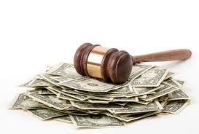
Rights & Responsibilities
EMPLOYERS
  Provide a workplace free from recognized hazards and comply with OSHA standards
  Provide training
  Protect all employees
  Provide the necessary Personal Protective Equipment (PPE)
EMPLOYEES
  Have a safe and healthful workplace
  Receive training
  Obey and comply with OSHA
  Identify and report safety hazards
  Request hazard correction
Notes:
Discuss the General Duty Clause 29 USC 654
“SEC. 5. Duties
(a) Each employer --
(1) shall furnish to each of his employees employment and a place of employment which are free from recognized hazards that are causing or are likely to cause death or serious physical harm to his employees;
(2) shall comply with occupational safety and health standards promulgated under this Act.
(b) Each employee shall comply with occupational safety and health standards and all rules, regulations, and orders issued pursuant to this Act which are applicable to his own actions and conduct.”
Make a distinction between employers responsibilities and employee’s rights

Slide 16
Fall Protection
CONVENTIONAL
Vs.
NON-CONVENTIONAL
Notes:
Discuss the what is conventional and what is non-conventional fall prevention methods. Equipment, materials, used in each. Discuss when do they apply.

Slide 17
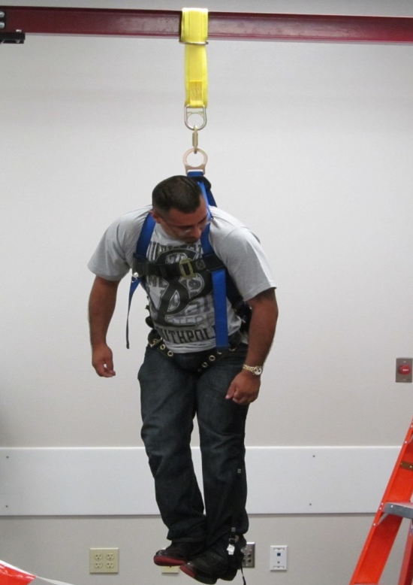
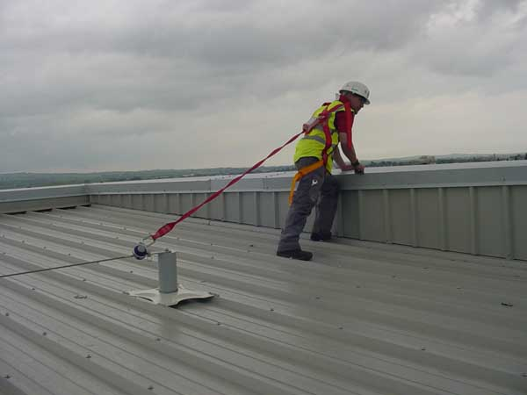
Fall Protection
ARREST
Vs.
POSITIONING/RESTRAINT
Notes:
Establish the importance of teaching employees when to use each type of fall protection and the advantages and limitations of each.

Slide 18
FALL PROTECTION IN CONSTRUCTION
6 Ft. GENERAL FALL PROTECTION- Subpart M (1926.500 – 1926.503)
10 Ft. Scaffolds – Subpart L (1926. 450 – 1926.454)
15 – 30 Ft. Steel Erection – Subpart R (1926.750 – 1926.761); Non-CDZ & Inside CDZ
+30 in. Stairways & Ladders – Subpart X (1926.1050 – 1926.1060)
New Residential Guidance 1926.501
Notes:
Briefly state the height restriction of each different type of standard, depending on the industry the requirements will vary greatly.

Slide 19
Train the Trainer
Safety Meeting or Safety Training?
Who can conduct a safety meeting or training session?
YOU CAN!
Notes:
Discuss who can teach, or conduct a training/meeting. Is it the same? Establish the difference between meeting and training.

Slide 20
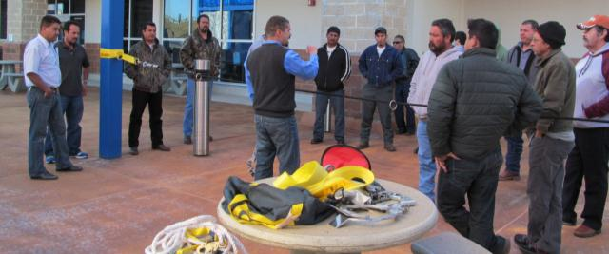
SAFETY MEETING
  Informal
  Specific Reason or General Issue
  Imparts Knowledge
  Expect Cooperation from Attendees
  Attendees should be able to ask questions
  Sign-in for Attendance Documentation
Notes:
Briefly discuss the characteristics of a safety meeting.

Slide 21
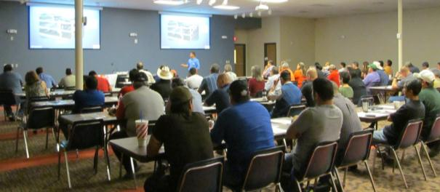
SAFETY TRAINING
  Required Documented Training
  Expected Outcome (Objectives)
  Method of Training
    Classroom Lecture/Demonstration
    Video and/or PowerPoint Presentation
  Testing
    Written – Oral – Performance Evaluation
Notes:
Briefly discuss the characteristics of a safety training.

Slide 22
Trainer
KNOW YOUR AUDIENCE
  Who are they? (age, length of employment, type of work, experience; supervisor / non-supervisor)
  What do they need to know?
  How will they receive the information?
  Will they understand the data?
    Testing
  LANGUAGE: MUST BE DONE IN THE EMPLOYEE’S LANGUAGE (English, Spanish, Other)
Notes:
Discuss the variables of employees/audience. Stress the importance of Language; proper improper, street vs. classroom.

Slide 23
Trainer
MEETING DAY DECISIONS:
  Length of Training
  Handouts
  Location for Meeting (No Disturbances)
  Standing Up or Sitting Down
  Proper equipment/supplies on hand
  Sign-In Sheet (Individual or Group)
Notes:
Preparations for the day.

Slide 24
Trainer
SUBJECT OF MEETING/TRAINING:
  Be familiar with the subject
  Organize presentation in logical format
  Be prepared to answer questions
    What would you ask?
  Practice, Practice & Practice
  What do you want your audience to know?
Notes:
Make sure you know what you are talking about. If no one asks you questions, start asking questions yourself. If no one answers, repeat what you told them, make sure there are no doubts. Their life depends on it.

Slide 25


Trainer
Remember the 3 types of learning:
and, The Adult Learning Theory!
Notes:
Remember the 3 types of learning. Discuss each briefly. Mention the Adult Learning Theory. Discuss each statement of the theory with students. Gather feedback.

Slide 26

QUESTIONS?
Notes:
Any questions?

Slide 27
Online Resources
http://www.osha.gov/
http://www.osha.gov/stopfalls/index.html
http://www.osha.gov/as/opa/spanish/index.html
http://www.osha.gov/dcsp/compliance_assistance/spanish_dictionaries.html
http://stopconstructionfalls.com/
http://www.cdc.gov/niosh/construction/stopfalls.html
http://bls.gov/iif/
http://www.tdi.texas.gov/wc/txcomp.html
http://www.texasmutual.com/safety/safety.shtm
http://www.millerfallprotection.com/
http://solutions.3m.com/wps/portal/3M/en_US/PPESafetySolutions/PPESafety/PersonalProtectiveEquipment/Construction/
http://en.capitalsafety.us/
Notes:
If time permits, go thru each website, showing the contents, and indicating possible usage. At this time, do a quick recap of the day, discuss what is in the memory stick, and proceed to distribute the post-test, the instructor surveys and give time to complete the test, discuss the test and provide certificates and memory sticks.

