Slide 1

Safety First!
Institute of Occupational Safety and Health
Mold Safety
Awareness

Slide 2


FY-12 OSHA Susan Harwood Grant Program
This material was produced under grant number SH22297-SH1 from OSHA. It does not necessarily reflect the views or policies of the U.S. Department of Labor, nor does mention of trade names, commercial products, or organizations imply endorsement by the U.S. Government.

Slide 3
Objectives
Participants will:
Examine the “basics” of mold
Analyze health hazards associated with mold
Identify and recognize safety hazards
Describe fundamental protective measures
Interpret rules and regulations regarding mold

Slide 4
A Little History About Mold
Leviticus 14:37-55 (House Plague)
Mushroom poisonings happen every day from eating wild mushrooms
Ergot poisoning (St. Anthony’s “fire” and Salem Witch Trials)
Irish potato famine - millions of Irish to immigrate to US because a mold killed the staple crops (potato)

Slide 5
What are we talking about?
Fungi – naturally occurring organisms that are essential to decay of organic matter.
Mold & Mildew –describes fungi
Biologicals - water source IAQ problems like fungi
Bio-Aerosols (biological aerosols) – Airborne droplets containing mold spores, bacteria, and microbial volatile organic compounds (VOC)

Slide 6
Mold Basics
Molds are a part of the natural environment
  Breaks down organic matter
Mold should be avoided indoors
Mold can grow on almost any surface
Water or excessive moisture speeds up mold growth
Notes:
Mold Basics
Molds are part of the natural environment. Molds are fungi that can be found anywhere - inside or outside - throughout the year. About 1,000 species of mold can be found in the United States, with more than 100,000 known species worldwide.
Mold decomposition
Outdoors, molds play an important role in nature by breaking down organic matter such as toppled trees, fallen leaves, and dead animals. We would not have food and medicines, like cheese and penicillin, without mold.
Indoors, mold growth should be avoided. Problems may arise when mold starts eating away at materials, affecting the look, smell, and possibly, with the respect to wood-framed buildings, affecting the structural integrity of the buildings.
Molds gradually damage building materials and furnishings. If left unchecked, mold can eventually cause structural damage to a wood framed building, weakening floors and walls as it feeds on moist wooden structural members. If you suspect that mold has damaged building integrity, consult a structural engineer or other professional with the appropriate expertise.
Mold can grow any where
Molds can grow on virtually any substance, as long as moisture or water, oxygen, and an organic source are present. Molds reproduce by creating tiny spores (viable seeds) that usually cannot be seen without magnification. Mold spores continually float through the indoor and outdoor air.
Mold needs moisture
Molds are usually not a problem unless mold spores land on a damp spot and begin growing. They digest whatever they land on in order to survive. There are molds that grow on wood, paper, carpet, foods and insulation, while other molds feast on the everyday dust and dirt that gather in the moist regions of a building.
When excessive moisture or water accumulates indoors, mold growth often will occur, particularly if the moisture problem remains uncorrected. While it is impossible to eliminate all molds and mold spores, controlling moisture can control indoor mold growth.
All molds share the characteristic of being able to grow without sunlight; mold needs only a viable seed (spore), a nutrient source, moisture, and the right temperature to proliferate. This explains why mold infestation is often found in damp, dark, hidden spaces; light and air circulation dry areas out, making them less hospitable for mold.
Since mold requires water to grow, it is important to prevent excessive moisture in buildings. Some moisture problems in buildings have been linked to changes in building construction practices since the 1970s, which resulted in tightly sealed buildings with diminished ventilation, contributing to moisture vapor buildup. Other moisture problems may result from roof leaks, landscaping or gutters that direct water into or under a building, or unvented combustion appliance. Delayed or insufficient maintenance may contribute to moisture problems in buildings. Improper maintenance and design of building heating/ventilating/air-conditioning (HVAC) systems, such as insufficient cooling capacity for an air conditioning system, can result in elevated humidity levels in a building.

Slide 7
Mold basics
Mold does not need sunlight to grow, only needs a spore and the right temperature
  Damp dark spaces
Can damage building materials and furnishings
Can eventually lead to structural damage
Notes:
All molds share the characteristic of being able to grow without sunlight; mold needs only a viable seed (spore), a nutrient source, moisture, and the right temperature to proliferate. This explains why mold infestation is often found in damp, dark, hidden spaces; light and air circulation dry areas out, making them less hospitable for mold.
Molds gradually damage building materials and furnishings. If left unchecked, mold can eventually cause structural damage to a wood framed building, weakening floors and walls as it feeds on moist wooden structural members. If you suspect that mold has damaged building integrity, consult a structural engineer or other professional with the appropriate expertise.
Since mold requires water to grow, it is important to prevent excessive moisture in buildings. Some moisture problems in buildings have been linked to changes in building construction practices since the 1970s, which resulted in tightly sealed buildings with diminished ventilation, contributing to moisture vapor buildup. Other moisture problems may result from roof leaks, landscaping or gutters that direct water into or under a building, or unvented combustion appliance. Delayed or insufficient maintenance may contribute to moisture problems in buildings. Improper maintenance and design of building heating/ventilating/air-conditioning (HVAC) systems, such as insufficient cooling capacity for an air conditioning system, can result in elevated humidity levels in a building.

Slide 8
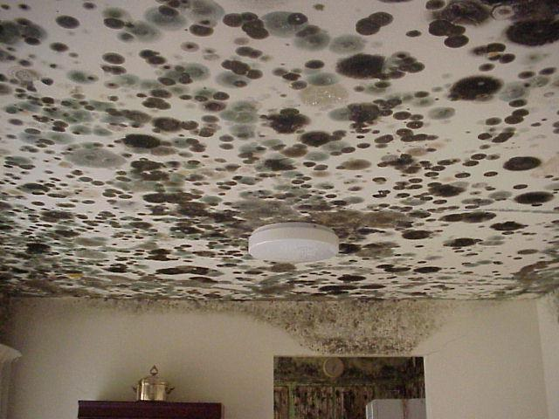
Just Add Water and They Grow!

Slide 9
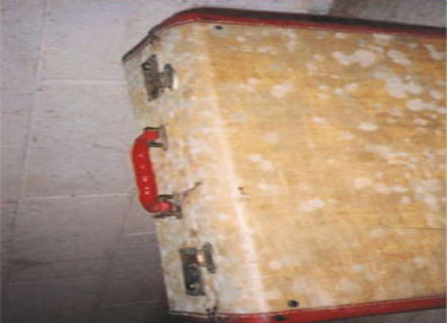
Mold growing on a suitcase in a humid basement

Slide 10
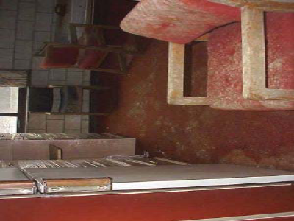
Water damage from Hurricane Floyd - September 1999

Slide 11
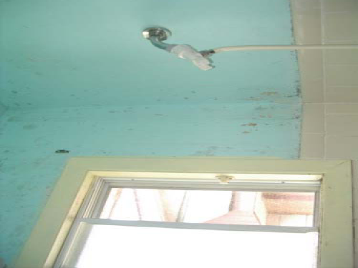
What can help prevent mold in a bathroom?
Notes:
“Tile wasn't installed high enough to accommodate the splash area, but the biggest contributor to the perfect environment for
mold is the absence of a ceiling exhaust fan.”

Slide 12
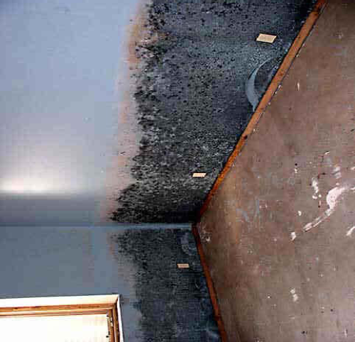
Act Fast….Mold will Continue to Grow
Notes:
“All indoor mold growth situations should be resolved and quickly.”

Slide 13
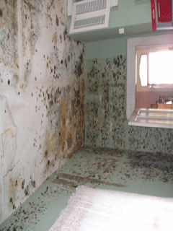
New Orleans / Katrina
(Photo courtesy of NRDC)
Notes:
Mold is still prevalent in many homes in New Orleans. It's believed to be causing respiratory
health problems among residents.

Slide 14
Health Effects
Burning eyes
Headache
Nausea
Nose bleeds
Allergic Reactions
Asthma
Exhaustion
Sinus infections
Cognitive disorders
Pulmonary hemorrhage
Liver damage
Central nervous system damage
Brain damage
Cancer
Death
Notes:
There are many types of mold. Most typical indoor air exposures to mold do not present a risk of adverse health effects. Molds can cause adverse effects by producing allergens (substances that can cause allergic reactions). Potential health concerns are important reasons to prevent mold growth and to remediate existing problem areas.
The onset of allergic reactions to mold can be either immediate or delayed. Allergic responses include hay fever-type symptoms such as runny nose and red eyes.
Molds may cause localized skin or mucosal infections but, in general, do not cause systemic infections in humans, except for persons with impaired immunity, AIDS, uncontrolled diabetes, or those taking immune suppressive drugs. An important reference with guidelines for immuno-compromised individuals can be found at the Centers for Disease Control and Prevention (CDC) website.
Molds can also cause asthma attacks in some individuals who are allergic to mold. In addition, exposure to mold can irritate the eyes, skin, nose and throat in certain individuals. Symptoms other than allergic and irritant types are not commonly reported as a result of inhaling mold in the indoor environment.
Some specific species of mold produce mycotoxins under certain environmental conditions. Potential health effects from mycotoxins are the subject of ongoing scientific research and are beyond the scope of this document.
Eating, drinking, and using tobacco products and cosmetics where mold remediation is taking place should be avoided. This will prevent unnecessary contamination of food, beverage, cosmetics, and tobacco products by mold and other harmful substances within the work area.
All molds have the potential to cause health effects.
(US Environmental Protection Agency)
The ACGIH approach has been to emphasize that active fungal growth in indoor environments is inappropriate and may lead to exposures and adverse health effects.
(American Conference of Governmental Industrial Hygienists)
“There are very few case reports that toxic molds inside homes can cause unique or rare health conditions…” “The common health concerns from molds include hay-fever like allergic symptoms.”
(Centers for Disease Control and Prevention)

Slide 15
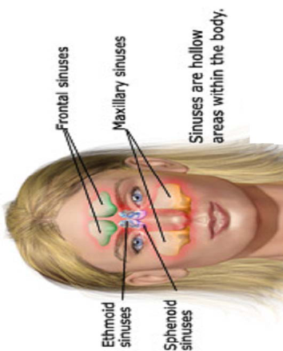

Many chronic sinus infections are linked to mold exposure.

Slide 16
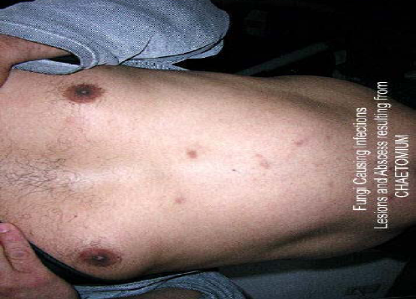
Mold Skin Disorder caused by exposure to Mold.

Slide 17
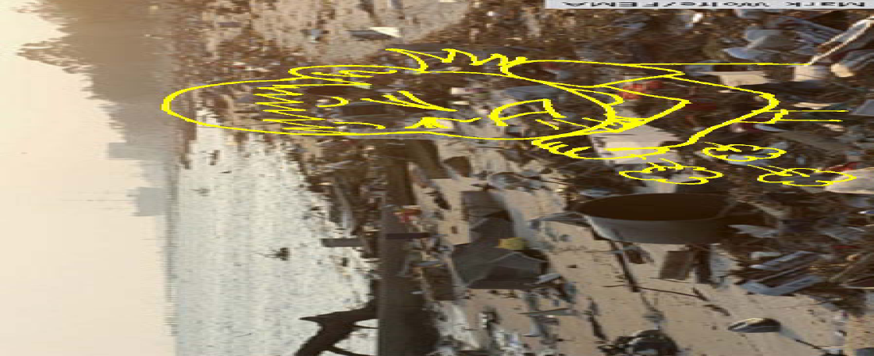
Katrina Cough
Notes:
Respiratory illness thought to be linked to exposure to mold and dust after the 2005 Hurricane Katrina in the United States

Slide 18
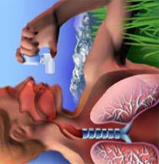
“Recent studies have linked mold to the rapid rise of the asthma rate over the past 20 years.”

Slide 19
"Sick Buildings"
Buildings don't get sick, people do
One building can't contaminate another one
"Sick" buildings can't be cured
Key to fungal growth in buildings is excess moisture

Slide 20
Prevent Measures
Repairing plumbing leaks
Looking for condensation and wet spots
Preventing moisture from condensing
Keeping HVAC drip pans clean, flowing properly, and unobstructed
Maintaining indoor relative humidity below 70%
Notes:
Prevention
Moisture control is the key to mold control. When water leaks or spills occur indoors - act promptly. Any initial water infiltration should be stopped and cleaned promptly. A prompt response (within 24-48 hours) and thorough clean- up, drying, and/or removal of water-damaged materials will prevent or limit mold growth.
Mold prevention tips include:
Repairing plumbing leaks and leaks in the building structure as soon as possible.
Looking for condensation and wet spots. Fix source(s) of moisture incursion problem(s) as soon as possible.
Preventing moisture from condensing by increasing surface temperature or reducing the moisture level in the air (humidity). To increase surface temperature, insulate or increase air circulation. To reduce the moisture level in the air, repair leaks, increase ventilation (if outside air is cold and dry), or dehumidify (if outdoor air is warm and humid).
Keeping HVAC drip pans clean, flowing properly, and unobstructed.
Performing regularly scheduled building/ HVAC inspections and maintenance, including filter changes.
Maintaining indoor relative humidity below 70% (25 - 60%, if possible).

Slide 21
Preventive measures
Venting moisture-generating appliances
Venting kitchens and bathrooms
Cleaning and drying wet or damp spots
Providing adequate drainage around buildings
Pinpointing areas where leaks have occurred
Notes:
Venting moisture-generating appliances, such as dryers, to the outside where possible.
Venting kitchens (cooking areas) and bathrooms according to local code requirements.
Cleaning and drying wet or damp spots as soon as possible, but no more than 48 hours after discovery.
Providing adequate drainage around buildings and sloping the ground away from building foundations. Follow all local building codes.
Pinpointing areas where leaks have occurred, identifying the causes, and taking preventive action to ensure that they do not reoccur.

Slide 22
Emergency Procedures
Major Fiber Release (> 3 sq.ft)
Stop Work Immediately
Do Not Attempt Clean-up
Secure Area
Notify Supervisor
Contact Emergency Personnel
Do Not Reenter Area Until Instructed To Do So
Notes:
If you encounter a major fiber release you should take additional measures to protect yourself and other building occupants. A major release of asbestos fibers is defined as a release of greater than 3 square feet of material and could include a major release of asbestos fibers from water damaged ceilings, inadvertent disruption of ACM by maintenance staff, or pipe rupture. So, if you walk into a classroom that you know has asbestos-containing ceilings or you don’t know if they contain asbestos and there is a pile of ceiling debris on the floor then you should do the following immediately:
Stop work immediately and leave the area.
Do not attempt to clean up debris.
Secure the area by closing and locking the doors.
Notify your supervisor.
Contact the Environmental Health and Safety Office (328-6166) immediately. Do not reenter the area until instructed to do so by the Environmental Health and Safety Office.

Slide 23
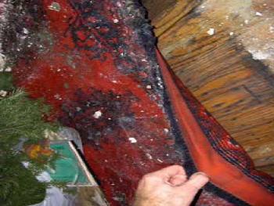
Call a Licensed Professional
Notes:
“If a major mold problem is discovered, be sure that professional becomes involved at an early stage. You don‘t want to run the risk of cross contaminating other areas of your home.”

Slide 24
Rules and Regulations
OSHA
EPA
Florida Statutes
Notes:
There are many rules and regulations which we must comply with when dealing with Asbestos. I’m sure most of you have heard of OSHA (Occupational Safety and Health Administration) and EPA (Environmental Protection Agency). OSHA deals primarily with employee protection whereas the EPA covers air and water releases as well as proper disposal of asbestos waste. There is also a State Agency which governs how we manage asbestos. They are the NC Hazard Management Branch which is part of DENR. We also have a University Asbestos Management Program which includes policy and guidelines. This program is operated in accordance with applicable rules and regulations including the OSHA Construction Industry Standard for Asbestos 29 CFR 1926.1101, the OSHA General Industry Standard 29 CFR 1910.1001, the OSHA Respiratory Protection Standard 29 CFR 1910.34, the EPA National Emission Standards for Hazardous Air Pollutants (NESHAP) 40 CFR 61 Subpart M and the North Carolina Asbestos Hazard Management Legislation NC General Statute 130A, Article 19. The Environmental Protection Agency’s (EPA) documents, Guidance for Controlling Asbestos-Containing Materials in Buildings (the 1985 Purple Book) and Managing Asbestos In Place: A Building Owner’s Guide to Operations and Maintenance Programs for Asbestos-Containing Materials (1990) were also used in development of this program. These documents and other information concerning asbestos are available from the Office of Environmental Health and Safety located in Ragsdale 009.

Slide 25

New Florida Standard on Assessment and Remediation
Enforcement of Unlicensed Activity for Mold Assessors and Mold Remediation began July 1, 2011
  Florida Statute Chapter 468
    Mold Remediation
    Mold Assessor
Notes:
For a mold remediator, at least a 2-year associate of arts degree, or the equivalent, with at least 30 semester hours in microbiology, engineering, architecture, industrial hygiene, occupational safety, or a related field of science from an accredited institution and a minimum of 1 year of documented field experience in a field related to mold remediation; or
A high school diploma or the equivalent with a minimum of 4 years of documented field experience in a field related to mold remediation.
For a mold assessor, at least a 2-year associate of arts degree, or the equivalent, with at least 30 semester hours in microbiology, engineering, architecture, industrial hygiene, occupational safety, or a related field of science from an accredited institution and a minimum of 1 year of documented field experience in conducting microbial sampling or investigations; or
A high school diploma or the equivalent with a minimum of 4 years of documented field experience in conducting microbial sampling or investigations.

Slide 26
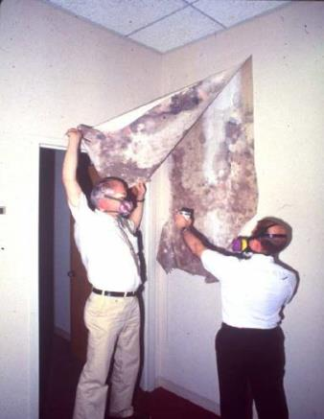

Respiratory Protection
APR and PAPR
P100 cartridge
Notes:
Instructor will show the different types of respirators and explain how to use them, inspection of the respirator, where to purchase them. Always, remind the particpants that they must be Florida certified to do remediation or assessment.
Source: New York
Times Magazine,
August 12, 2001

Slide 27
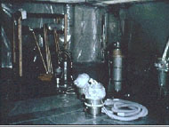
Asbestos Abatement Methods
Encapsulation
Enclosure
Removal
Notes:
Occasionally asbestos material must be abated because of the condition of the material presents a significant health risk or because of a renovation or demolition. Asbestos abatement activities include removal, enclosure (airtight, impermeable, permanent barrier around asbestos-containing materials to prevent the release of asbestos fibers) or encapsulation (treatment of asbestos-containing materials with a material that surrounds or embeds asbestos fibers in an adhesive matrix to prevent the release of fibers, as the encapsulant creates a membrane over the surface or penetrates the material and binds its components together) of asbestos-containing material. All abatement activities must be performed in accordance with all applicable federal, state, and University rules and regulations and can only be performed by accredited personnel (received special training and passed certification exam).

Slide 28
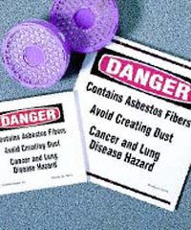
Asbestos Abatement Tasks
Survey to Identify ACM
Occupant Notification
Work Area Containment
Posting of Work Areas
Engineering Controls/PPE
Air Monitoring
Accredited Contractor
Notes:
Prior to initiation of any renovation or abatement project, the area must first be inspected to determine if there are any asbestos-containing materials that may be disturbed in the course of the project. Inspection must be conducted by an accredited inspector. If asbestos is identified, an accredited asbestos designer may be needed to design the abatement project to make sure it complies with all applicable health and safety rules and regulations. Prior to the project, permits must be obtained from the State and building occupants must be notified of what will be done and when it will take place. The contractor will construct a containment area to separate the work area from surrounding occupied areas. These containment areas will be posted with warning signs. You should not enter these areas. The contractor will use engineering controls to protect employees and building occupants. They will set up negative air machines so if there are any leaks in the containment it will be inward instead of out into clean areas. Employees working in these areas will use PPE for protection so if you see men in white suits and respirators you will know what’s going on. Air monitoring will be conducted before, during and after the project to assure the containment area and surrounding areas safe for occupancy.

Slide 29

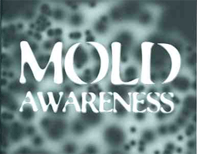
Mold Awareness DVD
Notes:
Molds are literally everywhere. While most molds are harmless to humans, some forms are believed responsible for respiratory illness. This informational video examines the different types of mold, explains how to reduce it in indoor environments and demonstrates what to do if your facility has a mold outbreak.
This DVD will reinforce the training objectives in this lesson:
What is mold?
How is it spread in your facility?
How can you reduce it?
Who should avoid exposure?
What should you do if you see mold?

Slide 30
Level of Knowledge Activity
What is Asbestos?
Name 3 Building Materials That May Contain Asbestos?
Name 3 Diseases Associated With Asbestos Exposure?
When is Asbestos a Health Hazard?
What disease is directly related to asbestos exposure?
Who are you going to call if asbestos must be removed or encapsulated?

Slide 31
OSHA Resources
OSHA has many helpful programs, including assistance about safety and health programs, state plans, workplace consultations, voluntary protection programs, strategic partnerships, training and education, and more

Slide 32
Summary
Let’s discuss what we learned about the “basics” of mold and how to analyze health hazards associated with mold. Now, help to identify and recognize safety hazards and describe fundamental protective measures. Finally, let’s re-cap the rules and regulations regarding mold remediation and assessment.

Slide 33
Reference List
OSHA Publication: http://www.osha.gov/Publications/preventing_mold.pdf
Mold Resources, EPA: http://www.epa.gov/mold/moldresources.html
2009 Florida Statutes Chapter 486:
http://www.leg.state.fl.us/Statutes/index.cfm?App_mode=Display_Statute&Search_String=&URL=0400-0499/0468/Sections/0468.8413.html
Notes:
Remediation can be conducted by the regular building maintenance staff as long as they are trained on proper clean-up methods, personal protection, and potential health hazards. This training can be performed as part of a program to comply with the requirements of the OSHA Hazard Communication Standard (29 CFR 1910.1200).
Respiratory protection (e.g., N-95 disposable respirator) is recommended. Respirators must be used in accordance with the OSHA respiratory protection standard (29 CFR 1910.134). Gloves and eye protection should be worn.

