Slide 1

Hazard Communication
Training
Institute of Occupational Safety and Health
Your “Right to Know”
29 CFR 1910.1200
This material was produced under grant number 46D6-HT31 from OSHA. It does not necessarily reflect the views or policies of the U.S. Department of Labor, nor does mention of trade names, commercial products, or organizations imply endorsement by the U.S. Government.

Slide 2


FY-11 OSHA Susan Harwood Grant Program
This material was produced under grant number SH22297-SH1 from OSHA. It does not necessarily reflect the views or policies of the U.S. Department of Labor, nor does mention of trade names, commercial products, or organizations imply endorsement by the U.S. Government.

Slide 3
Objectives: Participants will:
  Define the OSHA Hazard Communication Standard
  Compare and contrast labeling and warning systems
  Identify Physical and Health Hazards of Chemicals
  Define the OSHA Hazard Communication Standard
  Identify Employee Rights to Know / OSHA Standards
  Compare and Contrast Labeling and Warning systems
  Analyze each section of the Material Safety Data Sheets (MSDS)
  Use the Emergency Response Guide (ERG) to Identify Chemical Hazards

Slide 4
Objectives: Participants will:
  Define the OSHA Hazard Communication Standard
  Compare and contrast labeling and warning systems
  Analyze each section of the Material Safety Data Sheets (MSDS)
  Use the Emergency Response Guide (ERG) to identify chemical hazards
  Recognize and implement protective measures

Slide 5

OSHA Hazard Communication Standard, 29 CFR 1910.1200:
Convey knowledge of work hazards
Communicate protection measures
Reduce occupational safety mishaps, illness or fatalities
Notes:
The Hazard Communication (HazCom) standard establishes uniform requirements to make sure that the hazards of all chemicals imported into, produced, or used in U.S. workplaces are evaluated, and that this hazard information is transmitted to affected employers and exposed employees.
The HazCom standard is different from other OSHA health rules because it covers all hazardous chemicals. The rule also incorporates a “downstream flow of information,” which means that producers of chemicals have the primary responsibility for generating and disseminating information, whereas users of chemicals must obtain the information and transmit it to their employees.

Slide 6

Elements of the OSHA Hazard Communication Standard
  Written Program
  Material Safety Data Sheets
  (MSDS)
  Labeling
  Training
  Materials Inventory and Hazard
Notes:
The OSHA Hazard Communication Standard is composed of five key elements. These five key elements are:
Written Program - A written program must be developed which ties all of the below elements together
Material Safety Data Sheets - A detailed description of each hazardous material listed in the Materials Inventory
Labeling - Containers of hazardous materials must have labels which identify the material and warn of its potential hazard to employees
Training - All employees must be trained to identify and work safely with hazardous materials
Materials Inventory and Hazard Assessment - A list of the hazardous materials and other physical hazards present in your work area

Slide 7


  Employee: Rights to Know
  OSHA requires:
    Workers informed of chemical
    hazard exposures.
    Workers will be able to:
      Identify chemicals
      Analyze chemicals
      Protect themselves from chemical hazard exposures.
Notes:
OSHA’s Hazard Communication Standard:
employees have a need and a right to know hazards and identities of chemicals possibly exposed to at work.
Employees need to know protective measures available to prevent adverse effects.

Slide 8


Coastal DVD @ www.coastal.com
Employee “Right to Know” DVD

Slide 9
Physical Hazards of Chemicals:
Combustible liquid | Flammable Liquid
Compressed gas | Explosive
Organic peroxide | Oxidizer
Pyrophoric | Unstable
Water Reactive
Notes:
Combustible Liquid - above 100° F, produces vapors that will burn. (Example: Motor Oil)
Flammable Liquid – below 100° F, produces vapors that will burn. (Example: Alcohol)
Compressed Gas – a gas under pressure that will release violent energy if its container is ruptured. (Example: Nitrogen)
Explosive – will explode when subjected to sudden shock, pressure, or high temperature. (Example: TNT)
Organic Peroxide/Peroxide Former – can produce explosive mixture. (Example: Tetrahydrofuran
Oxidizer – releases oxygen to allow fires to start easily or to burn with greater intensity. (Example: Hydrogen Peroxide)
Pyrophoric – will ignite spontaneously in normal air. (Example: Diborane)
Unstable (Reactive) – by itself or with other chemicals, it can produce hazardous reactions if exposed to sudden shock, pressure, or temperature. (Example: Nitroglycerin)
Water Reactive – when it contacts water, it produces gases that are flammable or a health hazard. (Example: Metallic sodium)

Slide 10




Chemical Health Hazards
Carcinogen
Corrosives
Irritant
Toxic
Highly Toxic
Sensitizer
Anesthetics
Asphyxiates
Systemic Poisons
Biohazards
Notes:
Carcinogen – can cause cancer. (Example: Benzene, Ethylene Oxide, Formaldehyde)
Corrosive – cause irreversible damage to the skin, eyes, or the respiratory tract at the site of contact. (Example: Acids and Bases)
Irritant – can cause reversible inflammatory effect on the skin, eyes, or the respiratory tract. (Example: Most industrial and household solvents)
Toxic – overexposure to small amounts of these types of chemicals can lead to serious injury or death. (Example: Sodium Fluoride)
Highly Toxic – overexposure to very small amounts of these types of chemicals can lead to serious injury or death. (Example: Strychnine, Sodium Cyanide, many insecticides and rodenticides)
Sensitizer – causes allergic reaction after repeated exposure. (Example: Epoxy Glues and Isocyanates)
Anesthetics – can cause loss of sensation. (Example: halothaine or procaine)
Asphyxiates – cause inability to breathe. (Example: hydrogen cyanide, hydrogen sulfide and carbon monoxide)
Systemic Poisons – toxic substance that spreads throughout the body to dofferent organ systems. (Example: mercury and lead)
Biohazards – biological material that could potentially cause harm to humans. (Example: certain bacteria, viruses or fungi, parasites or other biological toxins/contaminates)

Slide 11
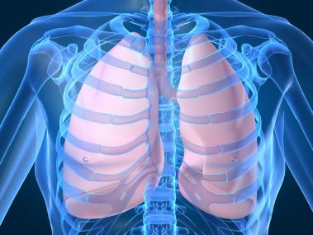
Chemical Routes of Entry
Exposure route is important in determining toxicity
Four Routes of Exposure:
1. Inhalation
2. Absorption
3. Ingestion
4. Injection
Notes:
Exposure route is important in determining toxicity. Some chemicals may be highly toxic by one route but not by others. Two major reasons are differences in absorption and distribution within the body.
Inhalation: Gases and vapours, aerosols and fumes are readily inhaled and may cause harm (including asphyxiation) anywhere in the respiratory system and may also be absorbed into the bloodstream. but inhalation of particles depends upon their size and shape-the smaller the particle, the further into the respiratory tract it can go.
Skin Absorption: some materials are capable of penetrating intact, healthy skin e.g. hydrogen cyanide, some steroid hormones, organic mercury compounds, and phenol.
Ingestion: Airborne particles that are swallowed are the most likely source of ingested chemical. Otherwise, ingestion is likely to be accidental on contaminated food, drink or make-up. Once absorbed through the stomach or intestine, the route to excretion may be damaging.
Injection: Accidental injection occurs mainly during the administration of drugs. Other injections may occur from the use of high pressure, air or liquid, such as in spray painting, or from the rupture of high-pressure lines

Slide 12

Factors Affecting Human Response To Chemical Exposure
Toxic substances
Route of exposure
Chemical dose
Individual factors / sensitivity
Interaction with other chemicals
Notes:
Discuss PowerPoint slides #5 and #6;
Have class members get into groups of 2-4 and share how each of the factors from slide #6 are important or affect exposure.
Teacher/trainer will walk around room, listening, participating in discussion when necessary/appropriate, facilitating discussion.

Slide 13
Short and Long Term Health Hazards
Acute Effects
  Fast
  Immediate
  High Concentrations Delivered
Chronic Effects
  Method takes years before any symptoms appear
  Small doses over a long period of time accumulates to form a large dose

Slide 14

Chemical Labeling
OSHA requires manufacturers to label drums,
cylinders, bags, and container that holds a hazardous
chemicals.
  Signals Words:
    Danger
    Caution
    Warning
  Secondary labelling
“Always read the label before you move, handle, or open a chemical container”
Notes:
Every container must have a label or similar hazard warning. OSHA requires all labels include the following information:
The identity of the chemical
The name and address of the chemical manufacturer or distributor
Emergency phone numbers
Warnings about the chemical’s specific physical and health hazards
Signal words such as - DANGER, CAUTION, or WARNING
Procedures, protective clothing, and equipment needed to work safely with the chemical
First aid instructions
Special instructions concerning children.
Valuable information is found on labels.
Always read the label before you move, handle, or open a chemical container.

Slide 15
Sample Label
WD-40
CAS No’s 8052-41-3, 68476-85-7, 64742-65-0
EYES Contact with eyes may cause irritation, tearing, and redness
SKIN Prolonged contact with the skin may cause drying or irritation of the skin
INHALATION Over-exposure may cause anesthesia, headache, dizziness, nausea and/or upper respiratory irritation
INGESTION May cause irritation, nausea, vomiting, and/or diarrhea

Slide 16
Understanding a Material Safety Data Sheet
(MSDS)
Used by manufacturers and vendors to convey
hazard information
Obtained when a chemical is purchased
  All facilities must have (for each chemical):
  chemical inventory list; and
  MSDS
MSDS overview:
      Please turn to handouts #1 and #2
Notes:
1910.1200(f)
Chemical manufacturers and importers must convey the hazard information to downstream employers by means of labels on containers and Material Safety Data Sheets (MSDSs). Language used on the warning label does not have to be identical to that on the MSDS.
Chemical manufacturers, importers, and distributors must be sure that containers of hazardous chemicals leaving the workplace are labeled, tagged, or marked with:
- the identity of the chemical,
- appropriate hazard warnings, and
- the name and address of the chemical manufacturer, importer, or other responsible party
Consumer products having labels meeting requirements of the Consumer Product Safety Act do not have to have additional labeling under the HazCom Standard.
Various other chemical products (for example, pesticides, foods, drugs, cosmetics, beverage alcohols) that are subject to labeling laws administered by other Federal agencies are also exempt from the labeling requirements of the HazCom Standard.

Slide 17

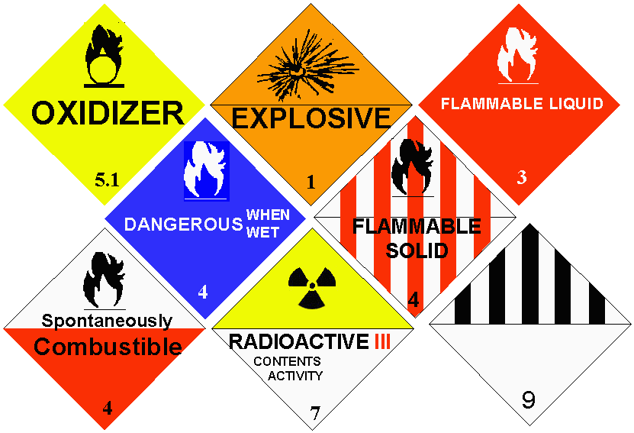
Why and What you Should Know about Chemical Labeling
National Fire Protection Association (NFPA) Diamonds
Hazardous Material Identification System (HMIS) labels
Department of Transportation (DoT) labeling and placards
Notes:
The Hazard Communication (HazCom) Standard (HCS) specifies that all containers of hazardous materials be labeled with an appropriate warning. Federal and state regulations mandate that all labels on original containers include the name of the chemical, the name and address of the manufacturer, the type of hazard that exists, how to properly handle the chemical or type of protective equipment necessary, and possible specific damage (i.e. lung, kidney, liver damage). Labels may include common names, amount of contents storage and handling instructions, special signal words (danger, warning, caution), special symbols (corrosive, flammable, poison, spontaneously combustible etc), special health hazards (carcinogen, toxic, irritant, sensitizer, nephrotoxin, hepatotoxin, neurotoxin etc.), special precautionary statements (first aid instructions), spill clean-up procedures, and fire precautionary factors.
Label (n): Any written, printed, graphic, sign or symbol, placard, process sheet or batch tickets displayed on or affixed to the hazardous chemical container which may be bags, barrels, bottles, test tubes, boxes, cans, cylinders, drums, or tanks etc.

Slide 18


Recognize Hazards by:
Thinking
Common Sense
Don’t Ignore Indicators
Attention to Details
Notes:
1) Think - Understand normal operations & equipment, understand hazards, use imagination: what could happen?
2) Pay Attention to - Be aware of surroundings and nearby activities, signs and your senses!
3) Use common Sense - Unlikely doesn’t mean impossible
4) Don’t ignore indicators- Getting away with it so far doesn’t make it safe or smart to do

Slide 19

Protective Measures
Engineering controls
Workplace practices
Product substitution
Personal protective equipment
Notes:
Engineering controls
Well designed work areas minimize exposure to materials which are hazardous. Examples of engineering controls would include exhaust systems and wetting systems to control dust
Work practices
Safe work practices will insure that chemicals are used correctly and safely
Product Substitution
Because many chemicals do similar jobs, it is important to select chemicals that do a good job, while being less toxic
Personal protective equipment
Respirators, eye protection, gloves, aprons, and other protective equipment and clothing are designed to protect you while you work - USE THEM!

Slide 20


Emergency Response Guidebook (ERG)
  * Identification of material
  * Outlines basic initial actions
  * Recommends protective actions
    http://hazmat.dot.gov/pubs/erg/guidebook.htm
Notes:
Serves as an initial incident safety plan
Chemical Identification
Associated hazards
Protective Measures
Time / Distance / Shielding
Classroom Participant Activity: ERG Classroom Drill (30-40 Minutes)
Divide class into 5 groups. (This can be accomplished by having every student “count off” 1-2-3-4-5, and repeating, then placing all the 1s in a group, 2s, 3s, etc.
Each group will be assigned one section of the ERG, to include:
Placards
Explosive Levels
Identification codes
Chemical Hazards
Chemical PPE
Show students how to effectively find the sections in the ERG.
Students have 15-20 minutes to read/review each section as a group and discuss the content.
See lesson plan for complete execution.

Slide 21

Summary
  Define the OSHA Hazard Communication Standard
  Identify Employee Rights to Know / OSHA Standards
  Compare and contrast labeling and warning systems
  Analyze each section of the Material Safety Data Sheets (MSDS)
  Use the Emergency Response Guide (ERG) to identify chemical hazards
  Recognize and implement protective measures

Slide 22
OSHA Contact Numbers
To report Unsafe Working Conditions, Safety and Health Violations Contact OSHA @:
1-800-321-OSHA (6742) / TTY1-877-889-5627
To File a Complaint Form:
To file an OSHA-7 report online, see how to file a complaint with OSHA (www.osha.gov)
For more information regarding your rights, see Worker Rights
Notes:
OSHA is here to assist you in preventing injuries by providing training and assistance to ALL individuals. For more in formation please contact OSHA.

Slide 23
Reference List
HAZARD Communication in the 21st Century, Retrieved from:
  http://www.osha.gov/dsg/hazcom/finalmsdsreport.html
HAZCOM: Foundation of Workplace Chemical Safety Programs. Retrieved from:
  http://www.osha.gov/dsg/hazcom/index.html

Slide 24

Institute of Occupational Safety and Health
Thank You
IOSH
Let’s not meet again . . . by accident!
IOSH

