Slide 1
Preventing Runovers and Backovers
Developing the Program

Slide 2

When Should an ITCP be Developed?
Different aspects of the ITCP will be identified and developed during the various construction phases of a project.
Depending on the phase, different people will be involved in the process.
Notes:
Ideally the ITCP should be considered from the very beginning of a project because some important elements--such as the size of the work space--will be dictated by the amount of right-of-way, number of lane closures, etc. To facilitate proper separation between workers on foot and mobile equipment, adequate space is necessary. If such considerations are not anticipated from the beginning, it will be more difficult to organize a complete ITCP.
The first phase (design) is when the project is first bid and won, a general plan should be created at that point. The second phase (planning) takes place when projects are being laid out, the original plan is flushed out into phases and plans are developed for those phases. The third phase (pre-construction) is the week before the work begins. In that phase any additional modification should be added to that plan like other activities on site or changes to internal traffic in the plan. The final phase (construction) begins the day of construction, any final changes need to be communicated to everyone on site that day. Phase 1 involves the DOT traffic engineer, site superintendent, safety professional, and other project managers. The second phase involves the DOT inspector (optional), site superintendent, safety professional, foreman, truck boss (optional), and other management personnel on site. The third phase involves the DOT inspector, safety professional, foreman, truck boss, key truck drivers, key workers, and QA/QC. The final phase involves everyone on site that day.

Slide 3
When Should an ITCP be Developed?
Bidding and Planning Stages
  Right of Way
  Temporary Traffic Control
  Risk Assessment
  Equipment Selection/ Identification
  Subcontractor Selection and Coordination
Notes:
State and local agencies have significant influence upon decisions made during early planning of a project that impact the options available to the contractor when developing an ITCP. For example, planners can ensure the project has access and egress points that are not encumbered by roadway geometry or structures such as bridges. Forethought to ITCP needs will impact the amount of right-of-way obtained for acceleration/deceleration lanes, access/egress points, and parking and staging of vehicles. Some consideration may be allowed for contractor selection based on past safety performance.
Such consideration during the planning phase is being encouraged by OSHA and other organizations under the concept of “Prevention through Design.” It should be noted, however, it is NEVER too late to set up and ITCP. Even if such a plan is conceived when construction is underway, many ITCP concepts can be employed to improve worker safety.

Slide 4
Contractor Planning Phase
Negotiation of Responsibilities
Assigning Duties
  Meeting Participation
  Use of Law Enforcement
  Location of Access/ Egress Points
  Lane Encroachments
Notes:
The Contractor Planning Phase is an ideal time to negotiate responsibility for executing certain elements of the ITCP. Duties can be allocated to the roadway owner, project engineer, superintendent, foremen and other personnel. Risk can be properly allocated and process can be assigned such as participation in safety meetings, how and if law enforcement will be used, location of access and egress points, and the amount of lane encroachments.

Slide 5
Construction Phase
Responsibilities
  The safety professional employees; assists in developing the ITCP; performs audits
  The site supervisor assists in developing the ITCP
  The fore/lead person develops and implements the ITCP
Notes:
The ITCP is implemented during the construction phase. The ITCP should be part of the project’s safety plan. The site supervisor/foreman should oversee implementation and will likely develop the site plan. As noted, foremen, supervisors, lead persons and others are crucial for plan implementation and should be taught the principles of safe construction traffic control. They will be in charge of daily set-up and monitoring of the ITCP. Responsibilities for key personnel are assigned and any remaining training is conducted during this phase. Onsite workers are provided training in both overall ITCP concepts and specific implementation elements at their assigned work area. To function properly, the ITCP must be reviewed and modified each day before the beginning of each shift so employees can receive instruction on how it will be implemented that day. In addition, ITCPs may be modified more frequently as conditions change throughout the day.

Slide 6

Construction Phase (continued)
Subcontractor selection, buy-in and communications (e.g. trucking, excavation, etc.)
Owner/agency coordination and communications
Selection of equipment
  Smaller blind spots
  Adding cameras/proximity warning
Notes:
A good communications plan is essential during the construction phase. A process must be engaged to coordinate the ITCP and site conditions among all those who will enter the work space. At this point, subcontractors will need to be engaged as their operations will be impacted by the creation and implementation of the ITCP. When seeking to identify all those impacted by the ITCP, it is imperative that all subcontractors and their operations are considered and educated about the program. A failure by one subcontractor can impact the safety and production of the entire site.

Slide 7
What Are the ITCP Elements
ITCP Diagram(s)
ITCP Notes
  Injury Reduction Measures
  Site Specific Conditions/Provisions
  Duties
  Equipment/Personnel List
  Notes on Safety Points
Notes:
The notes are critical to execution of the plan. They should include specific elements such as vehicle speed limits in the work space, near workers; how to identify and locate employees taking tickets; requirements for drivers to keep their window down (when appropriate) so they can hear site sounds and warnings. These notes become site audit tools that will assist supervisors in auditing the success of their safety program.

Slide 8
What Are the ITCP Elements
ITCP Key
Worker-Free Zone=
Paver=
Construction Barrel=
Roller=
Grader=
Tack Truck=
Full Truck=
Water Truck=
Empty Truck=
Car=
Notes:
The legend explains the symbols used on the ITCP diagram. Standard symbols are based on those used in the MUTCD. However, additional details on classes of personnel and vehicle types are needed in developing an ITCP for a paving operation. In this example, the orange hatched area is a worker-free zone which we will go over later. The orange circle is a construction barrel; the icon below that is a grader. A dump truck with a black bed is a full truck, while the dump truck with a yellow bed is an empty truck. The icon up in the right corner is a paver and the icon below that is the roller. The other icons on this slide are a tack truck, a water truck and a passenger car. The key may also be hand drawn. The important thing is that you provide a key so someone reading the diagram understands the symbols you have used.

Slide 9
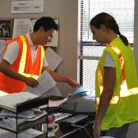


Creating the Plan
Identify project scope and plan scope, as these vary from job-to-job
Identify the operation that will take place (Paving, Trenching, Earthmoving, etc.)
Identify the individuals who will be involved (safety professional, foreman, superintendent, truck boss, DOT inspector, visitors)
Notes:
The first step is to recognize the scope of the operation and each of the tasks that will be performed. Based on these planned operations, the contractor will identify personnel who will be involved.

Slide 10

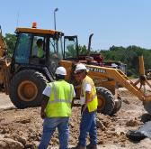
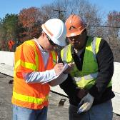
Creating the Plan
Review the site plan:
  Where will the operation take place?
  What equipment will be involved?
  Where will workers on foot need to be located?
  What is the traffic control plan?
Notes:
The next step is to review the site plan. Identify what will take place and where. Is there space for workers to park cars and safely access the work area? Where will restrooms, water coolers and break areas be located? What equipment will be on sight? How many workers are needed to operate the equipment? What work will be done by workers on foot? Can they be physically separated from equipment operating areas and vehicle travel paths? How is the TTCP organized? Are workers sufficiently protected by the TTCP? By asking and answering these questions, you will begin to formulate your internal traffic control plan.

Slide 11
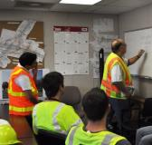

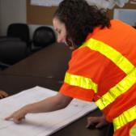
Creating the Plan
Review the site plan (continued):
  Where are the access/egress points?
  How often will deliveries be made or loads removed?
  How quickly will the work progress?
Notes:
Next, you will need to assess how your work will proceed once operations begin. How quickly will the operation move? For example, earth moving and site preparation work may remain in the same location for weeks, even months. Paving operations, particularly resurfacing, will move down the road more quickly. How often will access and egress points need to be relocated? How frequently will asphalt, aggregate or other materials be delivered to- or removed from the site? By addressing these questions you will begin to understand how frequently your ITCP will need to change or be updated.

Slide 12

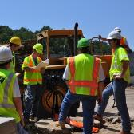
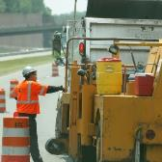
Creating the Plan
Implement Communications Plan:
  Who will develop the ITCP?
  Who will execute the ITCP?
  Who will instruct project leaders? Site employees? Operators? Subcontractors? Truck Drivers?
Once communications are in order, your plan is complete
Notes:
The final phase in ITCP development is implementing the communications plan--including training. Who will update the plan and stay in constant communication with site supervisors, foremen, subcontractors, workers, operators, etc. The most challenging part of ITCP implementation will be communicating with drivers of delivery trucks (dump trucks) and other site visitors who are not direct employees of the contractor. These communications can be difficult and require constant monitoring.

Slide 13

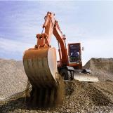

Creating the Plan
Identify sub-operations, such as:
  Asphalt Sampling
  Watering Rollers
  Loading/Off Loading Equipment
  Equipment Maintenance
Notes:
When developing your plan, take into consideration activities that support the main operation. For example, if the operation is laying asphalt, consider how rollers will be watered, asphalt will be sampled, etc. The key element to consider is the coordination of worker and equipment movements during these support operations.

Slide 14
Site Specific ITCP
Draw the basic work area layout
  May be taken from the Temporary Traffic Control Plan
The drawing need not be to scale, but should be sufficient size all drawing of vehicle and pedestrian worker paths
Plot the pedestrian worker and vehicles paths using ITCP principles
Notes:
Site specific ITCPs should be developed for different phases of the project as the site conditions change. Remember, ITCPs are “living” documents that must be updated to reflect current conditions.

Slide 15
Site Specific ITCP
Plot worker on foot locations
Plot equipment and vehicle locations
Plot vehicle and equipment paths including access/egress points for dump trucks and other site visitors
Plot location of utilities, storage areas and other obstacles or hazards
Notes:
Once you have the basic work area drawn out, plot where workers on foot and construction equipment will operate. Next plot the path of vehicles approaching and leaving the operation. Show on the drawing areas where ground workers are to avoid (worker-free-zones) and the path workers will take to complete their duties, check on materials, etc. Finally, plot the location of overhead and underground utilities, storage and staging areas, and any other known obstacle or hazard. This process creates the ITCP diagram, which can be used to show workers, equipment operators, dump truck drivers, and others how workers on foot and equipment will move about the site.

Slide 16

Worker Free- & Equipment Free Zones
Notes:
Remember, the main goal of the ITCP --- to the extent possible—is to remove workers from the risk of being struck by construction vehicles and equipment. To do this, layout on the ITCP diagram equipment paths and worker free zones.

Slide 17
Site Specific ITCP
Create plan “notes” explaining the diagram.
  Specify duties of all involved personnel
  Consider posting signs indicating “worker free zones” and “equipment free zones”
  Consider posting speed limits inside the work space
  Include other injury-reducing measures
Notes:
Now that the ITCP diagram is drawn up, create plan notes to explain important aspects of the diagram (such as worker-free zones) and any other site-specific safety points (such as on-site speed limits, spotting instructions for overhead power lines, or instructions for the ticket taker to stay on the driver’s side of dump trucks). Explain in the notes if special signage will be used to direct construction vehicles inside the work space.

Slide 18
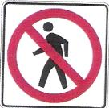

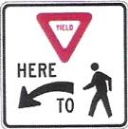

Can TCDs Be Used in an ITCP?
No specific devices or signs are needed in an ITCP, though some may be useful
Notes:
There are no specific ITCP signs. Any type of signage that displays direction to workers on foot or vehicles can be used, however. Before a new path, walkway, detour or temporary route is opened, intended signage should be in place. Signs required by road conditions or restrictions should be removed when those conditions are no longer necessary. If signs are used, care must be given to ensure ITCP signs do not confuse passing motorists for whom the signs are not intended. Signs should only be used where justified and should not be seen by passing motorists.

Slide 19
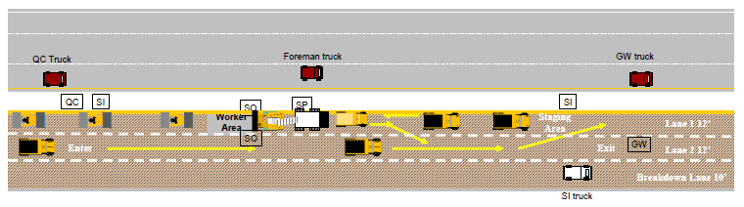
Internal Traffic Control Diagram
Notes:
This sample site diagram. The drawing shows an asphalt paving operation. The delivery trucks enter the job site, then approach the work site from behind the paving operation, drive along side the operation until they are in front. The dump truck then crosses in front of the paver and other dump trucks waiting for its turn in the queue. When the space is clear between the paver and dump truck, the truck backs a minimum distance and unloads its asphalt into the hopper. Trucks leaving the paver use the middle lane to a turn-around point, then came back using the right hand (lowest lane on slide) lane.
Though this drawing uses graphics, an ITCP can be created with simple drawings on a piece of paper. In fact, because conditions change on a daily basis, and even several times during the day, site diagrams need to be simple to understand and easy to modify.

Slide 20


Basic Model for Earth Moving
2
1
Notes:
Here’s a simple example of how internal traffic control might be set up. This is a fairly common situation where there would be a need to move material from a pile into a dump truck. The loader picks up a load, backs up, then goes forward to dump it into the truck. The idea here is of course to keep workers on foot out of the path of the loader.

Slide 21
Basic Model for Earth Moving
2
1
Notes:
Here is how the work site might be modified to reduce the risk of injury. The redline represents a fence, barrier or tape to create worker-free and equipment-free zones so workers on foot in the area would be re-directed away from the loader and around to the front of the truck.

Slide 22
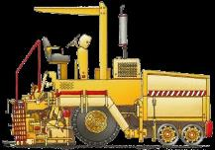


Basic Model for Paving
Roller
Spotter
Traffic Direction
Notes:
This is an example of a very basic paving operation. In this situation, workers on foot are working around a paving machine, followed by a roller. The truck carrying asphalt enters the work space from the traffic space, backs up to the paver, empties its load, then exits the work space. What are the critical/dangerous tasks during this operation that are most likely to place workers on foot in an hazardous situation? What changes can be implemented to improve safety?

Slide 23
Activity
Draw an ITCP for a simple paving operation

Slide 24
ITCP Example
Safety Notes
Stay in trucks except at lunch
Wear your vest on site
Reduce speed near paver and rollers to 15 mph, never enter high range
Caution entering and exiting site on to active traffic
Ticket taker shall wait until the truck is at the windrow to take the load ticket
When possible, stay on the driver’s side of the vehicle
Park pick-up trucks out of active truck travel lane, or equipment path, if possible on the shoulder
Park behind the operation
Place samples off the side of the road
Equipment l List
2 Rollers
1 Paver/Pick-up Machine
1 Tack Truck
1 Water Truck
1 Mechanic Truck
1 Broom
2 Quality Trucks
2 State Trucks
8 Dump Trucks
Personnel List
2 Roller Operators
1 Paver Operator
1 Screed Operator
1 Ground Worker
1 Foreman
2 Quality Control
2 State Inspector
Notes:
There are several components of an ITCP– the diagram, personnel and equipment lists, and safety points. A critical part of ITCP development is developing worker free zones, which on this drawing are depicted in yellow hatching.

Slide 25
Creating an ITCP
Determine locations for equipment and personnel
Determine where workers on foot are likely to face hazards:
  Backing Zones
  Access/Egress Points
  Work Activity Sites
  Worker Paths to Rest Areas
  Large Equipment Paths
  Utilities
  Site Visitors/Parking
  Material Storage Locations and Movement

Slide 26
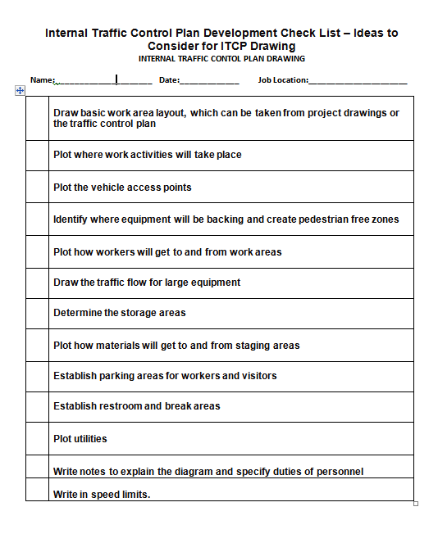

Creating and ITCP

Slide 27
Enforcing an ITCP
ITCP should be a team effort:
  Safety Officers
  Site Supervisor
Discipline should be given for violations
Should be treated as a violation of the company safety policy (and possibly state/federal regulations)
Notes:
The safety officer, foremen and supervisors are all responsible for maintaining work zone work zone compliance and should be able to warn workers on foot or vehicle operators of violations concerning the ITCP. ITCP notes become site audit tools that will assist supervisors in auditing the success of their safety program. Warning should be given to workers who stray from assigned positions, vehicle operators in pedestrian worker zones or truck drivers moving at speeds over the site speed limit. Violations should be treated as violations of other company safety policies.

Slide 28
Enforcing an ITCP
Inspectors, Truck Drivers and Site Visitors:
  All who enter the work space should be given instructions regarding the ITCP
  Instructions should include parking, staging and pedestrian work areas as well as vehicle paths and speed limits.
Notes:
When access points can be controlled, truck drivers and site visitors should be briefed or given and ITCP map showing how to enter the project site, paths to follow, where to stop for staging, and how the spotter will guide them. Truck drivers should also be briefed on procedures for leaving the work space and re-entering the traffic stream. A basic set of guidelines and rules should be developed for all truck drivers to follow when on-site. This would be supplemented with daily updates.

Slide 29
Discussion and Questions
End Module Six
“This material was produced under the grant SH-22285-11-60-F-11 from the Occupational Safety and Health Administration, U.S. Department of Labor, and contract 212-2009-M-32109 from the National Institute for Occupational Safety and Health. It does not necessarily reflect the views or policies of the U.S. Department of Labor or U.S. Department of Health and Human Services, respectively, nor does mention of trade names, commercial products, or organizations imply endorsement by the U.S. Government.”

