Slide 1
Preventing Runovers and Backovers
Principles of “Internal Traffic Control” for Roadway Construction

Slide 2
What is “Internal Traffic Control?”
Internal Traffic Control (ITC) is a principle of construction traffic coordination inside the activity area of a temporary traffic control zone.
The purpose of ITC is to separate – to the extent possible – construction vehicles and equipment from workers on foot.
Notes:
So what is an internal traffic control plan, or an ITCP? We are all familiar with the cones, barrels and signs that are guide motorists so that they can safely travel through work zones. The internal traffic control plan (ITCP) is a process that project managers and others who have production responsibility for roadway construction projects can use to coordinate and control the flow of construction vehicles, equipment, and workers operating in close proximity within the work space to ensure the safety of workers.

Slide 3
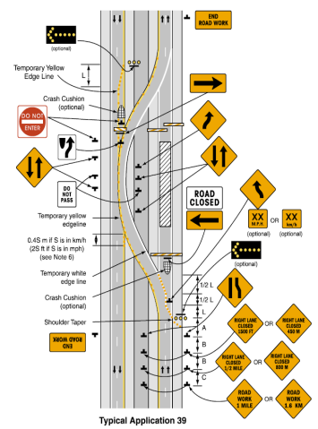
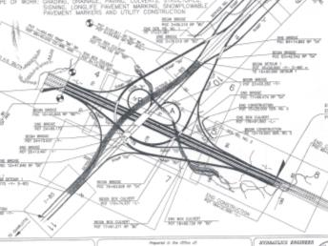
Where does the ITCP take place?
Internal traffic control plans fill in the details on how construction traffic should be set up inside the area marked by the hatched box on a TTCP.
Notes:
The ITCP organizes work activity inside the work zone to minimize the risk of workers being struck by operating equipment. The area where construction work takes place is shown on temporary traffic control plans and MUTCD “typical applications” as a hatched box. Internal traffic control plans fill in the details on how construction traffic should be set up inside this hatched box.

Slide 4
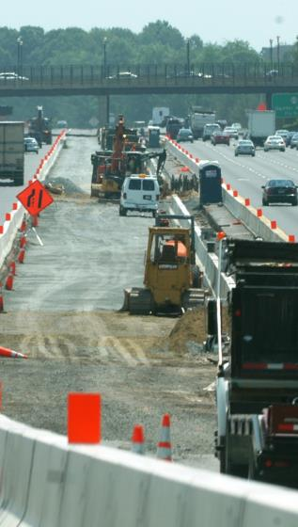
Internal Traffic Control - Overview
An effective ITC protocol informs all parties operating within the work space about the location of others.
ITC creates “zones” designed to minimize interaction between workers on foot and construction vehicles.
Notes:
In simple terms, ITCPs are a protocol to inform all parties operating within the work space about the location of others. ITCPs create “zones” designed to minimize interaction between workers on foot and construction vehicles by designating routes and operating procedures for large trucks delivering materials inside the “cone zone.”

Slide 5
Internal Traffic Control - Overview
An ITC plan designates routes and operating procedures for large trucks delivering materials.
The plan creates a traffic pattern to minimize backing.
ITC facilitates communication among key work zone parties in advance of arrival to the construction site.
Notes:
An effective plan enables communication among all work zone parties in advance of arrival to the construction site, making sure all parties know the location of access points and the proper path for truck and equipment movement, including pickup trucks and other work vehicles.

Slide 6
Internal Traffic Control - Overview
  Limits access points to the work zone
  Coordinates truck and equipment movements
  Provides Information on traffic paths and safe/unsafe work areas for workers
  Heightens awareness of workers on foot in relation to vehicle traffic in the work area
Notes:
When construction drivers understand there is an ITC Plan, they will be motivated to take ownership of the program and contribute to its success. The drivers may also provide input if they see a problem if they feel part of the “team.” Drivers rarely receive a “thank you” for their efforts, and expressions of gratitude for safe performance can go a long way towards getting their buy-in and cooperation. Once all parties understand how an ITCP operates, they will better understand instructions and verbal communications used to explain daily plans and changes.

Slide 7
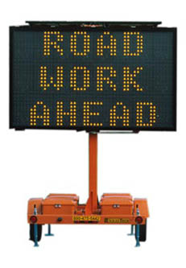
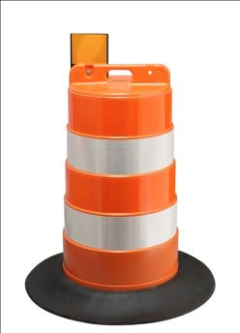
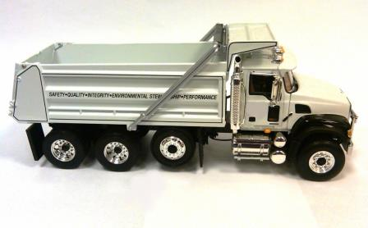
What is the difference between Internal Traffic Control and a Temporary Traffic Control?
Notes:
Those involved in roadway construction are likely familiar with temporary traffic control plans (TTCP) which describe how a specific work zone is to be set up to ensure the safety of the motoring public. Activity in the work space (hatched area) of the TTCP is not addressed in most TTC plans or MUTCD Typical Applications. This is the area where construction workers, equipment and vehicles interact. Internal Traffic Control Plans address this planning gap.

Slide 8
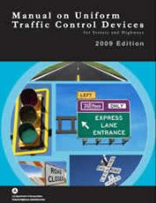
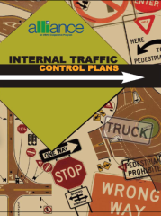
Temporary Traffic Control Plans
Temporary Traffic Control Plans are defined and prescribed in the U.S. Federal Highway Administration’s “Manual on Uniform Traffic Control Devices” or “MUTCD.”
Internal Traffic Control is an industry recommended practice and is not prescribed by law.
Notes:
Temporary Traffic Control Plans (to guide traffic) are REQUIRED by federal regulations. Internal Traffic Control to prevent runovers is an industry BEST PRACTICE.

Slide 9



Temporary Traffic Control Plans
Temporary Traffic Control Plans focus on moving traffic safely through a work zone.
Internal Traffic Control Plans focus on keeping workers on foot from being struck by construction equipment and large trucks within the activity area of a work zone.
Notes:
The movement of workers and equipment within the work space should be planned in a manner similar to the way the TTC plan guides road users through a work zone. Whereas Temporary Traffic Control Plans focus on moving traffic safely through a work zone, Internal Traffic Control Plans focus on keeping workers on foot from being struck by construction equipment and large trucks

Slide 10
Comparing
Traffic Control Plans and ITCPs
MUTCD Traffic
Control Plan
Internal Traffic
Control Plan
Motor Vehicles
MUTCD
Typicals
Typical Application Notes
Traffic Safety Engineer
Construction Equipment
NIOSH Development Guide
ITC Diagrams
Internal Traffic Control Notes
Supervisor/Site Superintendent
Notes:
Compare and contrast the differences between temporary traffic control and internal traffic control. A significant contrast between TTCPs and ITCPs is that TTCPs are a formal document; changes may require engineering judgment. ITCPs are informal plans and should be changed regularly as site conditions change.

Slide 11
Concepts in Common
While TTCPs and ITCPs each have a distinct focus, they carry common themes including:
  Providing clear direction to drivers
  Separating moving vehicles from workers on foot
  Using temporary traffic control devices to mark traffic paths
  Maintaining a smooth traffic flow
Notes:
TTCPs and ITCPs contain common principles, including:
Providing clear direction to drivers
Separating moving vehicles from workers on foot
Using temporary traffic control devices to mark traffic paths, and
Maintaining a smooth traffic flow

Slide 12
Primary Differences
As noted, there are significant differences in ITCPs and TTCPs:
  TTCPs do not address traffic in the work space
  ITCPs focus on worker safety; TTCPs focus on motorist safety
  ITCPs focus primarily on directing movement of construction vehicles engaged in construction work
Notes:
TTCPs and ITCPs are very different in some ways:
TTCPs do not address traffic in the work space
ITCPs focus on worker safety; TTCPs focus on motorist safety
ITCPs focus primarily on directing movement of construction vehicles engaged in construction work

Slide 13
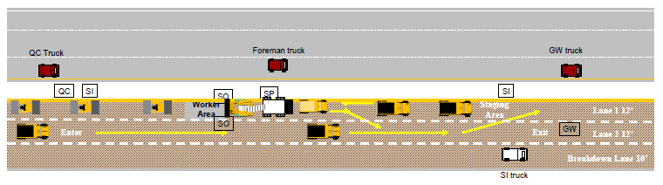
Part 2: Why Internal
Traffic Control?

Slide 14

ITCPs Protect Workers on Foot
Workers on foot or “pedestrian workers” are those employees who perform most of their duties outside vehicles and equipment. They are particularly vulnerable to being struck by equipment. Every person on the site has the responsibility to be vigilant and work safely.
Notes:
Workers on foot – or pedestrian workers - ground workers – are those employees who perform their tasks outside construction equipment and other vehicles. They are exposed to the hazards of being struck by motorists and construction vehicles. While there are many terms used to describe such workers, in this course we will refer to them as “workers on foot.”

Slide 15

Two “Struck-By” Hazards
Workers Killed by Motorists
Workers Killed by Construction Trucks and Equipment
MORE WORKERS ARE KILLED BY CONSTRUCTION
VEHICLES THAN BY MOTORISTS

Slide 16
Runovers/Backovers are the Primary Cause of Roadway Worker Deaths
Source: U.S. Bureau of Labor Statistics
Notes:
On average, 50-60 workers are killed in struck-by incidents on roadway construction sites. Greater industry and public education needs to be focused on eliminating distractions, such as cell phone use, which can contribute to these deaths and injuries to reduce incidents caused by motorists. ITCPs can protect against accidents caused by construction vehicles. See article on worker fatalities by Stephen Pegula contained in the Instructor Background Materials.

Slide 17
More Workers are Killed by Construction Equipment than Motorists
Source: Bureau of Labor Statistics/ Stephen Pegula
Notes:
More workers are killed by construction-related vehicles or equipment (38 percent) than by cars, tractor-trailer trucks, and vans (33 percent). Coordination of workers and equipment doing different activities in close proximity can improve work flow and reduce conflicts between workers on foot and equipment operators. (See state –by-state statistics in instructor materials.)

Slide 18
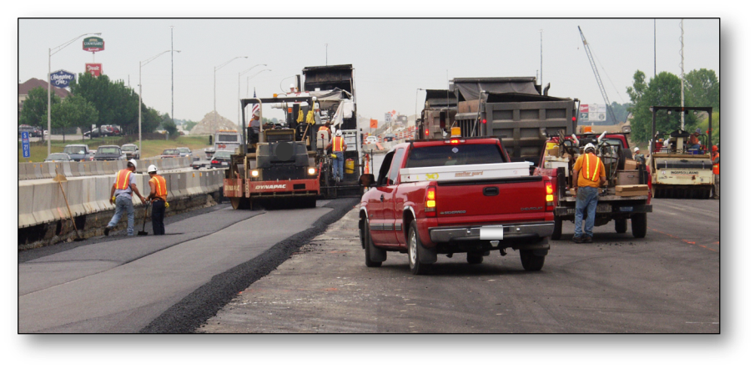
Construction Vehicles are the Greatest Hazard
Notes:
Compliance with the MUTCD and OSHA regulations is a necessary first step in providing a safe work environment. However, these sources, taken together, do not provide comprehensive guidance to ensure worker safety in roadway work zones. The interaction between workers on foot and construction trucks and equipment is the single biggest hazard in the heavy and highway industry. There are several hazards workers should be aware of to enable them to protect themselves against work zone hazards.

Slide 19
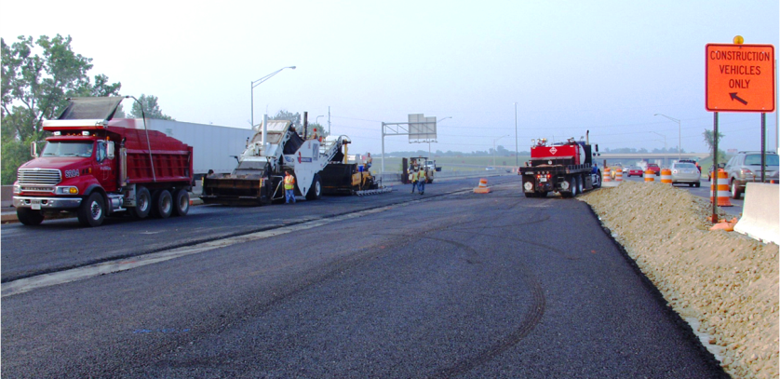
Vehicles Frequently Enter and Exit
Notes:
The constant movement of vehicles in and out of the work area can create hazards if the travel paths are not set and coordinated. ITCPs can also be used to communicate the need to keep entry and exit points free of parked vehicles and equipment. Note the tire marks on the pavement indicating vehicles are turning around in the work area. Ideally, ITCPs minimize backing and turning. Start each day with a risk assessment discussion with workers and subcontractors (including employees).

Slide 20
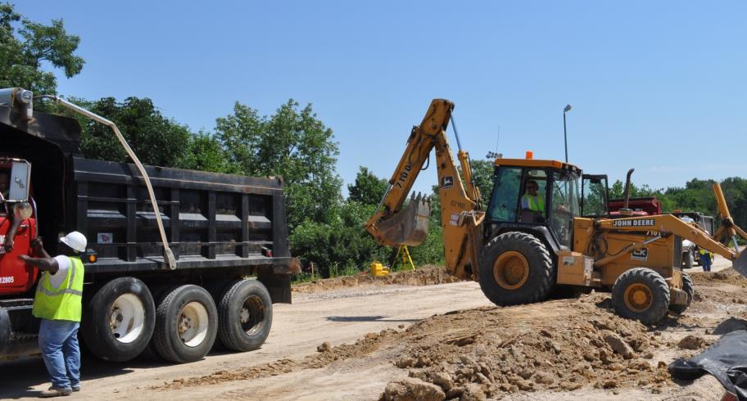
Workers on Foot Labor in Close Proximity to Large Vehicles
Notes:
Note the size of workers on foot in relation to the size of the construction equipment and vehicles. Because workers are relatively short compared to construction vehicles, it can be difficult or impossible to see them, especially in areas known as “blind spots.”

Slide 21
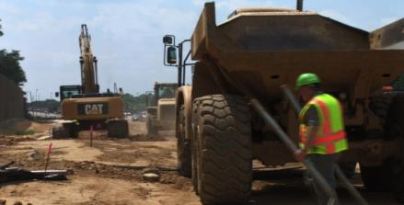
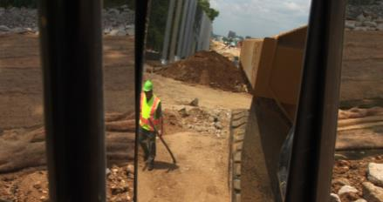
Blind Spots
Blind Spots are the locations around equipment and vehicles where workers on foot are invisible to the operator through his windows and mirrors.
Behind the Vehicle
Outside Mirror Range
Notes:
A blind spot (or blind area) is the area around a vehicle or piece of construction equipment that is not visible to the operator, either by direct line-of-sight or indirectly by use of internal and external mirrors. Blind areas can be reduced by properly setting mirrors on equipment in a “mirror check station.”

Slide 22
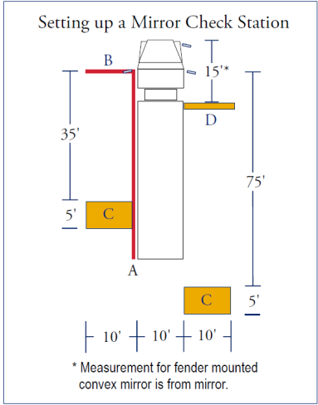
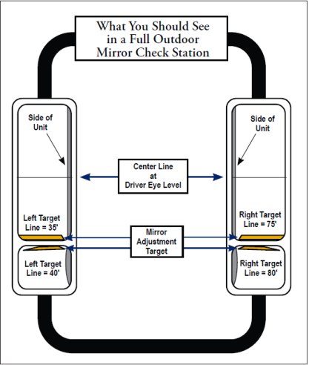
Mirror Check Station
Notes:
Images provided by, and used with permission of Liberty Mutual Insurance. See Liberty Mutual Mirror Check Station handout in Instructor Materials.

Slide 23
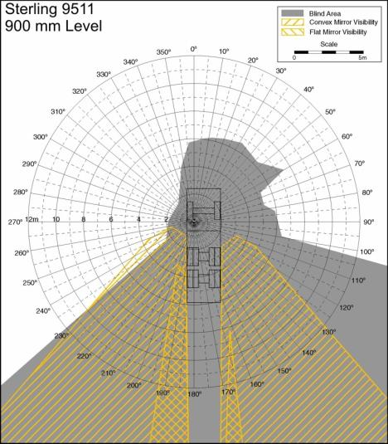
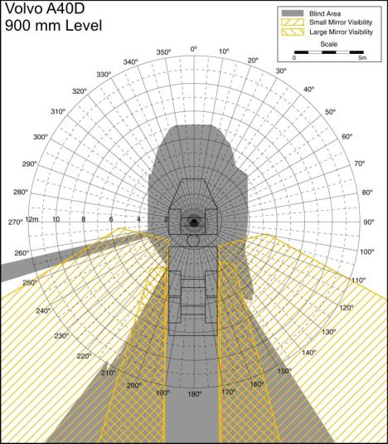
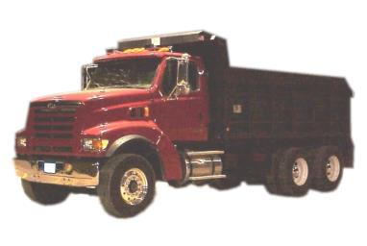

Be Familiar with Your
Vehicle's Blind Spots
Notes:
Each vehicle has its own, unique blind spots. Operators should be familiar with the blind spots surrounding each piece of equipment he or she operates and should be sensitive to the fact workers and other objects cannot be seen – even when using mirrors.

Slide 24
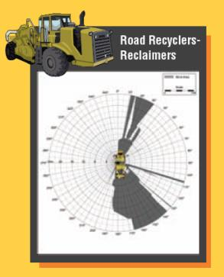
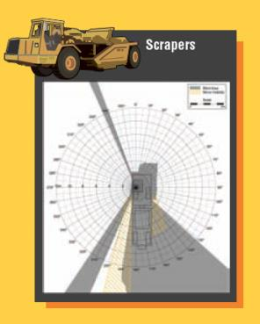
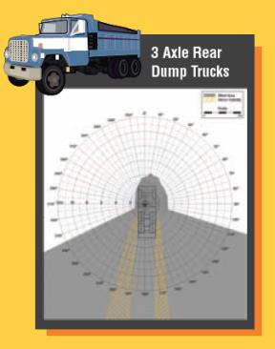
Blind Spots
Each type and make of vehicle has its unique blind spots.
Notes:
Note the gray areas in the diagrams indicating the various shapes and sizes of blind spots for different vehicles. The yellow hatched lines show areas visible using the mirrors. More examples can be found at: http://www.cdc.gov/niosh/topics/highwayworkzones/BAD/imagelookup.html. See also Blind Spot poster from the National Work Zone Safety Information Clearinghouse. These posters are available for free from the Clearinghouse and would make a good handout for this section. You can create maps like these--and appreciation for the blind areas for your vehicles--by having workers on foot take turns sitting in the cab and viewing their surroundings. Have another worker walk around the vehicle so the person in the cab can identify the blind spots.

Slide 25
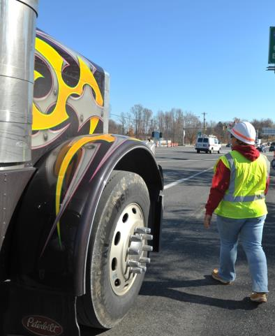
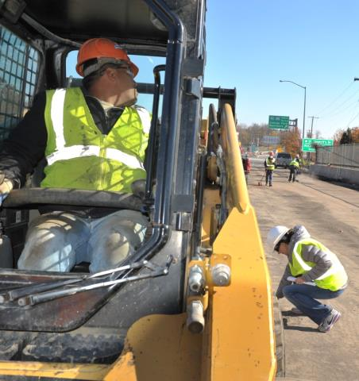
Workers Are Vulnerable in Blind Spots
Notes:
As a worker on foot, if you can’t see the driver and the driver can’t see you, you’re in a dangerous situation. Companies and projects should identify a specific side of the vehicle where a worker should walk for each operation. Consistency is important for safety.

Slide 26
Workers Killed by Motorists
As noted previously, the primary cause of worker deaths in roadway construction is caused by workers being struck by construction vehicles and equipment.
The second highest cause is workers being struck by motorists or when a vehicle crashes.
Notes:
While much of this training focuses on keeping workers safe from construction vehicles and equipment, ITCP planning will also consider hazards posed by motorists driving next to the work space.

Slide 27

Two Ways Workers Are Killed
Workers Enter the Traffic Space
Motorists Enter the Work Space

Slide 28
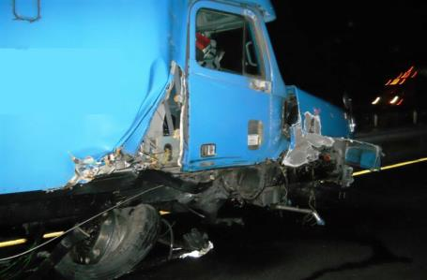
Workers Killed by Motorists
Motorists are likely to enter the work space when:
  Workers are not visible to motorists
  Motorists are surprised by the work zone and Temporary Traffic Control set up
  Motorists ignore warnings
  TTCDs are confusing/ non-compliant
Notes:
In situations where motorists strike workers, those in the construction industry often assume the fault is with the driver. We must be careful in both the design and execution of the TTCP and ITCP that our work is not a contributing factor. Improper TTC design and workers straying into the traffic space are often cited as a cause of worker fatalities.

Slide 29
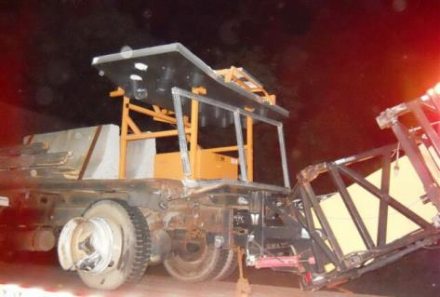
Workers Killed by Motorists
Motorists are likely to enter the work space when:
  Drivers are distracted or impaired (phones, food, drugs, alcohol, drowsy, etc.)
  Traffic is traveling at high speed through the work zone
Notes:
One of the most common reasons drivers stray into the work space is because they are impaired, distracted or speeding.

Slide 30
Risky Worker Behavior
Workers stray into traffic space
  Preoccupied by work
  Become “comfortable” in dangerous environment
  No convenient access to and from work space
    rest rooms
    food and water
    shade/breaks
    other local work areas
    staging of company and personal vehicles
  Workers cross traffic lanes (especially in high-speed locations)
Notes:
The organization of the work space can and does impact worker behavior. Workers are more likely to take risks such as entering the traffic space if circumstance entice or compel them to do so. When creating your safety/ITCP plan, consider the location of rest areas, water stations, parking, etc. To the extent feasible, these should be located to minimize workers crossing traffic or construction vehicle pathways. (This will be discussed in more depth in the following module.)

Slide 31
How Can We Prevent Deaths
Caused by Motorists?
Temporary Traffic Control Devices Must be Set Up Properly
  Comply with MUTCD or corresponding state document
  Inspect and maintain TTCDs
  Ensure only a qualified engineer makes necessary modifications
Create Safe Procedures for Deployment and Retrieval of TTCDs
Ensure sufficient TTCDs for all parts of the project (ramp geometry, exits, closures, etc.)
Notes:
Depending upon the nature of the work being done, TTCDs may be set-up by the site workers, or on more complex or large jobs, this will be accomplished by a specialized contractor or crew. In any situation, the devices should be set-up in compliance with the MUTCD or comparable document. TTCDs not only provide guidance for traffic, but are part of the worker safety strategy.

Slide 32
How Can We Prevent Deaths
Caused by Motorists?
Workers Should Be Aware of TTCDs in their work location.
Workers should be trained to notify supervisor immediately if devices are:
  Not in proper position
  Damaged or dirty
  Not being observed or recognized by motorists
Workers may correct misaligned devices if it is safe for them to do so and they understand where the device is supposed to be situated.
Notes:
Workers should be able to recognize if TTCDs are out of place. They should be informed if they have the authority to re-set misaligned devices or the process for notifying their supervisor when they see a problem. In all situations, misaligned, missing or non-performing devices should be corrected immediately.

Slide 33
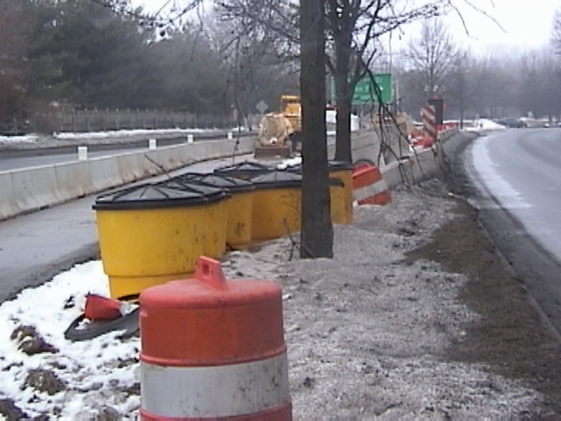
Workers Should be Aware of
Basic TTC Rules
Notes:
Most workers will not be trained to set up and maintain temporary traffic control. Nevertheless, they should understand the purpose of a temporary traffic control plan and function of temporary traffic control devices so they can recognize when they are not functioning correctly.

Slide 34
Discussion and Questions
End Module One
“This material was produced under the grant SH-22285-11-60-F-11 from the Occupational Safety and Health Administration, U.S. Department of Labor, and contract 212-2009-M-32109 from the National Institute for Occupational Safety and Health. It does not necessarily reflect the views or policies of the U.S. Department of Labor or U.S. Department of Health and Human Services, respectively, nor does mention of trade names, commercial products, or organizations imply endorsement by the U.S. Government.”

