Slide 1
RESPIRATORY SELECTION for
Farm Families and Workers
This material was produced under a grant (SH22284SH1) from the Occupational Safety and Health Administration, U.S. Department of Labor. It does not necessarily reflect the views or policies of the U.S. Department of Labor, nor does the mention of trade names, commercial products, or organization imply endorsement by the U.S. Government.
Notes:
Introduction of Presentation
Introduction of Presenter
Disclaimer

Slide 2
Focus Areas for Presentation
Present overview of Agricultural Respiratory Exposures
Discuss types of Respirators
Discuss Respiratory Protection for Specific Hazards with specific focus on Grain and Hog exposures
Present Respiratory Selection Guide as a Resource
Inform attendees about AgriSafe Network
Concerns and Questions from producers/workers
12/20/2013
2
Notes:
Over view of Focus areas /objectives of presentation
Want to spend time discussing some of the concerns and questions that I hear from agricultural workers .
Allow time for questions

Slide 3
Respiratory Protection
Multiple exposures
Multiple types of protection
Multiple questions from Agricultural population
Choices can be expensive
Compliance is an issue
Right choice for exposure
Notes:
Respiratory protection can be complicated for
The individual needing the protection
The company that is trying to protect the worker
The health care provider who is making a recommendation
Reasons for the difficulties:
Multiple types of exposures
Multiple types of protection – different types of masks
Cost can be a factor
Once a choice is made – compliance is difficult for some individuals for reasons we will talk about
Keeping those things in mind – most important to make certain making the right selection based on the exposure
The right mask for the job

Slide 4
High Risk Areas for Individual Farmer,
Family, and Worker
Respiratory Hazards are one of many
  injuries
  respiratory
  hearing
  chemical exposures
  skin cancer
  musculoskeletal
  health and wellness
  stress
12/20/2013
4
Notes:
4
Many high risk areas – respiratory is only one
But a very important one
can be difficult to get accurate information

Slide 5
Hazardous Substances
Many substances pose a hazard to the respiratory system in the agricultural setting, especially in enclosed settings
  Dusts
  Molds
  Toxic Fumes
12/20/2013
5
Notes:
Hazards are not straight forward and simple
Many types of substances make up the variety of hazards
Examples include
Dusts
Molds
Toxic fumes
Will discuss each type of substance in this presentation

Slide 6
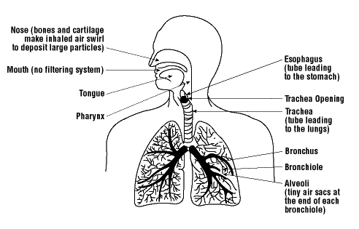
Respiratory System
Notes:
Brief overview of respiratory system
Back to basic pathophysiology
Respiratory System includes more than just the lungs
Starts at the nose
Sinuses
Mouth
Upper airway – throat and tracheal esophageal area
Large airways – bronchioles
Smaller airways

Slide 7
Particulates Enter the
Respiratory System – Important!
SIZE OF PARTICLE
30 μm (microns) lands in nasopharyngeal area
10 μm stops in the trachea, bronchi, and bronchioles
Less than10 μm can reach the alveoli – considered Respirable
Source: Agricultural Medicine, Occupational and Environmental Health for Health Professionals, Donham, Thellin,2006
12/20/2013
7
Notes:
The size of the particle is important
Particles small enough to stay airborne may be inhaled through the nose (nasal route) or the mouth (oral route).
The probability of inhalation depends on particle aerodynamic diameter, air movement round the body, and breathing rate.
The inhaled particles may then either be deposited or exhaled again, depending on a whole range of physiological and particle-related factors.
The five deposition mechanisms are sedimentation, inertial impaction, diffusion (significant only for very small particles < 0.5 m m), interception, and electrostatic deposition.
The largest inhaled particles, with aerodynamic diameter greater than about 30 m m, are deposited in the airways of the head, that is the air passages between the point of entry at the lips or nares and the larynx
Retention after deposition is helped by mucus, which lines the nose.

Slide 8
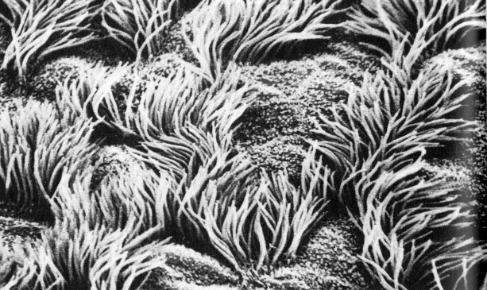
Normal defense mechanisms
Mucociliary Clearance
Air filtration and mucus trapping in upper airway
  Removes large particles
  Smaller particles still can reach the alveoli
Notes:
Of the particles which fail to deposit in the head, the larger ones will deposit in the tracheobronchial airway region
may later be eliminated by mucociliary clearance

Slide 9
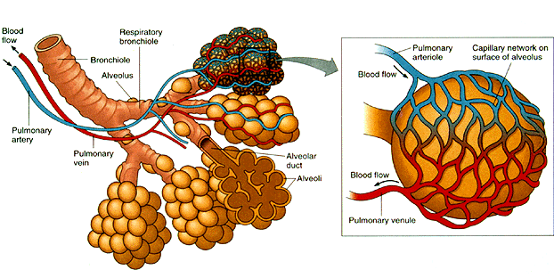
Bronchioles and Alveoli
  Smaller particles can reach the smaller airways and aren’t trapped by mucus or cilia
  Less than10 μm can reach the alveoli and are considered “Respirable “
Notes:
Alveoli is where oxygen exchange takes place
Grape like clusters
Respirable dust is defined as particle less than 10 microns
Respirable dust can end up in this area of the lung

Slide 10
Defense Mechanisms
Cough Reflex
  Clears the airway of secretions
Reflex Bronchoconstriction
  Response to breathing in large amounts of irritating substances such as dusts
12/20/2013
10
Notes:
Defense mechanisms also play a role in where particles end up.
Larger particles can cause symptoms but are not as hazardous to respiratory system because the individual coughs them up, swallows etc
Other factors influencing the deposition and retention of particles include cigarette smoking and lung disease.

Slide 11
Types of Respiratory Hazards
Livestock & Poultry confinements
Confined Animal Feeding Operations (CAFOS)
Pesticides
Grain Handling
Anhydrous Ammonia
Welding
Using gas or diesel engine indoors
Fumigation
Silo Entry
Paint (spraying)
Woodworking
12/20/2013
11
Notes:
Sources of respiratory hazards are varied
What is a CAFO - Confined Animal Feeding Operation

Slide 12
General Symptoms
Headache
Dizziness
Runny or sore eyes
Sore throat
Stuffy nose or sneezing
Cough
Wheezing or tightness in chest
Shortness of breath
Nausea or vomiting
Monday morning syndrome
Notes:
Monday morning syndrome – what is this – make sure to describe this
When an agricultural worker leaves the work environment for a brief period (perhaps a vacation or a weekend) symptoms subside or go away completely when gone but return when goes back into the work environment
Similar to Sick building syndrome– this is a name for when a person exhibits the listed general symptoms related to indoor air quality problems.

Slide 13
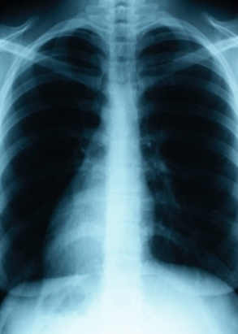
Respiratory Protection
Understand Respiratory Hazards
Engineering controls
Avoid High Risk Exposures if Possible
Baseline Testing of Lung Function
Protection
  Right mask for the job
  The right fit for the mask
  Have masks available
  Protective Equipment Storage Box
12/20/2013
13

Slide 14
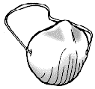
Inadequate Protection
Simple one-strap dust masks are not good enough
Not considered a respirator according to NISOH
12/20/2013
14
Notes:
One strap mask is not considered a Respirator by NIOSH
Mask only as good as the fit
Number of contact points on the face are key

Slide 15
Types of Respirators
Air Purifying
Supplied Air
12/20/2013
15

Slide 16
Air Purifying
Air Purifying
    Filtering face piece
      N series = not for use in presence of oil mist
      R series = some resistance to oil mist
      P series = for use where oil present
    Half mask face piece
    Full face piece
    Powered air purifying
12/20/2013
16

Slide 17
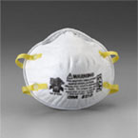
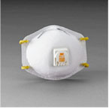
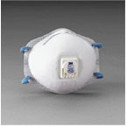
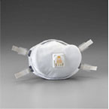
Two-strap disposable masks
8210 – N95
8511 –N95
8271 – N95
8233 – N100
Filtering Face piece masks
12/20/2013
17
Notes:
Filtering Face piece masks also require fit testing
Fit testing method is different for 2 strap filtering face pieces
OSHA requires fit testing of these respirators (filtering face pieces)
if the employer requires the use of respirators
or the employee is exposed above the OSHA permissible exposure levels - Permissible Exposure Limits (PELs)
NOTE: if workers wear these respirators on a voluntary basis, no fit testing is required.

Slide 18
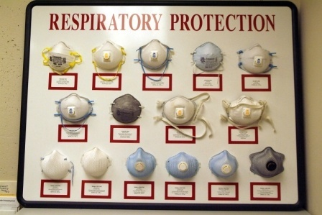
Filtering Face Piece Masks
2 strap disposable
12/20/2013
18

Slide 19
Filter Efficiency
Designation according to filter efficiency
  95 =moderate filtering efficiency (95%)
  99 = high filtering efficiency (99%)
  100 = highest filtering efficiency (99.97%)
12/20/2013
19

Slide 20
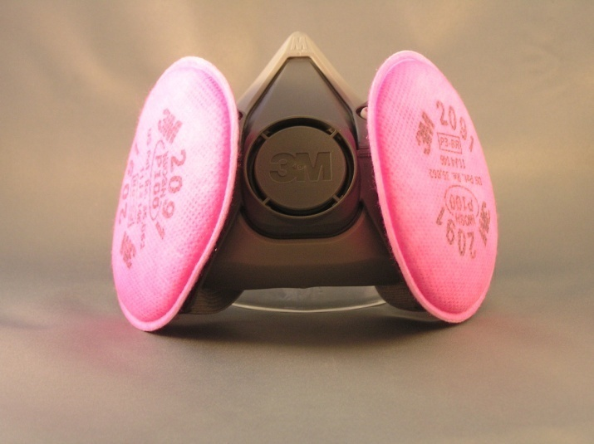
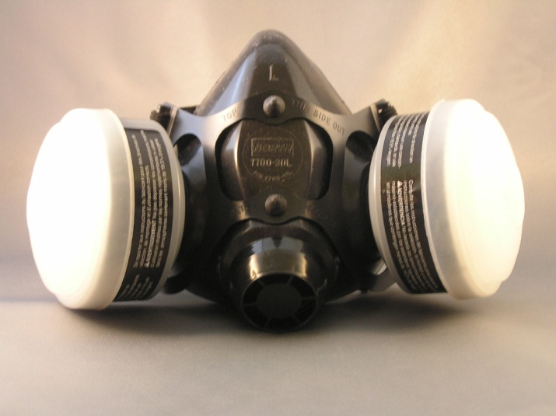
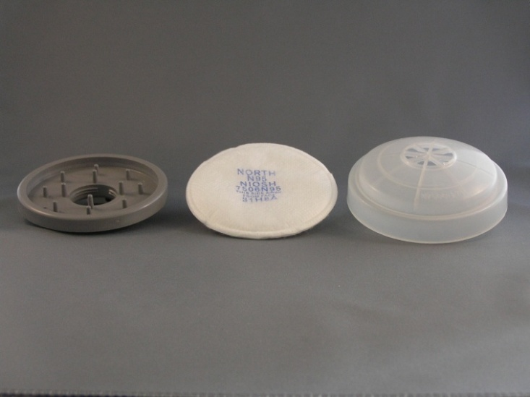
Half-mask respirator
Requires fit testing
Different brands and styles available
Several Cartridge choices
12/20/2013
20
Notes:
half-face respirators; which uses cartridges and filters (pre-filters).

Slide 21
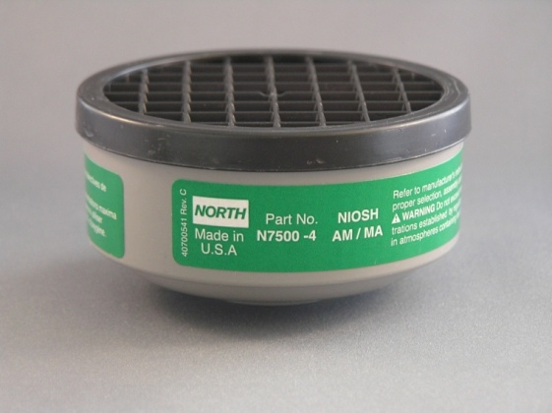
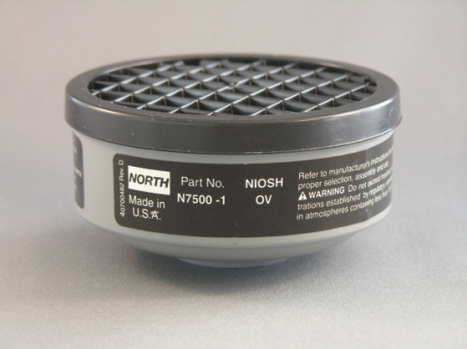
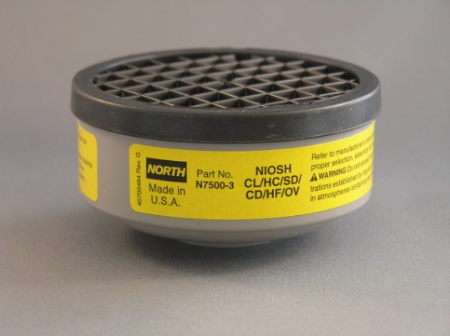
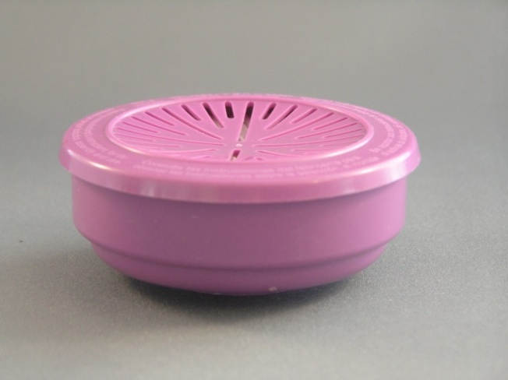
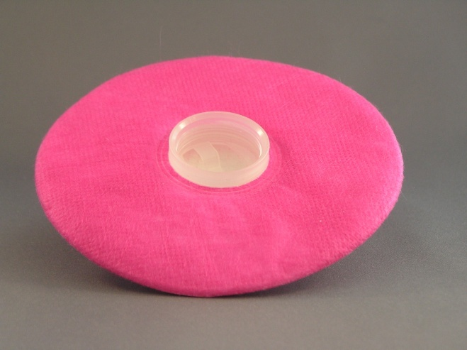
Half Mask Cartridges
Ammonia
Organic Vapor
Acid Gas
HEPA
HEPA pancake
North products
12/20/2013
21

Slide 22
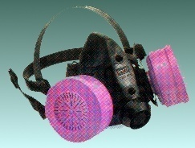
HEPA filter half-mask
99.97% efficient in removing very small particles
Excellent choice

Slide 23
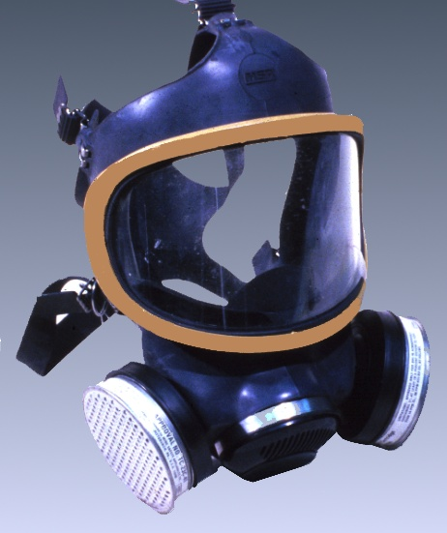
Air-purifying Respirator
A respirator with an air-purifying filter, cartridge, or canister that removes specific air contaminants by passing ambient air through the air-purifying element

Slide 24
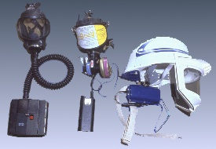
Powered Air-Purifying Respirator
An air-purifying respirator that uses a blower to force the ambient air through air-purifying elements to the inlet covering.

Slide 25
Using a Powered Air-purifying
Respirator
When do you need to use a powered air-purifying respirator?
  If you have heart and lung conditions that prevent use of other types of respirators or if unable to get a good fit with other types.
12/20/2013
25

Slide 26
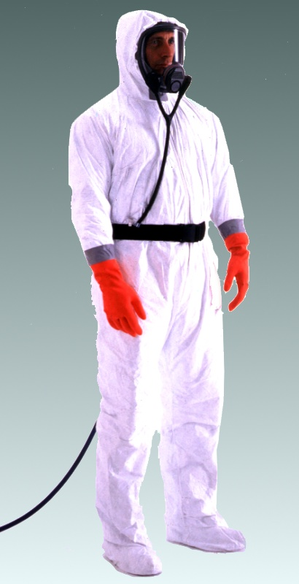
Supplied Air Respirator
When to use
Manure pits or confinement buildings during pit agitation or pumping
Environments with poor ventilation creating high levels of carbon monoxide
Fumigation in enclosed areas
An atmosphere-supplying respirator for which the source of breathing air is not designed to be carried by the user. Also called airline respirator.
Notes:
Need to make sure that it is clear on airline type versus tank – clarify these two
Airline versus tank
Problems with these related to hose – cutting off air supply etc

Slide 27
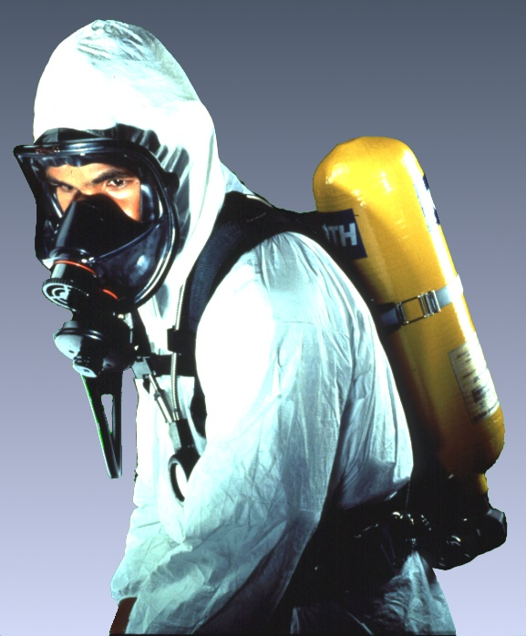
Self-contained Breathing Apparatus
An atmosphere-supplying respirator for which the breathing air source is designed to be carried by the user.
When to use:
- Manure pits or confinement buildings during pit agitation or pumping
- Environments with poor ventilation creating high levels of carbon monoxide
- Fumigation in enclosed areas
- Silo entry that is oxygen limiting

Slide 28
Respiratory Program
Procedures for selecting respirators –
Assessing the hazard
Written Standard Operating Procedures
Medical Evaluation of employees required to wear respirators
Training
Fit Testing
Respirator Inspection, Cleaning, Maintenance, and Storage
Surveillance of Work Area Conditions and Worker Exposure – continued assessment of hazard since the hazard can change
Respirator Program Evaluation

Slide 29
Medical Evaluation
Questionnaire in the OSHA respiratory protection standard used for evaluating physical condition of workers. (29 CFR 1910.134)
Medical examination may include pulmonary function testing.
Additional medical evaluations should be provided if:
An employee reports medical signs or symptoms that are related to ability to use a respirator;1910.134(e)(7)(ii)
A PLHCP (Physician or other licensed health care professional , supervisor, or the respirator program administrator informs the employer that an employee needs to be reevaluated;1910.134(e)(7)(iii)
Information from the respiratory protection program, including observations made during fit testing and program evaluation, indicates a need for employee reevaluation; or
A change occurs in workplace conditions (e.g., physical work effort, protective clothing, temperature) that may result in a substantial increase in the physiological burden placed on an employee.
Notes:
Add new standard for follow up

Slide 30
Fit Testing
Mandatory
Initially
Annually thereafter
Employer - employee relationship
If employer requires respirator
Exposure is above recommended
Permissible Exposure Limits (PEL)
Follow-up testing
Periodically as warranted to determine employees continued fitness to wear respirators. 1910.134(f)(3)
The employer shall conduct an additional fit test whenever the employee reports, or the employer, PLHCP, supervisor, or program administrator makes visual observations of, changes in the employee's physical condition that could affect respirator fit. Such conditions include, but are not limited to, facial scarring, dental changes, cosmetic surgery, or an obvious change in body weight.
Notes:
OSHA requires fit testing performed annually [in 29 CFR 1910.134(f)(2)] if the employee is required to wear the respirator by the employer or is exposed above the PELs.

Slide 31
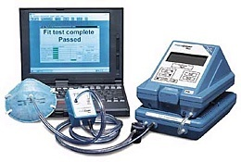
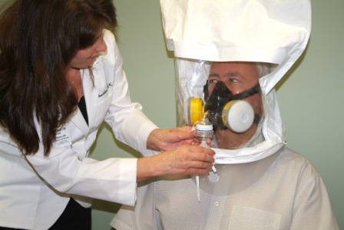
Type of Fit Testing
  Quantitative
  - Portacount test
Qualitative
- Bitrex, Saccharin,
  Use OSHA approved fit test protocols (Appendix A to § 1910.134: Fit Testing Procedures)
  Available on OSHA.gov website

Slide 32
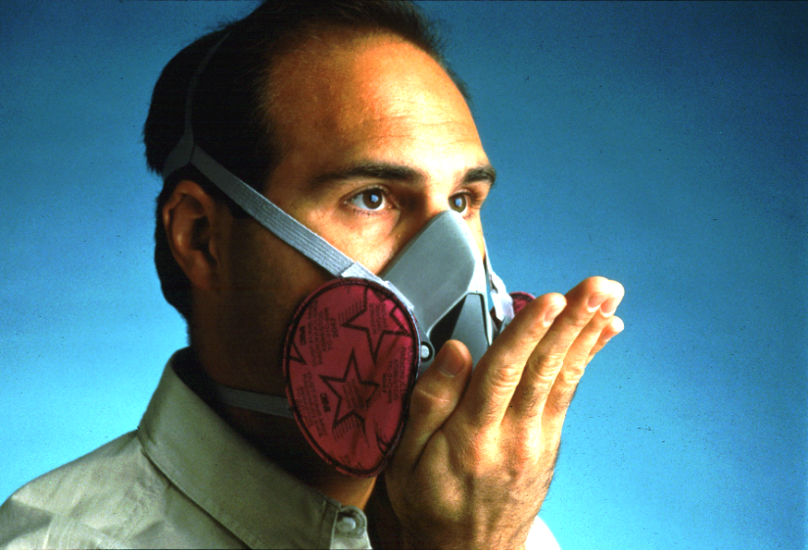
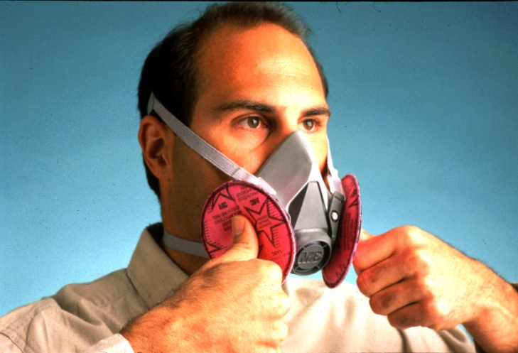
User Seal Check
An action conducted by the respirator user to determine if the respirator is properly fitted to the face.
Positive Pressure Check
Negative Pressure Check
Notes:
User seal check is part of the fit test that is taught to the individual – this assists them each time they put the mask on
Assist in tightening straps – adjusting the face piece and helps determine need to replace headpiece (cradle)
the fit check the user does is in addition to the annual fit test required by OSHA
Make sure audience knows if a worker is required to wear a respirator, MUST also have fit test and a seal check is not the only thing the employer is required to do
Source of picture: OSHA Website
http://www.osha.gov/dte/library/respirators/presentation/slide55.html

Slide 33
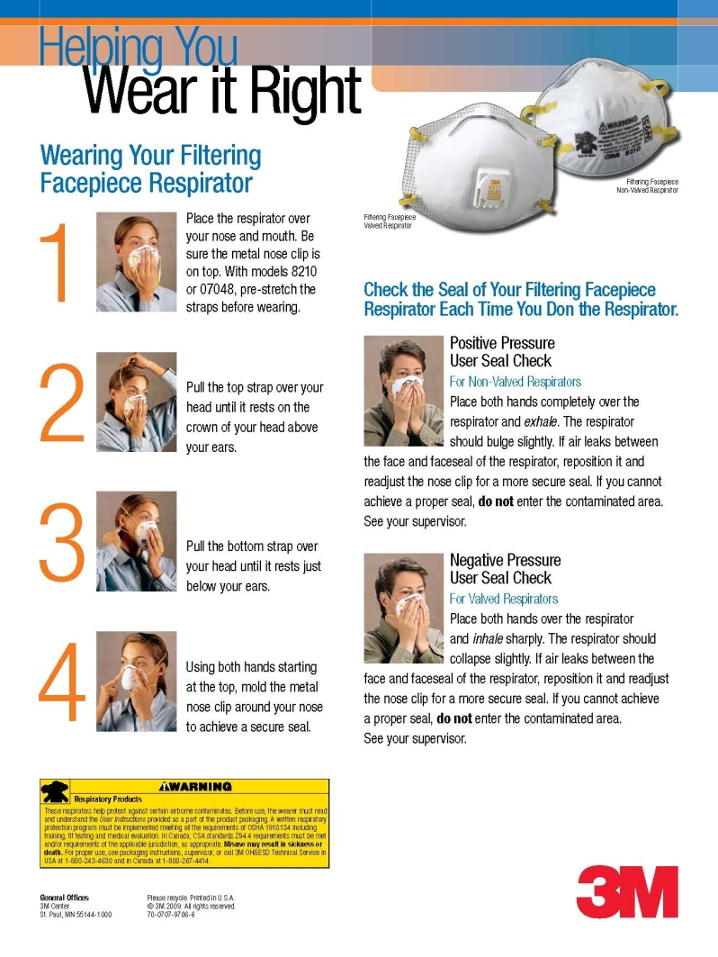
Filtering Face piece Fit Test
Fit Testing is required if:
the employer requires the use of respirators
the employee is exposed above the OSHA permissible exposure levels (PELs)
if workers wear these respirators on a voluntary basis NO fit testing is required.
Notes:
Filtering Face piece masks also require fit testing
Fit testing method is different for 2 strap filtering face pieces - see 3M poster that is available through 3M
OSHA requires fit testing of these respirators (filtering face pieces)
if the employer requires the use of respirators
or the employee is exposed above the OSHA permissible exposure levels - Permissible Exposure Limits (PELs)
NOTE: if workers wear these respirators on a voluntary basis, no fit testing is required.

Slide 34
Information Presentation
Activity
Exposure
Respiratory Protection
  Air Purifying
  Supplied Air respirator
12/20/2013
34

Slide 35
Hog or Poultry confinement
Common exposure in Midwest
Combination of hazards
Different types of masks are appropriate

Slide 36
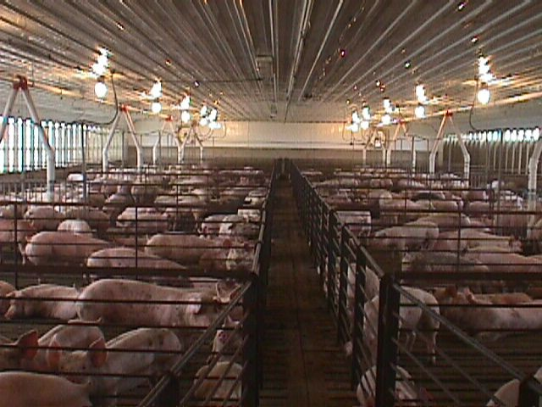
What’s in the air?
Particles of grain
Hog manure
Insect parts
Bacteria
Ammonia

Slide 37
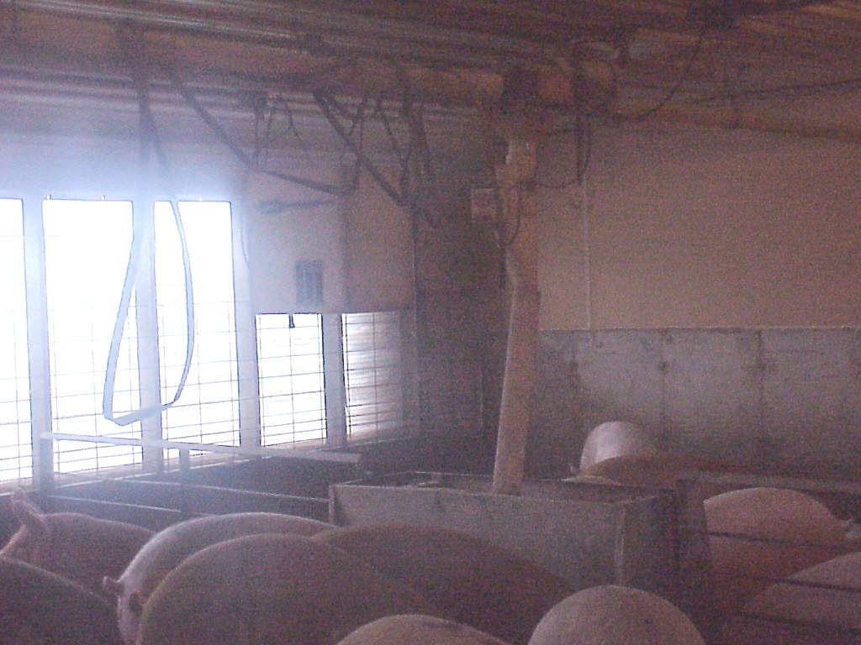
Airborne Dust
Not just Dust

Slide 38
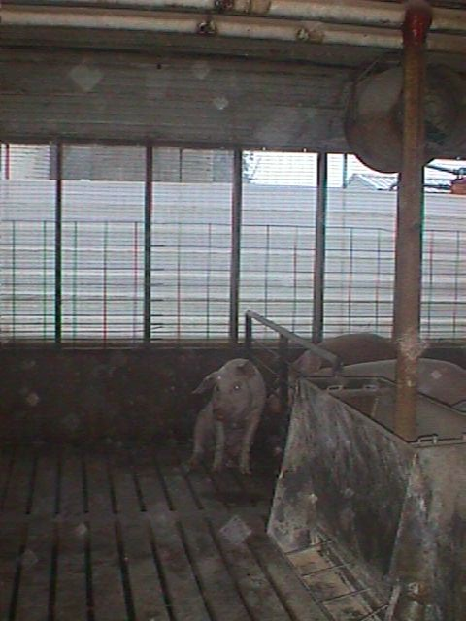
Pigs sometimes have trouble breathing too

Slide 39
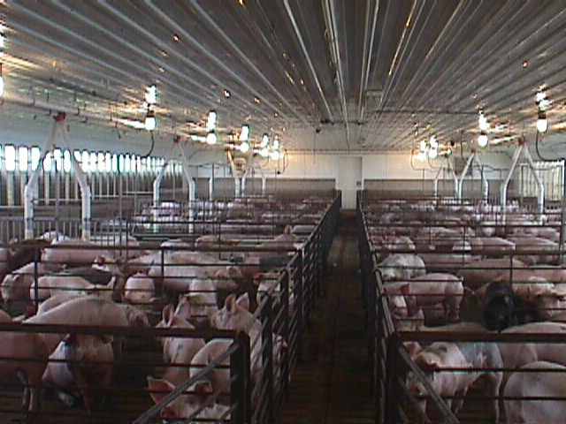
Symptoms of
Toxic Dust Organic Syndrome
Dry irritated cough
Fever
Muscle aches
Occur 4 to 6 hours after exposure

Slide 40
Prevention of
Organic Toxic Dust Syndrome (ODTS)
Improve ventilation, especially in winter when buildings are more closed up
Two-strap disposable respirator – NIOSH certified
Half-face masks with filters for organic dust
Powered air-purifying respirators

Slide 41

Hog or Poultry Confinement
Exposure = Respirator recommendation
Organic Dust = Filtering face piece, disposable 2 strap mask or half mask with dust cartridge or HEPA filter
Examples: 3M 8210,8511,8271,8233 Moldex 2200 or 2300
Ammonia = Filtering face piece or if symptomatic or dislike ammonia smell use half or full face mask with ammonia cartridge and prefilter
12/20/2013
41
Notes:
Ammonia – field application is different
Pre filter is important
Add picture with ammonia cartridge and prefilter

Slide 42
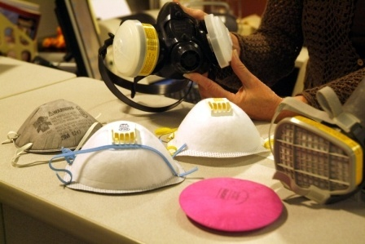

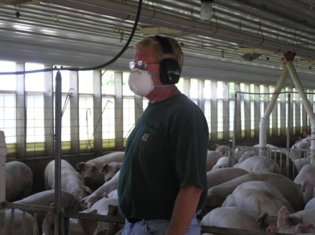
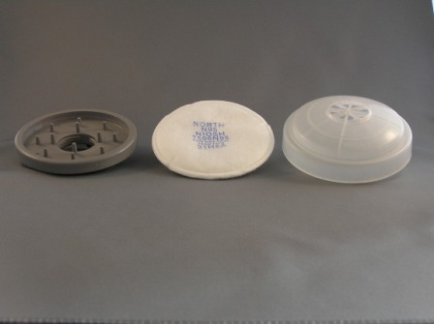
Choices and Comfort

Slide 43
Hog or poultry confinement (cont)
Disinfectants = half mask with acid gas cartridge
Carbon Monoxide = supplied air respirators
Hydrogen Sulfate = supplied air respirators

Slide 44
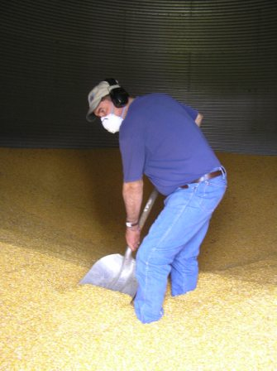

Grain Dust
Hazard is organic dust (feed or grain dust, molds and spores)
Can cause Toxic Dust Organic Syndrome or Farmers Lung
3M 8271
3M half mask HEPA filters

Slide 45
Signs and Symptoms of Farmer’s Lung (Hypersensitivity Pneumonitis)
Fever – Occurs 4 to 6 hours after the exposure, along with other following symptoms
Cough w/ sputum
Chest tightness
Shortness of breath

Slide 46
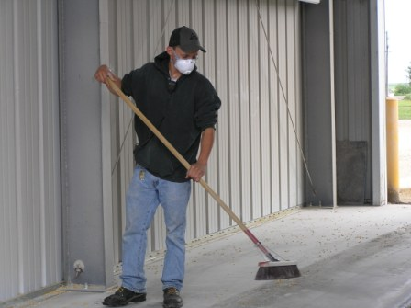
Preventing Toxic Organic Dust Syndrome or Farmer’s Lung
Half-mask respirators
  Filtering face piece – N series
  Half Mask face piece – N or P series
  Full Face piece – Nor P series
  HEPA filter
Powered air-purifying respirators

Slide 47
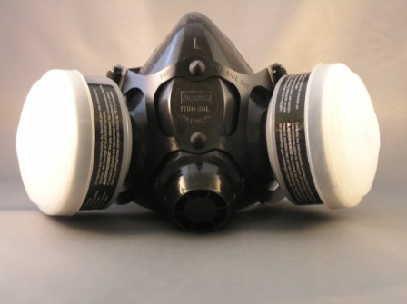
Pesticides
Hazard is organic vapors and aerosols (solid and sprayed liquids)
Respirator selection
Solids – filtering face piece N,R, or P series
Liquids – Half mask face piece with Organic Vapor cartridge and P prefilter
Can also use Full face piece or powered air – purifying respirator
Notes:
Appropriate filter and or cartridge related to Label and exposure

Slide 48
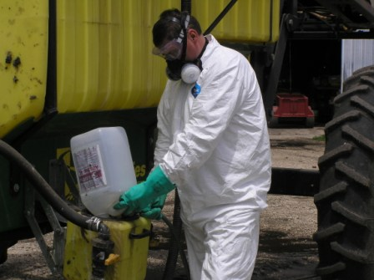
Pesticides
NOTE: Read Label or MSDS which provides information on respirator selection

Slide 49
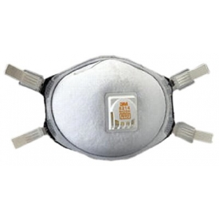
Welding
Hazard is Metal fumes
  Particulates
Respirator selection
Air purifying Respirator which is N100, R100,or P100
Filtering face Piece, Half mask face piece or full face piece
3M 8233 3M 8214
Notes:
Welding – Specific for welding respirator is on the package
Add another example
N1000
8293?
Depends on what you are welding on

Slide 50
Gas or Diesel Indoors
Hazard: Carbon Monoxide
Respirator selection
NO air purifying respirator is effective
ventilate area or use supplied air or SCBA
NOTE: Using gas or diesel engines indoors such as power washers and skid loaders can create an oxygen deficient atmosphere which can cause death.

Slide 51
Hobbies - Off Farm Work
Painting: Hazard is aerosol organic vapors and metal particulates – metals can become vapors
Air purifying Filtering face piece N,P, or R series
Half mask face piece or full face piece with Organic Vapor cartridge and P series prefilter
NOTE: Isocyanate paints require supplied air respirators – read labels and MSDS sheets
Wood Working/ Remodeling: Hazard is aerosols (wood, sheetrock, dusts) and organic vapors from lacquers, thinners, varnish and adhesives
For aerosols or dusts
  N, R,or P Filtering face piece,
  N or P Half mask
  Full face piece with N or P filter
  Or HEPA filters
For organic Vapors – use half mask with Organic Vapor Cartridges
Notes:
Need prefilter and cartridge
Based on the paint
How are you applying
It can become a vapor

Slide 53
Respirator Selection Guide
Purpose of the guide is to assist trained Agricultural Health Professions to recommend appropriate respirators based on the clients agricultural exposure. Includes:
  General Information
  Selection Guide Logic
Available from AgriSafe Network Inc. cost is $35
In process of being revised
12/20/2013
53

Slide 54

Does not include all of OSHA Standard 29CFR 1910.134 Appendix C is questionnaire
Notes:
This tool will be revised
Does not include all of the OSHA standards - reference OSHA standard 29CFR 1910. 134
One of the appendices' is the questionnaire (appendix C )

Slide 55
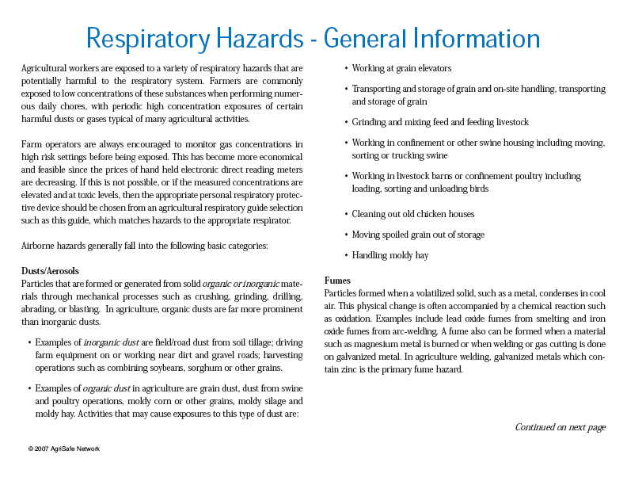

Slide 56
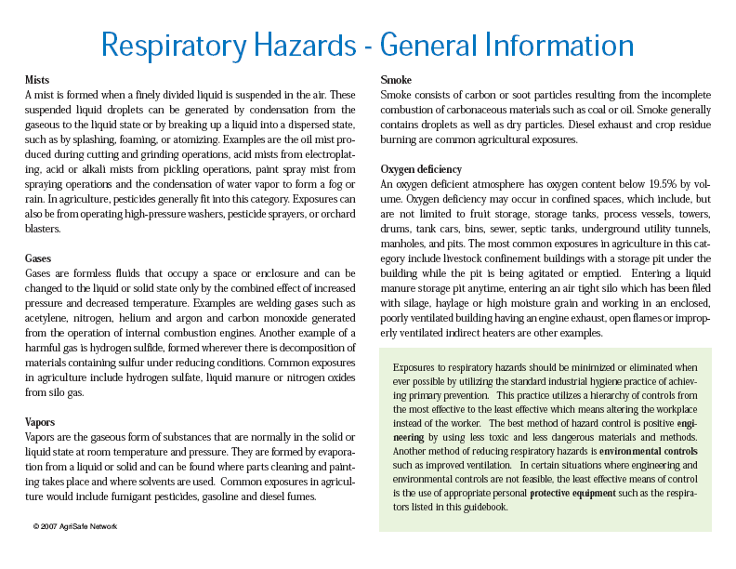

Slide 57
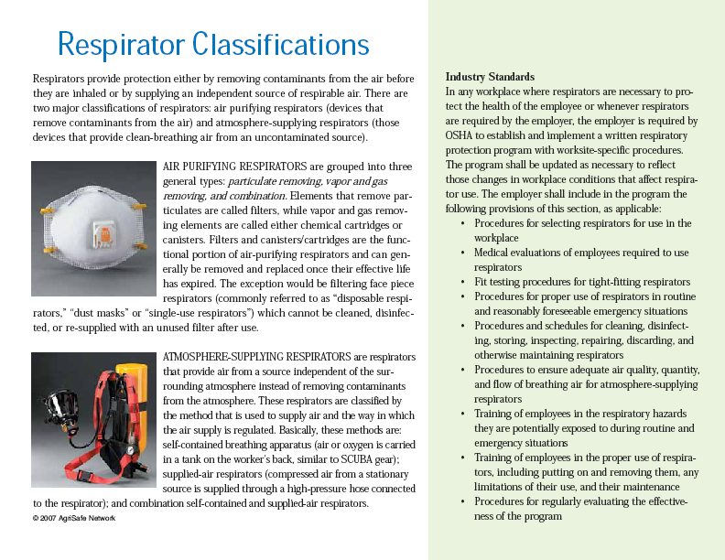

Slide 58
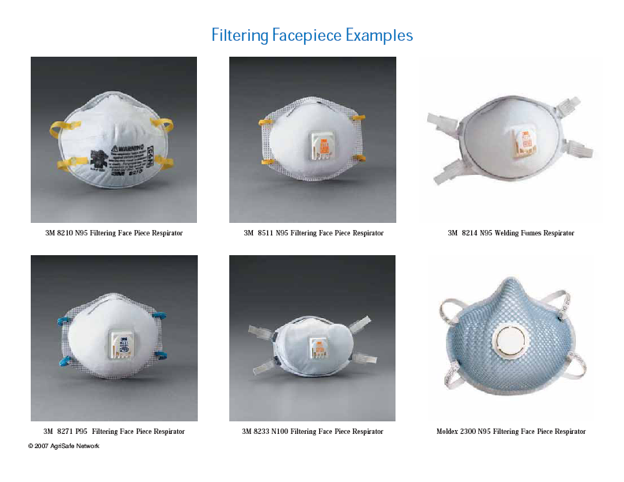

Slide 59
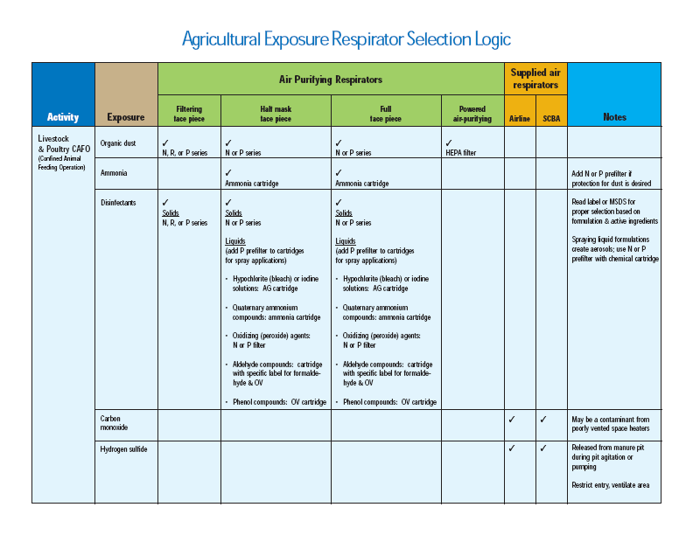

Slide 60
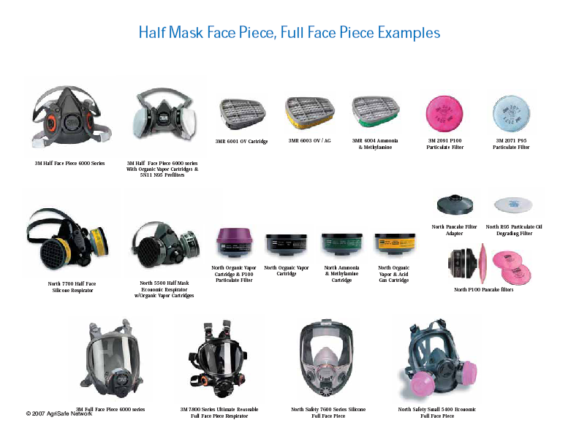

Slide 61
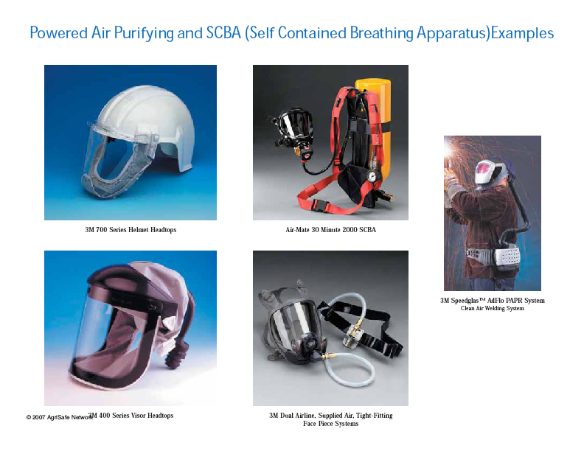

Slide 62
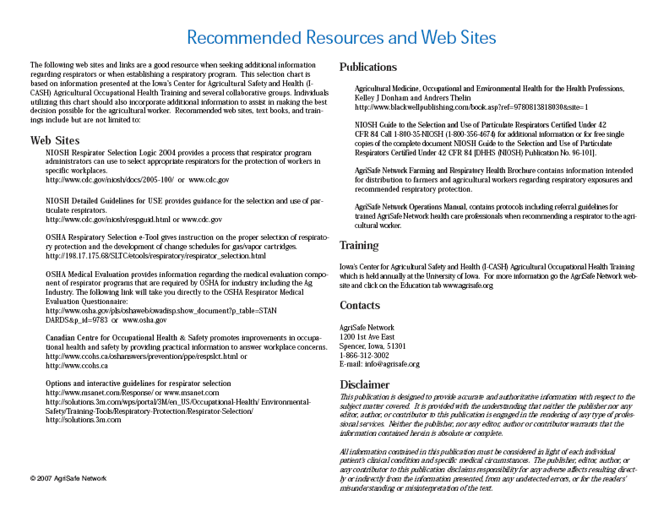

Slide 63
OSHA Resources
www.osha.gov
OSHA Respiratory selection e-tool
Respiratory uses
Medical Requirements
Maintenance and care of respirators
Fit testing
Written Programs
Voluntary Use of Respirators
Respiratory Change Schedules
Respirator Selection

Slide 64
OSHA Resources
Respirators QuickCard™
(OSHA 3280 - 2005) (English: HTML PDF )
(OSHA 3280 - 2005) (Spanish: HTML PDF )
Respiratory Protection Standard: Small Entity Compliance Guide
(English: PDF )
Respiratory Protection: Assigned Protection Factors for the Revised Respiratory Protection Standard
(OSHA 3352 - 2009) (English: HTML PDF )
Respiratory Protection: Respiratory Infection Control - Respirators Versus Surgical Masks Fact Sheet
(English: HTML PDF)

Slide 65
Publications:
Respiratory Protection Standard: Small Entity Compliance Guide- 2011, (OSHA 3384-09 20)
Agricultural Medicine, Occupational and Environmental Health for the Health Professions, Kelley J Donham and Andrers Thelin
Agricultural Respirator Selection Guide, available online, AgriSafe Network www.agrisafe.org

Slide 66


Slide 67
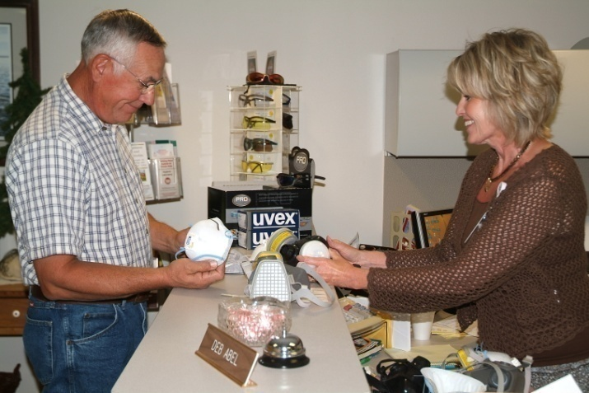
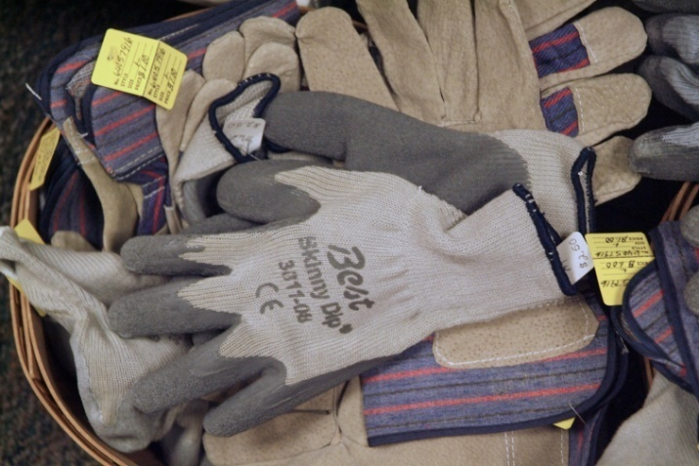



Right PPE for the Job

Slide 68
Employee Rights and Responsibilities
You have the right to:
  A safe and healthful workplace
  Know about hazardous chemicals
  Information about injuries and illnesses in your workplace
  Complain or request hazard correction from employer

Slide 69
Employee Rights and Responsibilities
You have the right to:
  Training
  Hazard exposure and medical records
  File a complaint with OSHA
  Participate in an OSHA inspection
  Be free from retaliation for exercising safety and health rights

Slide 70
Employee Rights and Responsibilities
OSHA website: http://www.osha.gov and OSHA offices: Call or Write (800-321-OSHA)
Compliance Assistance Specialists in the area offices
National Institute for Occupational Safety and Health (NIOSH) – OSHA’s sister agency
OSHA Training Institute Education Centers
Doctors, nurses, other health care providers
Public libraries
Other local, community-based resources

