Slide 1
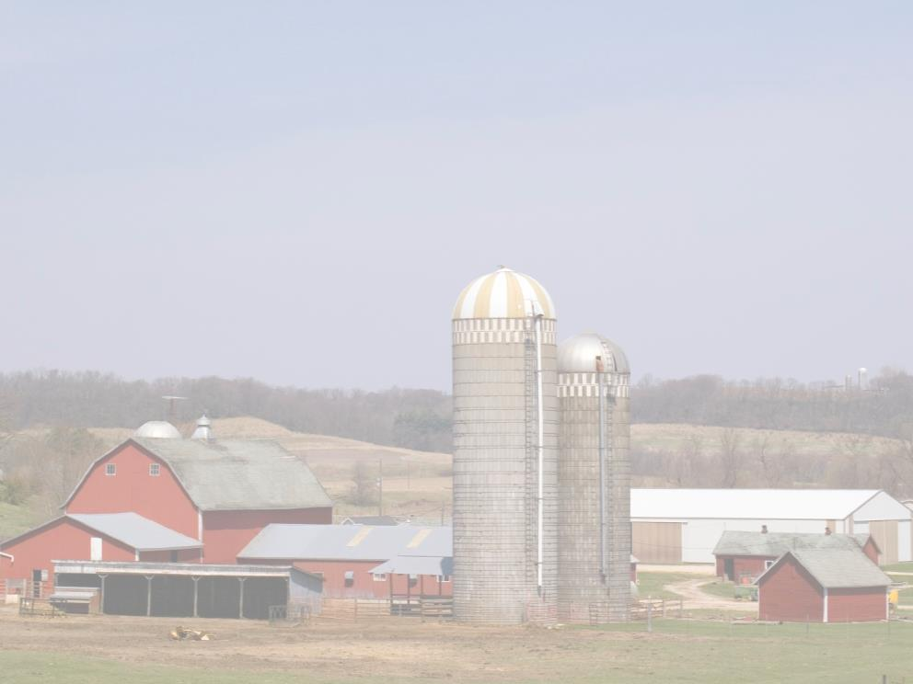
Combustible Dust in Grain Handling Facilities
29 CFR 1910.272
This material was produced under a grant (SH22284SH1) from the Occupational Safety and Health Administration, U.S. Department of Labor. It does not necessarily reflect the views or policies of the U.S. Department of Labor, nor does the mention of trade names, commercial products, or organization imply endorsement by the U.S. Government.

Slide 2
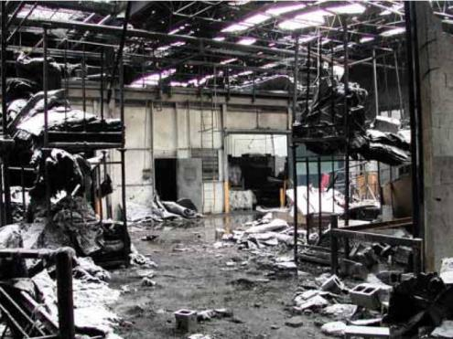
Overview of Combustible Dust in the
Grain
Industry
Dust explosion
ruins
Notes:
Photo was from Kirkwood material

Slide 3
Overview of Combustible Dust in Industry
Unit Objectives
At the conclusion of this unit you will be able to::
1. Describe several recent dust explosions and the dust deflagration process;
2. Identify the basic considerations used in a facility hazard analysis for dust; and,
3. Describe the prevention and mitigation techniques used in control of the combustible dust hazard.
Notes:
NOTE TO INSTRUCTOR:
Discuss the unit objectives:
On completing this section students should be able to:
Describe several recent dust explosions and the dust deflagration process.
2. Identify the basic considerations used in a facility hazard analysis for dust
3. Describe the prevention and mitigation techniques used in control of the combustible dust hazard

Slide 4
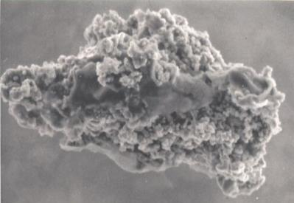

This presentation is based on
“Combustible Dust in Industry. . .” - OSHA Safety and Health Information Bulletin (SHIB 07-31-2005) (download at http://www.osha.gov/dts/shib/index.html )
NFPA 654
Notes:
This presentation is based on “Combustible Dust in Industry. . .” - OSHA Safety and Health Information Bulletin (SHIB 07-31-2005) (download at http://www.osha.gov/dts/shib/index.html ).
and
NFPA 654
http://www.nfpa.org/aboutthecodes/list_of_codes_and_standards.asp
At the above web address, the following steps will allow in accessing a NFPA standard only in readable format: 1) select the standard, 2) click "Preview this Document", 3) agree to the disclaimer, and 4) open the standard.

Slide 5
Background
This section describes and examines a series of horrific dust explosions that have occurred recently.
The U.S. Chemical Safety and Accident Investigation Board (CSB) and OSHA have identified these explosions as representative of a national safety problem.
Notes:
This unit describes and examines a series of horrific dust explosions that have occurred recently. A U.S. Chemical Safety Board (CSB) and OSHA have identified these as representative of a national safety problem. A CSB study indicated that there were about 280 explosions and fires of significance between about 1980 and 2005. The Chairman of the CSB testified before a congressional committee that CSB had identified an additional 80 since 2005, an increase in frequency. Dust explosions are often catastrophic events.
Photo was from the Kirkwood slides

Slide 6
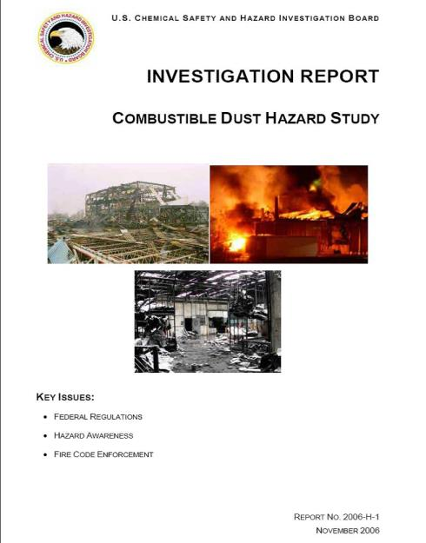
US Chemical Safety Board
  Found a pattern of catastrophic dust explosions
  Recommended that OSHA take action
  MSDS sheets often fail to provide dust explosion information
Notes:
The CSB issued its report, the “Combustible Dust Hazard Study”. This document indicated a pattern of catastrophic dust explosions. The board recommended that OSHA develop a comprehensive standard on combustible dust, implement a nation wide inspection program focused on dust and take several other actions. The study also revealed that MSDS sheets often fail to provide dust explosion information and advised OSHA to update its standard on Hazard Communication to address this failing.

Slide 7
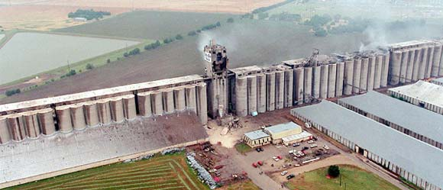
Experience in the Grain Handling Industry
In the late 1970s grain dust explosions left 59 people dead and 49 injured.
Notes:
In the late 1970s, series of grain dust explosions left at least 59 dead and 49 injured.
Haysville, Kansas June 8, 1998 7 killed, 10 injured
Atchison, Kansas, October 28, 2011 6 killed , 2 injured
Photo is from the Kirkwood series

Slide 8
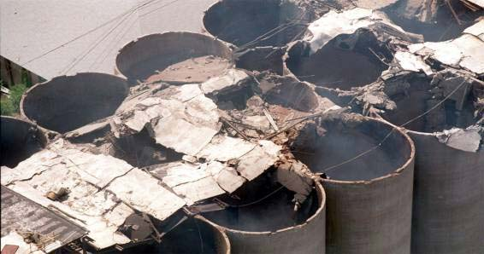
Experience in the Grain Handling Industry
In 1987, OSHA promulgated the Grain Handling Facilities standard (29 CFR 1910.272) still in effect
Notes:
OSHA promulgated a specific standard in 1987 for the control of combustible dust in the grain handling industry. It resulted in a fairly significant decline in the rate of grain explosions. The standard and attempts to comply with it have resulted in a better understanding of the hazard. In addition, the standard provides specific mandatory controls to use as a model. The OSHA standard specifically regulates hazardous work practices and housekeeping. It requires engineering controls on equipment and addresses maintenance, fire protection, emergency planning, appropriate exiting and other requirements. The Grain Handling Facilities standard (29 CFR 1910.272) is still in effect.
Photo came from Kirkwood series

Slide 9
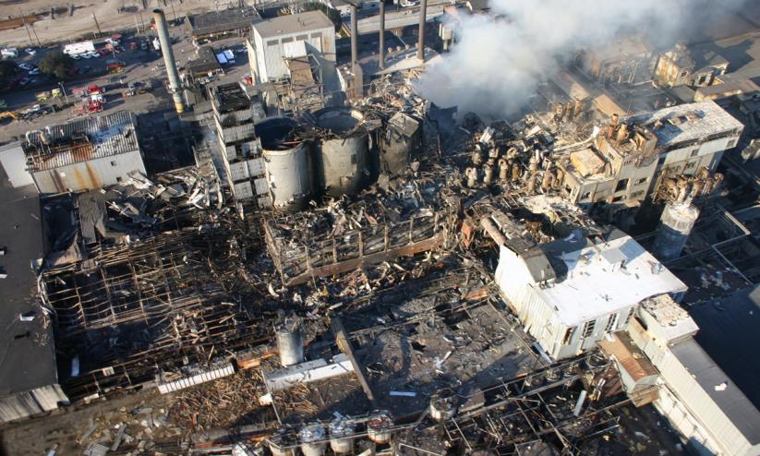
Imperial Sugar Company
Port Wentworth GA
Explosion and Fire
February 7, 2008
14 Deaths and Numerous serious injuries
Notes:
Demonstrating that the examples described identify a continuing problem, a disastrous series of explosions and fires occurred at the Imperial Sugar Company in Port Wentworth Georgia on February 7, 2008. There were 14 deaths and at least 36 other serious burns and injuries. Causal factors included unacceptable housekeeping to control dust accumulations, design flaws in the ventilation system, a lack of hazard assessment, and a lack of explosion prevention and mitigation measures.
Photo came from Kirkwood series

Slide 10
OSHA INSTRUCTION
U.S. DEPARTMENT OF LABOR Occupational Safety and Health Administration
DIRECTIVE NUMBER: CPL 03-00-008 EFFECTIVE DATE: March 11, 2008
SUBJECT:
Combustible Dust National Emphasis Program
This allows increase enforcement activities
Notes:
In response, OSHA established the Combustible Dust National Emphasis Program. This allows increase enforcement activities.
NEP- National Emphasis Program

Slide 11
Combustible Dust Explosions
Practice Quiz
1. A combustible dust explosion or deflagration may occur when combustible dust, an ignition source, air or other oxidant, ______________ are present.
  Dispersion of the dust
  B. Confinement
  C. A and B above
  D. None of the above

Slide 12
Combustible Dust Explosions
Practice Quiz
1. A combustible dust explosion or deflagration may occur when combustible dust, an ignition source, air or other oxidant, ______________ are present.
  Dispersion of the dust
  B. Confinement
  C. A and B above
  D. None of the above

Slide 13
Dust Explosion Requirements
Dust is combustible.
It must be dispersed in air or another oxidant in a concentration at or above the minimum explosible concentration (MEC).
There is an ignition source, such as
        an electrostatic discharge,
        spark,
        glowing ember,
        hot surface,
        friction heat, or
        a flame
that can ignite the dispersed combustible mixture
With confinement there is an explosion
Notes:
NOTE TO INSTRUCTOR:
Be sure to define these terms.
Combustible dust – a combustible particulate solid that presents a fire or deflagration hazard when suspended in air or some other oxidizing medium over a range of concentrations, regardless of particle size or shape.
2. Minimum explosible concentration (MEC) – the minimum concentration of combustible dust suspended in air, measured in mass per unit volume, that will support a deflagration.
A fire is usually considered to involve fuel, the air, and heat as an ignition source. Two additional factors, or elements, are usually involved in a dust explosion - dispersion of finely divided particles and confinement. When dust is combustible it may cause an explosion or deflagration when it is dispersed in air or another oxidant, present in a concentration at or above the minimum explosible concentration (MEC), there is an ignition source, and confinement produces the disaster. The flame front of an expanding fire ball formed around the ignition point approaches the barrier confining the event. It is pushing concentrated fuel out in front of it. The reaction speeds up as it approaches the barrier. The high pressure bursts the barrier – an explosion. A catastrophic dust explosion involves five things: fuel, ignition source, oxygen, dispersion and, confinement. It is rare that all these things will come together and produce an explosion but a catastrophe occurs when it happens
The dust explosion requirements are shown in terms of a pentagon, with each side representing one of the required elements: combustible dust, dispersion of the dust particles in sufficient quantity and concentration, oxygen in the air or another oxidizer, an ignition source, and confinement.

Slide 14
Combustible Dust Explosions
Practice Quiz
2. A combustible dust explosion in a piece of equipment or area where dust has accumulated:
  May shake loose more accumulated dust
  B. Damage a containment system
  C. Cause one or more destructive secondary explosions
  D. All of the above

Slide 15
Combustible Dust Explosions
Practice Quiz
2. A combustible dust explosion in a piece of equipment or area where dust has accumulated:
  May shake loose more accumulated dust
  B. Damage a containment system
  C. Cause one or more destructive secondary explosions
  D. All of the above

Slide 16
Dust Explosion in a Work Area
Dust
Dust settles on flat surfaces
Some event disturbs the settled dust into a cloud
Dust cloud is ignited and explodes
Adapted from CSB
Notes:
NOTE TO INSTRUCTOR:
Be sure to define:
1. Explosion – the bursting or rupture of an enclosure or a container due to the development of internal pressure from a deflagration. The explosion is the result. The deflagration is the process that produces the result.
A dust explosion occurs in a work area because dust is deposited around the work site. The dust settles on bar joists, beams, ledges, equipment and other surfaces. Some event disturbs the settled dust into a cloud. The dust cloud is ignited and explodes, a catastrophic event.
2. Deflagration - combustion that propagates through a gas or along the surface of an explosive at a rapid rate driven by the transfer of heat combustion, burning - a process in which a substance reacts with oxygen to give heat and light. ( The Free Dictionary)

Slide 17
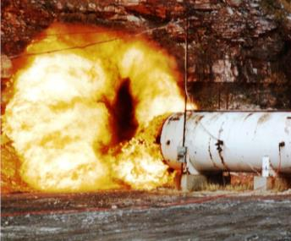
Dust Explosions
An initial (primary) explosion in
processing equipment or in an area where fugitive dust has accumulated:
  may shake loose more accumulated dust; or,
  damage a containment system (such as a duct, vessel, or collector).
The additional dust dispersed into the air may cause one or more secondary explosions.
These can be far more destructive than a primary explosion.
Notes:
When an initial (primary) explosion in processing equipment occurs, or when such an explosion occurs in an area where fugitive dust has accumulated, it can shake loose accumulated dust in other areas. It can damage a containment system such as a duct, vessel, or collector. The additional dust dispersed into the air may cause one or more secondary explosions. These can be far more destructive than a primary explosion.

Slide 18
A Dust Explosion Event
Primary deflagration inside process equipment
0 25 50 75 100 125 150 175 200 225 250 300 325
Time, msec.
(Timing of actual events may vary)
Notes:
This series of 9 slides show the sequence and timing of a dust explosion event. They are adapted from OSHA diagrams prepared by
John M. Cholin, P.E., FSFPE, J.M. Cholin Consultants, Inc.
This represents a primary event, called a deflagration, inside process equipment. The time involved in these events varies but is a matter of milliseconds or thousandths of a second.
NOTE TO INSTRUCTOR:
Be sure to define:
Deflagration – propagation of a combustion zone at a velocity that is less than the speed of sound in the un-reacted medium. This action releases large quantities of heat very rapidly. This causes the air and gases to expand rapidly and create large pressures that can lead to structural failure and cause employee injuries.
Slide from Kirkwood series

Slide 19
A Dust Explosion Event
Shock wave caused
by primary deflagration
0 25 50 75 100 125 150 175 200 225 250 300 325
Time, msec.
Notes:
The shock waves caused by the primary deflagration spread through the facility. This may involve only a few milliseconds.

Slide 20
A Dust Explosion Event
Shock waves reflected by surfaces within the building cause accumulated dust to go into suspension
0 25 50 75 100 125 150 175 200 225 250 300 325
Time, msec.
Notes:
Shock waves reflected by surfaces within the building cause accumulated dust to go into suspension.

Slide 21
A Dust Explosion Event
Dust clouds thrown in the air by the shock waves
0 25 50 75 100 125 150 175 200 225 250 300 325
Time, msec.
Notes:
Dust clouds are thrown into the air by the shock waves.

Slide 22
A Dust Explosion Event
Primary deflagration breaks out of the equipment enclosure - creating a source of ignition
0 25 50 75 100 125 150 175 200 225 250 300 325
Time, msec.
Notes:
The primary deflagration may break out of the equipment enclosure, creating a source of ignition.

Slide 23
A Dust Explosion Event
Secondary deflagration ignited
0 25 50 75 100 125 150 175 200 225 250 300 325
Time, msec.
Notes:
This or some other ignition source can cause a secondary, more generalized, event within the facility.

Slide 24
A Dust Explosion Event
Secondary deflagration is propagated through the dust clouds
0 25 50 75 100 125 150 175 200 225 250 300 325
Time, msec.
Notes:
This secondary deflagration is propagated through the dust clouds and around the work area.

Slide 25
Secondary deflagration bursts from the building
0 25 50 75 100 125 150 175 200 225 250 300 325
Time, msec.
Notes:
It bursts from the building roof and walls – an explosion.

Slide 26
A Dust Explosion Event
Collapsed building with remaining fires
0 25 50 75 100 125 150 175 200 225 250 300 325
Time, msec.
Adapted from OSHA diagrams prepared by
John M. Cholin, P.E., FSFPE, J.M. Cholin Consultants, Inc.
Notes:
In what may only be one third of a second or less, what remains is a collapsed building and residual fires.

Slide 27
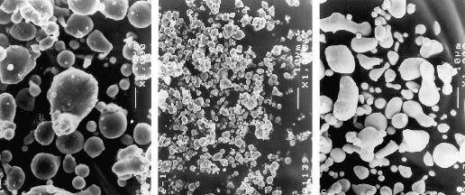
Dust Explosion Hazard
“. . .any industrial process that reduces a combustible material and some normally noncombustible materials
  to a finely divided state
  presents a potential for a serious fire or explosion.” (NFPA’s Industrial Fire Hazards Handbook)
Notes:
The dust explosion hazard has been described as “. . .any industrial process that reduces a combustible material, and some normally noncombustible materials, to a finely divided state presents a potential for a serious fire or explosion.” This description is in the NFPA Industrial Fire Hazards Handbook and is well recognized by industry safety experts.

Slide 28


Combustible Dust Explosions
In the past section, we discussed a series of horrific dust explosions that have occurred recently.
  Common causes were identified
  How the explosions occurred was outlined
  The factors needed to produce an explosion and the explosion process were discussed in detail.
Dust
Notes:
In the past section, we discussed a series of horrific dust explosions that have occurred recently. Common causes were identified. How the explosions occurred was outlined. The factors needed to produce an explosion and the explosion process was discussed in detail.

Slide 29
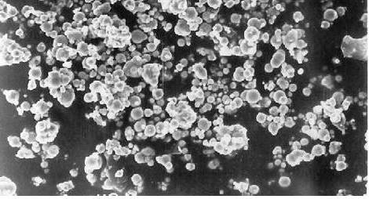
Particles
In this section, particles that participate in an explosion process are discussed.
Their characteristics are identified.
How they form in an industrial process is outlined.
Grain Dust Particles
Notes:
In the particle section, particles that participate in an explosion process are discussed. Their characteristics are identified. How they form in an industrial process is outlined.

Slide 30
Particles
Practice Quiz
1. Regarding combustible dust particles – grinding and polishing waste:
  A. Hazard decreases as particle size increases.
  B. Hazard increases as particle size decreases.
  C. They produce no hazard.
  D. None of the above.

Slide 31
Particles
Practice Quiz
1. Regarding combustible dust particles – grinding and polishing waste:
  A. Hazard decreases as particle size increases.
  B. Hazard increases as particle size decreases.
  C. They produce no hazard.
  D. None of the above.

Slide 32
Combustible Particulate Solid
Any combustible solid material composed of distinct particles or pieces, regardless of size, shape or chemical composition
Includes
Dusts
Fines
Fibers
Flakes
Chips
Chunks
Mixtures of any of the above
Notes:
Wherever combustible particulate solids are produced, processed, handled or conveyed, fine particulates break off during processing. Thus all combustible particulate solids should be expected to contain combustible dusts.
NOTE TO INSTRUCTOR:
Be sure to define:
Combustible particulate solid – any combustible solid material composed of distinct particles or pieces, regardless of size, shape or chemical composition.
From NEP

Slide 33
Combustible Dust
A combustible particulate solid that presents a fire or deflagration hazard when suspended in air or some other oxidizing medium over a range of concentrations, regardless of particle size of shape
Dusts are just a small fraction of combustible particulate solids
The term combustible dust does NOT encompass all hazardous particulates
Notes:
NOTE TO INSTRUCTOR:
Review the definition of combustible dust: a combustible particulate solid that presents a fire or deflagration hazard when suspended in air or some other oxidizing medium over a range of concentrations, regardless of particle size or shape.

Slide 34
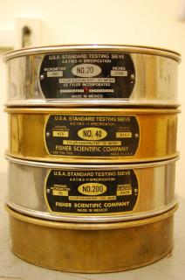
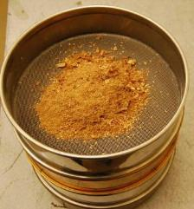
Particles
Size
  Pellets > 2mm diameter
  Granules 0.42mm - 2mm
  Dust particles < 0.42mm (420 ųm)
Hazard increases as particle size decreases
  Larger surface area for combustion
  Fine particles may have a larger role in dust cloud ignition and explosion propagation
Notes:
The hazard of combustible dust increases as particle size decreases. Intuitively we understand that more particles of a small size in a given volume provide a larger surface area for combustion. It is thought that fine particles may have a larger role in dust cloud ignition and explosion propagation. The smaller the particle, the easier it is to heat to the kindling temperature of the substance.
There are a series of ASTM tests that are recognized by OSHA and industry professionals as appropriate. These tests are used to determine if there is a combustible dust hazard at the plant. Screening the dust is one type of test.
A .42 mm or 420 micron particle (spherical or cubical) is thought to be large enough to remain airborne or dispersed for a considerable period. This size particle may pass through a #40 US standard screen. It is considered a laboratory standard. Particles 420 microns or smaller are considered “dust”. We will discuss this a little more later.
IMPORTANT: Oblong or flake particles that do NOT pass through a US #40 sieve can still be hazardous.

Slide 35
Particles
Dusts may occur in the process stream and cause a hazard, regardless of starting particle size of the material
may break
into
or
This
Notes:
Dusts may occur in the process stream and cause a hazard, regardless of starting particle size of the material. This is because larger particles may break into small or very small particles.

Slide 36
Facility Dust Hazard Assessment
In this section, the various components of a facility dust hazard assessment are discussed.
Several factors are identified as critical to the assessment:
  Facility hazard analysis to identify the potential for dust explosions
  Measures to prevent dust explosions
  Measures to mitigate the damage of dust explosions
  Training—for both prevention and mitigation
Dust
Hazard Analysis Couch
Notes:
Where do you start? You perform a facility dust hazard analysis to identify the potential for dust explosions.
Then you determine what measures are being or can be used to
Prevent explosions
and/or
Mitigate the damage of dust explosions that are not prevented.
Finally, you determine the training required for both prevention and mitigation.

Slide 37


Facility Hazard Analysis Components
Carefully identify:
Materials that can be combustible when finely divided;
Processes which use, consume, or produce combustible dusts;
Equipment in which dust may be concentrated;
Open areas where combustible dusts may build up;
Hidden areas where combustible dusts may accumulate;
Means by which dust may be dispersed in the air; and
Potential ignition sources.
Notes:
There are several items to consider when analyzing and examining a facility to determine if there is a combustible dust hazard. Some points to check include those listed on this slide:
Materials that can be combustible when finely divided;
Processes which use, consume, or produce combustible dusts;
Equipment in which dust may be concentrated;
Open areas where combustible dusts may build up;
Hidden areas where combustible dusts may accumulate;
Means by which dust may be dispersed in the air; and
Potential ignition sources.

Slide 38
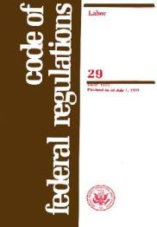
Determine Applicable Standards
Identify and follow the applicable federal, state, and local laws and regulations. Some commonly applicable mandatory requirements
  OSHA General Duty Clause and Standards
  The International Code Council’s International Fire Code®
  NFPA’s Uniform Fire Code®.
29 CFR 1910
OSHA
  Local building codes frequently adopt NFPA dust standards by reference
Notes:
It is important to identify the standards and regulations that apply to the workplace. Inquiry should be made to determine the applicable federal, state, and local laws and regulations. Some commonly applicable mandatory requirements
OSHA General Duty Clause and Standards
The International Code Council’s International Fire Code®
NFPA’s Uniform Fire Code®.
Local building codes frequently adopt NFPA dust standards by reference
In the absence of a legal mandate to comply with the consensus standards, they should be considered a very useful source of guidance.

Slide 39
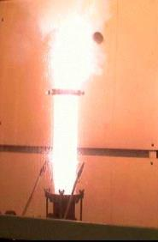

Dust Combustibility – One Element of the Dust Explosion Pentagon
See Explosives regulations
The primary factor in an analysis of these hazards is whether the dust is in fact combustible.
Determine if a dust cloud will:
  Detonate
  Deflagrate
  Present a fire hazard
  Or will Not burn or ignite
Testing may be necessary
Notes:
To determine if an explosion can occur at a facility, an analysis of the dust must be made. The primary factor in analysis is whether the dust is in fact combustible. It is determined if a dust cloud will detonate, deflagrate, present a fire hazard or will not burn or ignite at all. This is usually done through a series of laboratory tests.
There are a series of ASTM tests that are recognized by OSHA and other industry professionals as appropriate. The Laboratory tests that OSHA will perform as part of the NEP are described in Appendix E of CPL 03-00-008.

Slide 40
Dust Combustibility
See Explosives regulations
A detonation is a combustion event that burns faster than the speed of sound:
Not common in industry;
Not generally the problem in an industrial dust explosion.
A deflagration is a combustion event that burns slower than the speed of sound:
A pushing force;
The mechanism of destruction in most combustible dust explosions.
Notes:
NOTE TO INSTRUCTOR:
Define the following terms:
1. Detonation - a combustion event in which the propagation of a flame or combustion zone through a fuel-air mixture occurs at a velocity greater than the speed of sound in the un-reacted medium (usually air) A detonation has a shattering force and creates its own confinement. Materials that detonate are not common in industry and are not generally the problem in an industrial dust explosion.
When detonations do occur, there is generally no available means of fighting them. Prevention is the only alternative.
2. Deflagration - a combustion event in which the combustion zone propagates at a speed that is less than the speed of sound in the un-reacted medium (usually air). A deflagration has a pushing force that is the mechanism of destruction in most combustible dust explosions.
Under the right conditions dust deflagrations can transition into detonations, but this is rare, usually limited to long ducts or pipes.

Slide 41

Dust Combustibility
Combustible dust per NFPA 654
Prior to 2006 - “Any finely divided solid material that is 420 microns or smaller in diameter (material passing a U.S. No. 40 Standard Sieve) and presents a fire or explosion hazard when dispersed and ignited in air.”
2006 Edition – A combustible particulate solid that presents a fire or deflagration hazard when suspended in air or some other oxidizing medium over a range of concentrations, regardless of particle size or shape.
Notes:
Until the 2006 edition of an NFPA dust standard, NFPA 654, a combustible dust was defined as shown in the text. “Any finely divided solid material that is 420 microns or smaller in diameter (material passing a U.S. No. 40 Standard Sieve) and presents a fire or explosion hazard when dispersed and ignited in air.” In the 2006 edition the definition was changed to “a combustible particulate solid that presents a fire or deflagration hazard when suspended in air or some other oxidizing medium over a range of concentrations, regardless of particle size or shape.”
The intent was to be more inclusive and address the issue of some larger particles that would deflagrate but could not pass through a #40 US screen at the laboratory. These particles have a larger surface to volume ratio than a hypothetical 420 micron particle that will pass through the screen. The larger particles of this type will remain airborne long enough to ignite and propagate a deflagration through a cloud.
OSHA uses the 2006 definition as the basis for the Combustible Dust National Emphasis Program.

Slide 42
Dust Combustibility vs. Health Effects
IH
Range
Explosible Range
15 mg/m³
2.5 ug/m3
1200 g/m³
15 g/m³
0
Concentration
1000X
Notes:
The point of this course is to determine if there is a combustible dust hazard. An important part of this is “concentration in air”. The question, “how much dust can cause an explosion?” must be answered. A much greater concentration than enough dust to cause a health hazard is one answer. Approximately 1000 times more dust in air than the range of concentrations that is thought enough (and is listed as hazardous in the OSHA health regulations). This is an example.

Slide 43
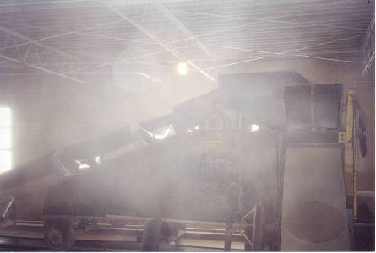
Dust is not confined
Dust will settle everywhere
What is wrong here?
Notes:
The amount of combustible dust shown in the photograph is far less than a combustible mixture. It is still a dust problem however. The dust particles in the air have not been trapped or confined and are going to settle out on the floors, walls, bar joists and other surfaces. This settling out and building up of a dust layer creates a potentially catastrophic hazard.

Slide 44
Other Hazard Analysis
Considerations
A thorough analysis will consider all possible scenarios in which dust can be disbursed,
  The normal process and
  Potential failure modes
Where dust is concentrated:
In equipment such as dust collectors, a combustible mixture could be present whenever the equipment is operating.
Other locations to consider are those where dust can settle, both
  in occupied areas and
  in hidden concealed spaces.
Tnkg Cap
Notes:
Other Hazard Analysis considerations include the following:
A thorough analysis will consider all possible scenarios in which dust can be disbursed, both the normal process and potential failure modes. Where dust is concentrated in equipment such as dust collectors, a combustible mixture could be present whenever the equipment is operating. Other locations to consider are those where dust can settle, both in occupied areas and in hidden concealed spaces.

Slide 45
Prevention and Mitigation
After the hazard analysis is completed, one or more of the following may be applied:
Prevention
  Dust control
  Ignition control
Mitigation
  Damage control
Training must be carried out for both Prevention and Mitigation
Notes:
NOTE to INSTRUCTOR:
Emphasize the difference between Prevention of a dust explosion or fire and Mitigation of the effects of the explosion or fire.
Explosion management can be handled in two ways, Prevention and Mitigation.
Prevention means not letting the situation get to the level of deflagration. Mitigation is handling the energy after deflagration has occurred.
Prevention includes
Construction,
Dust Control,
Housekeeping,
Oxidant concentration reduction,
Bonding and Grounding,
Elimination of Ignition,
Fire Prevention Plan and
Training.
Damage created by combustible dust may be controlled by construction of the work place.
Operations that are especially susceptible to fire or deflagration should be isolated by outside or in another building.
Separation by distance within same room and segregation by use of a barrier are other methods to reduce damage.

Slide 46
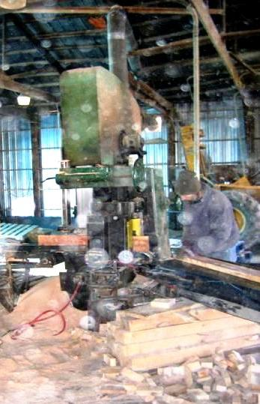
Prevention –
Dust Control
Spots are not raindrops
NFPA 654 - contains comprehensive guidance
Some recommendations:
Minimize the escape of dust from process equipment or ventilation systems
Use dust collection systems
Utilize surfaces that minimize dust accumulation and facilitate cleaning
Notes:
NFPA 654 - contains comprehensive guidance. Some recommendations are: Minimize the escape of dust from process equipment or ventilation systems. Use dust collection systems.
Photo from Kirkwood series

Slide 47
Dust Control
Deadly Dust
NFPA 654 – guidance
Provide access to all hidden areas to permit inspection
Inspect for dust residues in open and hidden areas, at regular intervals
Clean dust residues at regular intervals
?
Notes:
Provide access to all hidden areas to permit inspection. Inspect for dust residues in open and hidden areas, at regular intervals. Clean dust residues at regular intervals.

Slide 48
Dust Control
NFPA 654
Use cleaning methods that do not generate dust clouds;
Only use vacuum cleaners approved for dust collection;
Class II
Div 1
Group EFG
HAZ LOC
HAZ LOC
Notes:
Use cleaning methods that do not generate dust clouds. Only use vacuum cleaners approved for dust collection.

Slide 49


Dust Control
NFPA 654
Locate relief valves away from dust hazard areas; and
Develop and implement a hazardous dust
  inspection,
  testing,
  housekeeping, and
  control program
  (Written, and specifying frequency and methods).
Dust
Clean
Up
Notes:
Locate relief valves away from dust hazard areas. Develop and implement a hazardous dust inspection, testing, housekeeping, and control program. This program should be prepared in writing and establish the frequency and method to be used.

Slide 50
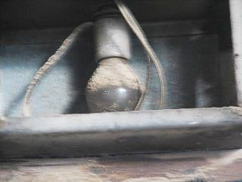
Prevention – Ignition Control
NFPA 654
Use appropriate electrical equipment and wiring methods;
Control static electricity, including bonding of equipment to ground;
Control smoking, open flames, and sparks;
No!
NFPA 77
Notes:
In controlling the ignition of combustible dusts, implement the following: Use appropriate electrical equipment and wiring methods. Control static electricity, including bonding of equipment to ground. Control smoking, open flames, and sparks.

Slide 51
Ignition Control
Hot work
permit
_________
_________
_________
_________
Separate heating systems from dusts;
Proper use of cartridge-activated tools; and
Adequately maintain equipment.
Kaboom!
Grinder
Notes:
Heating systems must be separated from dusts. Hot water or low pressure steam systems are usually preferred. Cartridge-activated tools are a special concern as they involve an ignition source, a concussion and the potential to have a “lost” cartridge cause an ignition later. Maintaining equipment and controls for proper function prevents many potential sources of ignition from occurring in the workplace.

Slide 52
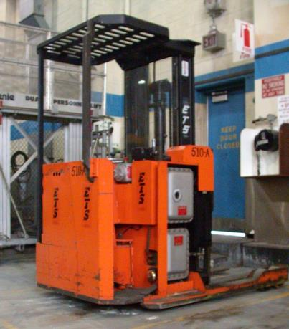
Ignition Control
Other ignition sources
OSHA 29 CFR 1910.178 (c) regulates powered industrial trucks in dust areas
Class I & II
Group D & G
Notes:
There are other ignition sources as well. For example, OSHA 29 CFR 1910.178 (c) regulates powered industrial trucks in dust areas, permitting only certain approved trucks, depending on the nature of the operations being conducted.

Slide 53
Ignition Control
Intermediate bulk containers (IBC)
  Manual dumping of particulate matter directly into a vessel from an IBC is not permitted
    Where the vessel contains a flammable mixture of gases or vapors
    Where displacement could cause a flammable atmosphere external to the vessel NFPA 654 (9.3.3)
Dust
Vessel
With
Flammable
mixture
Notes:
Dumping of combustible dust from intermediate bulk containers (IBCs) may cause a static ignition risk. NFPA 654 discusses the various types of IBCs and the ignition risk to the dust alone from each type of IBC. More conductivity associated an IBC reduces the ignition risk associated with it. It is not permitted however to manually dump particulate matter directly into a vessel from an IBC where the vessel contains a flammable mixture of gases or vapors or where displacement could cause a flammable atmosphere external to the vessel. Flowing materials can cause static electricity.

Slide 54
Ignition Control
Intermediate bulk containers (IBC)
Manual additions into a vessel containing flammable vapors through an open port or man-way are permitted in 50 lb. batches or less NFPA 654 (9.3.3)
< 50 lbs.
Vessel
With
Flammable
mixture
Notes:
Manual additions into a vessel containing flammable vapors through an open port or man-way are permitted in 50 lb. batches or less. The smaller amount of product reduces the risk of a fire ball enveloping the worker.

Slide 55
Mitigation - Damage Control
Methods of controlling and reducing severity of an explosion
Explosion suppression
Dilution with non-combustible dust
Venting through a listed dust retention and flame arresting device
Oxidant concentration reduction
Separation of the hazard (isolate with distance);
Segregation of the hazard (isolate with a barrier);
Deflagration venting
Spark and ember detection
Notes:
Some methods controlling and reducing hazard involve separation of the hazard (isolate with distance) or segregation of the hazard (isolate with a barrier). These and/or the other methods listed on this slide can fit into carefully planned engineering solutions.

Slide 56
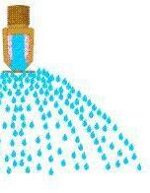
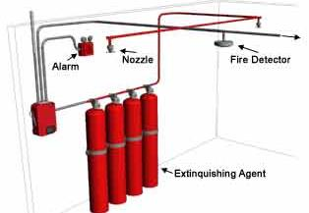
Damage Control
AS
Specialized Agents
  Gaseous agents
  Dry chemicals
  Water spray or mist
  Others
NFPA 654 (10)
Sprinkler systems; and
The use of other specialized suppression systems.
Notes:
Special automatic sprinkler systems or other specialized suppression systems may be considered for use, depending on the type of hazard present. Building fire sprinklers are basic to fire suppression, but will not suppress a dust explosion.

Slide 57
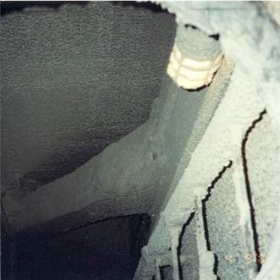
Training – For Both Prevention and Damage Control
Employees need to be trained
To recognize and prevent hazards associated with combustible dust
In taking preventative action; and/or
How to alert management
Hazardous vertical surface accumulation
Notes:
Employees need to be trained to recognize and prevent hazards associated with combustible dust. They also need to know how to take preventative action, and/or how to alert management to a hazard that needs attention.

Slide 58
Training
Employees need to know
The safe work practices applicable to their job tasks
The overall plant programs for dust control and ignition source control
Emergency procedures
Training must be
Before they start work
Periodically to refresh their knowledge
When reassigned
When hazards or processes change
Notes:
Employees need to know the safe work practices applicable to their job tasks and the overall plant programs for dust and ignition source control. Training must be completed before they start work; periodically to refresh their knowledge; when reassigned; and when hazards or processes change.
The hazard communication standard requires that employees be trained in emergency procedures. This may involve what kind of personal protective equipment to use or other measures to assure their own protection. They should also be trained in what they are to do in case of an emergency regarding mitigation or damage control.

Slide 59


Training
Management’s Responsibility
Comply with the Hazard Communication Standard
Have a qualified team conduct a facility analysis (or have one done by qualified outside persons) prior to the introduction of a hazard and
Develop a prevention and protection/mitigation scheme tailored to the operation.
List of Chemicals
Notes:
Management must take responsibility complying with the hazard communication standard relating to combustible dust. A qualified team must conduct a facility analysis (or have one done by qualified outside persons) prior to the introduction of a hazard. A prevention and protection scheme tailored to the operation must be developed. Look for change in Haz Com standard in 2013.

Slide 60
Training
Supervisors and managers should be aware of and support the plant dust and ignition control programs.
Their training should include
  identifying how they can encourage the reporting of unsafe practices and
  facilitate abatement actions.
Notes:
Supervisors and managers should be aware of and support the plant dust and ignition control programs. Their training should include identifying how they can encourage the reporting of unsafe practices and facilitate abatement actions.

Slide 61
Facility Dust Hazard Assessment
In this section, the various components of a facility dust hazard assessment were discussed.
Several factors were identified as critical to the analysis:
  Facility hazard analysis to identify the potential for dust explosions
  Measures to prevent dust explosions
  Measures to mitigate the damage of dust explosions
  Training—for both prevention and mitigation
Gentle sweeping only
Notes:
There are several items to consider when analyzing and examining a facility to determine if there is a combustible dust hazard. Some points to check include :
Materials that can be combustible when finely divided;
Processes which use, consume, or produce combustible dusts;
Equipment in which dust may be concentrated;
Open areas where combustible dusts may build up;
Hidden areas where combustible dusts may accumulate;
Means by which dust may be dispersed in the air; and
Potential ignition sources.
Once a combustible dust hazard is identified, measures to prevent and/or mitigate the damage of a dust explosion are determined.
Training needs are identified.

Slide 62
Training
Necessary training for dust explosion prevention was discussed in this section.
Training needs were identified for:
  Employees
  Supervisors
  Managers.
Dust
Explosion
Not
Permitted
Notes:
Necessary training and education for dust explosion prevention were discussed in this section. Training needs were identified for employees, supervisors and managers.

Slide 63
Guidelines and Standards
The Dusty BIG 10 from NFPA
61 . . .Agricultural and Food Processing . . .
68 . . . Venting of Deflagrations
69 . . . Explosion Prevention Systems
70 . . . National Electrical Code, Articles 500, 502, 503
91 . . . Exhaust Systems for Air Conveying . . .
484 . . .Combustible Metals
499 . . . Classification of Combustible Dusts and of Hazardous (Classified) Locations . . .
654 . . .Manufacturing, Processing, and Handling of Combustible Particulate Solids
655 . . . Sulfur Fires and Explosions
664 . . .Wood Processing and Woodworking Facilities
Notes:
This slide and the following slide present lists of standards and guidelines important to the control of combustible dust hazards. It is obvious that NFPA standards are significant in providing guidance on this topic. The NFPA documents are available online in readable format, without charge, at:
http://www.nfpa.org/aboutthecodes/list_of_codes_and_standards.asp
At the above web address, the following steps will allow in accessing a NFPA standard only in readable format: 1) select the standard, 2) click "Preview this Document", 3) agree to the disclaimer, and 4) open the standard.

Slide 64
Housekeeping Citations and Violations
29 CFR 1910.22 (a) Housekeeping.
(1) All places of employment, passageways … and service rooms shall be kept clean…
(2) The floor of every workroom shall be maintained in a clean…condition.”
  Depths presenting explosion, deflagration or other fire hazards.
  Not small amounts in isolated spots
  Representative measure-ments at several locations
  Submit sample to lab
BIG
Notes:
The NEP identifies the general housekeeping standard as addressing the issue of combustible dust. The requirement for a clean workplace and clean floor has been found to regulate combustible dust by the OSHA Review Commission. The lack of specific benchmarks for dust levels means that the agency refers to recognized industry good practices (e.g.: NFPA 654) to determine acceptable conditions at a facility. The Compliance Officers (CO) are to evaluate specific depths presenting explosion, deflagration or other fire hazards. They are not to be concerned about small amounts in isolated spots but accumulated dust deposits over time. The COs are to take representative measurements at several locations if necessary. In general, they are to send their samples to the Salt Lake City OSHA Technical Center laboratory in Utah for analysis. A separate arrangement has been made for state consultants to submit samples (for a fee) to a similar laboratory at the University of Wisconsin.

Slide 65
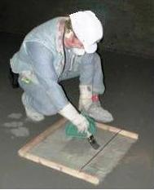
OSHA NEP on Housekeeping
NFPA 654 and FM Global Data Sheet 7-76 are referenced.
Clean immediately whenever a dust layer of 1/32-inch thickness accumulates
  over a surface area of at least 5% of the floor area of the facility or any given room,
  Not to exceed 1,000 ft²
Sampling coal dust
Notes:
In discussing the hazard of combustible dust accumulation the NEP references how the topic is handled in NFPA 654 and FM Global Data Sheet 7-76. FM 7-76 is available on the web.
The NEP instruction indicates that acceptable housekeeping requires that employers must be cleaning immediately whenever a dust layer of 1/32-inch thickness accumulates over a surface area of at least 5% of the floor area of the facility or any given room, not to exceed 1,000 ft². This is approximately the thickness of wire used in making common office paper clips.
NEP-National Emphasis Program

Slide 66
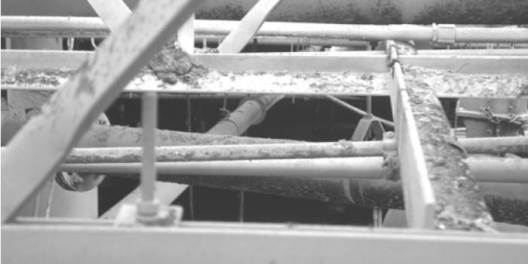
OSHA NEP on Housekeeping
Include:
  Overhead beams, joists, ducts,
  The tops of equipment, and other surfaces
  Even vertical surfaces if they are dusty
Rough calculations may show
  surface area of bar joists is approximately 5% of the floor area and
  the equivalent surface area for steel beams can be as high as 10%.
Notes:
The calculation is to include overhead beams, joists, ducts, the tops of equipment, and other surfaces even vertical surfaces if they are dusty. The NEP indicates that rough calculations may show the surface area of bar joists is approximately 5% of the floor area and the equivalent surface area for steel beams can be as high as 10%. The overhead structures alone might exceed the limit.
NEP-National Emphasis Program

Slide 67
OSHA NEP on Housekeeping
An idealized approach based on
Uniformity of the dust layer
Bulk density of 75 lb/ ft³,
Dust concentration of 0.35oz/ ft³, and
Dust cloud height of 10 ft.
5% of 20,000 ft² building
10 Ft
25 Ft
40 Ft
Notes:
The idea that 1/32 inch dust is hazardous is based on a calculation in NFPA 654. The NEP refers to this calculation in concluding that an accumulation over 5% of the area of a room or building, not to exceed 1000 square feet is a housekeeping hazard. It is based on an idealized approach analyzing dust in a 25 X 50 foot room with a 10 foot ceiling height. The dependent factors are:
Uniformity of the dust layer;
Bulk density of the dust at 75 lb/ ft³;
Dust concentration of 0.35oz/ ft³; and,
Dust cloud height of 10 ft.
NEP-National Emphasis Program

Slide 68

Additional Citations and Violations
Egress violations 29 CFR 1910.33-37
Where a absence of safe, convenient access to exits and exit routes is noted
Notes:
Areas where combustible dust are dispersed, accumulated, processed within equipment with a dust explosion hazard are considered “high hazard contents” by the OSHA means of egress standard and the Life Safety Code, NFPA 101. Where a absence of safe, convenient access to exits and exit routes is noted, it is suggested that violations of the means of egress standards, 29 CFR 1910.33-37, be issued.

Slide 69
Additional Citations and Violations
Fire protection violations
29 CFR 1910.156 (fire brigades) and 1910.157 (portable fire extinguishers) where violations of these standards are found.
Where company policy requires designated employees to use fire extinguishers and others to evacuate, there are mandates for
  An emergency evacuation plan, meeting 29 CFR 1910.38 and
  A fire prevention plan meeting the requirements of 29 CFR 1910.39.
Notes:
When employees engage in fire suppression activities as an organized group, a fire brigade exists. Violations of 29 CFR 1910.156 (fire brigades) and 1910.157 (portable fire extinguishers) where violations of these standards are found. Where company policy requires designated employees to use fire extinguishers and others to evacuate. There are mandates for an emergency evacuation plan, meeting 29 CFR 1910.38 and a fire prevention plan meeting the requirements of 29 CFR 1910.39.

Slide 70
Employee Rights and Responsibilities
You have the right to:
  A safe and healthful workplace
  Know about hazardous chemicals
  Information about injuries and illnesses in your workplace
  Complain or request hazard correction from employer
Notes:
70

Slide 71
Employee Rights and Responsibilities
You have the right to:
  Training
  Access to Hazard exposure and medical records
  File a complaint with OSHA
  Participate in an OSHA inspection
  Be free from retaliation for exercising safety and health rights
Notes:
71

Slide 72
Employee Rights and Responsibilities
OSHA website: www.osha.gov and OSHA offices: Call or Write (800-321-OSHA)
Compliance Assistance Specialists in the area offices
National Institute for Occupational Safety and Health (NIOSH) – OSHA’s sister agency
OSHA Training Institute Education Centers
Doctors, nurses, other health care providers
Public libraries
Other local, community-based resources
Notes:
72

Slide 73
Review of Combustible Dust in Industry
Unit Objectives
1. Describe several recent dust explosions and the dust deflagration process;
2. Identify the basic considerations used in a facility hazard analysis for dust; and,
3. Describe the prevention and mitigation techniques used in control of the combustible dust hazard.
Notes:
NOTE TO INSTRUCTOR:
Review the unit objectives:
On completing this section students should be able to:
Describe several recent dust explosions and the dust deflagration process.
2. Identify the basic considerations used in a facility hazard analysis for dust
3. Describe the prevention and mitigation techniques used in control of the combustible dust hazard

Slide 74
Agriculture Exemption
Enforcement Guidance for Small Farming Operations
The Appropriations Act exempts small farming operations from enforcement of all rules, regulations, standards or orders under the Occupational Safety and Health Act. A farming operation is exempt from all OSHA activities if it:
Employs 10 or fewer employees currently and at all times during the last 12 months; and
Has not had an active temporary labor camp during the proceeding 12 months.
  Note: Family members of farm employers are not counted when determining the number of employees.
  Important to check with your state OSHA since there are 25 states that match or exceed this OSHA Instruction
  Source: OSHA Instruction CPL 02-00-051
Notes:
Important to understand that not all of the agricultural population is required to follow OSHA regulations. These regulations are designed to keep individuals safe. Even if the individual does not have to meet the OSHA standards we still strive to protect them at the same level. This is done through education and recommendations that are based on OSHA standards.
Agricultural Exemption - Appropriations Act
Enforcement Guidance for Small Farming Operations. The Appropriations Act exempts small farming operations from enforcement of all rules, regulations, standards or orders under the Occupational Safety and Health Act.
A farming operation is exempt from all OSHA activities if it:
Employs 10 or fewer employees currently and at all times during the last 12 months; and
Has not had an active temporary labor camp during the proceeding 12 months.
Note: Family members of farm employers are not counted when determining the number of employees.
Important to check with your state OSHA since there are 25 states that match or exceed this OSHA Instruction
Consider giving an example from a state – California is typically more stringent

Slide 75
Disclaimers
This material was produced under a grant (SH22284SH1) from the Occupational Safety and Health Administration, U.S. Department of Labor. It does not necessarily reflect the views or policies of the U.S. Department of Labor, nor does the mention of trade names, commercial products, or organization imply endorsement by the U.S. Government.
Notes:
Material possible from
US Dept of Health and Human Services
EPA
OSHA

