Slide 1
Sawmill Safety
Module 3
Trim Saws, Sorting, Bins, Stacking and Handling

Slide 2
Timber Products Safety
There is a high incidence of serious and fatal injuries in our industry.
The Timber Products Manufacturers Association along with your employer recognizes the need for improved safety training for the industry.
With a grant from OSHA, TPMA has developed the following training module to contribute toward the need for improved safety training and hazard recognition skills for those employed in America’s timber industry.

Slide 3
This Training Module
Uses adult learning techniques
Photos and video of actual practices at sawmills
Interviews with experienced timber industry workers
Short interactive exercises
New techniques for recognizing hazards

Slide 4
Training Module Worksheet
Since adults learn the most by doing, a worksheet has been prepared to help you retain the most important information.
You will complete the worksheet as we move through the material. This means that you will fill in the blanks or complete lists.
You can keep the worksheet as a reference to the key points presented in this module.

Slide 5
Safety:
A process for reducing risk and preventing incidents by effectively managing the movement of people, equipment, material and energy.
Notes:
Let’s get started with a functional definition of safety. It is called a functional definition because it is easy to remember and is fundamental to incident prevention. “Safety is a process for reducing risk and preventing incidents by effectively managing the movement of people, equipment, material and energy”. There are some key words in this definition. The first one is movement. No injury or incident has ever occurred without some form of movement. The other key words are people, equipment, material and energy. They are key because they are the only four things that can move. Think about it, if we were able to effectively control the movement of people, equipment, material and energy in our process, we would have no injuries or incidents.

Slide 6
Incident:
An unplanned event that happens after an unsafe behavior or unsafe condition or both that interrupts the normal progress of an activity and may result in injury or damage.
Notes:
An incident is an unplanned event that happens after an unsafe behavior or unsafe condition or both that interrupts the normal progress of an activity and may result in injury or damage. Three bad things can happen when incidents occur. Someone may be injured, equipment may be damaged or the process may be interrupted. All three are unnecessary, expensive and in one way or another painful. The most important thing to remember is that before every incident there is an unsafe behavior or unsafe condition or a combination of the two. If you wanted to be proactive and prevent incidents, What would you do? I think we can all agree that we would focus on the elimination of unsafe behaviors and unsafe conditions because they always happen before an incident

Slide 7
Hazard:
Any source of danger.
The two major types of hazard are:
Unsafe conditions
and
Unsafe behaviors
Notes:
This is a very simple definition of hazard. A hazard is any source of danger. There are two major types of hazard – unsafe conditions and unsafe behaviors. Incidentally, when we talk about unsafe behaviors we are looking at behavior in the scientific sense – an observable action.

Slide 8
A sequence of events lead to incidents
The Hazards
(Unsafe Behaviors and Unsafe Conditions)
The Event
(Movement)
The Result
(Incident)

Slide 9
What is the Best Way to Prevent Incidents?
Recognize the Hazards
Manage the Movement of People, Equipment, Material and Energy
Notes:
First of all recognize the hazards. Once the hazards are recognized there is an opportunity to manage the movement of people, equipment, material and energy. The objective is to separate people from the hazards in an organized and controlled manner.

Slide 10
Manage the Movement
All incidents are initiated with movement.
Either the person moves to the hazard or the hazard moves to the person.

Slide 11
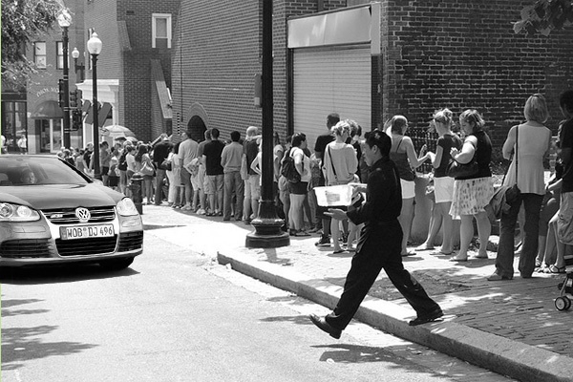
In Less Than 1 Second –
This Man Will Move To The Hazard

Slide 12
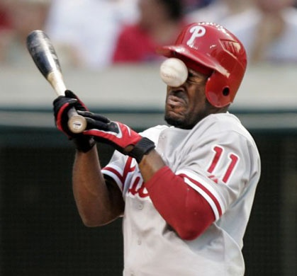
This Hazard Arrived in .41 Seconds

Slide 13
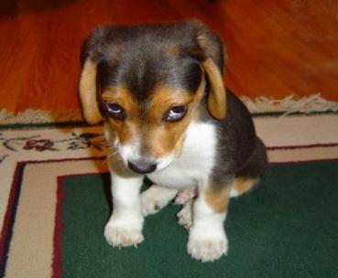
What is the Best Way to Protect Yourself?
Manage Your Movement
Do You Think He Managed His Movement Today?

Slide 14

Failing to Manage Movement Has Consequences!

Slide 15
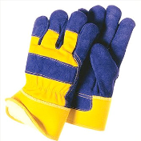
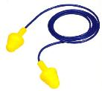
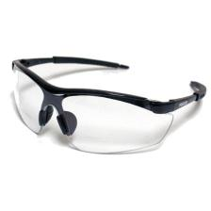
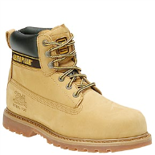

Basic Personal Protective Equipment for Sawmill Workers
Ear Plugs
Gloves
Hard Hat
Safety Glasses
Steel Toed Boots

Slide 16
Sawmill Flow Chart
Trim Saws
Grading
Sorting
Shipping
Wrapping
Stacking

Slide 17
#1 Potential for Serious Injury
The number one potential for serious injury in terms of severity that involves Trim Saws, Sorting, Bins, Stacking and Handling is falling to a lower level.

Slide 18
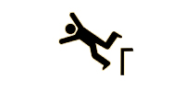
Event Classification
Falls
Fall lower level
(Fatality, head injuries, spinal cord injuries, dislocations, multiple fractures etc....)

Slide 19
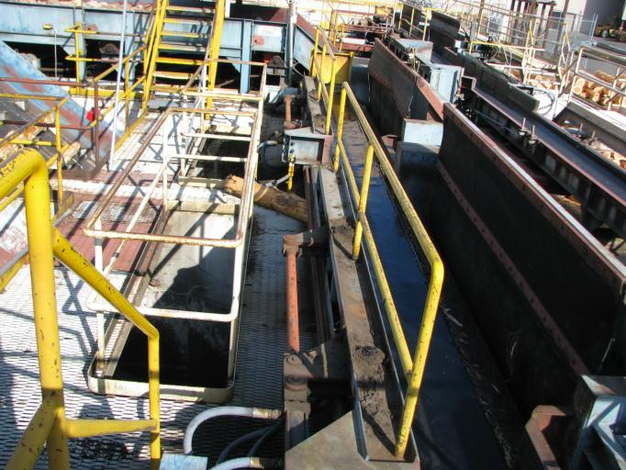
Stairways, Platforms and Floor Openings

Slide 20
What if ?
What if floor openings are not guarded?
What if walkways are not free of materials and debris?
What if engineered access to other levels is not provided?
Here are some real life examples:

Slide 21
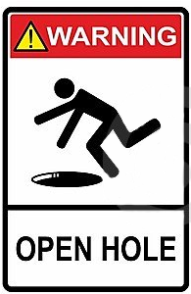
What if #1 - floor openings are not guarded
Employee #1 was seriously injured at a sawmill when he stepped into a 19 in. deep unprotected floor trough. He suffered a fracture to his right leg near the ankle when he stepped into the open trough while in route to assist a second worker who was clearing a jam.

Slide 22
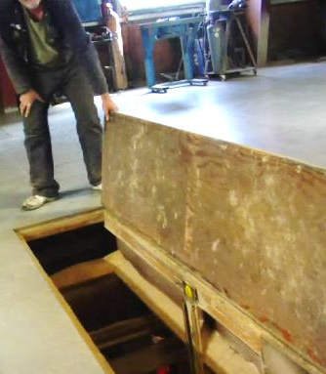
What if #2 - floor openings are not guarded
Two coworkers had raised the cover on a floor opening to lower a motor to the ground floor. While they were busy fastening the motor to the hoist, Employee #1 approached the opening and stepped into it. He fell 9 ft to the level below and fractured his back.

Slide 23
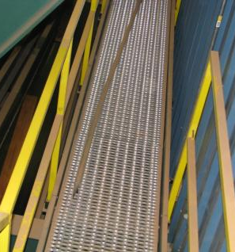
What if #3 - walkways are not free of materials and debris
Similar Hazard Obstruction On Walkway
Employee #1 was walking on the frame work of the planer chain, he tripped on a board laying on the frame of the planer chain support and fell approximately 47 inches to the concrete floor. He suffered a compression fracture to his back.

Slide 24
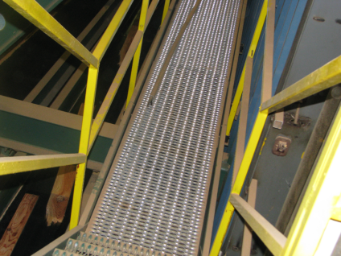
What if #4 - walkways are not free of materials and debris
Employee #1 was kneeling on an elevated walkway along a conveyor belt helping to clear a plugged conveyor below the elevated conveyor. A coworker on the lower conveyor pulled on a board that was plugging the two conveyors. The board broke and slipped sideways, striking her and pushing her to the side and off the walkway. She fell 15 ft to the ground and fractured her pelvis.

Slide 25
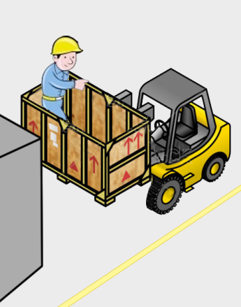
What if #5 - engineered access to other levels is not provided
A wooden box containing saw blades was elevated 14 feet to the first level of the mill. Employee #1, who was on the first level, stepped into the wooden box on the elevated forks to remove the last saw and the box slipped off the forks. He, the box and the saw fell to the floor below.

Slide 26
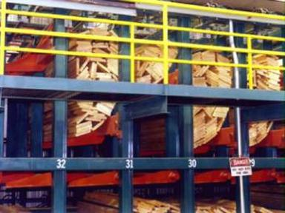
What if #6 - engineered access to other levels is not provided
Employee #1, a Bin Chaser on a sorting machine, left the walkway and climbed into the bin sorter area to un-jam a board. He fell approximately 12 ft to the floor and fractured bones in his back. He did not wear the required fall protection when he left the walkway.
Bin Sorter with Engineered Walkway
Courtesy USNR
Woodland, WA

Slide 27
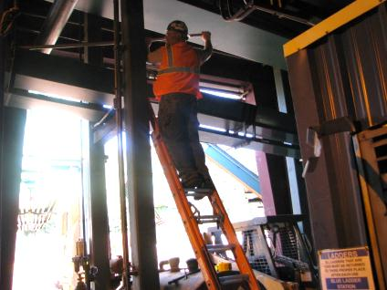
What if #7 - engineered access to other levels is not provided
Employee #1 was standing on a ladder using a pike pole to clear a jam in the conveyor system. The ladder slipped as he performed the task and he fell, breaking his left ankle.

Slide 28
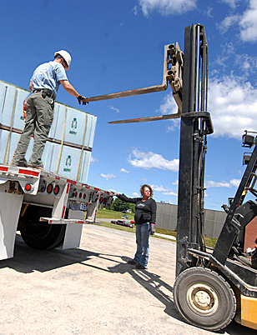
What if #8 - engineered access to other levels is not provided
Employee #1 collected extra spacers from the deck of a flatbed trailer and stepped onto the elevated forks of a forklift to stack them for removal. He was trying to shift from the right fork to the left when he slipped and fell between 7 and 8 ft to the ground. His left shoulder was dislocated and four ribs fractured.

Slide 29
So What’s The Problem?
Well, there is a problem whenever –
floor openings are not guarded!
walkways are not free of materials and debris!
engineered access to other levels is not provided!

Slide 30
Small Group Exercise
Your assignment is to identify three situations where someone has put themselves in danger of falling to a lower level at your facility while performing tasks involving trim saws, sorting, bins, stacking and handling. Your examples may include something you have done personally or something you have observed others doing. Do not include names or other identifying information in your examples.

Slide 31
What you can do to avoid falling to a lower level
Stay on engineered stairs, walkways and platforms.
Wear fall protection equipment when it is required.
Guard floor openings.
Keep walkways free of materials and debris.

Slide 32
#2 Potential for Serious Injury
The number two potential for serious injury in terms of severity that involves Trim Saws, Sorting, Bins, Stacking and Handling is being caught in on or between equipment or materials.

Slide 33
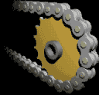
Event Classification
Contact with objects and equipment.
Caught in, on or between
(Amputations, fractures, crushing injuries etc....)

Slide 34
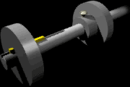
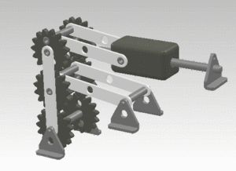

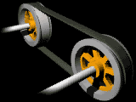
Hazardous Mechanical Movement
Rotating
Reciprocating
In running Nip
Transverse

Slide 35
Caught In, On, or Between Incident #1
Employee #1 was working at the stacker out feed deck at a sawmill. The employee for some reason placed himself between a bundle of lumber and a steel plate used to square up the end of the bundle. This employee sustained fatal injuries from being pinned between the bundle and the steel plate.

Slide 36
Caught In, On, or Between Incident #2
Employee #1 was operating a forklift stacking bundles of lumber. He dismounted the forklift and moved in front of his load to prepare the landing area for the bundle. While he was preparing the area, the forklift rolled forward and pinned him between the load on his forklift and a bundle of lumber in storage. He sustained fatal injuries.

Slide 37
What you can do to avoid being caught, in, on or between
Do not climb over guard rails.
Do not wear loose fitting clothing.
Set the parking brake when dismounting a
forklift.
Don’t climb on or over conveyors.
Stay out of restricted areas.
Follow specific procedures when clearing jams.

Slide 38
#3 Potential for Serious Injury
The number three potential for serious injury in a sawmill in terms of severity is being struck by.

Slide 39
Event Classification
Contact with objects and equipment.
Struck by
(Fractures, punctures, foreign bodies in eye, amputations etc....)

Slide 40
Struck By Incident #1
Employee #1 was walking in an area designated for pedestrian traffic. He was using a crosswalk located in an area where there is forklift traffic. The area was lighted but it was raining. While he was in the crosswalk, he was struck by a forklift attempting to enter the sawmill to pick up a load of lumber. His injuries required him to be hospitalized.

Slide 41
Struck By Incident #2
As Employee #1 stepped into the driveway, he was struck by a forklift carrying a scrap lumber dump box. He sustained multiple fractures and was hospitalized.

Slide 42
Struck By Incident #3
Employee #1 was pushing a unit of fence boards out to be picked up by a forklift . A forklift was parked across the aisle. His back and the rear of the forklift were facing each other. The forklift operator put the forklift into reverse, and backed up. His left foot was struck by the forklift and his ankle was fractured.

Slide 43
What you can do to avoid being struck by
Wear the required PPE.
Follow the rules.
Stay behind barriers.
Stay out of the line of fire.
Make sure guards are in place before
operating equipment.
Be alert for and cautious of forklift traffic.

Slide 44
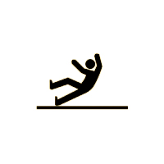
Event Classification
Falls
Fall same level
(Fractures, dislocations, sprains, strains, head injuries etc....)

Slide 45
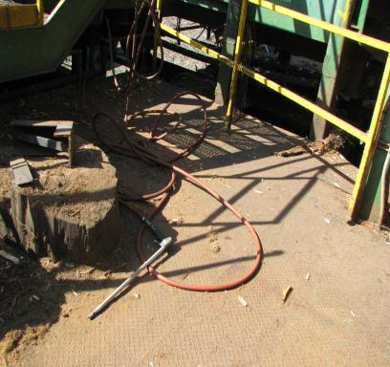
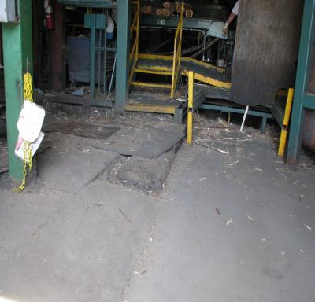
What you can do to avoid falling at the same level #1
Watch your step!
Conditions Change

Slide 46
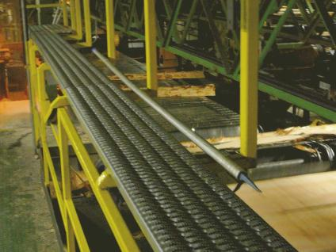
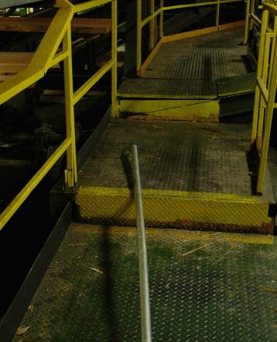
What you can do to avoid falling at the same level #2
Return Tools to Proper Storage

Slide 47
Event Classification
Contact with objects and equipment.
Struck against
(Cuts, bruises, fractures, punctures, splinters etc..)
Notes:
The American National standard for Information Management for Occupational Safety and Health provides a classification structure for 46 different events and exposures. We are going to take a look at seven of those events and exposures that occur most frequently at sawmills from the arrival of logs to decking . Remember the key words in the definition of safety – well the key word movement is demonstrated well in each event classification that we will discuss. As a matter of fact, I want you to begin thinking of every event classification as some form of movement. The first event classification that we will discuss is STRUCK AGAINST. What movement is involved in this event classification? (The person moves into an object). Generally, the energy involved in struck against events is limited to what the person can generate in movement. Struck Against events produce injuries such as cuts, bruises, fractures and punctures.

Slide 48
Summary
All incidents are initiated with movement.
Either the hazard moves to the person or the person moves to the hazard.
You must manage your own movement.

Slide 49
Summary 2
The number one potential for serious injury involves
falling to a lower level
The number two potential for serious injury involves
caught in, on or between
The number three potential for serious injury involves struck by

Slide 50
Hazard Recognition Skills
Focus only on one incident classification at a time
Fall to lower level Fall same level
Caught in, on or between Strike against
Struck by
Observe only for that type of movement.
Your hazard recognition skills will be improved just by narrowing your focus.
Each of you has the potential to produce great results with this technique.

Slide 51
OSHA NOTICE & DISCLAIMER
“This material was produced under grant SH22245SH1 from the Occupational Safety and Health Administration, U.S. Department of Labor. It does not necessarily reflect the views or policies of the U.S. Department of Labor, nor does mention of trade names, commercial products, or organizations imply endorsement by the U.S. Government”

