Slide 1
Sawmill Safety
Module 1 – Log Handling
Log Arrival to Log Decking

Slide 2
Timber Products Safety
There is a high incidence of serious and fatal injuries in our industry.
The Timber Products Manufacturers Association along with your employer recognizes the need for improved safety training for the industry.
With a grant from OSHA, TPMA has developed the following training module to contribute toward the need for improved safety training and hazard recognition skills for those employed in America’s timber industry.

Slide 3
This Training Module
Uses adult learning techniques
Photos and video of actual practices at sawmills
Interviews with experienced timber industry workers
Short interactive exercises
New techniques for recognizing hazards

Slide 4
Training Module Worksheet
Since adults learn the most by doing, a worksheet has been prepared to help you retain the most important information.
You will complete the worksheet as we move through the material. This means that you will fill in the blanks or complete lists.
You keep the worksheet as a reference to the key points presented in this module.

Slide 5
Safety:
A process for reducing risk and preventing incidents by effectively managing the movement of people, equipment, material and energy.
Notes:
Let’s get started with a functional definition of safety. It is called a functional definition because it is easy to remember and is fundamental to incident prevention. “Safety is a process for reducing risk and preventing incidents by effectively managing the movement of people, equipment, material and energy”. There are some key words in this definition. The first one is movement. No injury or incident has ever occurred without some form of movement. The other key words are people, equipment, material and energy. They are key because they are the only four things that can move. Think about it, if we were able to effectively control the movement of people, equipment, material and energy in our process, we would have no injuries or incidents.

Slide 6
Incident:
An unplanned event that happens after an unsafe behavior or unsafe condition or both that interrupts the normal progress of an activity and may result in injury or damage.
Notes:
An incident is an unplanned event that happens after an unsafe behavior or unsafe condition or both that interrupts the normal progress of an activity and may result in injury or damage. Three bad things can happen when incidents occur. Someone may be injured, equipment may be damaged or the process may be interrupted. All three are unnecessary, expensive and in one way or another painful. The most important thing to remember is that before every incident there is an unsafe behavior or unsafe condition or a combination of the two. If you wanted to be proactive and prevent incidents, What would you do? I think we can all agree that we would focus on the elimination of unsafe behaviors and unsafe conditions because they always happen before an incident

Slide 7
Hazard:
Any source of danger.
The two major types of hazard are:
Unsafe conditions
and
Unsafe behaviors
Notes:
This is a very simple definition of hazard. A hazard is any source of danger. There are two major types of hazard – unsafe conditions and unsafe behaviors. Incidentally, when we talk about unsafe behaviors we are looking at behavior in the scientific sense – an observable action.

Slide 8
A sequence of events lead to incidents
The Hazards
(Unsafe Behaviors and Unsafe Conditions)
The Event
(Movement)
The Result
(Incident)

Slide 9
What is the Best Way to Prevent Incidents?
Recognize the Hazards
Manage the Movement of People, Equipment, Material and Energy
Notes:
First of all recognize the hazards. Once the hazards are recognized there is an opportunity to manage the movement of people, equipment, material and energy. The objective is to separate people from the hazards in an organized and controlled manner.

Slide 10
Manage the Movement
All incidents are initiated with movement. Either the person moves to the hazard or the hazard moves to the person.
Notes:
Remember that all incidents begin with some form of movement. Either the person moves to the hazard or the hazard moves to the person in an uncontrolled or disorganized environment.

Slide 11
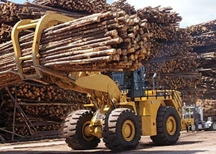
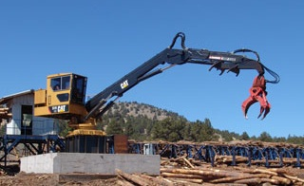
Terminology
LeTourneau or
Wheel Loader
Sorter, Shovel or
Knuckleboom Loader

Slide 12
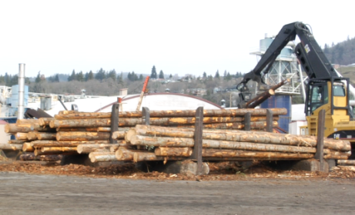
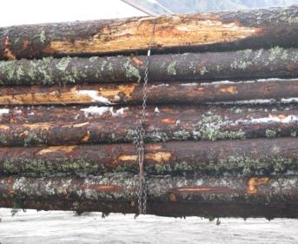
Terminology
Bunks
Wrappers

Slide 13
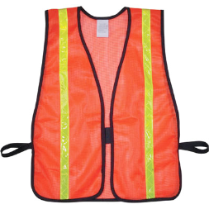
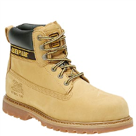
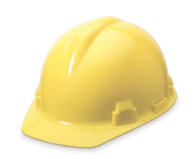
Basic Personal Protective Equipment for Log Yard Workers
Hard Hat
High Visibility Vest
Steel Toed Boots

Slide 14
Log Flow Chart
Truck Arrival
Truck Unloading
Roll Out
To Plant…
Sorting and Decking
Scaling

Slide 15
#1 Potential for injury in the Log Yard
Being struck by equipment or material

Slide 16
Event Classification
Contact with objects and equipment.
Struck by
(Fractures, punctures, foreign bodies in eye, amputations etc....)
Notes:
The second event in the classification Contact with objects and equipment is STRUCK BY. What is the movement with a struck by event? (Something moves into the person) Obviously, the energy of being struck by something has the potential to be much greater than the energy involved in the event Struck Against. Consequently, the severity of injuries in Struck By events may be much greater. Struck by events produce injuries such as fractures, punctures, foreign bodies in the eye, amputations, etc.

Slide 17
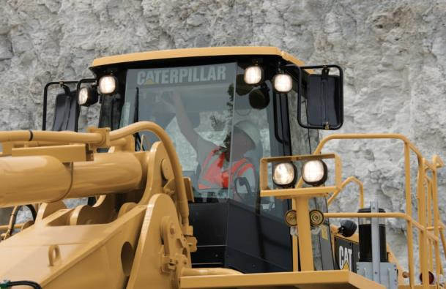
One would think…
…equipment operators have perfect visibility because they’re up high.
But the view maybe obstructed by the equipment itself.

Slide 18
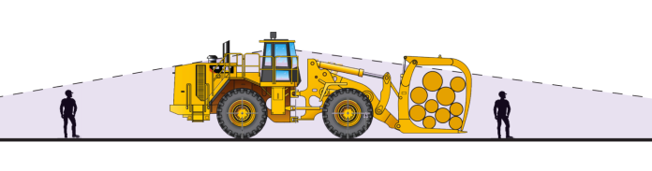
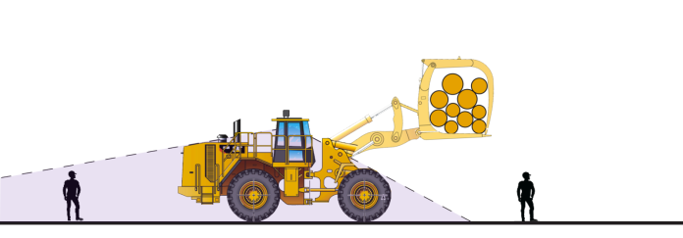
Why the Equipment Operator Can’t See You
Equipment design and log loads create blind spots.
Carry Loads high to increase visibility, drive slowly and carefully as logs can fall.

Slide 19

Other Visibility Hazards
Inclement
weather such
as rain, snow
or fog
Darkness
Bright sun

Slide 20
What you can do to avoid being struck by equipment
Knowing and understanding the traffic patterns at the log yard are important to your safety.
Always make eye contact with equipment operators before approaching. Make sure they see you and it is safe to approach (for instance, attachment down).
Be alert for blind corners and intersections.

Slide 21
Small Group Exercise
Employee Is Struck By Falling Logs That Rolled Off A Truck
Accident: 171262231 – OSHA Report ID: 0522000 –
Event Date: 09/23/2002
On September 23, 2002, an employee drove a truckload of logs to a sawmill. He was unstrapping them in preparation for off-loading, when three logs rolled off the top and fell on him. The employee was killed.

Slide 22
Event Classification
Contact with objects and equipment.
Caught in, on or between
(Amputations, fractures, crushing injuries etc....)
Notes:
The third and final event in the classification Contact with objects and equipment is CAUGHT IN, ON OR BETWEEN. What is the movement with a Caught in, on or between event? (The person moves into the line of fire of some mechanical motion) Obviously, the energy of being caught in, on or between some mechanical motion has the potential to be much greater than the energy involved in the events Struck Against or Struck By. Consequently, the severity of injuries in Caught in, on or between events is usually severe. Caught in, on or between events produce injuries such as amputations, fractures, crushing injuries, etc.

Slide 23
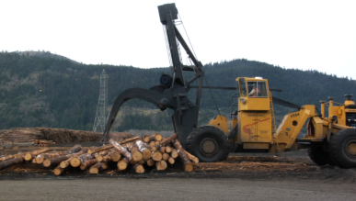
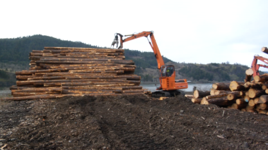
Caught Between
Roll Out
Log and fixed object
Log Deck
Log and ground or log and log

Slide 24
What you can do to avoid being caught between
Stand clear of any log handling process such as transporting, sorting, rolling, or stacking.
If climbing a log deck, check for deck stability.
  Is the base solid and stable?
  Have any of the logs shifted?
  Have there been any significant changes in the weather that may cause the bark to slough off enough to cause movement?

Slide 25
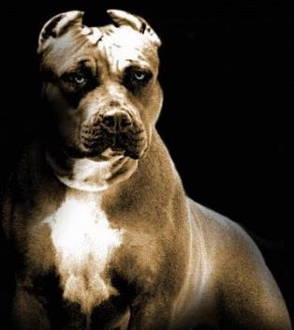
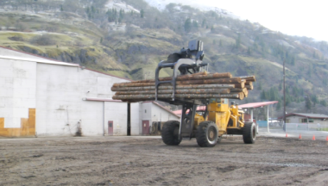
All Logs and Some Dogs Are Unfriendly
Always stay at least a log’s length away from log movement (40 feet).
Logs are unfriendly, and so is Jake

Slide 26
40 Foot Chain
You wouldn’t want to be in reach of Jake’s chain…
Imagine a log being handled has a 40’ chain.

Slide 27

Event Classification
Falls
Fall lower level
(Fatality, head injuries, spinal cord injuries, dislocations, multiple fractures etc....)

Slide 28
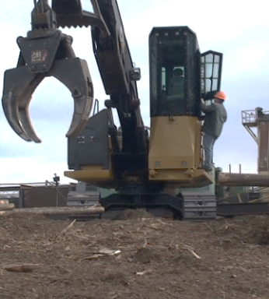
Fall Lower Level
Climbing into the cab
Ensure steps are in good condition
Maintain three point support when mounting or dismounting
Ensure the condition of the steps has not changed before dismounting

Slide 29
What you can do to avoid falling to a lower level
Ensure steps are in good condition
Maintain three point support when mounting or dismounting
Ensure the condition of the steps has not changed before dismounting

Slide 30
Event Classification
Contact with objects and equipment.
Struck against
(Cuts, bruises, fractures, punctures etc....)
Notes:
The American National standard for Information Management for Occupational Safety and Health provides a classification structure for 46 different events and exposures. We are going to take a look at seven of those events and exposures that occur most frequently at sawmills from the arrival of logs to decking . Remember the key words in the definition of safety – well the key word movement is demonstrated well in each event classification that we will discuss. As a matter of fact, I want you to begin thinking of every event classification as some form of movement. The first event classification that we will discuss is STRUCK AGAINST. What movement is involved in this event classification? (The person moves into an object). Generally, the energy involved in struck against events is limited to what the person can generate in movement. Struck Against events produce injuries such as cuts, bruises, fractures and punctures.

Slide 31
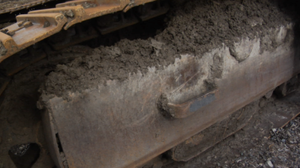
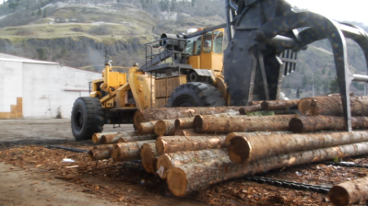
Struck Against
First step for mounting equipment
Protruding logs

Slide 32
What you can do to avoid striking against something
Look in the direction of travel
Check the condition of the step before climbing
Be alert to changing conditions

Slide 33
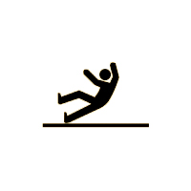
Event Classification
Falls
Fall same level
(Fractures, dislocations, sprains, strains, head injuries etc....)

Slide 34
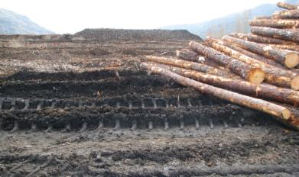
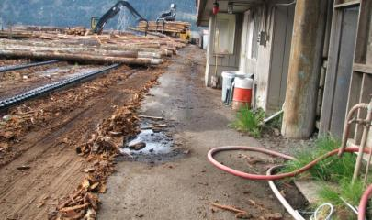
What you can do to avoid falling at the same level
Yard surface
Watch your step!
Other tripping hazards

Slide 35
Summary
What is the #1 potential for injury in a log yard?
Managing your own movement is key to personal safety.
  Know the traffic patterns
  Make eye contact when approaching heavy equipment
  Be alert for blind corners

Slide 36
Summary 2
Managing your own movement is key to personal safety. (cont)
  Stand clear of any log handling process
  When working around decks, check for stability
  Watch your next step
  Always look in the direction of travel
  Use 3 point support when climbing and keep your weight centered between the 3 points

Slide 37
OSHA NOTICE & DISCLAIMER
“This material was produced under grant SH22245SH1 from the Occupational Safety and Health Administration, U.S. Department of Labor. It does not necessarily reflect the views or policies of the U.S. Department of Labor, nor does mention of trade names, commercial products, or organizations imply endorsement by the U.S. Government”

