Slide 1
1926 Subpart P
Excavations
This material was produced under grant number SH-22224-11-60-F-18 from the Occupational Safety and Health Administration, U.S. Department of Labor. It does not necessarily reflect the views or policies of the U.S. Department of Labor, nor does mention trade names, commercial products, or organizations imply endorsement by the U.S. Government.

Slide 2

Introduction and Objectives
State the greatest risk that is present at an excavation.
State the greatest risk that is present at an excavation.
Name at least three factors that pose a hazard to employees working in excavations, and at least one way to eliminate or reduce each of the hazards.
Describe the role of a competent person at an excavation site
Trained and knowledgeable in soil analysis, use of protective systems, and requirements of the standard.
Site evaluation/inspection and planning responsibilities.

Slide 3
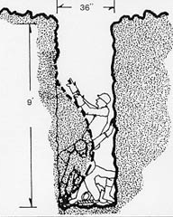
Introduction
Excavating is recognized as one of the most hazardous construction operations
Fatality rate for excavations is twice that of construction as a whole
Cave-ins number one hazard
OSHA Excavation Video

Slide 4
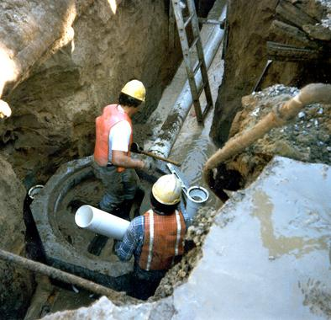
Introduction
Cave-ins are much more likely to result in worker fatalities than other excavation-related accidents.
90% of all violations related to lack of cave-in protection involved manhole installations
During inspections where these violations were cited, the excavations were nearly vertical

Slide 5
Definitions
"Excavation" means any man-made cut, cavity, trench, or depression in an earth surface, formed by earth removal.
"Trench (Trench excavation)" means a narrow excavation (in relation to its length) made below the surface of the ground.
  In general, the depth is greater than the width, but the width of a trench (measured at the bottom) is not greater than 15 feet (4.6 m).
  If forms or other structures are installed or constructed in an excavation so as to reduce the dimension measured from the forms or structure to the side of the excavation to 15 feet (4.6 m) or less (measured at the bottom of the excavation), the excavation is also considered to be a trench.

Slide 6

Definitions
Competent Person for Excavations:
  Training, experience, and knowledge of:
  - soil analysis;
  - use of protective systems; and
  - requirements of 29 CFR Part 1926 Subpart P.
  Ability to detect:
  - conditions that could result in cave-ins;
  - failures in protective systems;
  - hazardous atmospheres; and
  - other hazards including those associated with confined spaces.
  Authority to take prompt corrective measures to eliminate existing and predictable hazards and to stop work when required.

Slide 7
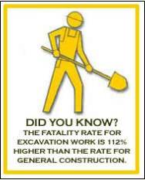
1926.651 Specific Excavation
Daily inspections made by Competent Person -
Prior to start of work and repeated as necessary
After every rainstorm
After any hazard increasing occurrence
Employees removed until hazards are until safe
Notes:
Daily inspections of excavations, the adjacent areas, and protective systems shall be made by a competent person for evidence of a situation that could result in possible cave-ins, indications of failure of protective systems, hazardous atmospheres, or other hazardous conditions. An inspection shall be conducted by the competent person prior to the start of work and as needed throughout the shift. Inspections shall also be made after every rainstorm or other hazard increasing occurrence. These inspections are only required when employee exposure can be reasonably anticipated.
Where the competent person finds evidence of a situation that could result in a possible cave-in, indications of failure of protective systems, hazardous atmospheres, or other hazardous conditions, exposed employees shall be removed from the hazardous area until the necessary precautions have been taken to ensure their safety.

Slide 8
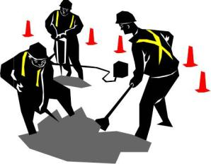
1926.651 Specific Excavation
Prior to Entry
Remove all surface encumbrances
Determine location of all underground utilities before opening excavation
Use safe means to determine exact locations & protect underground utilities
Notes:
All surface encumbrances that are located so as to create a hazard to employees shall be removed or supported, as necessary, to safeguard employees.
The estimated location of utility installations, such as sewer, telephone, fuel, electric, water lines, or any other underground installations that reasonably may be expected to be encountered during excavation work, shall be determined prior to opening an excavation.
Utility companies or owners shall be contacted within established or customary local response times, advised of the proposed work, and asked to establish the location of the utility underground installations prior to the start of actual excavation. When utility companies or owners cannot respond to a request to locate underground utility installations within 24 hours (unless a longer period is required by state or local law), or cannot establish the exact location of these installations,the employer may proceed, provided the employer does so with caution, and provided detection equipment or other acceptable means to locate utility installations are used.

Slide 9
1926.651 Specific Excavation
Surface encumbrances
Underground installations
Access and egress
Exposure to vehicular traffic
Exposure to falling loads
Warning system for mobile equipment
Hazardous atmospheres
Protection from hazards associated with water accumulation
Stability of adjacent structure
Protection of employees from loose rock or soil
Inspections
Fall protection

Slide 10
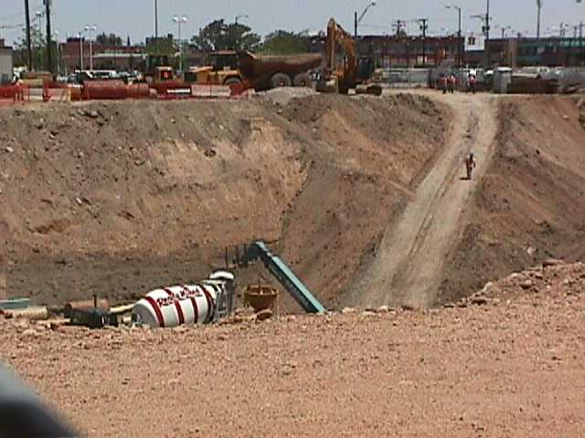
1926.651 Specific Excavation
Access & Egress:
  Ramps for egress designed by CP in structural design & constructed according to design
  Segments of ramps must be connected without creating a tripping hazard
  Uniform thickness
Notes:
Structural ramps that are used solely by employees as a means of access or egress from excavations shall be designed by a competent person. Structural ramps used for access or egress of equipment shall be designed by a competent person qualified in structural design, and shall be constructed in accordance with the design.
Ramps and runways constructed of two or more structural members shall have the structural members connected together to prevent displacement.
Structural members used for ramps and runways shall be of uniform thickness.
Cleats or other appropriate means used to connect runway structural members shall be attached to the bottom of the runway or shall be attached in a manner to prevent tripping.
Structural ramps used in lieu of steps shall be provided with cleats or other surface treatments o the top surface to prevent slipping.

Slide 11

1926.651 Specific Excavation
Stairway, ladder, ramp or other safe means of egress shall be located in trench excavations that are 4 feet or more in depth to require no more than 25 feet of lateral travel for employees.
4' or greater
Every 25'

Slide 12
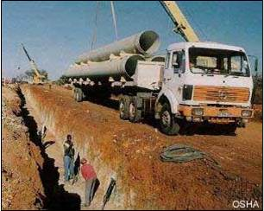
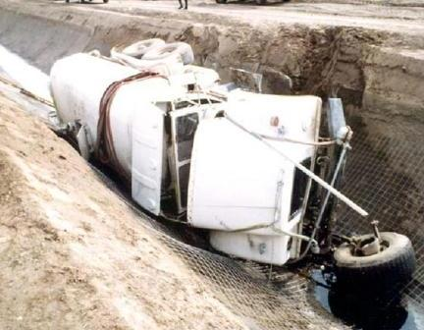
1926.651 Specific Excavation
In traffic areas reflective vests required
No workers underneath loads handled by lifting or digging equipment.
Barricades, stop logs or hand signals for mobile equipment operating near excavations

Slide 13
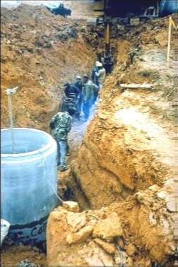
1926.651 Specific Excavation
In excavations 4 feet or more where hazardous atmospheres are likely to exist must test atmosphere before entering
Ventilation or PPE must be used as required
Retest atmospheres as necessary
Rescue equipment available
Notes:
Where oxygen deficiency (atmospheres containing less than 19.5 percent oxygen) or a hazardous atmosphere exists or could reasonably be expected to exist, such as in excavations in landfill areas or excavations in areas where hazardous substances are stored nearby, the atmospheres in the excavation shall be tested before employees enter excavations greater than 4 feet (1.22 m) in depth.
Adequate precautions shall be taken to prevent employee exposure to atmospheres containing less than 19.5 percent oxygen and other hazardous atmospheres. These precautions include providing proper respiratory protection or ventilation in accordance with subparts D and E of this part respectively.
Adequate precaution shall be taken such as providing ventilation, to prevent employee exposure to an atmosphere containing a concentration of a flammable gas in excess of 20 percent of the lower flammable limit of the gas.
When controls are used that are intended to reduce the level of atmospheric contaminants to acceptable levels, testing shall be conducted as often as necessary to ensure that the atmosphere remains safe.

Slide 14
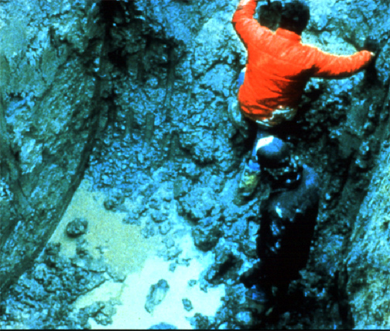
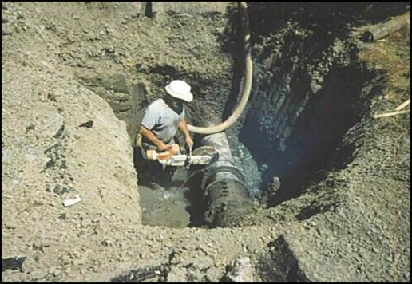
1926.651 Specific Excavation
Precautions required before working for water in excavations
CP must monitor control measures
If diverting surface water must take steps to prevent water from entering trench
Notes:
Employees shall not work in excavations in which there is accumulated water, or in excavations in which water is accumulating, unless adequate precautions have been taken to protect employees against the hazards posed by water accumulation. The precautions necessary to protect employees adequately vary with each situation, but could include special support or shield systems to protect from cave-ins, water removal to control the level of accumulating water, or use of a safety harness and lifeline.
If water is controlled or prevented from accumulating by the use of water removal equipment, the water removal equipment and operations shall be monitored by a competent person to ensure proper operation.
If excavation work interrupts the natural drainage of surface water (such as streams), diversion ditches, dikes, or other suitable means shall be used to prevent surface water from entering the excavation and to provide adequate drainage of the area adjacent to the excavation. Excavations subject to runoff from heavy rains will require an inspection by a competent person and compliance with paragraphs (h)(1) and (h)(2) of this section.

Slide 15
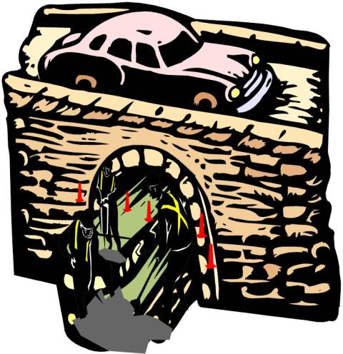
1926.651 Specific Excavation
Structures adjacent to excavations must be supported if stability is affected
No entry where workers below adjacent footings unless shored, or stable rock, or approved by PE
No undermining pavements unless supported

Slide 16
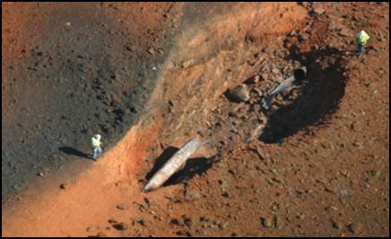
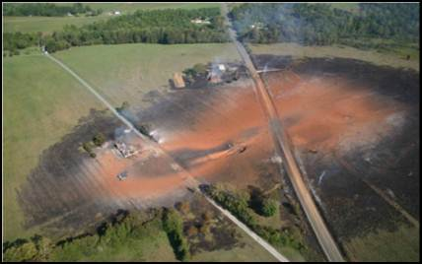
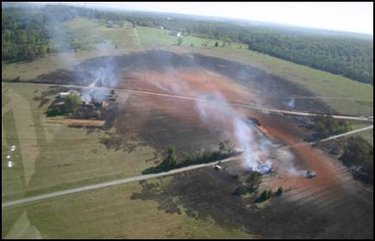
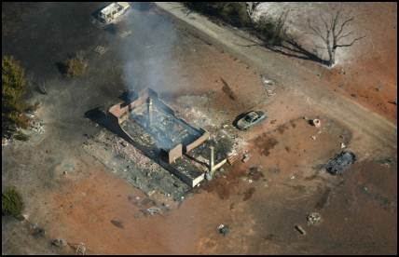
CALL Before You Dig!
This incident was caused by a tractor mounted auger
Notes:
Daily inspections of excavations, the adjacent areas, and protective systems shall be made by a competent person for evidence of a situation that could result in possible cave-ins, indications of failure of protective systems, hazardous atmospheres, or other hazardous conditions. An inspection shall be conducted by the competent person prior to the start of work and as needed throughout the shift. Inspections shall also be made after every rainstorm or other hazard increasing occurrence. These inspections are only required when employee exposure can be reasonably anticipated.
Where the competent person finds evidence of a situation that could result in a possible cave-in, indications of failure of protective systems, hazardous atmospheres, or other hazardous conditions, exposed employees shall be removed from the hazardous area until the necessary precautions have been taken to ensure their safety.

Slide 17
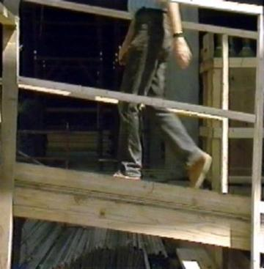
1926.651 Specific Excavation Requirements
Walkways for employees crossing excavations
Guardrails for walkways six feet above lower levels
Wells, pits, shafts, barricaded & covered
Upon completion filled

Slide 18
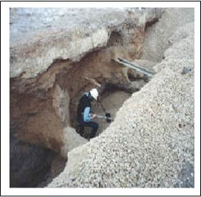
1926.652 - Requirements for Protective Systems
Protection of employees in excavations
Design of sloping and benching systems
Design of support systems, shield systems, and other protective systems
Materials and equipment
Installation and removal

Slide 19
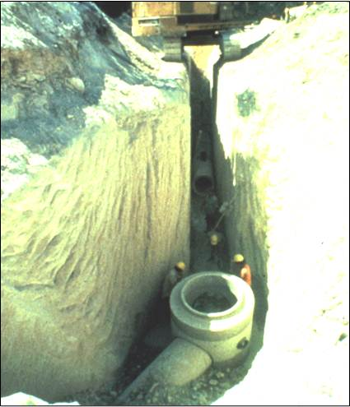
1926.652 - Requirements for protective systems
Provide full worker protection from cave-ins except:
  Excavation completely in stable rock
  Less than five feet deep & CP determines no potential for cave-in

Slide 20
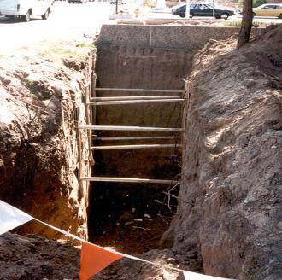
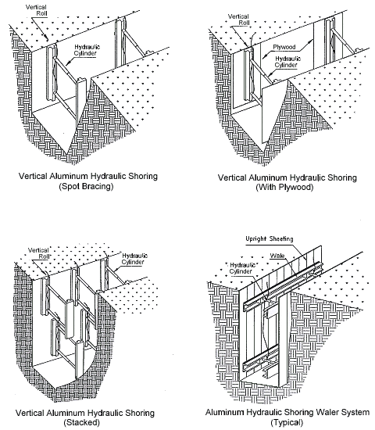
1926.652 - Requirements for Protective systems
Protective systems shall have the capacity to resist without failure all loads that are intended or could reasonably be expected to be applied or transmitted to the system.

Slide 21
1926.652 - Requirements for Protective Systems
Four choices for sloping:
  Slope for type ‘C’
  Use sloping choices from Appendix B
  Tabulated data determined by a PE
  Designed by a PE
C
Notes:
The tabulated data shall be in written form and shall include all of the following:
Identification of the parameters that affect the selection of a sloping or benching system drawn from such data;
Identification of the limits of use of the data, to include the magnitude and configuration of slopes determined to be safe;
Explanatory information as may be necessary to aid the user in making a correct selection of a protective system from the data.
1926.652(b)(3)(iii) -- At least one copy of the tabulated data which identifies the…
At least one copy of the tabulated data which identifies the registered professional engineer who approved the data, shall be maintained at the jobsite during construction of the protective system. After that time the data may be stored off the jobsite, but a copy of the data shall be made available to the Secretary upon request.

Slide 22
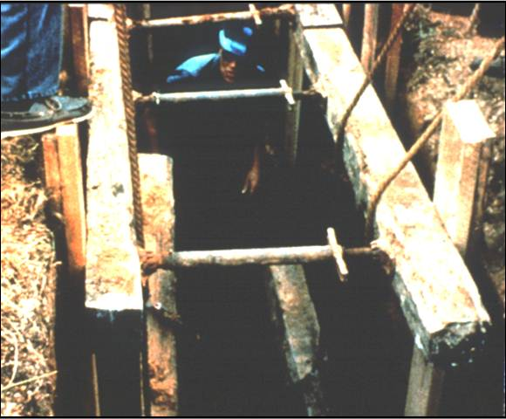
1926.652 - Requirements for Protective Systems
Materials for protective systems free from damage & defects
Used according to manufacturers specifications
If damaged CP must determine suitability for continued use
Notes:
Materials and equipment used for protective systems shall be free from damage or defects that might impair their proper function.
Manufactured materials and equipment used for protective systems shall be used and maintained in a manner that is consistent with the recommendations of the manufacturer, and in a manner that will prevent employee exposure to hazards.
When material or equipment that is used for protective systems is damaged, a competent person shall examine the material or equipment and evaluate its suitability for continued use. If the competent person cannot assure the material or equipment is able to support the intended loads or is otherwise suitable for safe use, then such material or equipment shall be removed from service, and shall be evaluated and approved by a registered professional engineer before being returned to service.

Slide 23
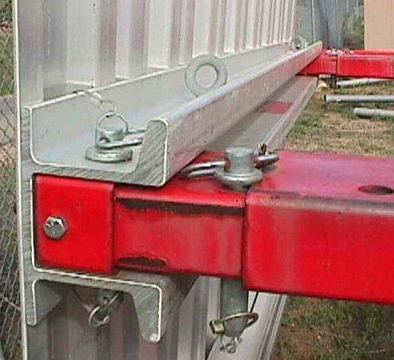
1926.652 - Requirements for Protective Systems
Support system members securely connected together
Installed & removed to assure employee safety
Support systems not subjected to loads exceeding their capacity
Notes:
Members of support systems shall be securely connected together to prevent sliding, falling, kickouts, or other predictable failure.
Support systems shall be installed and removed in a manner that protects employees from cave-ins, structural collapses, or from being struck by members of the support system.
Individual members of support systems shall not be subjected to loads exceeding those which those members were designed to withstand.

Slide 24
1926.652 - Requirements for Protective Systems
Removal of support systems from bottom up
Backfilling progresses with the removal of shoring
Notes:
Removal shall begin at, and progress from, the bottom of the excavation. Members shall be released slowly so as to note any indication of possible failure of the remaining members of the structure or possible cave-in of the sides of the excavation.
Backfilling shall progress together with the removal of support systems from excavations.

Slide 25
1926.652 - Requirements for Protective Systems
Excavation of up to 2 feet underneath support system allowed only if:
  System designed for support of full depth
  No evidence of loss of soil loss behind or below
2'
Notes:
Excavation of material to a level no greater than 2 feed (.61 m) below the bottom of the members of a support system shall be permitted, but only if the system is designed to resist the forces calculated for the full depth of the trench, and there are no indications while the trench is open of a possible loss of soil from behind or below the bottom of the support system.
Installation of a support system shall be closely coordinated with the excavation of trenches.

Slide 26
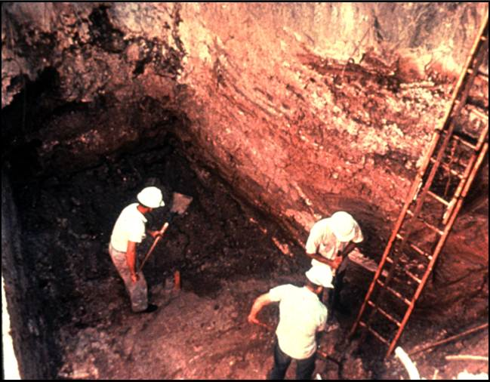
1926.652 - Requirements for Protective Systems
No working on sloped or benched faces unless employees below are protected
Notes:
Sloping and benching systems. Employees shall not be permitted to work on the faces of sloped or benched excavations at levels above other employees except when employees at the lower levels are adequately protected from the hazard of falling, rolling, or sliding material or equipment.

Slide 27
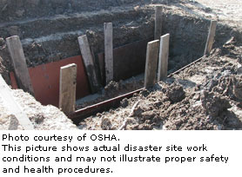
Factors Involved in Designing a Protective System
Soil classification
Depth of cut
Water content of soil
Changes due to weather and climate
Other operations in the vicinity
Notes:
1926.652(c)
The employer or his designee must select and construct designs of support systems, shield systems, and other protective systems
Trenches more than 5 feet require shoring or must have a stabilized slope
Trenches less than 5 feet - a competent person must inspect to determine that a protection system is not necessary in soils where there is no indication of a potential cave-in
In hazardous soil conditions trenches under 5 feet need protection

Slide 28
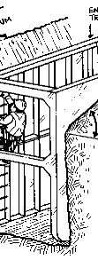
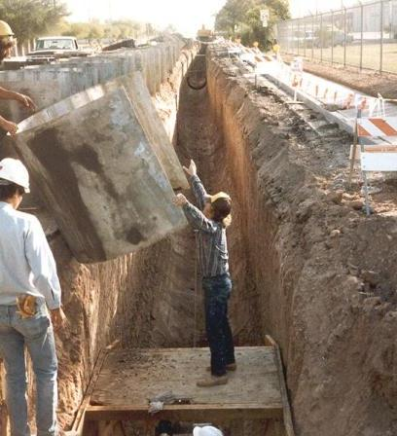
1926.652 - Requirements for Protective Systems
Shield systems not subject to loads exceeding their capacity
Installed to restrict lateral movement
Employee protection provided while entering/exiting shields
No employees in trench during installation or removal of shields
Notes:
Shield systems shall not be subjected to loads exceeding those which the system was designed to withstand.
Shields shall be installed in a manner to restrict lateral or other hazardous movement of the shield in the event of the application of sudden lateral loads.
Employees shall be protected from the hazard of cave-ins when entering or exiting the areas protected by shields.
Employees shall not be allowed in shields when shields are being installed, removed, or moved vertically.

Slide 29
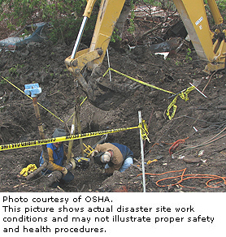
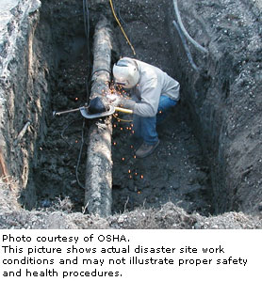
Inadequate Protective System
Notes:
Reference 1926.652(a) and (b) and (c)

Slide 30
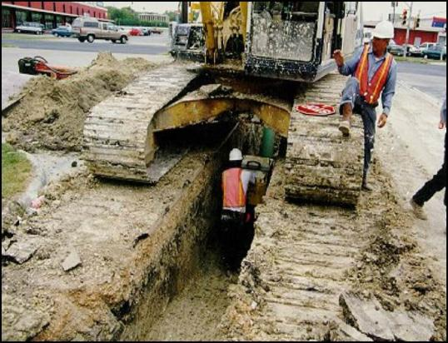
1926 Subpart P Appendix A - Soil Classification
A method of categorizing soil and rock deposits in a hierarchy of:
  Stable Rock,
  Type A,
  Type B, and
  Type C

Slide 31
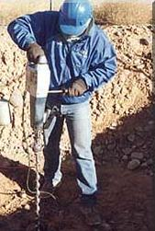
1926 Subpart P Appendix A - Soil Classification
"Stable rock" means natural solid mineral matter that can be excavated with vertical sides and remain intact while exposed.
"Type A" means cohesive soils with an unconfined, compressive strength of 1.5 ton per square foot (tsf) or greater.
Examples of cohesive soils are: clay, silty clay, sandy clay, clay loam.

Slide 32
1926 Subpart P Appendix A - Soil Classification
However, no soil is Type A if:
  (i) The soil is fissured; or
  (ii) The soil is subject to vibration from heavy traffic, pile driving, or similar effects; or
  (iii) The soil has been previously disturbed; or
  (iv) The soil is part of a sloped, layered system where the layers dip into the excavation on a slope of four horizontal to one vertical (4H:1V) or greater;

Slide 33
1926 Subpart P Appendix A - Soil Classification
"Type B" means:
  (i) Cohesive soil with an unconfined compressive strength greater than0.5 tsf but less than 1.5 tsf ; or
  (ii) Granular non-cohesive soils including: angular gravel (similar to crushed rock), silt, silt loam, sandy loam and,
  (iii) Previously disturbed soils except those which would otherwise be classed as Type C soil,
  (iv) Type A, but is fissured or subject to vibration; or
  (v) Dry rock that is not stable

Slide 34
1926 Subpart P Appendix A - Soil Classification
"Type C" means:
  (i) Cohesive soil with an unconfined compressive strength of 0.5 tsf (48 kPa) or less; or
  (ii) Granular soils including gravel, sand, and loamy sand; or
  (iii) Submerged soil or soil from which water is freely seeping; or
  (iv) Submerged rock that is not stable

Slide 35
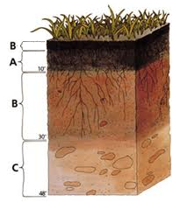
Additional soil classification
LAYERED GEOLOGICAL STRATA:
  Where soils are configured in layers, i.e., where a layered geologic structure exists, the soil must be classified on the basis of the soil classification of the weakest soil layer.
  Each layer may be classified individually if a more stable layer lies below a less stable layer, i.e., where a Type C soil rests on top of stable rock.

Slide 36
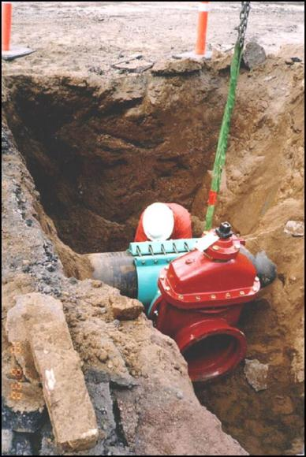
Classification of Soil and Rock Deposits
Classification must be based on the results of at least one visual and one manual analysis conducted by a Competent Person.
In a layered soil system, the system must be classified in accordance with its weakest layer. However, each layer may be classified individually where a more stable soil lies under a less stable soil.

Slide 37
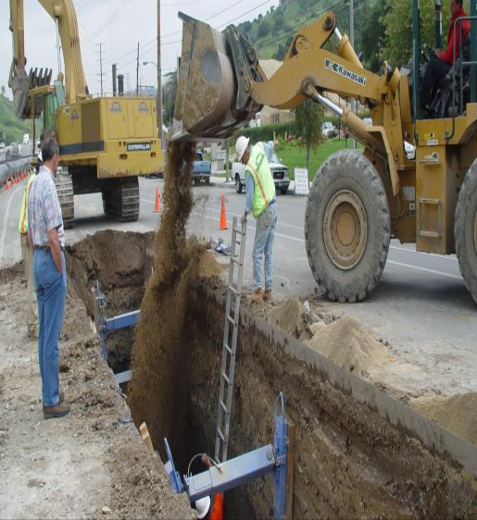
Inspections of Excavations
A Competent Person must make daily inspections of excavations, areas around them and protective systems:
  Before work starts and as needed,
  After rainstorms, high winds or other occurrence which may increase hazards, and
  When you can reasonably anticipate an employee will be exposed to hazards.
Notes:
Reference 1926.651(k)
Daily inspections of excavations, the adjacent areas, and protective systems shall be made by a competent person for evidence of a situation that could result in possible cave-ins, indications of failure of protective systems, hazardous atmospheres, or other hazardous conditions. An inspection shall be conducted by the competent person prior to the start of work and as needed throughout the shift. Inspections shall also be made after every rainstorm or other hazard increasing occurrence. These inspections are only required when employee exposure can be reasonably anticipated.

Slide 38
1926 Subpart P Appendix A - Soil Classification
"Unconfined compressive strength" means the load per unit area at which a soil will fail in compression.
It can be determined by laboratory testing, or estimated in the field using a pocket penetrometer, by thumb penetration tests, and other methods.

Slide 39
1926 Subpart P Appendix A - Soil Classification
"Wet soil" means soil that contains significantly more moisture than moist soil, but in such a range of values that cohesive material will slump or begin to flow when vibrated.
Granular material that would exhibit cohesive properties when moist will lose those cohesive properties when wet.

Slide 40
1926 Subpart P Appendix A - Soil Classification
Each soil and rock deposit shall be classified by a competent person as Stable Rock, Type A, Type B, or Type C
The classification of the deposits shall be made based on the results of at least one visual and at least one manual analysis.

Slide 41
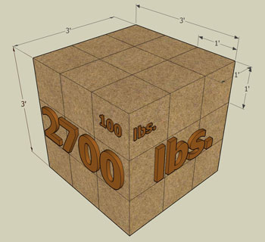
Soil Mechanics
UNIT WEIGHT OF SOILS refers to the weight of one unit of a particular soil. The weight of soil varies with type and moisture content. One cubic foot of soil can weigh from 110 pounds to 140 pounds or more, and one cubic meter (35.3 cubic feet) of soil can weigh more than 3,000 pounds.

Slide 42
Soil Mechanics
A number of stresses and deformations can occur in an open cut or trench.
For example, increases or decreases in moisture content can adversely affect the stability of a trench or excavation.
The following diagrams show some of the more frequently identified causes of trench failure.

Slide 43

Soil Mechanics
TENSION CRACKS. Tension cracks usually form at a horizontal distance of 0.5 to 0.75 times the depth of the trench, measured from the top of the vertical face of the trench.

Slide 44
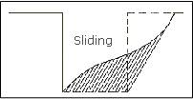
Soil Mechanics
SLIDING or sluffing may occur as a result of tension cracks, as illustrated below.

Slide 45
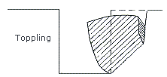
Soil Mechanics
TOPPLING. In addition to sliding, tension cracks can cause toppling. Toppling occurs when the trench's vertical face shears along the tension crack line and topples into the excavation.

Slide 46
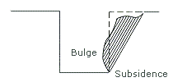
Soil Mechanics
SUBSIDENCE AND BULGING. An unsupported excavation can create an unbalanced stress in the soil, which, in turn, causes subsidence at the surface and bulging of the vertical face of the trench. If uncorrected, this condition can cause face failure and entrapment of workers in the trench.

Slide 47
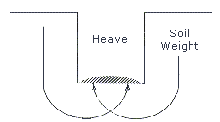
Soil Mechanics
HEAVING OR SQUEEZING. Bottom heaving or squeezing is caused by the downward pressure created by the weight of adjoining soil. This pressure causes a bulge in the bottom of the cut, as illustrated in the drawing above. Heaving and squeezing can occur even when shoring or shielding has been properly installed.

Slide 48
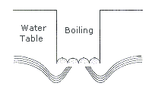
Soil Mechanics
BOILING is evidenced by an upward water flow into the bottom of the cut. A high water table is one of the causes of boiling. Boiling produces a "quick" condition in the bottom of the cut, and can occur even when shoring or trench boxes are used.

Slide 49
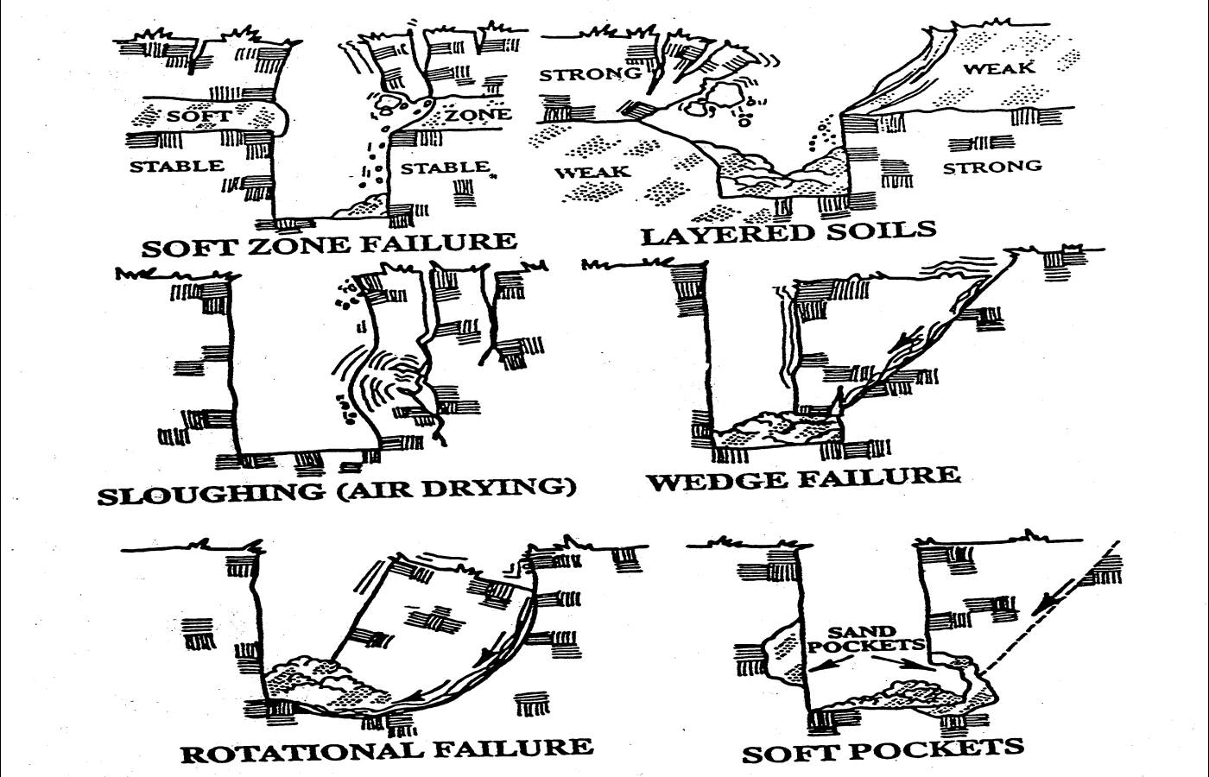
Other Soil Mechanics

Slide 50
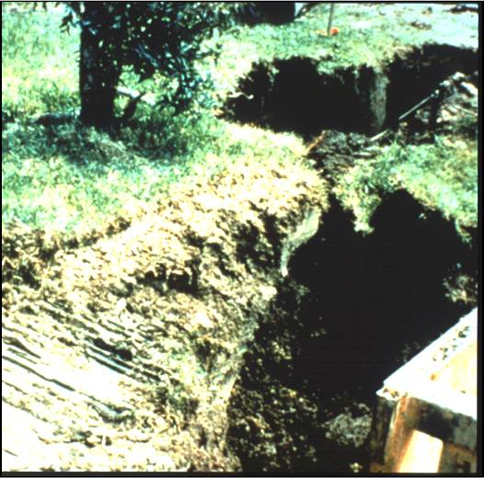
Visual Tests
To determine qualitative information regarding the excavation site consider:
  the soil adjacent to the excavation;
  the soil forming the sides of the open excavation;
  the soil taken as samples from excavated material.

Slide 51
Visual Tests
Observe the side of the opened excavation and the surface area adjacent to the excavation.
Crack-like openings such as tension cracks could indicate fissured material.
If chunks of soil spall off a vertical side, the soil could be fissured.
Small spalls are evidence of moving ground and are indications of potentially hazardous situations.

Slide 52
Visual Tests
Observe the area adjacent to the excavation and the excavation itself for evidence of existing utility and other underground structures, and to identify previously disturbed soil.
Observed the opened side of the excavation to identify layered systems. Examine layered systems to identify if the layers slope toward the excavation. Estimate the degree of slope of the layers.

Slide 53
Visual Tests
Observe the area adjacent to the excavation and the sides of the opened excavation for evidence of surface water, water seeping from the sides of the excavation, or the location of the level of the water table.
Observe the area adjacent to the excavation and the area within the excavation for sources of vibration that may affect the stability of the excavation face.

Slide 54
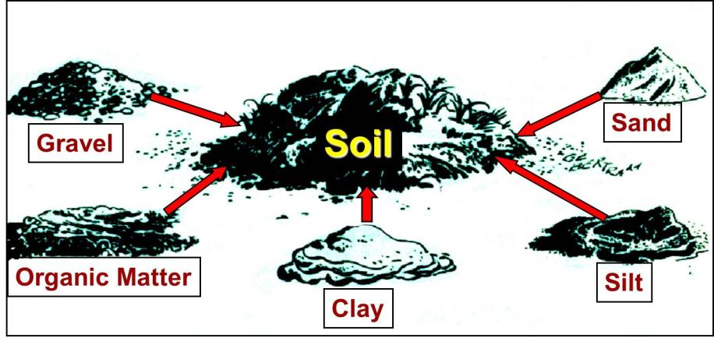
Observe samples of soil that are excavated and soil in the sides of the excavation.
Estimate the range of particle sizes and the relative amounts of the particle sizes. Soil that is primarily composed of fine-grained material material is cohesive material.
Soil composed primarily of coarse-grained sand or gravel is granular material. The evaluator also considers the effects of vibration.

Slide 55
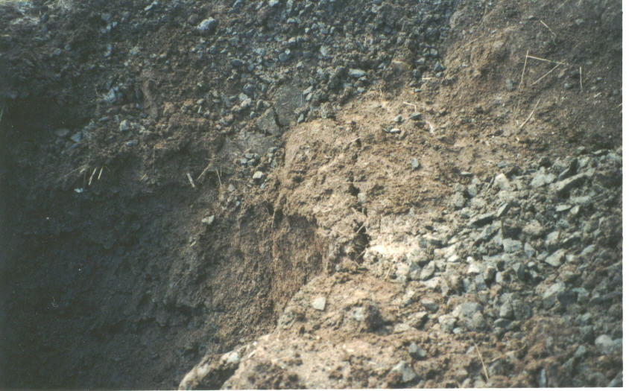
Visual Inspections
Fissured Soil - Observe the side of the opened excavation and the surface area adjacent to the excavation. Crack-like openings such as tension cracks could indicate fissured material.

Slide 56
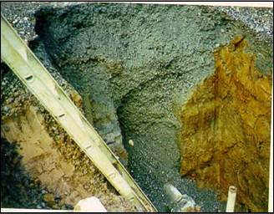
Visual Inspections
Previously Disturbed Soil - Observe the area adjacent to the excavation to identify previously disturbed soil (i.e. evidence of existing utility, prior fill material).

Slide 57
Soil Characteristics
Soil that remains in clumps when excavated is cohesive.
Soil that breaks up easily and does not stay in clumps is granular.
Cemented soil is highly cohesive, will not break with finger pressure
Cohesive soil high in clay, does not break apart into particles, can be formed

Slide 58
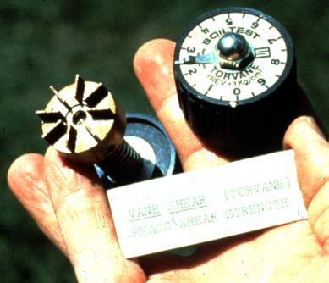
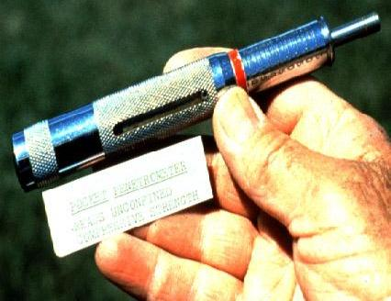
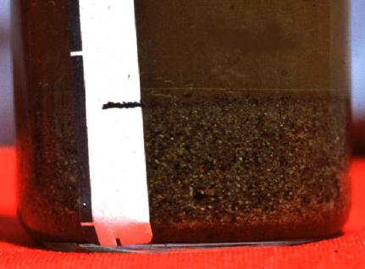
Soil Field Tests
Plasticity and Pat
Thumb Test
Pocket Penatrometer
Torvane Shear
Sedimentation

Slide 59
Manual Testing Methods
Plasticity and Pat Test - Mold a moist or wet sample of soil into a ball and attempt to roll it into threads as thin as 1/8 inch in diameter. Cohesive soil can be successfully rolled into threads without crumbling. If at least a 2 inch length of 1/8 inch thread can be held on one end without tearing, the soil is cohesive.
Spread a 1/8 or 1/4 inch thick sample of wet soil on the palm of the hand. Wipe the surface of the sample with a finger to remove visible water. With the palm facing up, slap the back of the hand moderately 5 to 10 times. If water rises to the surface of the sample (surface will appear shiny), then the soil is mostly cohesion less silt or sand. If no water appears, then the soil is mostly cohesive clay.

Slide 60
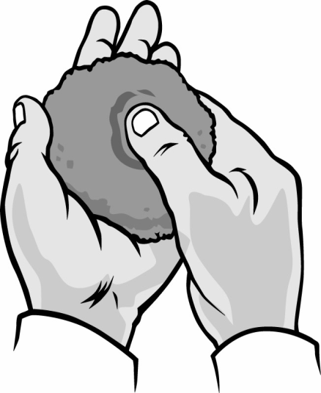
Thumb Test
Thumb Penetration Test. This test roughly estimates the unconfined compressive strength of a sample. Press your thumb into the soil sample. If the sample resists hard pressure, it may be Type A soil. If it’s easy to penetrate, the sample may be type C.

Slide 61
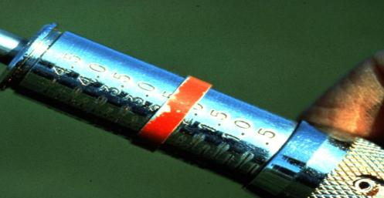
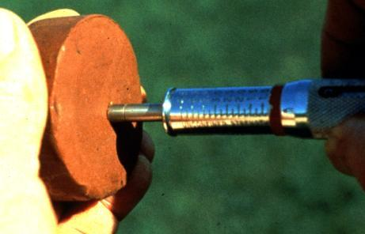
Pocket Penetrometer
Penetrometers are direct-reading, spring-operated instruments used to determine the unconfined compressive strength of saturated cohesive soils
Once pushed into the soil, an indicator sleeve displays the reading.
The instrument is calibrated in either tons per square foot (tsf) or kilograms per square centimeter (kPa).
However, Penetrometers have error rates in the range of ± 20-40%.

Slide 62


Torvane Shear
Select fresh clod or block of undisturbed soil from spoil pile
Cut a smooth surface on the clod
Insert vanes of device into the soil
Set indicator at zero
Hold device firmly against soil and twist in clockwise manner until soil fails in shear

Slide 63

Sedimentation
Flat bottom container at least 7 inches high
Fill glass jar
5 inches of water on top of soil
1 1/2 inches of soil
Place lid on jar and shake
  Set jar down
  Rotate slightly
  Larger particles settle out immediately
  Wait 30 seconds
  Mark jar
  Silt after several minutes
  Fine clays in an hour
  Make second mark

Slide 64
Visual tests & soil mechanics
The evaluator should also look for signs of bulging, boiling, or sluffing, as well as for signs of surface water seeping from the sides of the excavation or from the water table.
In addition, the area adjacent to the excavation should be checked for signs of foundations or other intrusions into the failure zone, and the evaluator should check for surcharging and the spoil distance from the edge of the excavation.

Slide 65
Protective Systems
Shoring is the provision of a support system for trench faces used to prevent movement of soil, underground utilities, roadways, and foundations.
Shoring or shielding is used when the location or depth of the cut makes sloping back to the maximum allowable slope impractical.
Shoring systems consist of posts, wales, struts, and sheeting.
There are two basic types of shoring, timber and aluminum hydraulic.

Slide 66

TIMBER SHORING

Slide 67
Protective Systems
The trend today is toward the use of hydraulic shoring, a prefabricated strut and/or wale system manufactured of aluminum or steel.
Hydraulic shoring provides a critical safety advantage over timber shoring because workers do not have to enter the trench to install or remove hydraulic shoring.

Slide 68
Protective Systems
Other advantages of most hydraulic systems are that they:
    Are light enough to be installed by one worker;
    Are gauge-regulated to ensure even distribution of pressure along the trench line;
    Can have their trench faces "preloaded" to use the soil's natural cohesion to prevent movement; and
    Can be adapted easily to various trench depths and widths.

Slide 69
Protective Systems
All shoring should be installed from the top down and removed from the bottom up.
Hydraulic shoring should be checked at least once per shift for leaking hoses and/or cylinders, broken connections, cracked nipples, bent bases, and any other damaged or defective parts.

Slide 71

Protective Systems
Screw jack systems differ from hydraulic and pneumatic systems in that the struts of a screw jack system must be adjusted manually.
This creates a hazard because the worker is required to be in the trench in order to adjust the strut.
In addition, uniform "preloading" cannot be achieved with screw jacks, and their weight creates handling difficulties.

Slide 72


Protective Systems
TRENCH BOXES protect workers from cave-ins and similar incidents.
The excavated area between the outside of the trench box and the face of the trench should be as small as possible.
The space between the trench boxes and the excavation side are backfilled to prevent lateral movement of the box.

Slide 73

Does this Comply with OSHA Requirements?

Slide 74

Does this Comply with OSHA Requirements?

Slide 75

Does this Comply with OSHA Requirements?

Slide 76

Does this Comply with OSHA Requirements?

Slide 77

Does this Comply with OSHA Requirements?

Slide 78

Does this Comply with OSHA Requirements?

Slide 79




Slide 80
SLOPING. Maximum allowable slopes for excavations less than 20 ft (6.09 m) based on soil type and angle to the horizontal are as follows:
Soil type Height/Depth ratio Slope angle Stable Rock Vertical 90°
Type A ¾:1 53°
Type B 1:1 45°
Type C 1½:1 34°
Type A (short-term) ½:1 63° (For a maximum excavation depth of 12 ft)

Slide 81




Slide 82







Slide 83



Slide 84

Temporary Spoil
Temporary spoil must be placed no closer than 2 ft (0.61 m) from the surface edge of the excavation, measured from the nearest base of the spoil to the cut.
This distance should not be measured from the crown of the spoil deposit.
Ensures that loose rock or soil from the temporary spoil will not fall on employees in the trench.

Slide 85

Temporary Spoil
Spoil should be placed so that it channels rainwater and other run-off water away from the excavation.
Spoil should be placed so that it cannot accidentally run, slide, or fall back into the excavation.

Slide 86

Other Excavation Hazards
Water accumulation
Oxygen deficiency
Toxic fumes
Access/Egress
Falls
Mobile equipment

Slide 87

“OSHA Save Lives” Photos

Slide 88


  “OSHA Saves Lives” Photos
Notes:
The discussion of this topic covers four main points. At the conclusion of the training, you should be able to:
1. State the greatest risk that is present at an excavation.
2. Briefly describe the three main methods for protecting employees from cave-ins.
3. Name at least three factors that pose a hazard to employees working in excavations, and at least one way
to eliminate or reduce each of the hazards.
4. Describe the role of a competent person at an excavation site.

Slide 89


  “OSHA Saves Lives” Photos
Notes:
The discussion of this topic covers four main points. At the conclusion of the training, you should be able to:
1. State the greatest risk that is present at an excavation.
2. Briefly describe the three main methods for protecting employees from cave-ins.
3. Name at least three factors that pose a hazard to employees working in excavations, and at least one way
to eliminate or reduce each of the hazards.
4. Describe the role of a competent person at an excavation site.

Slide 90

  “OSHA Saves Lives” Photos

Slide 91

The
End

Slide 93
Soils - Types & Particle Size
Gravel
  larger than 2 millimeters
Sand
  Smaller than 2 millimeters but larger than 0.075 millimeters
Silt
  Smaller than 0.075 millimeters but larger than 0.002 millimeters
Clay
  Smaller than 0.002 millimeters
.

Slide 94
1926.651 Specific Excavation Requirements
Protect workers from loose rock & soil
Spoil at least 2 feet away, or retained, or both
Notes:
Adequate protection shall be provided to protect employees from loose rock or soil that could pose a hazard by falling or rolling from an excavation face. Such protection shall consist of scaling to remove loose material; installation of protective barricades at intervals as necessary on the face to stop and contain falling material; or other means that provide equivalent protection.
Employees shall be protected from excavated or other materials or equipment that could pose a hazard by falling or rolling into excavations. Protection shall be provided by placing and keeping such materials or equipment at least 2 feet (.61 m) from the edge of excavations, or by the use of retaining devices that are sufficient to prevent materials or equipment from falling or rolling into excavations, or by a combination of both if necessary.

