Slide 1
Ergonomics and Safety Training for managers in
ELECTRIC Utilities

Slide 2
DISCLAIMER
This material was produced under grant number SH-22220-SH1 from the Occupational Safety and Health Administration, U.S. Department of Labor. It does not necessarily reflect the views or policies of the U.S. Department of Labor, nor does mention of trade names, commercial products, or organizations imply endorsement by the U.S. Government.
Notes:
SCRIPT: The presentation materials were developed at the University of Wisconsin-Milwaukee (UWM) through a Susan Harwood Grant provided by the Department of Labor.
LEARNING OBJECTIVE: Grant source

Slide 3
WHAT WE ARE GOING TO DO TODAY?
Pre-test
Safety & Ergonomics Awareness Training
Work Evaluation Methods
Employee Engagement
Cost Benefit Analysis
Program Implementation
Post-test

Slide 4
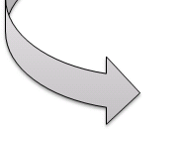
WHAT ELSE IS REQUIRED?
EMPLOYEE ENGAGEMENT
  AWARENESS TRAINING
PROGRAM IMPLEMENTATION
WORK EVALUATION METHODS
COST-BENEFIT ANALYSIS

Slide 5
THE WEAKEST LINK
EMPLOYEE
SAFER WORKPLACE
ORGANIZATION
TECHNOLOGY

Slide 6
HIERARCHY OF CONTROLS
ELIMINATION
SUBSTITUTION
ENGINEERING
ADMINISTRATIVE
IDENTIFIED HAZARD

Slide 7
INTANGIBLE PRODUCTS
TRAINING GOALS
KNOWLEDGE
ATTITUDE
BEHAVIOR

Slide 8
DO YOU WANT TO IMPROVE SAFETY AND ERGONOMICS AT YOUR FACILITY?
MANAGEMENT COMMITMENT IS REQUIRED FOR THIS PROGRAM TO SUCCEED!

Slide 9

WORK EVALUATION METHODS
Why is it important?
How do you evaluate jobs?
How do you prioritize improvements?
“What gets measured gets done”
- Tom Peters

Slide 10
WORK EVALUATION METHODS
OSHA Screening Tool
  Worksheet is available on your CD
NIOSH Lifting Equation
  Worksheet is available on your CD
Liberty Mutual Carrying Tables
  Worksheet is available on your CD
  http://libertymmhtables.libertymutual.com/CM_LMTablesWeb/taskSelection.do?action=initTaskSelection
Notes:
eLCOSH checklist: http://www.elcosh.org/en/document/4/d000003/construction-ergonomics-checklist.html
Ergonomics & Construction links
http://www.ohsu.edu/croetweb/links.cfm?subtopicID=350
MML org
http://www.mml.org/insurance/shared/publications/s_and_h_manual/14A.pdf

Slide 11
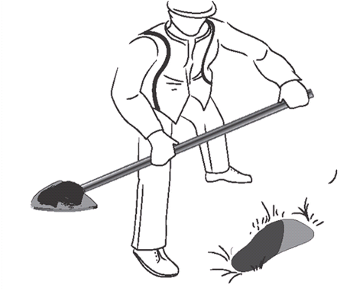
OSHA SCREENING CHECKLIST
Identifies risk factors present
by body region
Risk factors covered:
  Repetition, Force, Awkward
  Postures, Contact stress, Vibration
Body regions:
  Neck/Shoulder, Hand/Arm/Wrist
  Back/Shoulder, Leg/Knee/Ankle

Slide 12
OSHA CHECKLIST
You’ll need to:
  Observe a task in real time or video
  Read each element and determine if it occurs in the task
  For each body region, add up all the ‘Yes’ responses
Additional equipment: stopwatch

Slide 13
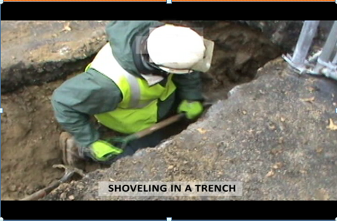
SHOVELING / DIGGING

Slide 14
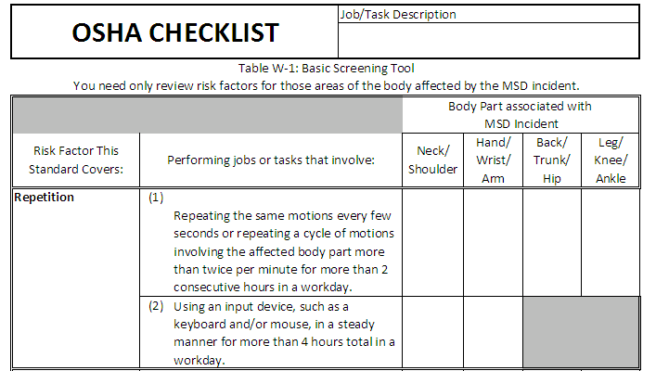
RISK FACTOR: REPETITION
Shoveling task
√
√
√
√

Slide 15

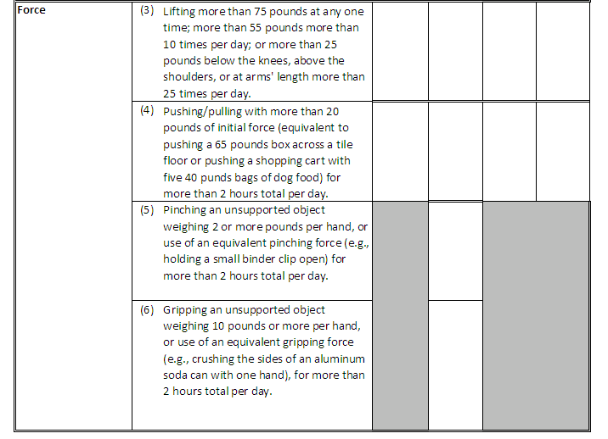
RISK FACTOR: FORCE
√
√
√
√
√
√
√

Slide 16
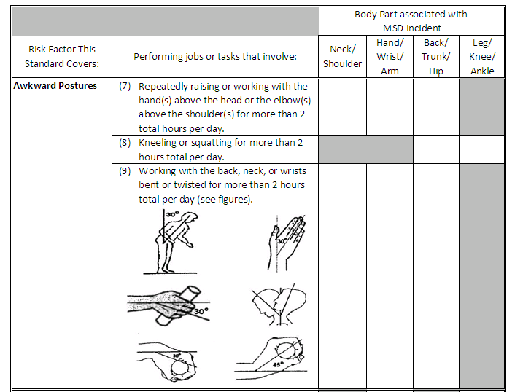
RISK FACTOR: AWKWARD POSTURE
√
√
√
√

Slide 17
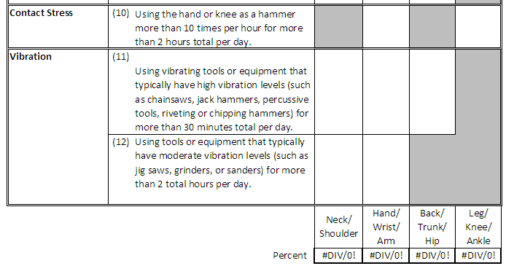
RISK FACTORS: CONTACT STRESS AND VIBRATION
√
2/8 =25%
5/11
=45%
5/7
=71%
4/5
=80%

Slide 18
NIOSH LIFTING EQUATION
Specifies a weight limit as a function of the following variables of the lifting task:
      H = horizontal location forward of the midpoint between the ankles
      at the origin of the lift.
      V = vertical location at the origin of the lift
      D = vertical travel distance between origin and destination of lift
      FM = frequency multiplier (table of values)
      A = angle between the midpoint of the ankles and the midpoint
      between the hands at the origin of the lift
      CM = coupling multiplier (good, fair, poor)
  Worksheet available on your CD
  Free web access at: http://personal.health.usf.edu/tbernard/ergotools/index.html

Slide 19
NIOSH LIFTING EQUATION
You’ll need to:
  Observe a task in real time or video
  Take measurements: height, distance traveled, force, weight, twisting angle, coupling, and determine how frequently a task is done
  Use measured values to find parameters from a table
  Multiply parameters from table to find the recommended weight limit (RWL)
  Compare RWL to actual lifted load to get the lifting index
Equipment: tape measure, scale, stopwatch

Slide 20
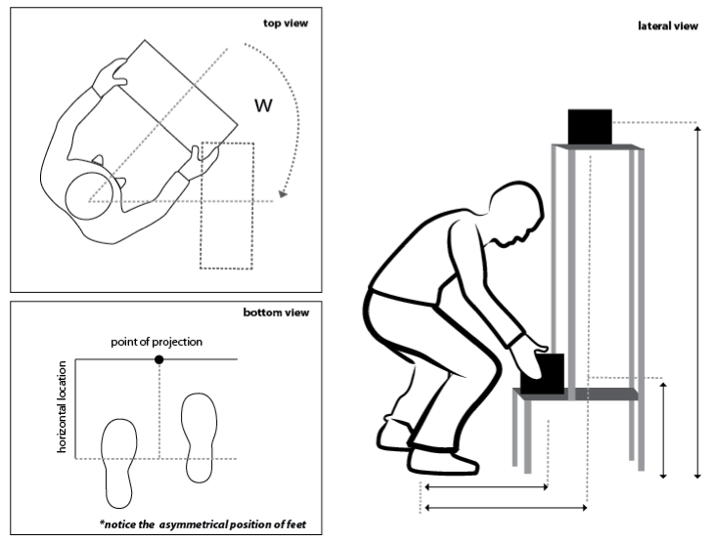
NIOSH LIFTING EQUATION FIGURE
Asymmetry
Angle
Vertical location
Distance
traveled
Horizontal location

Slide 21
MEASUREMENTS
Load location
  Horizontal (HM)
  Vertical (VM)
  Distance traveled (DM)
  Twist/Asymmetry (AM)
Frequency of lifts (FM)
Grasp of the load/coupling (CM)
Actual load weight lifted
Input values into worksheet

Slide 22
CALCULATE RECOMMENDED WEIGHT LIMIT
Recommended Weight Limit (RWL)
RWL = 51 lbs x HM x VM x DM x AM x FM x CM
Actual Load
RWL
Lifting
Index
RWL = 51 lbs x (10/H) x (1-(.0075-|V-30 |) x (.82 +(1.8/D)) x (1-(.0032A)) x FM x CM

Slide 23
NIOSH LIFTING EQUATION RESULTS
LI < 1
1 < LI < 3
LI > 3
When using the NIOSH lifting equation
no worker should be performing a task with
a lifting index greater than 3!
Safe
Increased Risk
Not Safe

Slide 24
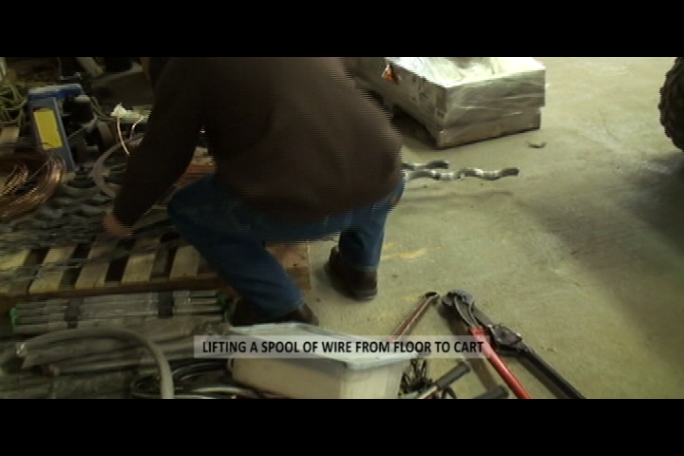
NIOSH LIFTING EQUATION EXAMPLE

Slide 25
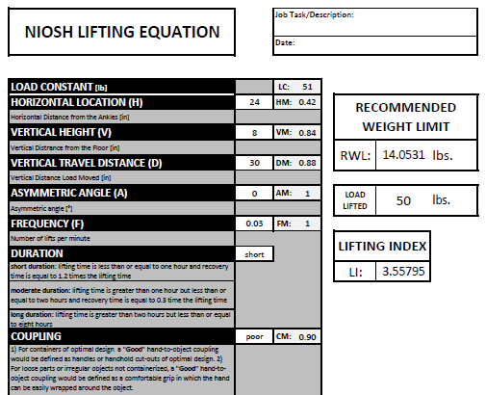
RESULTS - ORIGIN
Lifting spool from a pallet to the cart

Slide 26
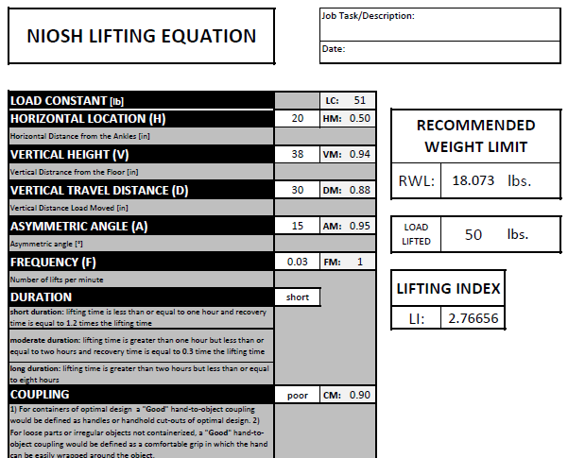
RESULTS - DESTINATION
Lifting meters from a pallet to the shelf

Slide 27


RESULTS
LI < 1
1< LI < 3
LI > 3
Safe
Increased Risk
Not Safe
ORIGIN
DESTINATION
Not Safe
Increased Risk

Slide 28
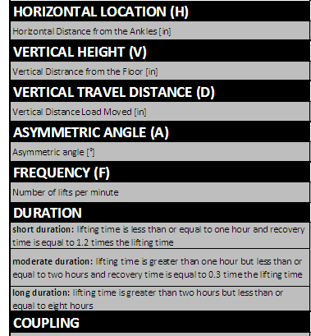

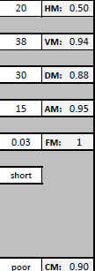
HOW TO LOOK FOR IMPROVEMENTS
ORIGIN
DESTINATION
Can the worker get closer to the load?
Can the load be raised?

Slide 29
LIBERTY MUTUAL TABLES
You’ll need to:
  Observe a task in real time or video
  Determine the desired worker population
  Measure: height, distance traveled, force
  Determine how frequently a task is done
  Look up values in a table
Equipment: tape measure, scale, stopwatch
!

Slide 30
PERCENT POPULATION
90
Nearly everyone
75
50
Designed for the average
25
10
Only the top or strongest

Slide 31
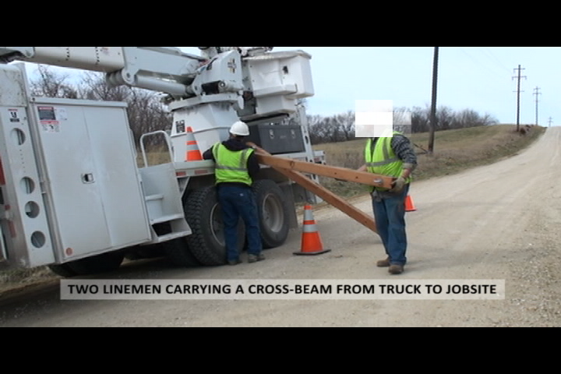
CARRYING A CROSS-ARM

Slide 32
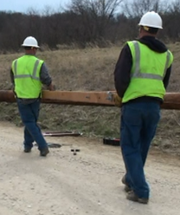
CARRYING A CROSS-ARM
Information needed:
  Male or Female
  Vertical distance : 111 cm
  Carrying distance: 2.1, 4.3 or 8.5 m
  Frequency
  1/6s, 1/12 s, 1/1 min, 1/2 min,
  1/5 min, 1/30 min, 1/8 hr
  Percent of population
  90, 75, 50, 25, 10
~43 inches
~27.8 feet
Vertical distance
Carrying distance

Slide 33
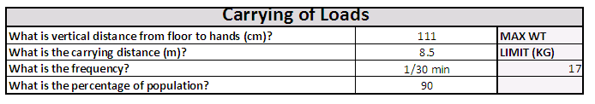
RESULTS - CARRYING
Now compare the result of 17 kg (37 lbs) to the actual weight carried.

Slide 34
Now YOU CAN EVALUATE JOBS….
QUESTIONS?
Notes:
How do you measure improvement if you don't know where you are now?
Free clipart image, website: http://www.clipartguide.com/_pages/0808-0801-1115-5658.html

Slide 35
PRIORITIZATION
Start with solutions, that are Low Cost
and
High Impact
Then move to other identified solutions
High Cost
Low Impact
High Cost
High Impact
Low Cost
Low Impact
Low Cost
High Impact

Slide 36
PRIORITIZATION
OSHA RECORDABLE INCIDENTS
LINE OF BUSINESS
SOURCE OF INJURY
POSSIBLE RISK FACTORS
AREAS FOR IMPROVEMENT

Slide 37
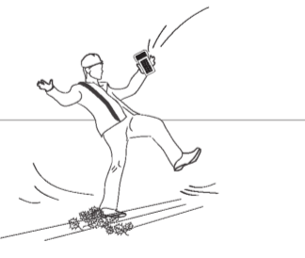

DO YOU KNOW?
How many injuries at your facility are attributed to a slip, trip or fall last year?
                $
                # $$

Slide 38
WHAT DO WE KNOW?
Employee
  Occupation, Job title, Age, Gender
Activity
Source of Injury
Type of injury
Affected body part(s)
Consequences
  Lost days, Restricted days
Cause
Do we really know the root cause????

Slide 39
WHAT DO WE REALLY KNOW?
CAUSE??
Walking down stairway
Cut on head
Sprain – left shoulder
Stepped off a curb
Whiplash
Reading residential meters
Climbing a ladder
Hole in Floor
SOURCE??
slip/trip/fall
struck/caught
overexertion
slip/trip/fall
struck/caught
slip/fall < 4 ft
slip
slip/trip/fall
BODY PART
Knee
Head
Shoulder
Foot/Ankle
neck
Chest
Leg, Elbow
Knee
INJURY
Contusion, Bruise
Lacer/Fracture
Sprain, Strain
Fracture
Sprain, Strain
Contusion, Bruise
Fracture
Sprain, Strain
LD | RD
0 | 2
0 | 0
15 | 0
110 | 70
1 | 0
37 | 0
42 | 47
1 | 58

Slide 40
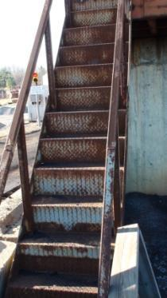
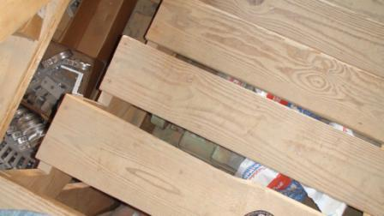
WHAT IS WRONG WITH THE STAIRS?
CAUSE | SOURCE | BODY PART | INJURY | LD | RD
Walking down stairway | slip/trip/fall | Knee | Contusion, Bruise | 0 | 2

Slide 41
CAUSE
Wrong stair design
Shoes
Slippery surface
Poor lighting
Obstructed view
Personal factors
Environment
Heat stress
Time pressure/rushing
Work schedules
Loss of balance

Slide 42
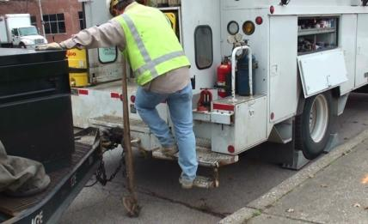
LADDERS/TRUCKS/HEIGHTS
CAUSE | SOURCE | BODY PART | INJURY | LD | RD
Stepping off ladder when exiting excavation | slip/trip/fall | Hip | Sprain, Strain | 5 | 22
Descending ladder | fall >4 ft | Whole Body | Contusion, Bruise | 2 | 20
Climbing a ladder | slip | Leg, Elbow | Fracture | 42 | 47
Climbing down off a utility truck | slip/trip/fall | Elbow | Laceration/Fracture | 3 | 51

Slide 43
CAUSES
Step design (narrow treads, very high first step, etc)
Lack of rails
Contaminants on steps or shoes
Surface finish (smooth metal/painted metal)
Changes in surface finish (rough to smooth)
‘Jumping from cab’ instead of using steps or ladder
Raised edges
Holding materials and/or obstructed view
Loss of balance
Environment – wind, mud, ice or snow
Heat stress
Time pressures/rushing, piecework or rewards for quickness
Work schedules – long hours, shift work, can lead to fatigue

Slide 44
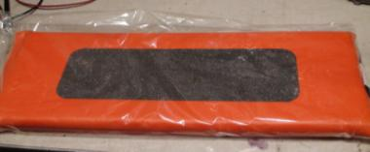
EXAMPLE
Employee was pulling on a crescent wrench to loosen anchor bolts while kneeling on a kneeling pad. The kneeling pad slipped and he hurt his right elbow.
Slip
Injury Classification
Sprain
Possible solution
!

Slide 45
DO YOU KNOW?
How many injuries at your facility could be attributed to a slip, trip or fall last year?
What was the root cause?
Did your facility address the root cause?
Did you share your improvement/change with others?
Some are tough questions …

Slide 46
SHARING INFORMATION
This can include:
  OSHA recordable injuries
  Worker’s compensation claims
  Near-miss reports
  Property damage
How do you communicate events throughout your organization?

Slide 47
TELEPHONE GAME
Who’s birthday is coming up next?
  Pass a piece of paper with a injury description to that person
  Ask them to memorize the injury, then repeat it to their neighbor, and so on

Slide 48
WHAT HAPPENED?
Last person: tell us about the injury
First person: what information changed?
Everyone: what information was missing from the first report?
Notes:
Discuss root cause of the injury here.

Slide 49
SHARING INFORMATION
What have we learned from the telephone game?
How will you change the communication of events (injuries, near-miss, property damage) in the future?

Slide 50

WHAT ELSE IS REQUIRED?
EMPLOYEE ENGAGEMENT
  AWARENESS TRAINING
PROGRAM IMPLEMENTATION
WORK EVALUATION METHODS
COST-BENEFIT ANALYSIS

Slide 51
EMPLOYEE ENGAGEMENT
Why is it important?
Where do you start?
How do you keep employees engaged everyday and for the long-haul?
!

Slide 52
WHY IS IT IMPORTANT?
Your employees reflect your company
  Many of your employees directly interact with your customers, therefore
  ________________________________________
  ________________________________________
And without your employees, the work doesn’t get done.

Slide 53
WHERE DO YOU START?
What do your employees want?
#1 To know what is expected of them
  Do your employees have the tools and materials to do their job safely everyday?
#2 Recognition
  When is the last time you praised good work?
#3 To know their opinions count
  Do you have an open-door policy that encourages employees to provide suggestions?
#4 To grow and have job security
  Do you encourage employees to expand their skills?
Notes:
http://gmj.gallup.com/content/102496/where-employee-engagement-happens.aspx

Slide 54
NOW ANSWER THE QUESTIONS
What do want from your employees?
#1 To provide a service to your customers
  Do your employees have the tools and materials to do their job safely everyday?
#2 To provide quality and cost-effective services
  When is the last time you praised good work?
#3 To know their opinions
  Do you have an open-door policy that encourages employees to provide suggestions?
#4 To grow your business
  Do you encourage employees to expand their skills?
Notes:
http://gmj.gallup.com/content/102496/where-employee-engagement-happens.aspx

Slide 55
TRAINING PROGRAM
TRAINING
Managers
Employees
Ideas

Slide 56

EMPLOYEE ENGAGEMENT
OPEN DISCUSSION
What are you going to do to encourage employee engagement
  Over the next week?
  Over the next month?
  In the following years?
Notes:
Free clipart image:
http://icons.mysitemyway.com/free-clipart-icons/1/solid-light-bulb-on-icon-id/80823/style-id/604/glossy-black-icons/business/
Talk about the training next week; ask what can be changed!
Visit a job site; ask what can be changed!
Re-do the training or parts of the training each year and every year.

Slide 57
WHAT ELSE IS REQUIRED?
EMPLOYEE ENGAGEMENT
  AWARENESS TRAINING
PROGRAM IMPLEMENTATION
WORK EVALUATION METHODS
COST-BENEFIT ANALYSIS

Slide 58
Questions?

Slide 59
COST-BENEFIT ANALYSIS
COSTS
BENEFITS
Purchase costs
Engineering costs
Training costs
Reoccurring costs (maintenance)
Other miscellaneous costs
Effectiveness of solution in eliminating or reducing risk
Productivity improvements
Preventing of a future injury
  Historical injury records
  Injury risk from job evaluation results
!

Slide 60
RANK THE SOLUTIONS EFFECTIVENESS
Eliminates risk = 70%
Reduces level of risk = 40%
Reduces duration of exposure = 15%
Relies on employee behavior = 10%
No reduction of risk = 10%
*Effectiveness of solution = possible reduction in injury costs/claims

Slide 61
ESTIMATE THE PRODUCTIVITY BENEFITS
Productivity improvement ranking
  High = 10%
  Medium = 5%
  Low = 2.5%
  No improvement = 0%
Employee cost
  Hourly wage $______ at 2,000 hours per worker
  #_____ of employees impacted by improvement

Slide 62
CONSIDER PREVIOUS INJURY COSTS
Direct costs from Worker’s Compensation claims
If previous claim was _____, the indirect costs ≈
  $0 - $2,999 = 4.5 x claim cost
  $3,000 - $4,999 = 1.6 x claim cost
  $5,000 - $9,999 = 1.2 x claim cost
  $10,000+ = 1.1 x claim cost

Slide 63
OTHER TYPICAL INJURY COSTS
Back strain ≈$9,000
Back injury w/surgery ≈ $58,000
Neck strain ≈$11,500
Shoulder strain ≈$11,500
Rotator cuff injury ≈$25,000
Elbow/forearm strain ≈$6,500
Epicondylitis ≈$10,000
Hand/wrist strain ≈$8,500
Hand/wrist tendinitis ≈$11,000
Carpal tunnel syndrome ≈$18,000
All other MSDs ≈$9,000
MSD costs were rounded up from values in the Washington State Calculator
Notes:
MSD costs were rounded up from values in the Washington State Calculator

Slide 64
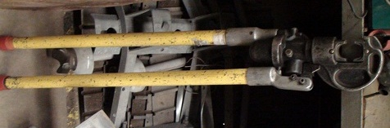
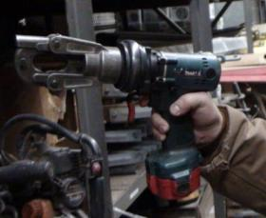
LET’S TRY AN EXAMPLE
Employees proposed the following option using a powered cutting tool
USE POWER CUTTING TOOL
MINIMIZE MANUAL CUTTING
Electric Cutter
Manual Cutter
Notes:
Script:
Learning Objective:

Slide 65
ELECTRIC CUTTING TOOL COSTS
Purchase costs
  Adapter for drill costs 3-5 times of manual cutting tool ~ $1700
  Need to have electric or hydraulic drill ~ $200
  Manual cutter cost ~ $450
  Cost difference of ≈ $1450
Engineering costs
  $0
Training costs
  $0
Recurring costs (maintenance)
  If battery operated will need to be replaced yearly ~ $125
Other miscellaneous costs
  $0
Notes:
Script:
Learning Objective: Cost of making change

Slide 66
ELECTRIC CUTTING TOOL BENEFITS
Productivity improvements
  Inexperienced user can decrease cutting time by 8 seconds for 0.5” cable and 46 seconds for 1” cable per cut.
  If making 19,500 cuts per year and saving 8-46 seconds per cut a total of 43-249 hours of labor costs would be saved
  Employee Costs
    Hourly wage $25
productivity improvement
= $1,075 annual savings for 0.5” cable
= $6,225 annual savings for 1” cable
Notes:
Script: It is assumed that for every foot of cable used, a cut is performed every 100 feet, a conservative estimate for the number of cuts performed for the top three cable types. From information gathered for six months the number of cuts for the top three cable types was 4762 which comprised 39% of all cables cut. Using this information it was approximated that 19,500 cuts would be made annually and this number was used in calculating the annual cost savings.
Learning Objective: Cost savings and productivity improvements

Slide 67
ELECTRIC CUTTING TOOL BENEFITS
Effectiveness of solution in eliminating or reducing risk
  Reduces the risk of exposure (15%)
Preventing future injuries (example)
  Injury records from last year, one injury
    Direct costs: one elbow/forearm strain injury ≈$6,500
    Indirect costs: $6,500 injury x 1.2 ≈ $7,812
  Injury risk from job evaluation results
    OSHA checklist found risk for the Neck/Shoulder and Hand/Arm/Wrist
($6,500 + $7,812) / 3 years x 15%
= $715 annual savings
Notes:
Script:
Learning Objective: Benefits of reducing injuries

Slide 68
COMPARE COSTS AND BENEFITS
COSTS
BENEFITS
≈ $1,450 part cost difference
≈ $3,650 productivity (average)
≈ $715 reduced injury costs
≈ $4,665 Total benefits
Payback = Costs/Benefits
$1,450 / $4,665 = less than one year to payback investment
Notes:
Script:
Learning Objective: Cost benefit analysis

Slide 69
PROGRAM IMPLEMENTATION
EMPLOYEE ENGAGEMENT
  AWARENESS TRAINING
PROGRAM IMPLEMENTATION
WORK EVALUATION METHODS
COST-BENEFIT ANALYSIS

Slide 70
PROGRAM IMPLEMENATION
What are the benefits?
What are steps?
What should be avoided?

Slide 71
EXAMPLES OF SUCCESSFUL ERGONOMICS & SAFETY PROGRAMS
Similar industry: Construction
  Hensel Phelps Construction Company
  Ohio BWC
Notes:
Utility industry
Wiesel, et al 1994 Potomac Energy Company; 5300 employees, 10 year study on injury surveillance system

Slide 72
HENSEL PHELPS CONSTRUCTION COMPANY
Implemented a comprehensive safety ergonomics program
  Completed on-site job evaluations
  Created customized training program, including pre-work stretching program
Results
  Over 104,000 labor hours without any reported work-related musculoskeletal disorders
Notes:
http://www.osha.gov/dcsp/success_stories/ergonomics/hensel.html

Slide 73
OHIO BUREAU OF WORKER’S COMPENSATION
Multiple examples of equipment and tools implemented in construction work available at http://www.ohiobwc.com/downloads/brochureware/publications/ConstSafeGrant.pdf
An example: powered dollies
  Situation
    Workers must move appliances, heating/air conditioning units, plumbing and other items up and down steps and stairways
  Implemented best practice
    Purchased and utilized powered dollies to move items. Powered dollies often have adjustable handles and stair climbing devices

Slide 74
POWERED DOLLY RESULTS
3 construction companies adopted the powered dolly
Return on Investment was 2.2 months
  Incident rate from 14.9 to 0, 100% improvement
  Lost work days from 29.8 days to 0, 100% improvement
  Employee turn-over rates reduced by 60%

Slide 75
THE STEPS IN 5 C’S
Commit
Communicate
Create
Continue the Challenge

Slide 76
THE STEPS: COMMIT
Commit to improving safety and ergonomics at your facility
  How? Set a goal to observe ______ number of jobs by ______
  Who follows up? Top managers

Slide 77
THE STEPS: COMMUNICATE
Communicate injury or potential injury events to all managers, and prevention methods
  Why? History repeats itself
  How? Monthly conference calls or Safety Bulletins
  Who follows up? Safety team, safety manager, ____________

Slide 78
THE STEPS: CREATE
Create a way for your employees to suggest changes and implement what you can
  Establish or enhance your safety team
    Identify jobs to evaluate
    Evaluate jobs and propose solutions
    Prioritize solutions
  Put up a suggestion box and reward employees for good ideas

Slide 79
THE STEPS: CONTINUE THE CHALLENGE
Continue the Challenge!
  Safety is not one’s persons job, it’s everybody’s job. Everyday, with every job, think about the job, and how to do it safely.
Notes:
Story: One of the companies told me a story about taking a job with a big retailer. For several months the retailer wouldn’t decide if they wanted natural gas service and the company really wanted their business. At the last minute, the big retailer wanted the service, but it was December and they were in the middle of a rainy season. The work was tough, and the employees were pulling themselves through the mud to get the service line and make the connection. No one was hurt, but the manager wished that they would have done the job differently. Two days after they finished the installation, there was the longest drought they had seen in decades.

Slide 80
WITH THIS PROGRAM
AVOID
Treating this as another written program
or
Check mark on a compliance audit
INSTEAD
Incorporate safety and ergonomics into the daily routine
Possible solution
Possible solution
NFPA
PSC
OSHA
DOT
???

Slide 81
Questions?

