Slide 1

Systems of Safety Applied to Focus Four Hazards
USDOL-OSHA
Susan Harwood Grant
SHT21005SH0

Slide 2
Systems of Safety Applied to Focus Four Hazards
This material was produced under grant number SHT21005SHO from the Occupational Safety and Health Administration, U.S. Department of Labor. It does not necessarily reflect the view or policies of the U.S. Department of Labor, nor does mention of trade names, commercial products, or organizations imply endorsement by U.S. Government.

Slide 3
STRUCK-BY

Slide 4
US Construction Struck by Fatalities 2007
Data Source: Bureau of Labor Statistics Census of Fatal Occupational Injuries

Slide 5
Learning Objectives
Identify the parts of a Struck-by program and how it works inside of a system of safety
Understand the different types of struck by incidents.
Understand what training OSHA requires and what safeguards must be in place during construction activities.
Review a Sample Struck-by Training Program.

Slide 6
Are workers exposed to overhead falling hazards ?
Does the company have an struck-by hazard protection program?
Do workers work around vehicles or machinery that can strike them such as trucks, excavations, road traffic?
Are workers trained in how to rig materials to be lifted?
Is there an inspection processes necessary for safely storing and moving materials and equipment?
Assess all hazardous sources of energy.
Assess
Write an struck by program.
Purchase PPE such as safety glasses, goggles, hardhats, high visibility vest.
Purchase new rigging equipment.
Establish a written procedure to coordinate with Controlling Entity their obligations when working with your employees to protect them.
Designate Competent Persons who understand stuck-by hazards and rigging of loads and storage
Control
Consultant
&
Committee
Review
Trials
Benchmark
Rigging Class
Competent Person Training
Personal Protection Equipment training.
Tool box talks
Job site orientation for struck-by hazards .
Control Access Zone Training
Limited Access Zone Training
Train
Test Runs
Competent
Person
Review
Implement
Perform daily inspections of rigging equipment.
Review Competent Person daily pre-task inspections of ppe and overhead controls.
Frequent communications with protection competent persons.
End of week employee debriefings
Accident or incident, near miss investigations
Monitor
Sample Struck-by Safety System

Slide 7
Struck-by Assessment of Hazards
Task | Hazard | Control | Means of Implementation
Walking around construction site | Struck by falling and flying objects Struck by machinery, vehicles, equipment | Safety glasses, goggles, hardhats. High visibility vests. Establish safety work zones for rigging loads, overhead hazards. Establish Limited/ Controlled Access Zones | Purchase PPE and train workers when and how to wear and maintain them. Coordinate various safety zones on site with controlling entity. Train workers who rig or store materials on the proper means and methods.
Notes:
Just walking around a jobsite can pose many struck-by hazards such as: falling or flying debris or moving equipment, machinery, and vehicles. You can be stuck-by a backhoe or a dump truck. You can be hit by a flying object as you walk by another worker using a table saw, you can be struck-by a bolt falling from the building you are working on because you were standing alongside the building. There are many instances where you can be struck-by things on a construction site.

Slide 8
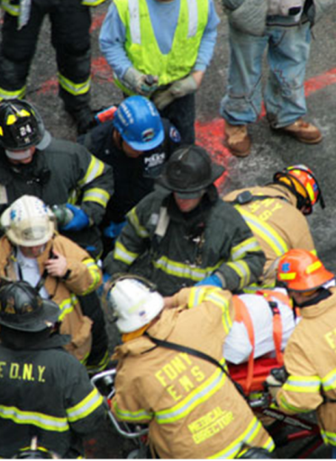
Typical Causes of
Struck-by Accidents and Fatalities
Falling Objects
Rigging Failure
Loose or Shifting Materials
Tip over or Malfunction
Lack of Overhead Protection
Vehicle and Equipment Strikes
Backing Incidents
Workers on Foot
Flying Objects

Slide 9
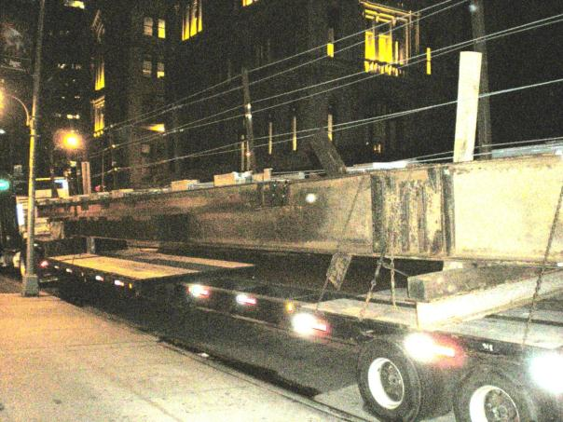
Struck-by Falling Objects
Installation of Perimeter Protection at Mill
Prefabrication: Elimination Controls

Slide 10
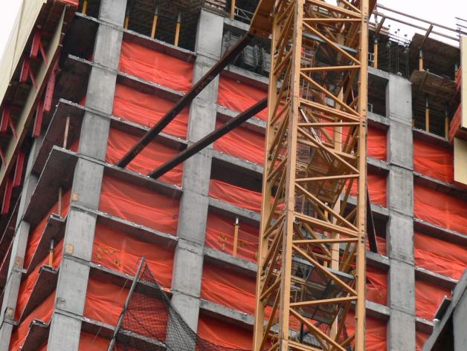
Struck-by Falling Objects
Control material from falling
Vertical Netting : Engineering Controls

Slide 11
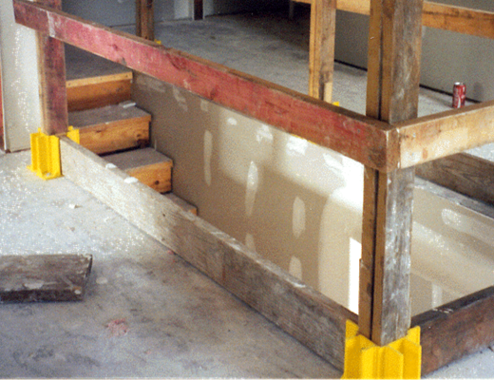
Struck-by Falling Objects
Control material from falling
Toeboards: Administrative Engineering Controls

Slide 12
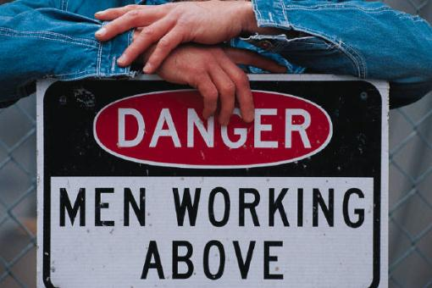
Struck-by Falling Objects
Control entry into fall zones with signage and barricades
Barricades: Administrative Engineering Controls

Slide 13


Struck-by Falling Objects
Hard hats are required for:
  Overhead hazards
  Falling objects
  Flying objects
  Electrical hazards
  Scaffold use
Personal Protection Equipment: Mitigation Controls
Notes:
All materials in a protective helmet must be lightweight, water resistant and impact resistant

Slide 14
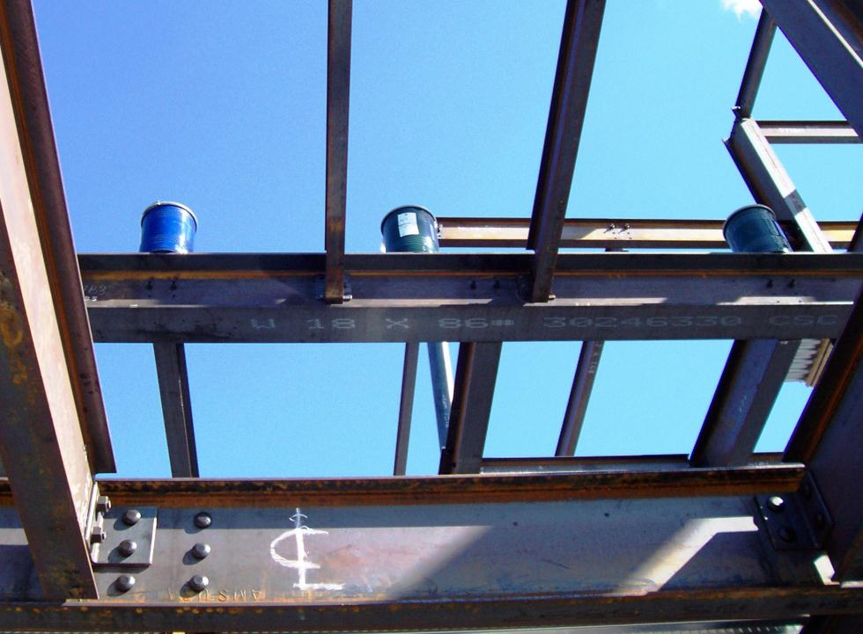

Slide 15
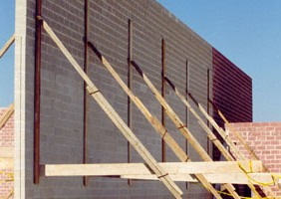
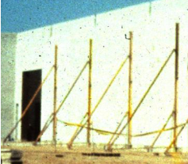
Struck-by Falling Objects
Limited Access Zone
Shall be established whenever a masonry wall is being constructed
Prior to start of construction
Equal to height of wall plus four feet for the entire length of wall
Opposite scaffold side
Only masons allowed
L.A.Z. shall remain in place until wall is supported
If wall is over eight feet tall it must be braced unless adequately supported
Bracing must remain until permanent
support structures are in place
Limited Access Zone: Administrative Controls

Slide 16
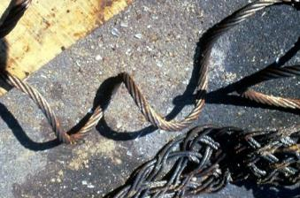
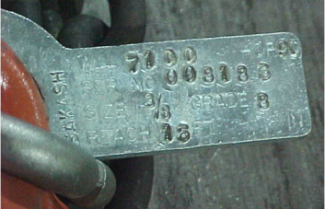
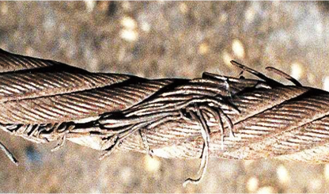
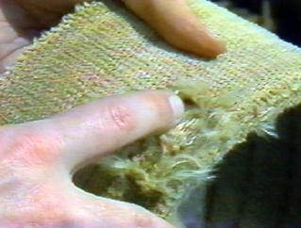
Struck-by Rigging Failure
Control Rigging inspected prior to shift(s)
Inspections: Administrative Controls
Notes:
Rigging equipment should be inspected before use and the competent and qualified person should assure that ratings of equipment are adequate for loads. Competent and qualified person can read rating capacities affixed to various equipment (upper right corner of adjoining slide)

Slide 17
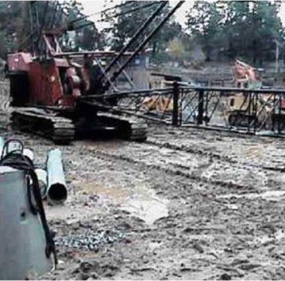
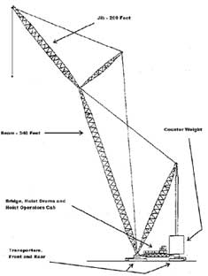
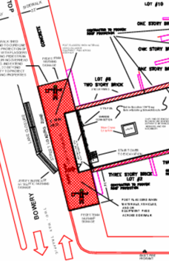
Struck-by Rigging Failure
Controlling Entity provides a clear, firm, drained and graded area and maintains a controlled access into various fall and swing zones. The Controlling Entity provides coordination and pre-pick planning.
Site Conditions and Coordination: Administrative Controls
Notes:
These photographs are merely illustrative depicting a crane accident and two examples of parts of plans.

Slide 18
Struck-by Rigging Failure
Operator Qualifications
Testing Criteria
OPTION 1:
Accredited testing organization
OPTION 2:
Audited employer program
OPTION 3:
U.S. military
OPTION 4:
State/local license
Knowledge (written test):
  Controls/performance characteristics
  Calculate capacity
  Preventing power line contact
  Ground conditions & equipment support
  Use and locate info in operating manual
  Appendix C to Subpart CC subjects
Practical test
Notes:
Appendix C to Subpart CC of Part
1926—Operator Certification: Written
Examination: Technical Knowledge
Criteria
This appendix contains information for
employers, accredited testing organizations,
auditors and government entities developing
criteria for a written examination to test an
individual’s technical knowledge relating to
the operation of cranes.
(a) General technical information.
(1) The functions and limitations of the
crane and attachments.
(2) Wire rope:
(i) Background information necessary to
understand the inspection and removal from
service criteria in § 1926.1413 and
§ 1926.1414.
(ii) Capacity and when multi-part rope is
needed.
(iii) Relationship between line pull and
safe working load.
(iv) How to determine the manufacturer’s
recommended rope for the crane.
(3) Rigging devices and their use, such as:
(i) Slings.
(ii) Spreaders.
(iii) Lifting beams.
(iv) Wire rope fittings, such as clips,
shackles and wedge sockets.
(v) Saddles (softeners).
(vi) Clamps (beams).
(4) The technical limitations of protective
measures against electrical hazards:
(i) Grounding.
(ii) Proximity warning devices.
(iii) Insulated links.
(iv) Boom cages.
(v) Proximity to electric power lines, radii,
and microwave structures.
(5) The effects of load share and load
transfer in multi-crane lifts.
(6) Basic crane terms.
(7) The basics of machine power flow
systems.
(i) Mechanical.
(ii) Electrical.
(iii) Pneumatic.
(iv) Hydraulic.
(v) Combination.
(8) The significance of the instruments and
gauge readings.
(9) The effects of thermal expansion and
contraction in hydraulic cylinders.
(10) Background information necessary to
understand the requirements of pre-operation
and inspection.
(11) How to use the safety devices and
operational aids required under § 1926.1415
and § 1926.1416.
(12) The difference between duty-cycle and
lifting operations.
(13) How to calculate net capacity for every
possible configuration of the equipment
using the manufacturer’s load chart.
(14) How to use manufacturer-approved
attachments and their effect on the
equipment.
(15) How to obtain dimensions, weight,
and center of gravity of the load.
(16) The effects of dynamic loading from:
(i) Wind.
(ii) Stopping and starting.
(iii) Impact loading.
(iv) Moving with the load.
(17) The effect of side loading.
(18) The principles of backward stability.
(b) Site information.
(1) How to identify the suitability of the
supporting ground/surface to support the
expected loads of the operation. Elements
include:
(i) Weaknesses below the surface (such as
voids, tanks, loose fill).
(ii) Weaknesses on the surface (such as
retaining walls, slopes, excavations,
depressions).
(2) Proper use of mats, blocking/cribbing,
outriggers, stabilizers, or crawlers.
(3) Identification of site hazards such as
power lines, piping, and traffic.
(4) How to review operation plans with
supervisors and other workers (such as the
signal person), including how to determine
working height, boom length, load radius,
and travel clearance.
(5) How to determine if there is adequate
room for extension of crawlers or outriggers/
stabilizers and counterweights.
(c) Operations.
(1) How to pick, carry, swing and place the
load smoothly and safely on rubber tires and
on outriggers/stabilizers or crawlers (where
applicable).
(2) How to communicate at the site with
supervisors, the crew and the signal person.
(3) Proper procedures and methods of
reeving wire ropes and methods of reeving
multiple-part lines and selecting the proper
load block and/or ball.
(4) How to react to changes in conditions
that affect the safe operation of the
equipment.
(5) How to shut down and secure the
equipment properly when leaving it
unattended.
(6) Know how to apply the manufacturer’s
specifications for operating in various
weather conditions, and understand how
environmental conditions affect the safe
operation of the equipment.
(7) How to properly level the equipment.
(8) How to verify the weight of the load
and rigging prior to initiating the lift.
(9) How to determine where the load is to
be picked up and placed and how to verify
the radii.
(10) Know basic rigging procedures.
(11) How to carry out the shift inspection
required in this subpart.
(12) Know that the following operations
require specific procedures and skill levels:
(i) Multi-crane lifts.
(ii) Hoisting personnel.
(iii) Clamshell/dragline operations.
(iv) Pile driving and extracting.
(v) Concrete operations, including poured in-
place and tilt-up.
(vi) Demolition operations.
(vii) Operations on water.
(viii) Magnet operations.
(ix) Multi-drum operations.
(13) Know the proper procedures for
operating safely under the following
conditions:
(i) Traveling with suspended loads.
(ii) Approaching a two-block condition.
(iii) Operating near power lines.
(iv) Hoisting personnel.
(v) Using other than full outrigger/crawler
or stabilizer extensions.
(vi) Lifting loads from beneath the surface
of the water.
(vii) Using various approved counterweight
configurations.
(viii) Handling loads out of the operator’s
vision (‘‘operating in the blind’’).
(ix) Using electronic communication
systems for signal communication.
(14) Know the proper procedures for load
control and the use of hand-held tag lines.
(15) Know the emergency response
procedure for:
(i) Fires.
(ii) Power line contact.
(iii) Loss of stability.
(iv) Control malfunction.
(v) Two-blocking.
(vi) Overload.
(vii) Carrier or travel malfunction.
(16) Know how to properly use outriggers
and stabilizers in accordance with
manufacturer specifications.
(d) Use of load charts.
(1) Know the terminology necessary to use
load charts.
(2) Know how to ensure that the load chart
is the appropriate chart for the equipment in
its particular configuration and application.
(3) Know how to use load charts. This
includes knowing:
(i) The operational limitations of load
charts and footnotes.
(ii) How to relate the chart to the
configuration of the crane, crawlers, or
outriggers/stabilizers extended or retracted,
jib erected or offset, and various
counterweight configurations.
(iii) The difference between structural
capacity and capacity limited by stability.
(iv) What is included in capacity ratings.
(v) The range diagram and its relationship
to the load chart.
(vi) The work area chart and its
relationship to the load chart.
(vii) Where to find and how to use the
‘‘parts-of-line’’ information.

Slide 19
Struck-by Rigging Failure
Rules of Rigging
1. Know the weight of the load
2. Know the center of gravity of the load.
3. Make load attachment above the center of gravity of the load.
4. Select hitch that will hold and control.
5. Know the rated capacity of slings and hardware.
6. Select sling best suited for load.
7. Inspect all rigging before the lift.
8. Protect sling from sharp surfaces.
9. Proper calculation of increased tension caused by sling angles (on all rigging components!).
10. Allow for proper D/d ratio (the D/d Ratio is the ratio of the diameter around which the sling is bent divided by the body diameter of the sling.)
11. Calculate reductions when using choker hitch.

Slide 20
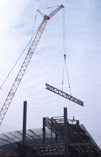
Struck-by Rigging Failure
Employers must use qualified riggers during assembly and disassembly and whenever workers are within the fall zone and hooking, unhooking, or guiding a load, or doing the initial connection of a load to a component or structure The qualified rigger must have ability to properly rig the load for a particular job.
Notes:
Reference (1926.1425(c)).

Slide 21
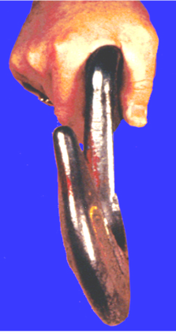
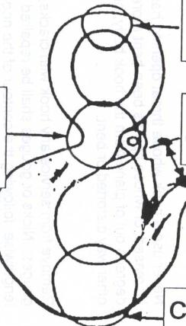
Struck-by Rigging Failure
Hook/Load Angles
A. Balanced 100%
B. 1/4 off center 86%
C. 1/2 off center 80%
D. 3/4 off center 70%
E. Point loading 40%
E
D
C
Avoid:
Side load
Back load
Tip load
Max Twist 10%
A
B
Only foundry hooks are designed for tip loading

Slide 22
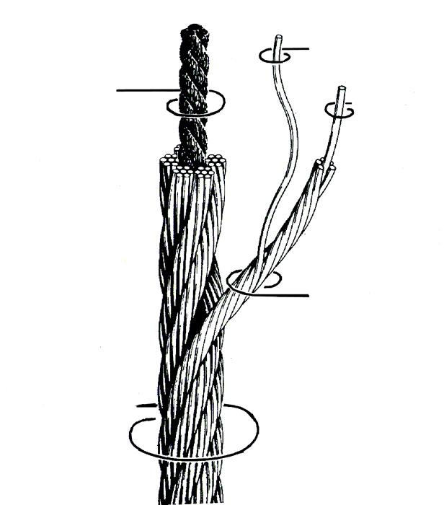
A wire rope is a Machine
with many moving parts
Wire
Core
Center
Wire rope wear is based on:
1. Loading
2. Bending
3.Frequencey of use cycles
4. Maintenance
Strand
Wire rope

Slide 23

Calculating the load on sling legs
L
H
LOAD
(Load ÷ Number of legs) X (L ÷ H) = Load each sling leg

Slide 24

Calculating the Correct Sling Angle
The longer set of sling legs (B) will improve load stability
LOAD

Slide 25
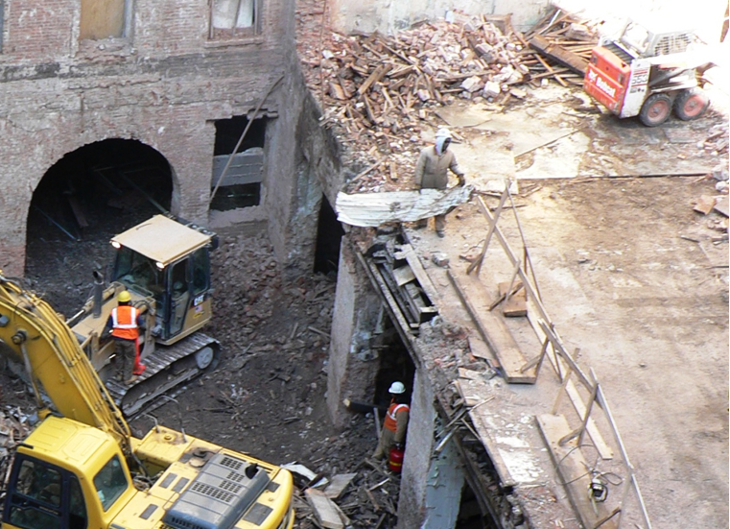
Struck-by Vehicle and Equipment
Notes:
Beside struck-by hazards (depicted by arrows) there are other hazards depicted in this photograph including missing and inadequate fall protection guardrails. Struck by: worker is standing in an unguarded area under another worker (who has no fall protection) who is dropping debris. Worker at top platform is now wearing a vest or garment that an equipment operator can see him. Also note that the small front end loader has no positive means of curbing of stops that would prevent the equipment from falling over side of floor.

Slide 26
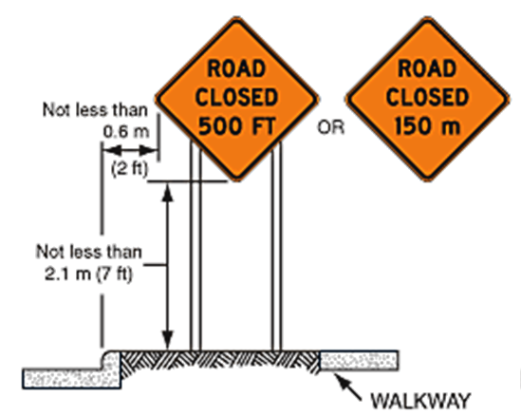
Struck-by Vehicle and Equipment
Closing a road to vehicular traffic is an example of an Elimination Control because it removes the chances of vehicular struck-by accidents by removing the hazards (vehicles)
Street Closure or Controlled Entry of Equipment
Elimination Controls
Notes:
Closing a roadway to vehicle traffic is an example of and elimination control or struck-by vehicles.

Slide 27
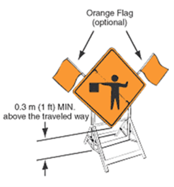
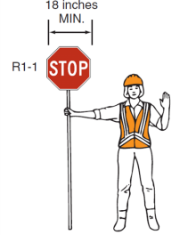
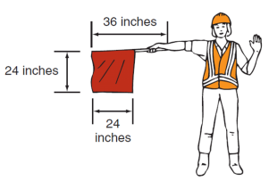
Struck-by Vehicle and Equipment
Accident prevention signs and tags
Traffic Signs.
(1) Construction areas shall be posted with legible traffic signs at points of hazard.
(2) All traffic control signs or devices used for protection of construction workers shall conform to Part VI of the Manual of Uniform Traffic Control
Signs and Flaggers: Administrative Controls
Notes:
These are examples of administrative controls that help prevent employee exposure to hazards (they are not intended here for knowledge transfer). The Manual on Uniform Traffic Control Devices, or MUTCD defines the standards used by road managers nationwide to install and maintain traffic control devices on all public streets, highways, bikeways, and private roads open to public traffic. The MUTCD is published by the Federal Highway Administration (FHWA) under 23 Code of Federal Regulations (CFR), Part 655, Subpart F. Competent persons, manager and flag persons must know and understand the proper controls applicable to their respective sites.

Slide 28
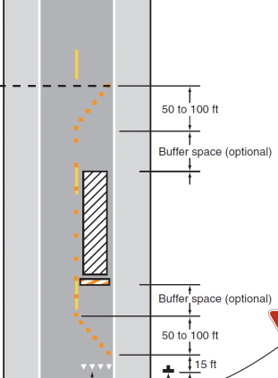
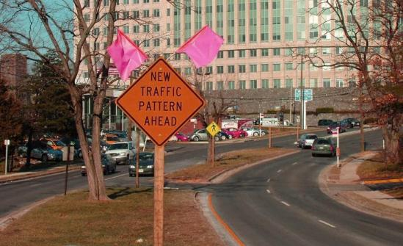
Struck-by Vehicle and Equipment
Example of (control) signage warning vehicles of approaching Work Zone around bend.
Example of Work Zone
Establish Safety Work Zones
Administrative Controls
Notes:
Another example: These are examples of administrative controls that help prevent employee exposure to hazards (they are not intended here for knowledge transfer).

Slide 29
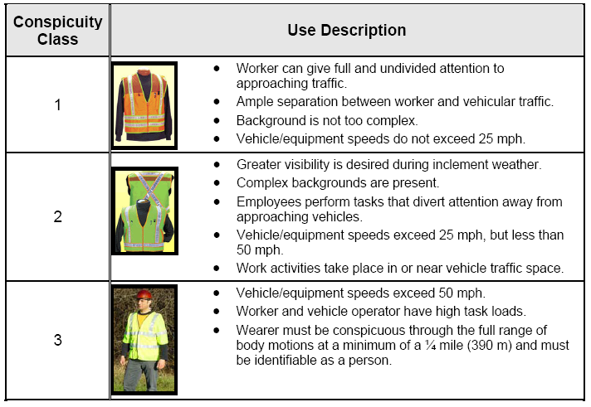
Struck-by Vehicle and Equipment
Notes:
- New provisions are incorporated into the MUTCD that require the use of high-visibility safety apparel by all workers (including flaggers) within the public right-of-ways of all federal-aid and non-federal-aid streets and highways. This is an expansion of the 23 CFR revisions adopted in 2006, to extend the applicability from just federal-aid highways to all roads open to public travel.
- A new option is added that allows first responders and law enforcement personnel to use safety apparel meeting a newly-developed ANSI standard for “public safety vests” because this type of vest will better meet the special needs of these personnel.
- Firefighters or other emergency responders engaged in emergency operations that directly expose them to flame, fire, heat, and/or hazardous materials may wear retroreflective turn-out gear that is specified and regulated by other organizations.
Also, a recommendation is added that all on-scene responders and news media personnel in traffic incident areas should wear high-visibility apparel.
The FHWA establishes a target compliance date of December 31, 2011 (approximately two years from the effective date of this final rule) for flagger apparel on non-Federal-aid highways. Required compliance of apparel for workers, including law enforcement officers, on Federal-aid highways has been in effect since November 24, 2008, pursuant to title 23 CFR Part 634.
Required for ALL workers within the public right of way
12/31/11 compliance date

Slide 30
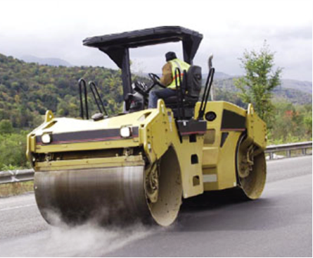
Struck-by Backing Incidents
Motor vehicles and Earthmoving equipment
All vehicles equipped with adequate audible warning device.
Motor vehicle equipment having an obstructed Reverse signal alarm audible above the surrounding noise level or:
Backed up only when an observer signals that it is safe to do so
Warning Audible, Flaggers, Spotters
Mitigation Controls
Notes:
Photograph is illustrative no comment.

Slide 31
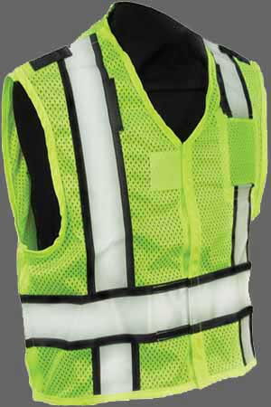
Properly Using a Spotter
Must wear highly visible safety vest.
Be out of vehicle traffic lanes and direct path of the moving/backing construction vehicle's movement.
Walk along the side of the backing vehicle and should not walk backwards while directing the vehicle.
Must always be visual to driver..
Establish traffic patterns , lanes and designated paths
Notes:
ANSI: (ANSI Class 2 minimum) The American National Standards Institute (ANSI) serves in the capacity of administrator and coordinator of the United States private sector voluntary standardization system. The Institute is a private, nonprofit membership organization supported by a diverse constituency of private and public sector organizations. Among other OSHA references to ANSI is the use of high-visablity personal protective equipment.
Subpart G by reference brings parts of Manual of Uniform Traffic Control Devices (MUTCD) and ANSI:
“All traffic control signs or devices used for the protection of workers must conform with Manual on Uniform Traffic Control Devices (MUTCD) for Streets and Highways (ANSI D6.1-1971).” The MUTCD is published by the Federal Highway Administration (FHWA) under 23 Code of Federal Regulations (CFR), Part 655, Subpart F. On December 16, 2009 a final rule adopting the 2009 Edition of the MUTCD was published in the Federal Register. States must comply with this rule within two years. The Federal Register notice, which provides detailed discussion of the FHWA's decisions on major changes from the 2003 edition, can be viewed at http://edocket.access.gpo.gov/2009/pdf/E9-28322.pdf (PDF, 716KB).

Slide 32
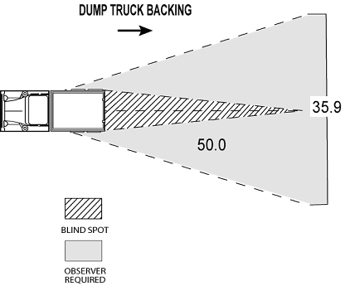
Struck-by Backing Incidents
Blind Spots
If the Driver doesn’t See the Spotter, the driver should stop the vehicle or equipment.

Slide 33
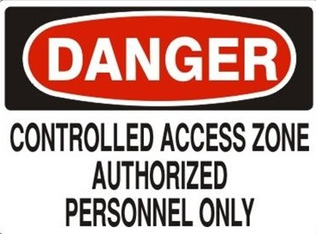
Struck-by Flying Objects
Controlled Access Zones (no worker exposure)
Elimination Controls

Slide 34
6 Steps to Lock-out Tag-out
1. Notify
employees
2. Shutdown
Equipment
3. Isolate
Energy
6. Verify Lockout
5. Release
Stored Energy
4. Attach Lockout
Device
Service &
Maintenance
Lock-out Tag-out Equipment Program
Engineering Controls

Slide 35
Typical Lock-Out Tag-Out
Start-up Procedures
Only authorized employee can do startup
All warned to stay clear
Remove all tools, locks and tags
Remove, reverse, open or reactivate isolating devices
Visual check that all is clear
Start up machine, process or line flow
Lock-out Tag-out Equipment Program
Engineering Controls

Slide 36
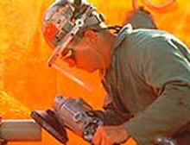
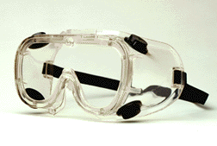

Struck-by Flying Objects
Personal Protection Equipment : Face Shield, Goggles, Safety Glasses
Mitigation Controls
Notes:
Photographs are illustrative

Slide 37
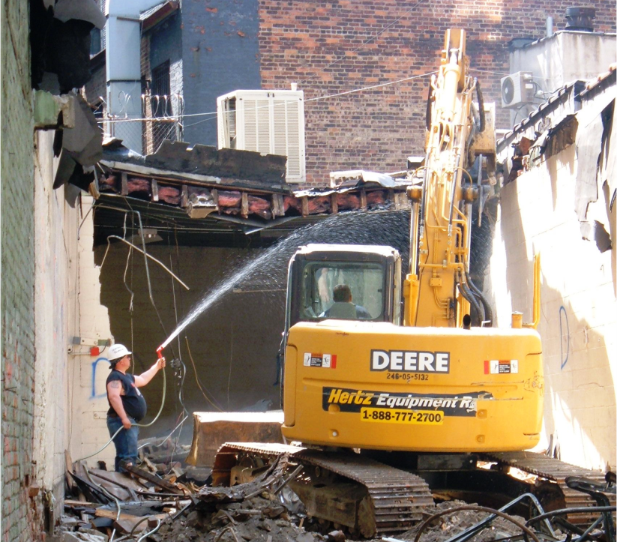
Notes:
There are many hazardous situations depicted in this photograph: Struck-by hazards include the machinery being operated with worker alongside, overhead hanging debris and structural components and equipment (air-condition compressor) and electrical hazards. Housekeeping debris.

Slide 38
Struck-by System Summary
You should know how a struck-by program works inside a system of safety.
You should know what OSHA, ANSI, MUTC requires in a struck by protection program
When working on any construction jobsite be aware of your surroundings..
Watch out for moving equipment.
Precautions must be taken to prevent being struck by falling objects by the employer and the controlling entity.
Notes:
Or instructor, if the instructor wants to be contacted.

Slide 39
The End
&
The
Beginning

