Slide 1
Hazards of Extreme Temperatures
Handling Heat & Cold
This material was produced under grant SH-120867-SHO from the Occupational Safety and Health Administration, U.S. Department of Labor. It does not necessarily reflect the views or policies of the U.S. Department of Labor, nor does mention of trade names, commercial products, or organizations imply endorsement by the U.S. Government.

Slide 2
Why do we care about heat or cold?
Suck it up. That’s just part of the job.
I think there’s more to it than that…
Notes:
Are extreme temperatures a comfort issue or a safety issue?

Slide 3
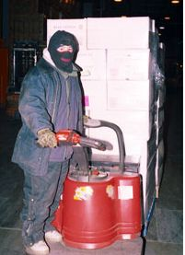
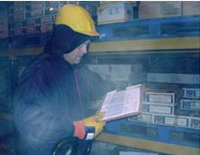
Notes:
Extreme cold is as dangerous as unguarded machinery or other serious safety hazards.
Here is just one example of an amputation due to extreme cold from OSHA’s files. We’ll discuss some aspects of this case later in the training.

Slide 4
On August 11, 2006, Employee #1 was working his first day on the job. At approximately 8:45 p.m., Employee #1 began shaking and showing signs of a seizure.
The Supervisor summoned emergency responders, who transported him to St. Francis Hospital.
Employee #1 remained in the hospital until he suffered multi-organ failure and died.
The temperature observed in the furnace area during OSHA's investigation reached 119 degrees Fahrenheit.
Notes:
http://www.osha.gov/pls/imis/establishment.inspection_detail?id=307169482
Here is an example of how extreme heat is also a serious and potentially deadly safety hazard.

Slide 5
Very hot and very cold environments can be dangerous to your health
Heat
Acute
Possible link to kidney, liver, heart , digestive system, central nervous system & skin problems
Cold
Acute
Chronic
Heat Stroke, Heat Syncope, Other heat illness
Chronic
Hypothermia, frostbite, trench foot
Respiratory and cardiovascular effects
Notes:
It’s clear that there are real hazards associated with working in extreme temperatures. These hazards are not just acute hazards – bad things that can happen immediately, but there are also long term health effects.
We are going to evaluate heat and cold by looking at the potential hazards – who can be affected and how. We will then look at how we evaluate the exposure – How do we measure exposure? How much is too much? What factors are important to consider?
Then we’ll look at controls – can we eliminate or reduce the hazard? What responsibilities do employers have? What can workers do on their own?
Finally, we’ll look at enforcement – What are the laws, and how are they enforced? What role can the union play?

Slide 6
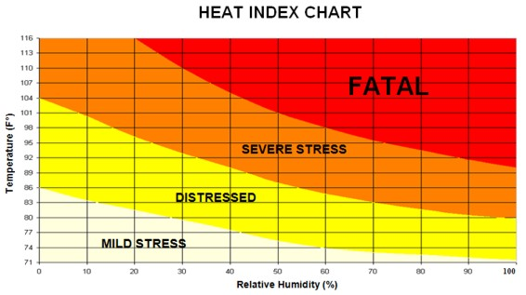
It’s not the heat, it’s the …
Notes:
Most people are familiar with the fact that the effect of heat on our bodies is not just the air temperature. We know humidity is also important

Slide 7
It’s not the air temperature, it’s the…
Humidity
Air movement
Radiant heat sources
Level of clothing & protective equipment
Physical exertion
Personal factors
  Age, heath, medications, etc.
Notes:
In fact, there are a number of factors that combine to influence how our bodies are affected by heat. This has to do with the way we handle heat – we get rid of heat by sending blood to the surface of our bodies, and we speed up the heat loss by sweating. We facilitate the loss of heat to the environment by the evaporation of our sweat. Sweating only cools us off if the sweat can evaporate – so air movement is helpful, low humidity is helpful, more exposed skin is helpful – unless there is a radiant heat source (such as the sun or a hot object that is glowing). Our ability to handle heat is also affected by a number of personal factors such as age, the health of our circulatory system, the medications we take, being pregnant, etc.
We also create heat in our bodies by working and moving.
This is information we all know intuitively – but it’s important to recognize that the air temperature alone is not always enough information to evaluate the heat hazard to an individual or a group of workers.

Slide 8
How can we evaluate hot conditions?
WGBT - $1500
Personal or Location Temp & Humidity Data Loggers - $170
Ingestible Core Body Temp Monitoring System - $2500
Notes:
Evaluating working conditions is tricky. We have to find a way to take in enough information to make a sound judgment, without over complicating it, or making it impossibly expensive.
Here are three examples of instrumentation designed to evaluate heat stress.
The first one was developed by the military – and it gives the wet globe bulb temperature, which is different from the air temperature (which is also sometimes called the dry bulb temperature).
The WGBT combines air temperature, air movement, humidity and the effect of radiant heat. This is a useful number because there are actual work/rest cycles that have been developed based on these numbers. (go to WGBT table).
It’s important for you to know about the WBGT in case you represent a workplace that uses this type of measurement. Also – some OSHA offices might use the WGBT.
If radiant heat is not a factor – in other words if the work is done indoors and there are no glowing furnaces or molten metals or molten glass, then the heat index is often used. The Heat Index is not the same as the WBGT because it does not include radiant heat or the effect of air movement – it is just a combination of the air temperature and the humidity. The middle instrument measures temperature and humidity. It is designed to be worn by an individual, and it records conditions throughout the work shift. The information can then be downloaded onto a computer and the temperature and humidity numbers can be combined to give the heat index. (go to heat index table).
The first two instruments are indirect monitors. They measure conditions so that we can make decisions about the effect of those conditions on workers. The third instrument directly measures what we want to know – the effect of the conditions on workers. It is used for firefighters to try to prevent the extremely high rate of fatalities firefighters suffer from heart attacks. The monitor is contained in a capsule that the firefighter swallows. It transmits information about the firefighter’s core temperature so that he or she can be relieved before suffering too much heat stress.
Obviously the workers and industries we represent will not be using this type of technology – but I’m including it because the concept is so important. When we measure conditions like temperature, humidity, etc. – we are only guessing about how that affects workers, and of course the effect will be different for each individual. The real information we want is what is going on inside each workers’ body. Always remember that individual differences are real and must be accounted for.

Slide 9
Heat & Humidity = Heat Index
Notes:
It’s not unusual for workplace temperatures to reach the 90’s, but you can see from this chart that can be a serious or even life-threatening condition if the humidity is high.

Slide 10
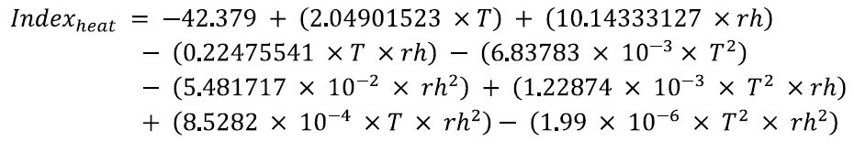
Heat Index
Not just heat + humidity
Easy to measure, but there are no recognized work / rest guidelines based on the Heat Index.
Notes:
The Heat Index is useful – but be sure to use a chart or Heat Index calculator to figure it out. It’s not a simple equation like Heat + Humidity.
A simplified version of the heat index equation is given in this slide. If you decide to use a monitor that measures heat and humidity then you can program the equation into a spreadsheet to get the heat index.

Slide 11
What can we do about hot conditions?
Eliminate Heat Sources
Engineering Controls
Isolate heat sources
Cool air
Targeted air showers
Misters?
Administrative Controls
Training
PPE
Water & Bathroom breaks
Reduce weight of PPE
Appropriate materials
Fix steam leaks and other heat/humidity sources
Work / Rest Cycle
Ventilation with an adequate mix of outside air
Fans?
Insulate hot surfaces
PPE Design
Cooling vortex on respirators
Acclimatization
Notes:
You are all probably familiar with the way we look at controlling hazards. We always start at the top of the pyramid by asking – Can we get rid of the hazard?
We move next to engineering controls, administrative controls, and then – if all else fails we look at personal protective equipment.
Let’s go through and look at each of these steps.

Slide 12
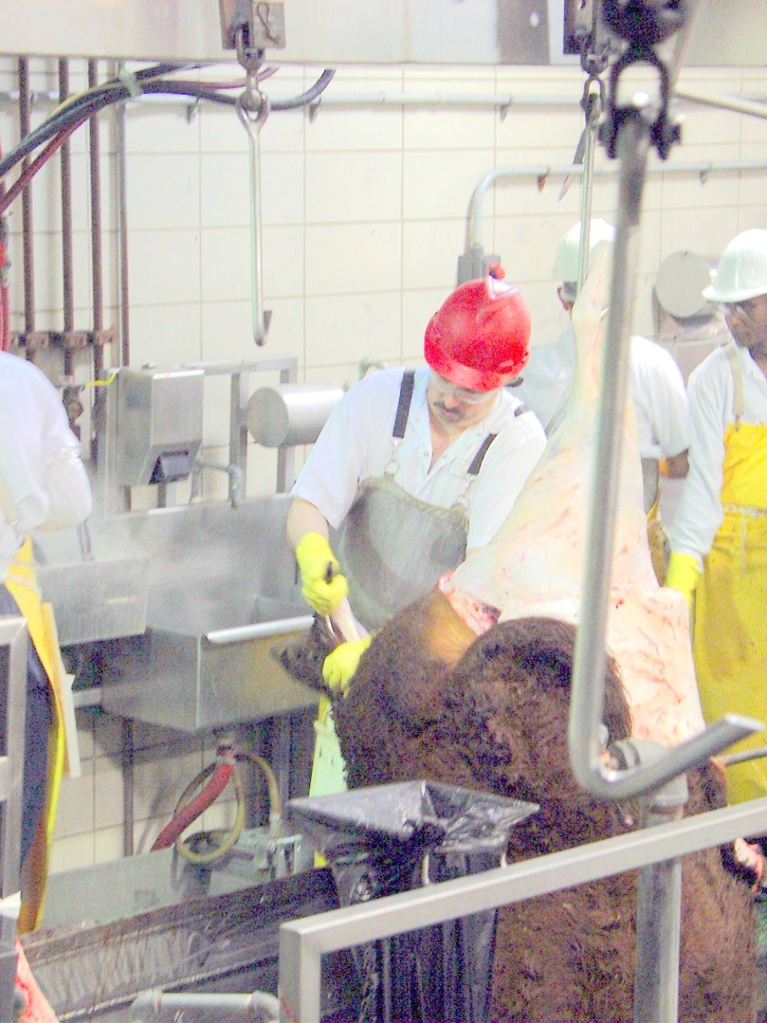
Eliminate or Reduce Heat / Humidity Sources
Steam Leaks
  Other heat sources?
Work/Rest Cycle
  Reduce internal heat production
Control Pace of Production
(Yes, I know – I must be dreaming…)
Notes:
With heat & humidity – there may be a few external sources we can control such as steam leaks or excessive pools of water.
One important source of heat is the heat we create by working. We all know that the harder we work, the more internal heat we generate. This is added to the heat burden of a hot environment. That can be controlled by implementing a work/rest cycle or by reducing the pace of production. I realize that’s not likely to happen – but it should be mentioned because it might be the most effective option.

Slide 13
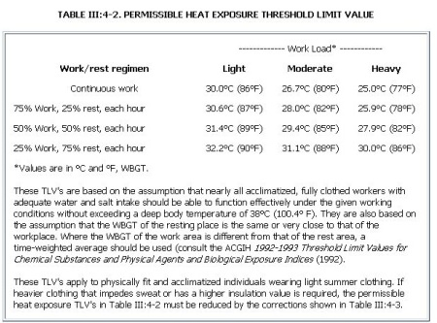
Work/Rest Cycle (WGBT only!)
Notes:
The WGBT table shows that if you are working hard – once the WGBT reaches 78 degrees, you should be resting for 15 minutes out of every hour. By the time the WGBT reaches 86 degrees, the recommendation is to rest for 45 minutes out of every hour.
This can be very confusing because the WGBT is not the same as the air temperature that you read from a regular thermometer. There is no simple conversion. You need a WGBT instrument to measure the temperature in this way.
Please be aware that the work/rest cycle is a guideline only. There is only one state that I know of that has put this guideline into their laws – that is Minnesota.
2. Here is the work/rest cycle we looked at before. Keep in mind the numbers are WGBT not regular thermometer readings.
As mentioned before, there are no work/rest guidelines based on the Heat Index.

Slide 14
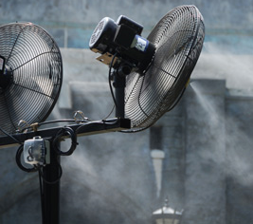
Engineering Controls
Condition air to be cool and dry
Ventilation with a good mix of outside air
Fans?
  Move hot air around
Misters
  Add humidity
Notes:
Once we’ve done what we can to try to eliminate the hazard, we look at engineering controls.
Conditioning the air to cool it and to reduce the humidity is the next best thing. Keep in mind – meat packing, poultry and food processing plants have the capability to make cold air. They just have to be convinced to put it where workers need it.
If they won’t cool the air, they can at least mix it with a good amount of dryer and possibly cooler air from the outside. You can ask your company what percentage of outside air is being mixed with inside air in their ventilation system. Find out where the outside air is being drawn in from. Usually it’s from the roof – but there have been cases where outside air was being drawn from the shipping or receiving docks. This can result in potential air contamination from exhaust fumes.
A lot of attention is given to fans. What is the problem with fans? They move hot air around. The air movement might help the sweat evaporate off your skin – but once the air temperature is above 99 degrees, fans will not cool you off.
Some plants have tried misters, like the one in the slide. They send out a fine water mist that gets blown around with the air. What do you think of that?
It’s really only appropriate for very dry climates or outdoor use.

Slide 15
Administrative Controls
Training
  Recognize signs of heat illness & how to respond
Acclimatization
Water & bathroom breaks
  Access means the employer must “… make toilet facilities available so that employees can use them when they need to do so.”
Notes:
After engineering controls we look at Administrative Controls – training, procedures, rules, signs, warnings, etc.

Slide 16
Administrative Controls
Training
  Danger Signs & how to respond
    Who can call 911?
  Drink lots of water
    2 gallons/day?
  Does training empower workers to slow down or take breaks?
Notes:
It’s important to train workers and managers about how to recognize a heat emergency and what actions to take. It is critically important to act quickly. I’ve seen many tragic examples of heat–related fatalities that could have been prevented by faster, more decisive action. Workers must know the warning signs and must feel empowered to act on them. It’s a good idea to find out if plant phones can get an outside line to make emergency calls, and to know the protocol for doing so.
It is important to point out that a good emergency response system is not evidence of a good heat program. In a good heat program no one will need emergency treatment.
Let’s look a little deeper into the issue of training.

Slide 17
On August 11, 2006, Employee #1, with General Carbon, was working his first day on the job and was being trained by a coworker on some of the duties of his position, which included a "pot change" task, which takes approximately 10 to 15 minutes to complete, where an employee would be exposed intermittently to the radiant heat of the furnace.
At approximately 8:45 p.m., Employee #1 began shaking and showing signs of a seizure. The Supervisor then summoned emergency responders, who stabilized Employee #1 and transported him to St. Francis Hospital.
Employee #1 remained in the hospital until he suffered multi-organ failure and died .
Notes:
Here is an example of a heat fatality. It might be hard for you to read

Slide 18
What do you think of OSHA’s conclusion?
The causal factor leading to the accident was failure to train on the importance of acclimatization and the necessity of water consumption, when working in a high temperature work area.
http://www.osha.gov/pls/imis/establishment.inspection_detail?id=307169482
Notes:
Two characteristics of new employees are:
They often go through an intensive orientation that includes safety rules, work rules, benefit plans, payroll issues, etc.
They are often on a probationary period during which they have to prove their work ethic.
Could either of these factors influence the effectiveness of training for a new employee?
Are there other measures that could be put in place to reinforce training?

Slide 19
Administrative Controls
Water & Bathroom Breaks
  OSHA spells out the need for bathroom breaks clearly
  “Increased frequency of voiding may also be caused by various medications, by environmental factors such as cold, and by high fluid intake, which may be necessary for individuals working in a hot environment.”
http://www.osha.gov/pls/oshaweb/owadisp.show_document?p_table=INTERPRETATIONS&p_id=22932
Notes:
In order for workers to increase fluid intake enough to deal effectively with hot conditions, they have to have unrestricted access to bathroom breaks.

Slide 20
Administrative Controls
Acclimatization
  Requires at least 5 days – up to 14 days
  Increased sweating
  Earlier onset of sweating
  Increased plasma volume
  Lower heart rate
  Armstrong, L.E. (1998). Heat acclimatization. In: Encyclopedia of Sports Medicine and Science, T.D.Fahey (Editor). Internet Society for Sport Science: http://sportsci.org. 10 March 1998.
Notes:
When workers are allowed to get used to hot temperatures gradually, their bodies can adapt. This process requires at least 5 days.
Acclimatization is not a guarantee that a worker will be able to tolerate any level of heat. Heat illness continues to be a concern.

Slide 21
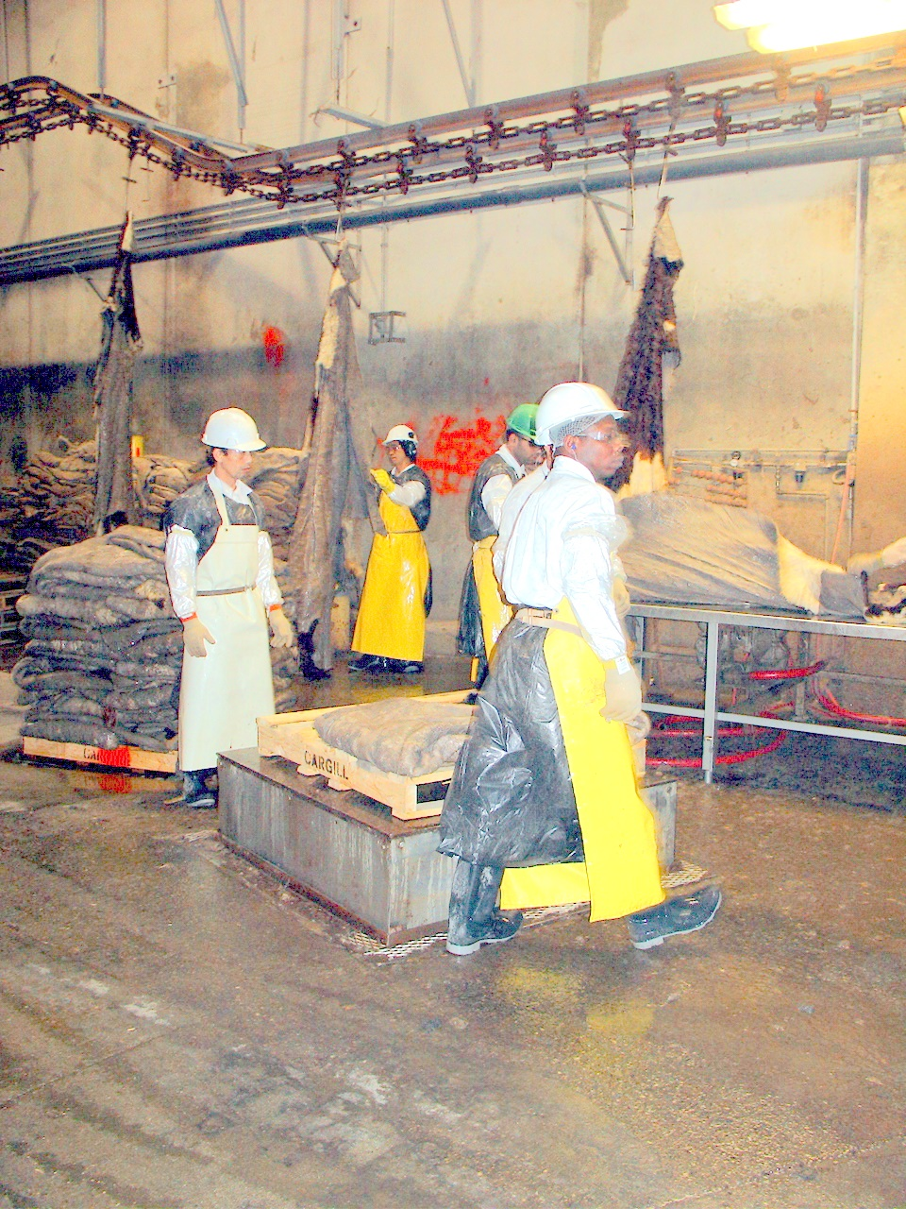
What is the effect of PPE on these workers?
Notes:
One reason why Personal Protective Equipment is a last resort for controlling hazards is that PPE can introduce new hazards. PPE can interfere with heat dissipation (how well we get rid of heat).

Slide 22
Enforcement
State Laws
OSHA
  General Duty Clause
  Ventilation requirements
Notes:
There are very few standards that deal specifically with heat in the workplace.

Slide 23
Pennsylvania
General Safety Law
Act No. 174
AN ACT
Section 3. Lighting, Heating, Ventilation, and Sanitary Facilities. --
All establishments shall be adequately lighted, heated, and ventilated.
Notes:
This slide should be address the state laws for the location where the training is presented.

Slide 24
General Duty Clause
The employer did not furnish each of his employees conditions of employment and a place of employment free from recognized hazards that were causing or likely to cause death or serious physical harm to employees in that employees were exposed to hazards associated with working in a hot environment: a)facility, wet kill - where the employer did not fully implement a heat stress related management program with employees working in the Gambrel Table, Shaving Stand, and De- Shackle areas that were exposed to a heat index of 121 degrees Fahrenheit.
http://www.osha.gov/pls/imis/establishment.violation_detail?id=313828857&citation_id=01001
Notes:
OSHA occasionally use the General Duty Clause to address the hazards of hot work places.

Slide 25
OSHA ventilation requirements
Blast cleaning enclosures
Grinding, polishing & buffing
Spray finishing
Open surface tanks (dipping & coating operations)
Notes:
OSHA’s specific ventilation standards do not apply to all industries. These requirements are intended to control chemical exposures rather than heat exposure.

Slide 26
What can we do?
Document conditions & symptoms
  Heat index?
  Data loggers?
  Surveys
Contract Language?
  Extra breaks
  Line speed reduction
  Increased crewing

Slide 27
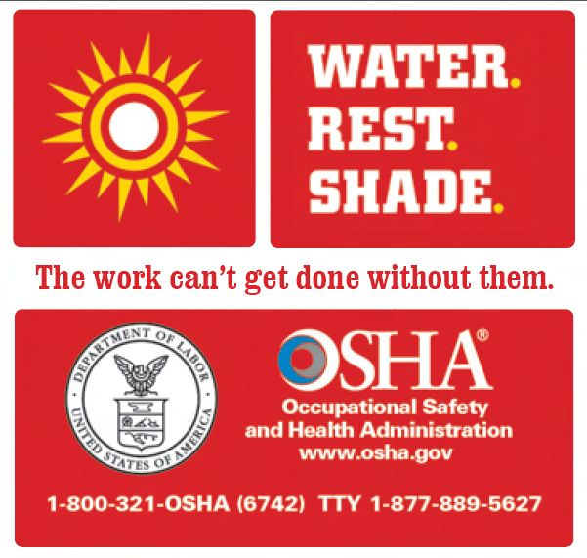
http://www.osha.gov/SLTC/heatillness/index.html

Slide 28
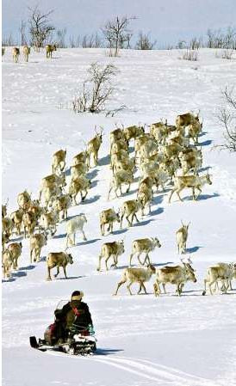
COLD
Notes:
Much of what we know about the effects of working in the cold come from studies done in Scandinavian countries – these studies include a lot of information about reindeer herders.

Slide 29
Working in the cold can have long-term (chronic) and short-term (acute) effects
Long term (chronic)
  Possible respiratory and cardiovascular changes
  Short term (acute)
    Frost bite
    Trench foot
    Musculoskeletal complaints
    Impaired abilities- increased accidents
Notes:
There is research that shows there can be long – term health effects from working in the cold

Slide 30
Chronic respiratory effects
Respiratory symptoms and pulmonary obstruction triggered by cold exposure may lead to a decrease in working capacity in the cold. Especially in subjects with an obstructive respiratory disease (asthma, COPD), symptoms are worsened in the cold and may lead to a decline in working capacity.
Health problems in Cold work. Makinen, T., Hassi, J. 2009

Slide 31
Working in the cold is strenuous for the heart
The cardiac load is higher in the cold due to cooling induced vasoconstriction, which increases the peripheral resistance and central blood volume
Cold exposure is strenuous for the heart and the increased workload may be further aggravated by exercise in the cold.
Work in the cold can be even more strenuous for patients suffering from a cardiovascular disease than for healthy persons
Heat and cold appear to have an acute effect on the incidence of cardiovascular diseases, but the possible chronic effect has seldom been investigated.

Slide 32
Effects on blood pressure
Repeated exposure to cold at work can increase the risk for hypertension (high blood pressure)

Slide 33
Some people are more susceptible to the effects of working in the cold
Diabetic patients report cardiac symptoms in the cold more frequently than non-diabetic persons.

Slide 34
…scientific evidence suggests there is an association between cold exposure and musculoskeletal complaints

Slide 35
Temperature extremes can result in impaired performance
A decrease of 1degree C in core temperature (subclinical hypothermia) may already markedly impair performance and could increase the risk of occupational injuries & accidents.

Slide 36
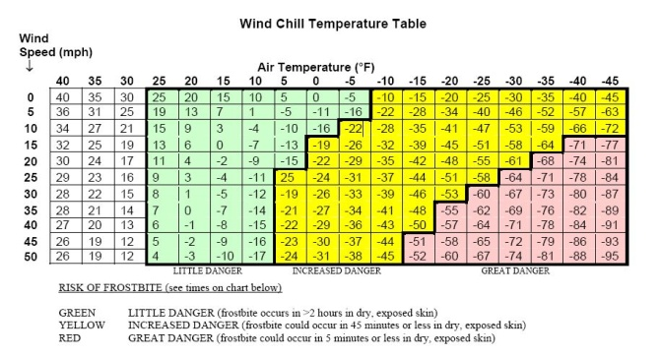
It’s not just the air temperature it’s the…
Notes:
Does anyone see a problem with using this chart for most indoor applications?

Slide 37
Wind chill calculations don’t help much for indoor conditions
0 mph – 4 mph is considered “calm” on wind chill carts
Equivalent to 0 – 352 feet per minute (fpm)
Indoor air is usually moving at less than 100 fpm
Conditions in blast freezers
  10 mph (1000 fpm)
  -20F to -40F
Notes:
Do wind chill calculations apply to blast freezer conditions?
Call

Slide 38
How can we evaluate cold conditions?
Handheld thermo- anemometer - $30
Personal or Location Temp & Humidity Data Loggers - $170
Thermo-anemometer data logger - $350
Notes:
Even though air movement inside the workplace usually does not reach speeds that can be used in wind chill calculations, air movement has an effect on worker comfort and safety.
Anemometers help identify patterns of air movement.
Temperature and humidity data loggers might be useful in workplaces where the cold is not the result of carefully regulated conditions. In workplaces where cold is a necessary condition of the process you can request those records from the company.
Humidity might not be a useful measure for evaluating cold conditions since the combined effect of humidity and cold temperatures on worker health is not clear.

Slide 39
What can we do about cold conditions?
Eliminate Cold
Engineering Controls
Minimize air velocity
Administrative Controls
Training
PPE
Adequate breaks
Not Applicable
PPE Design
Buddy System
Use wind deflectors and barriers
Insulate metal handles and bars
Functioning exit apparatus on inside doors

Slide 40
Engineering Controls
Cooling equipment and air distribution systems should minimize air velocity. Unit coolers should be placed as far away from workers as possible, and wind deflectors and barriers should be used to protect workers from wind-chill.

Slide 41
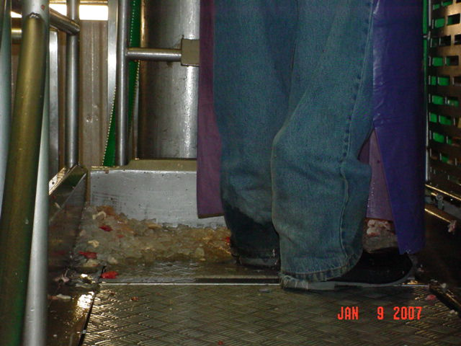
Notes:
Can you identify factors that could be controlled to reduce the effect of working in the cold on this worker?
Ice
Wet pant cuffs
Thin soles
Cold metal standing surface

Slide 42
On August 4, 2004, Employee #1, wearing a thermo-insulated jacket, overalls, and gloves began work in the freezer department of a supermarket chain warehouse. Employee #1's work consisted of selecting produce off warehouse shelves and delivering the product to the designated freezer truck. At the completion of the 8-hour work shift, Employee #1 went home and soon realized that he was in unbearable pain and that the toes on both his feet were black and blistering. Employee #1 immediately left his house and went to the hospital where his feet were treated for frost bite and he was hospitalized.
Notes:
Why didn’t this worker realize there was a problem sooner?

Slide 43
Administrative Controls - Training
Chemical frost bite
  Propane
  Ammonia
  Dry Ice (carbon dioxide)
Signs & Symptoms of cold stress
  Mental confusion
Notes:
In most cases, the victim is unaware of frostbite because the frozen tissues are numb.

Slide 44
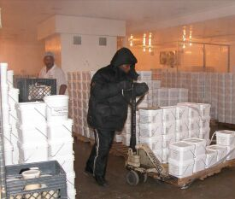
Administrative Controls – Buddy System/ Restricted Exposure Time
Notes:
Conditions in blast freezers can cause frostbite to exposed skin within 5 minutes.

Slide 45
PPE – How do we know if PPE is adequate?
Employee #1 was working in a -10 degrees F freezer. Although he was wearing gloves, they did not provide adequate protection for his hands. The employee was hospitalized for partial amputation of two fingers due to frostbite.
Notes:
Workers can request information about the amount of protection provided by PPE.

Slide 46

There is a standard for testing and rating cold-protective gloves
EN 511
Resistance to Convective cold
Resistance to Conductive cold
Permeability to water
1-4
1-4
0 or 1
Notes:
Convective cold is transferred through the air.
Conductive cold is from touching cold surfaces.

Slide 47
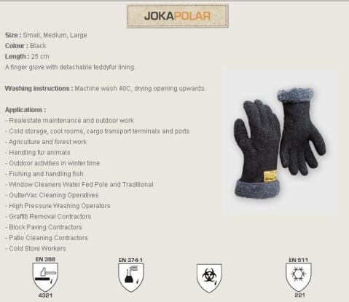
Notes:
Here is an example of EN 511-rated gloves.
This rating is NOT required in the US

Slide 48
Enforcement
OSHA General Duty Clause
  Appears to be used only in response to injury
No state regulation of workplace cold

Slide 49
What can we do?
Document conditions & symptoms
  Company records for Food Safety purposes
  Correlate with complaints / problems
Other?
Notes:
What are your experiences in your workplace?

Slide 50
Summary
Working in extreme temperatures can have immediate and long-term health effects
Humidity and air movement influence the effects of extreme temperatures
There are a number of tools available to help evaluate working conditions
Use the hierarchy of controls to find solutions to temperature-related work problems
What information was useful to you?

