Slide 1
your job doesn’t have to be a pain
AVOID INJURIES WITH ERGONOMICS
Safe and Secure
Safety Training Series

Slide 2
This material was produced under grant number
SH-20835-10-60-F-37 from the Occupational Safety and Health Administration, U.S. Department of Labor.
It does not necessarily reflect the views or policies
of the U.S. Department of Labor, nor does mention
of trade names, commercial products, or organizations
imply endorsement by the U.S. Government.
Telamon Corporation is an equal opportunity provider and employer. Auxiliary aids and services are available upon request to individuals with disabilities.

Slide 3
USING ERGONOMICS

Slide 4
Module Objectives
Participants will learn what ergonomics is and the influence it can have in the workplace. They will be able to recognize the factors involved as well as learn methods of prevention.

Slide 5
Using Ergonomics
What is Ergonomics?
Ergonomics is the study of how to bring the work to the worker, and not the other way around.
It’s about making the workplace a better fit the employee.

Slide 6
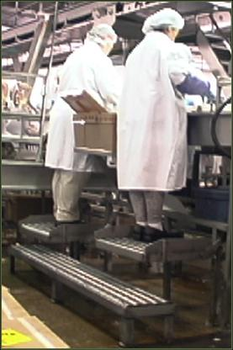
Ergonomics
It involves the design of tools, equipment, workstations and job tasks.
It is an effective way to reduce the number and severity of workplace injuries.

Slide 7

The Impact
          According to recent reports, almost 70% of OSHA inspections result in a citation.
This can cost a facility $7,000 for a serious violation. If the violation is “willful” or “repeated”, multiply that number by 10.
It’s doesn’t come off the tree, it comes out of your pocket.

Slide 8
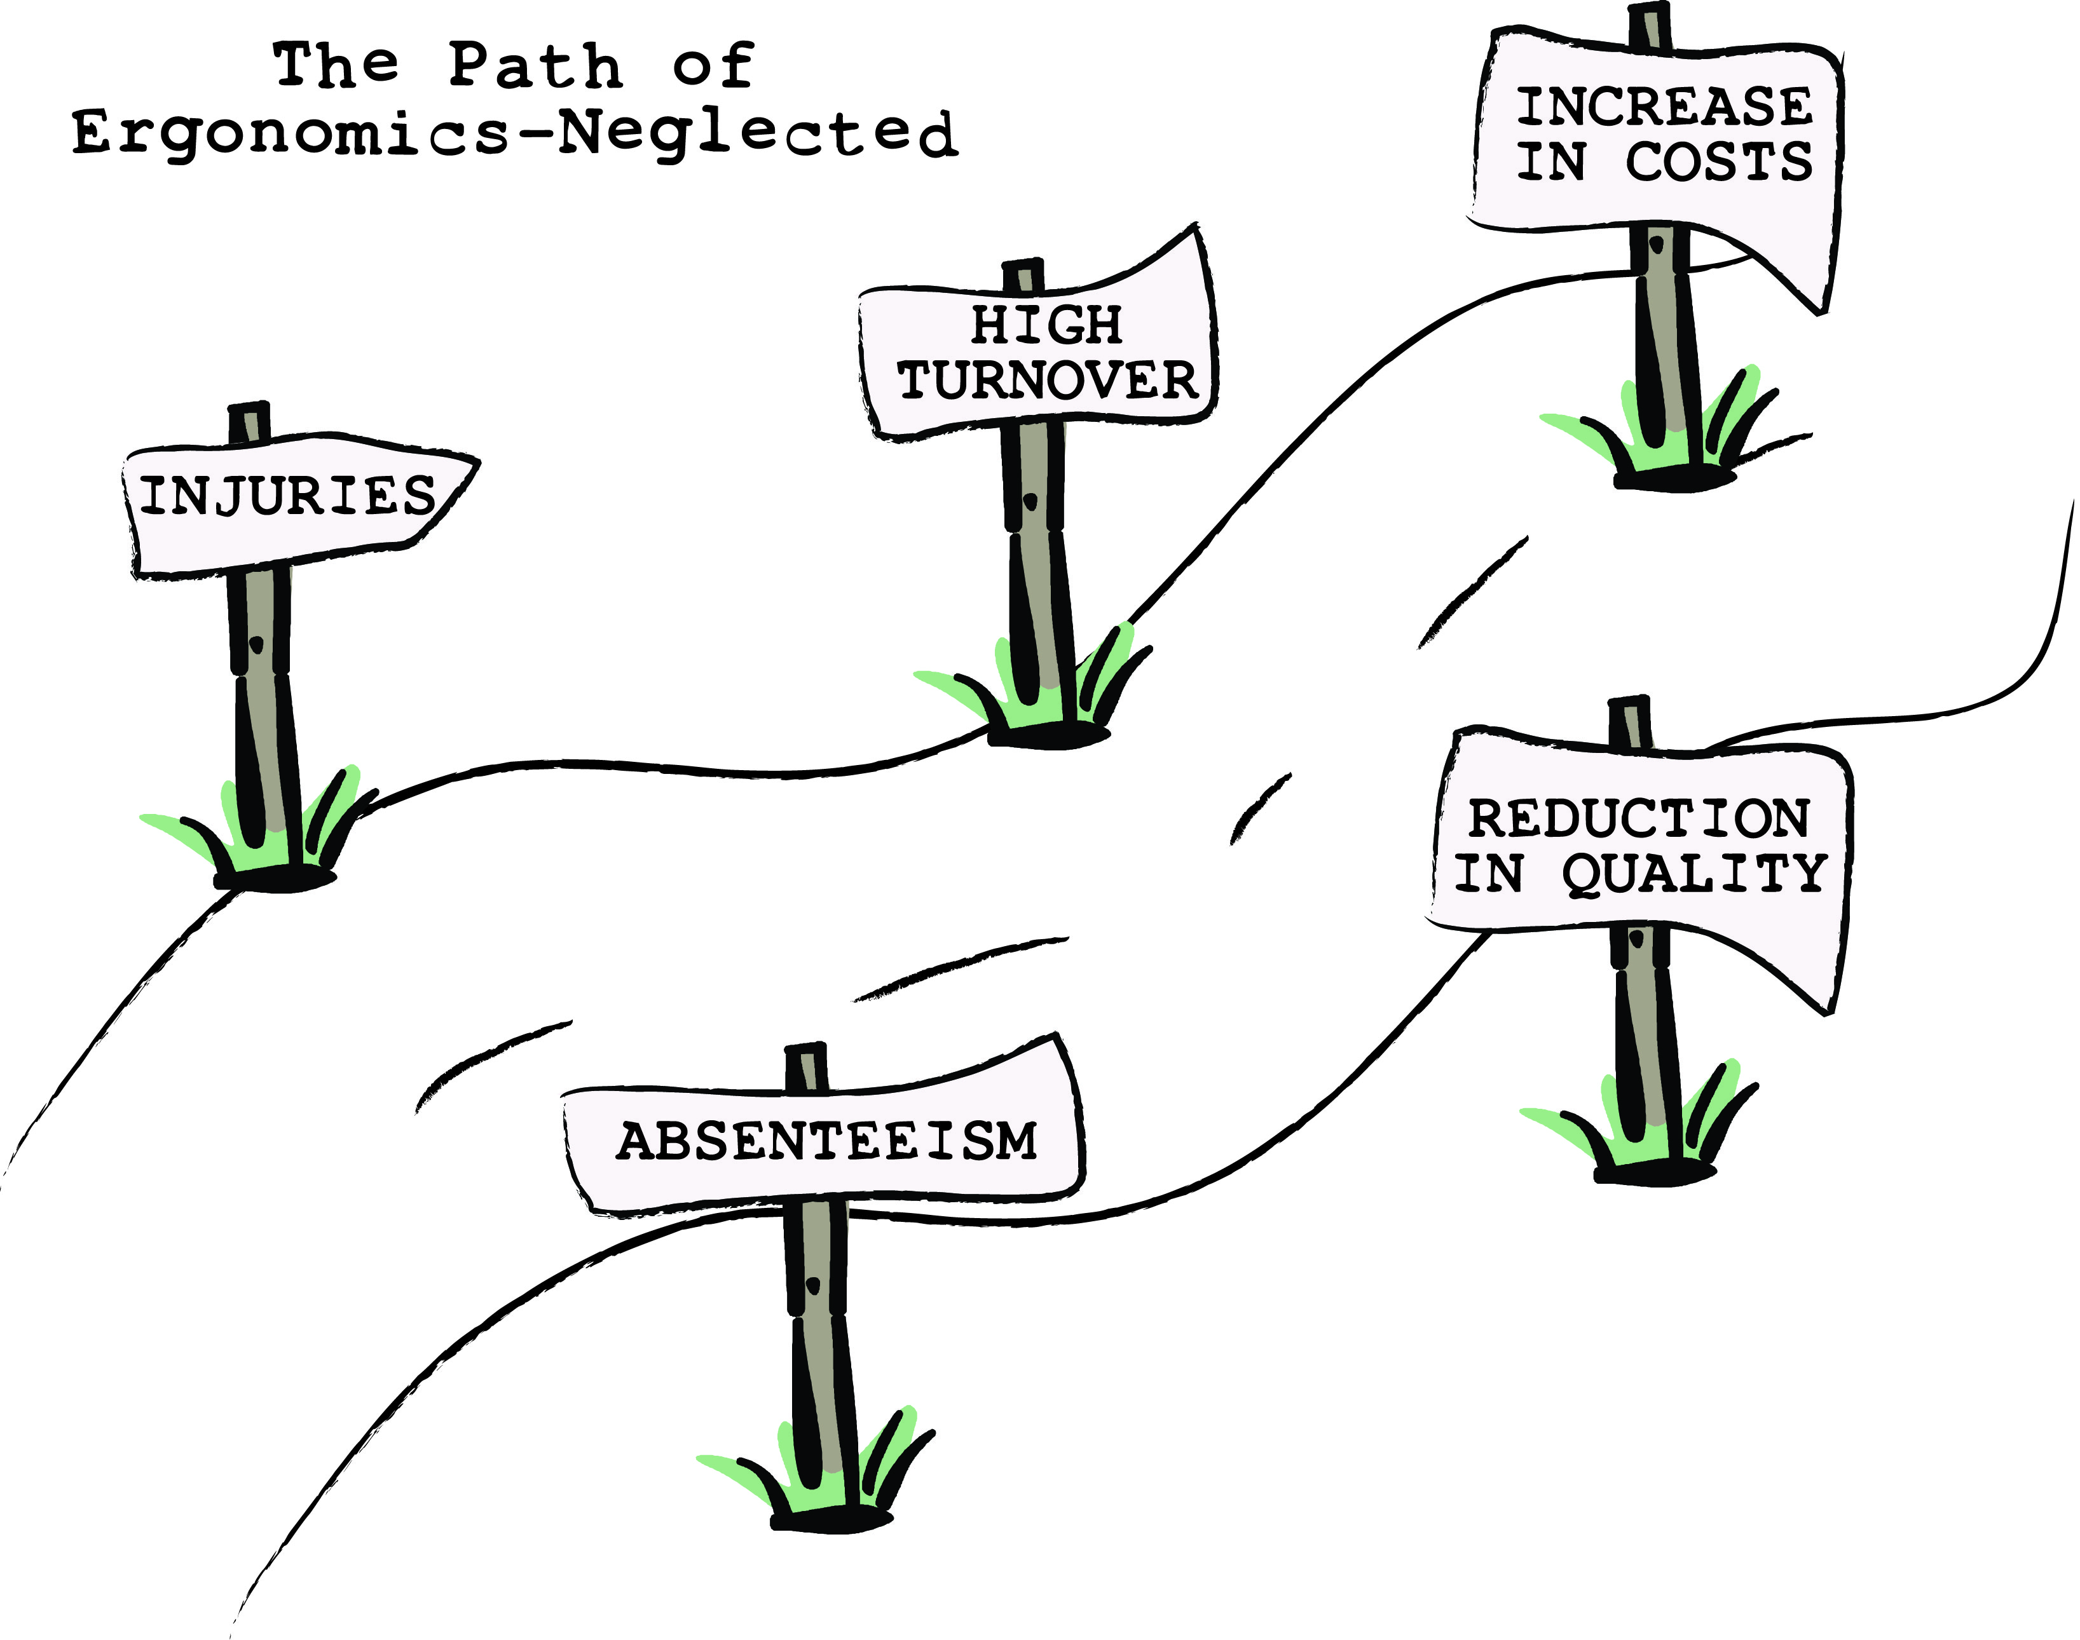

Slide 9
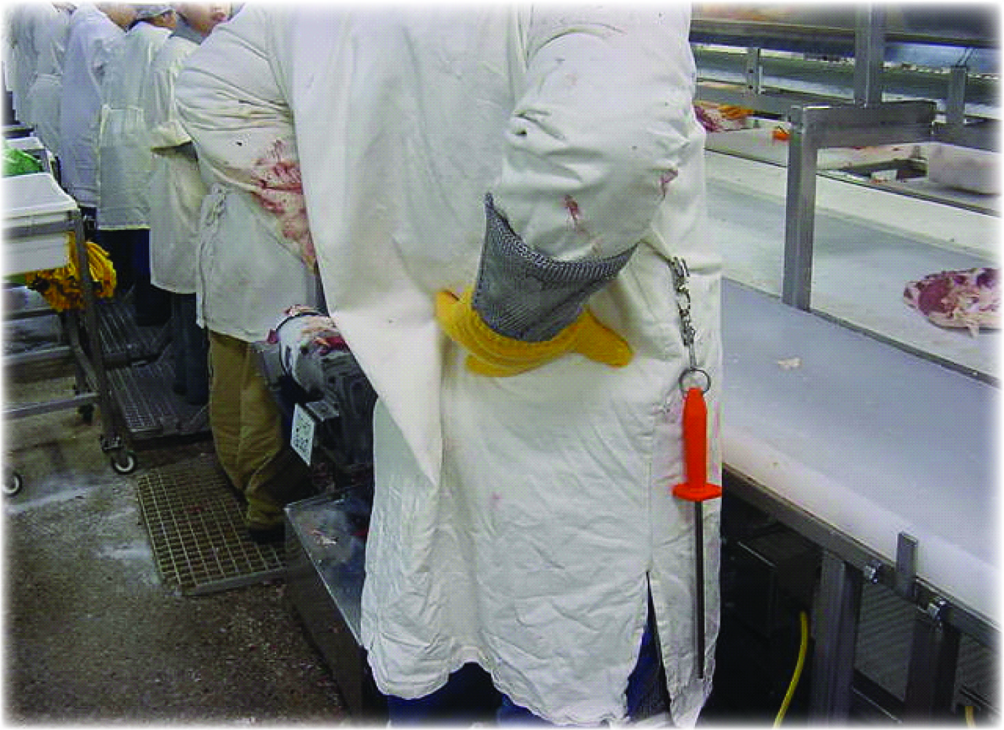
Ergonomic Factors
Working in the poultry industry, especially in the areas of cutting and deboning, can create added stress on the body.

Slide 10
Ergonomic Factors
To help avoid cumulative trauma, report pain to your supervisor as soon as it occurs.
Injuries that grow over time or cumulative trauma can be caused by exposure to repetitive, forceful or awkward tasks.
Cumulative trauma means it is not associated with one specific event.

Slide 11
Ergonomic Factors
Factors to consider are:
  Force
  Repetition
  Postures (Awkward & Static)
  Vibration
  Contact Stress

Slide 12
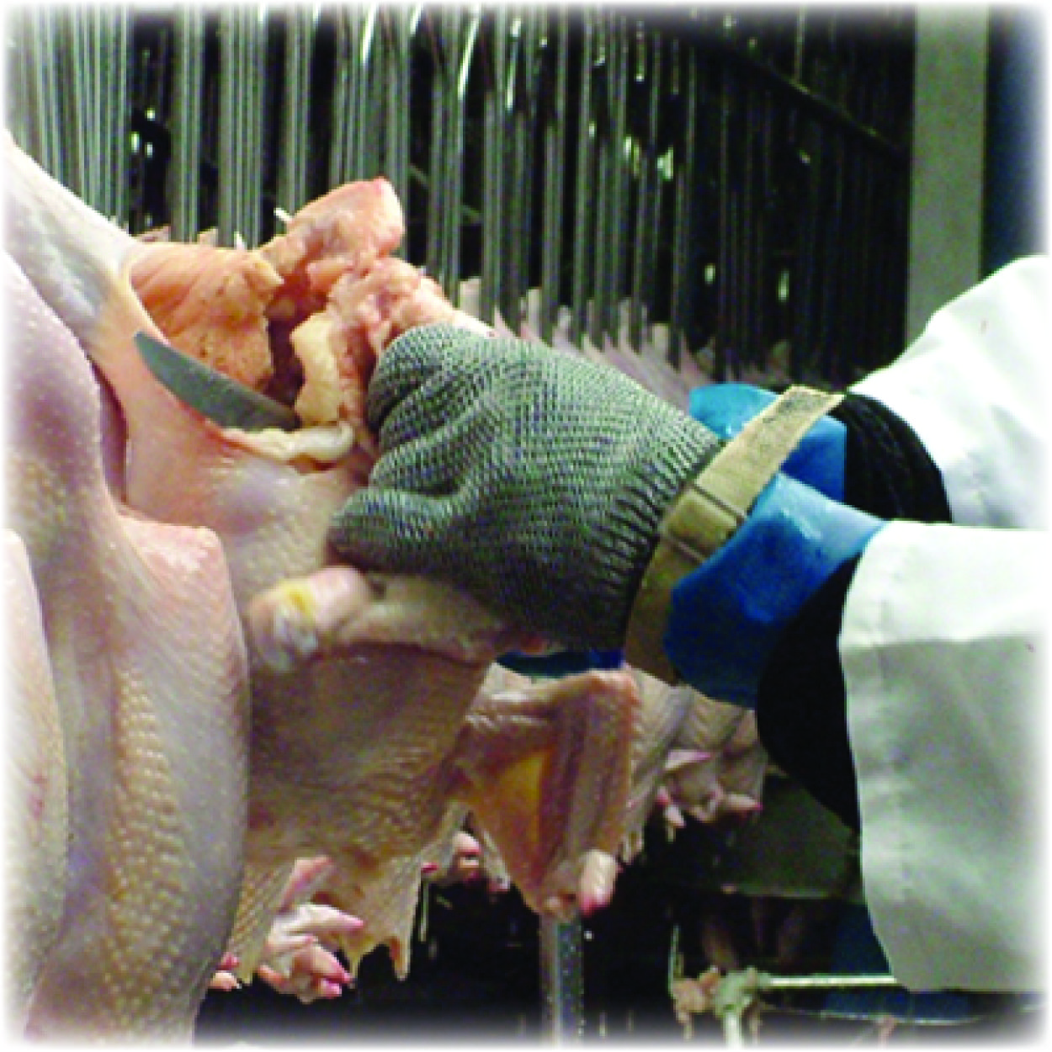
Force Factor
Tasks that require forceful exertions that don’t result in acute injury place higher loads on the joints and connective tissues.

Slide 13
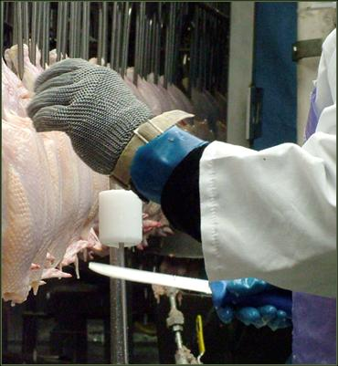
Repetition Factor
Repeated applications of force that do not cause immediate damage can, over time, induce fatigue in our connective tissues and wear them out.

Slide 14
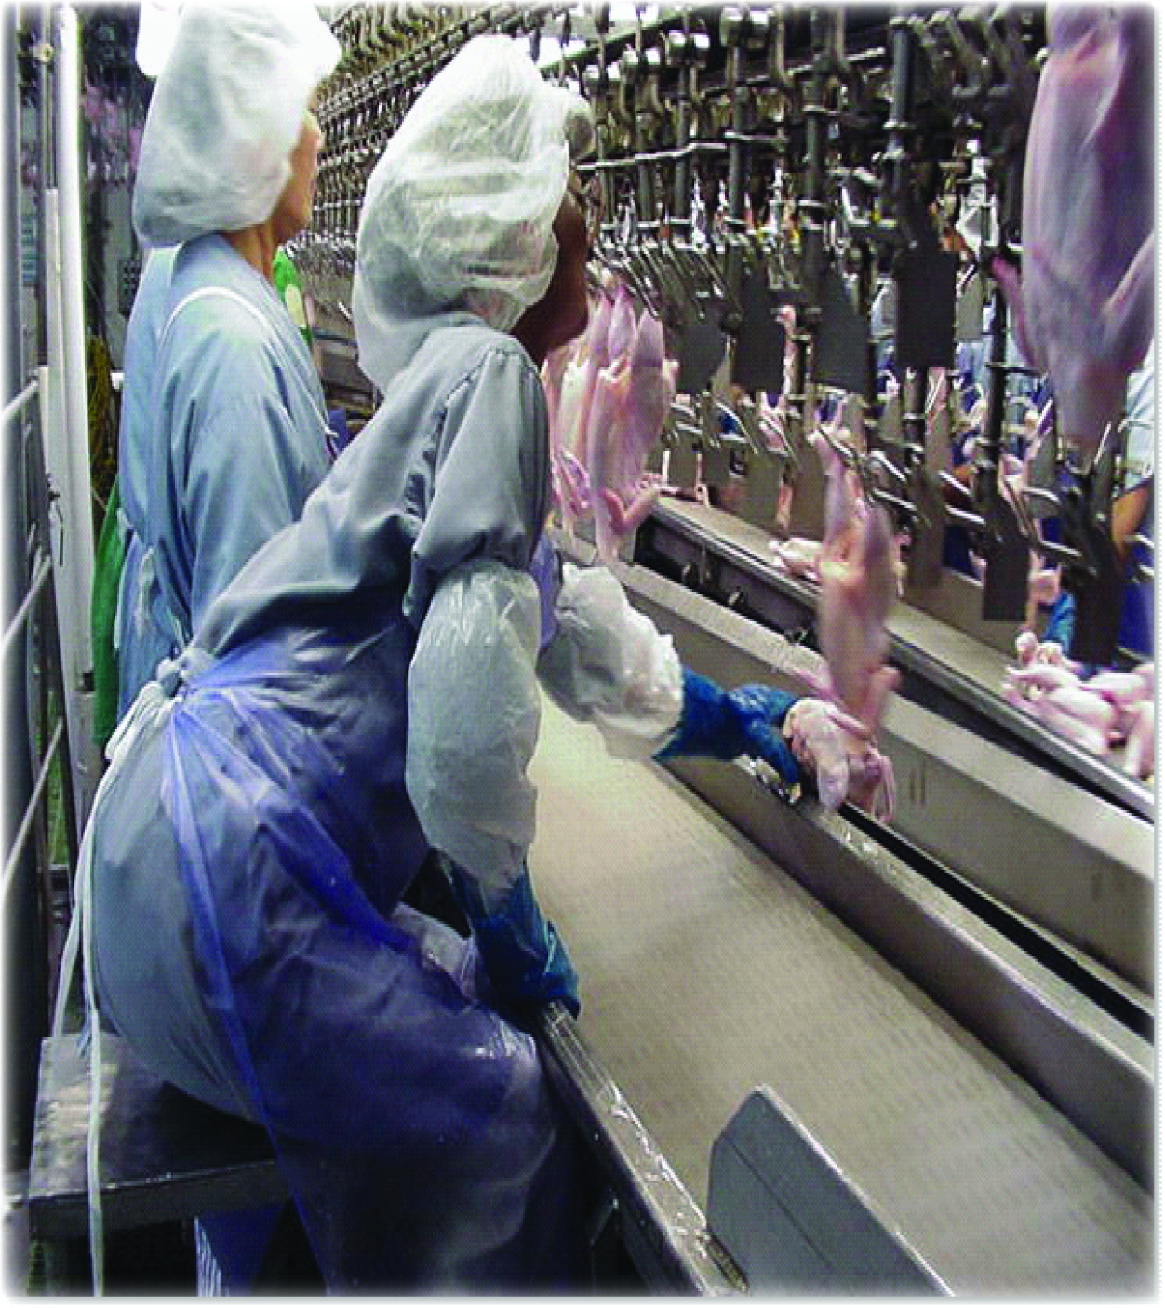
Posture Factor
Assuming positions that place stress on the body, such as reaching above shoulder height, kneeling, squatting, leaning over a worktable, twisting the torso while lifting, as well as holding or using tools (e.g., knives or scissors) in a non-neutral or fixed position.

Slide 15
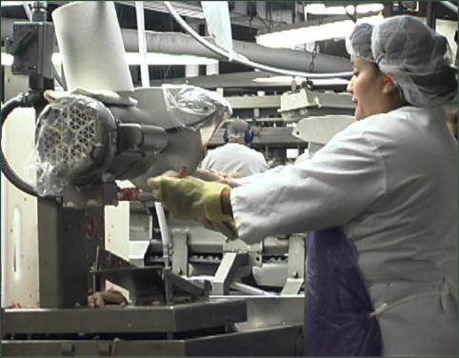
Vibration Factor
Contact with vibrating objects such as tools or while standing on a vibrating platform.

Slide 16
Contact Stress Factor
This is a dynamic force applied to the body, like when you use a hammer.

Slide 17
Other Factors
GLOVES - Working with gloves that fit too tight restrict the blood flow to the fingers and cause numbness in the fingers. Working with gloves that fit too large limit dexterity and result in a higher force for gripping. Gloves also increase the amount of force that a team member must exert in order to handle objects.

Slide 18
Other Factors
LOW TEMPERATURES - Exposure to temperatures below 66 degrees F for more than two hours can limit blood flow to the extremities, which can cause numbness and in the hands and fingers and reduces grip strength.

Slide 19
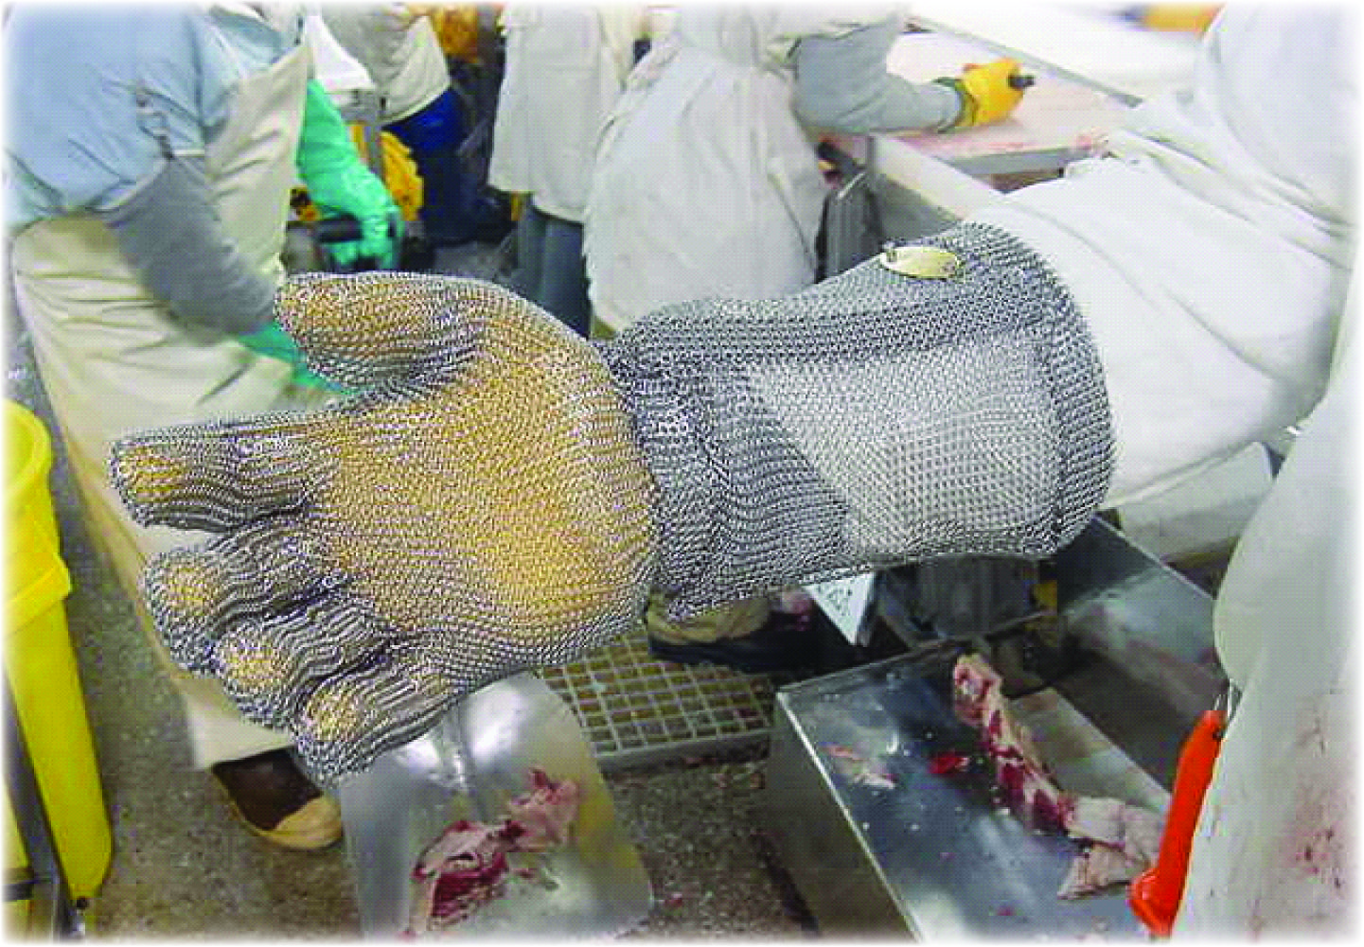
Protecting Your Body
Ergonomic factors can affect your body so you want to make sure to be protected.

Slide 20
Protecting Your Body
When your body is under too much pressure or strain it will let you know.
Effective treatment of pain and strain requires paying attention to early warning signs.
The body learns to move in the patterns that you teach it.

Slide 21
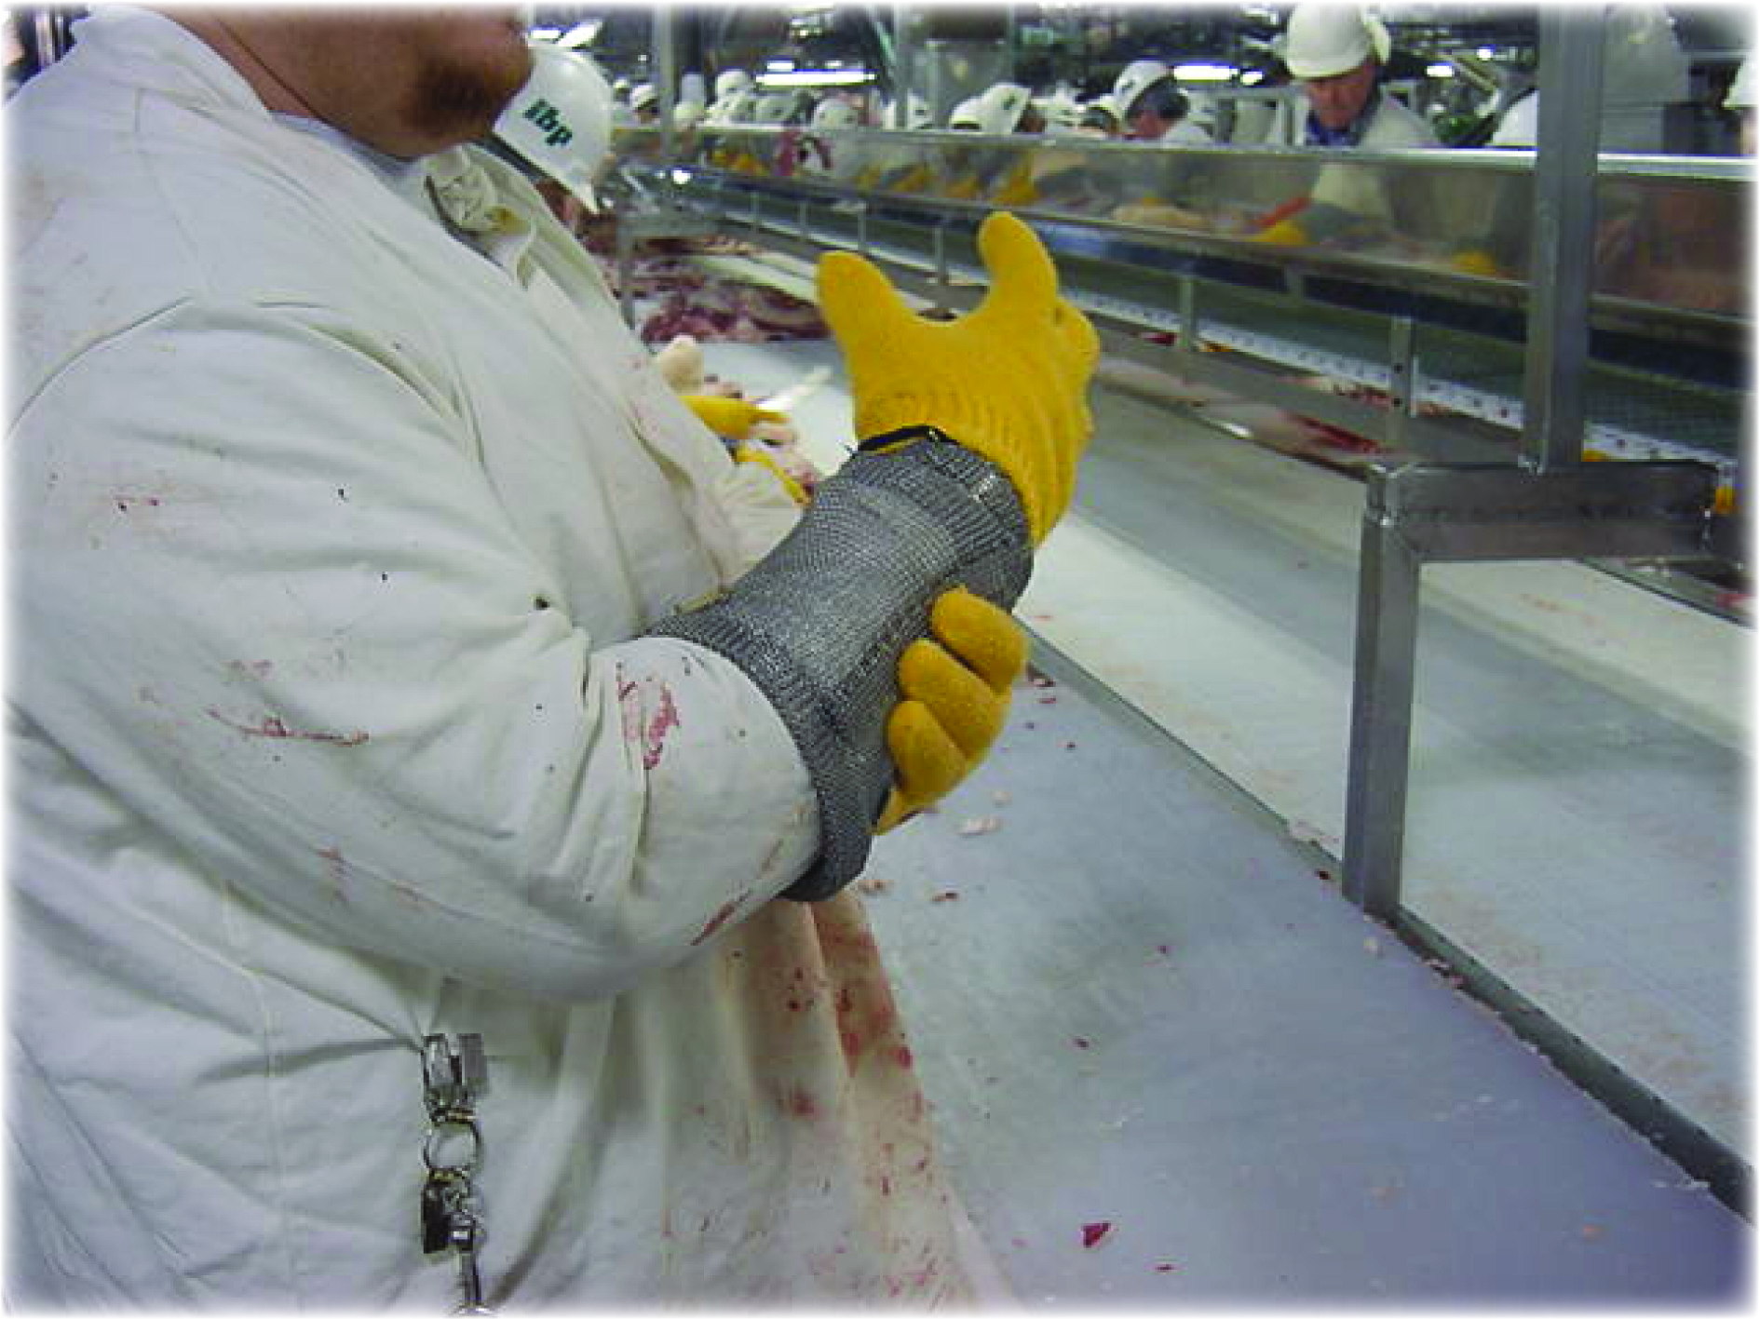
Protecting Your Body
Some of the early warning signs include:
  Swelling
  Numbness
  Tingling
  Discomfort
  Burning sensations
  Irritation
  Insomnia
  Stiffness

Slide 22
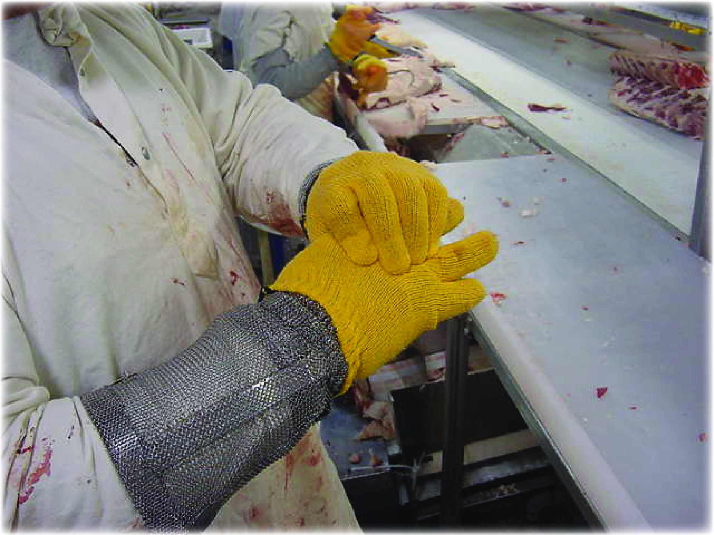
Protecting Your Body
You can experience these early warning signs in your back, neck, shoulder, elbows, forearms, wrists and hands.

Slide 23

Check for Understanding
Time for Group Activity!
BODY MAPPING: 10-15 MINUTES

Slide 24
Protecting Your Body
Warm-up exercises and stretch breaks can help prevent injuries and relieve pressure.

Slide 25
Exercise Demo
Notes:
Give a copy of Ergo Aid at the conclusion if available.

Slide 26
Check for Understanding
The ergonomic factor experienced when performing the same motion or series of motions repeatedly and frequently is:
Force
Repetition
Contact stress
Vibration

Slide 27
Check for Understanding
MULTIPLE CHOICE.
The ergonomic factor experienced when engaging in tasks that require exertions and result in pressure on joints is:
Vibration
Repetition
Force
Contact stress

Slide 28
Check for Understanding
MULTIPLE CHOICE.
What are early warning signs? (Check all that apply.)
Swelling E. Burning sensations
Irritation F. Insomnia
C. Stiffness G. Numbness
D. Tingling H. Discomfort

Slide 29
Check for Understanding
FILL IN THE BLANK.
The study of how to bring the work to the worker is called ______________.

Slide 30
To Extend Your Learning, Check Out the Resources Below
Poultry Processing Industry eTool (http://www.osha.gov/SLTC/etools/poultry/)
North Carolina Department of Labor Occupational Safety and Health Division, A Guide to Safe Work Practices in the Poultry Processing Industry
http://www.oshainfo.gatech.edu/ergo-training/trainer.html

Slide 31
Susan Harwood Safety Training Grant Program Team
Ivy Bonk, Program Coordinator
Debra Stewart, Corporate Risk Mgmt. Specialist
Jennifer Shahan, State Director
Telamon Corporation
Elizabeth Eades-Guerrero,
Regional EHS Manager, Tyson Foods
Sam Fulginiti, Safety Manager
Amick Farms, Maryland
Stephen Ridgell, Program Specialist, MOSH

