Slide 1

Respiratory Selection for the Agriculture Producer

Slide 2

Disclaimers
This material was produced under a grant (SH – 26280 - SH4) from the Occupational Safety and Health Administration, U.S. Department of Labor. It does not necessarily reflect the views or policies of the U.S. Department of Labor, nor does the mention of trade names, commercial products, or organization imply endorsement by the U.S. Government.

Slide 3

Focus Areas for Presentation
Present overview of agricultural respiratory exposures
Discuss types of respirators
Discuss respiratory protection for specific hazards with specific focus on grain and hog exposures
Present respiratory selection guide as a resource
Inform attendees about AgriSafe Network
Concerns and Questions from producers/workers
Notes:
Over view of Focus areas /objectives of presentation
Want to spend time discussing some of the concerns and questions that I hear from agricultural workers .
Allow time for questions

Slide 4

Respiratory Protection
Multiple exposures
Multiple types of protection
Multiple questions from agricultural population
Choices can be expensive
Compliance is an issue
Right choice for exposure
Notes:
Respiratory protection can be complicated for
The individual needing the protection
The company that is trying to protect the worker
The health care provider who is making a recommendation
Reasons for the difficulties:
Multiple types of exposures
Multiple types of protection – different types of masks
Cost can be a factor
Once a choice is made – compliance is difficult for some individuals for reasons we will talk about
Keeping those things in mind – most important to make certain making the right selection based on the exposure
The right mask for the job

Slide 5

High Risk Areas for Individual Farmer, Family and Worker
Respiratory Hazards are one of many
  injuries
  respiratory
  hearing
  chemical exposures
  skin cancer
  musculoskeletal
  health and wellness
  stress
Notes:
There are many high risk areas in agriculture – respiratory is only one.
But a very important one
It can be difficult for producers and health care providers to get accurate information

Slide 6

Hazardous Substances
Many substances pose a hazard to the respiratory system in the agricultural setting, especially in enclosed settings:
  Dusts
  Molds
  Toxic Fumes
Notes:
Hazards are not straight forward and simple
Many types of substances make up the variety of hazards
Examples include
Dusts
Molds
Toxic fumes
Will discuss each type of substance in this presentation

Slide 7

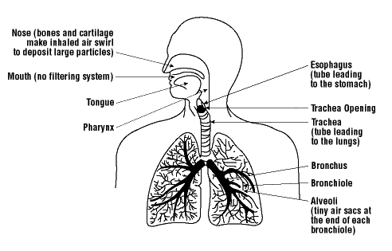
Respiratory System
Notes:
Brief overview of respiratory system
Back to basic pathophysiology
Respiratory System includes more than just the lungs
Starts at the nose
Sinuses
Mouth
Upper airway – throat and tracheal esophageal area
Large airways – bronchioles
Smaller airways
Resource: CDC/NIOSH Overview of Pulmonary Anatomy and Physiology available at
http://www.cdc.gov/niosh/docs/2004-154c/pdfs/2004-154c-ch1.pdf

Slide 8

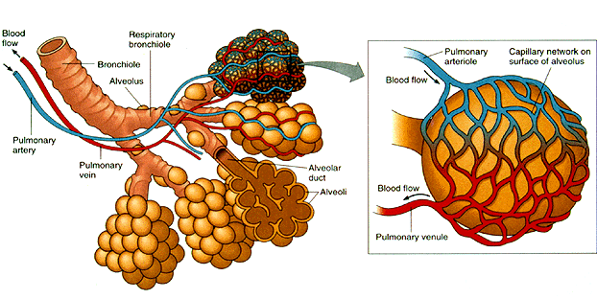
Bronchioles and Alveoli
  The size of particles is directly linked to their
  potential for causing health problems.
  30 μm (microns) lands in nasopharyngeal area.
  10 μm stops in the trachea, bronchi, and bronchioles.
  Small particles less than10 µm (microns) in diameter pose the greatest problems, because they can get deep into your lungs, and some may even get into your bloodstream.
Notes:
Alveoli is where oxygen exchange takes place
Grape like clusters
Respirable dust is defined as particle less than 10 microns
Respirable dust can end up in this area of the lung

Slide 9

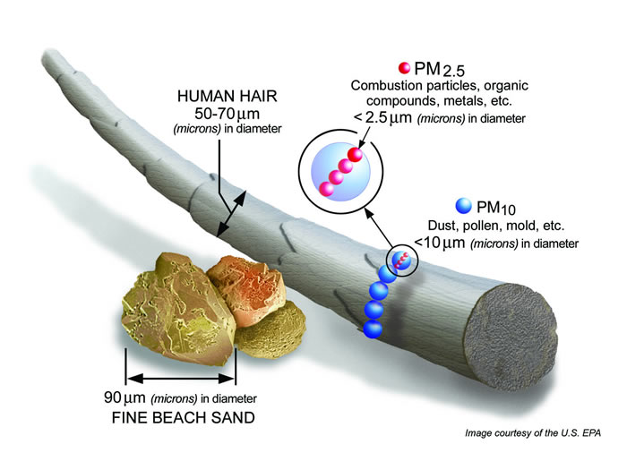
Particle Size
Particulate Matter (PM)
Notes:
Examples and comparison of Particle size
PM = Particle matter
Fine Beach Sand = 90 microns
Human hair is 50-70 microns
Dust, pollen and mod < 10 microns
Organic compounds, metal =< 2.5 microns

Slide 10

Defense Mechanisms
Cough Reflex
  Clears the airway of secretions
Reflex Bronchoconstriction
  Response to breathing in large amounts of irritating substances such as dusts
Notes:
Defense mechanisms also play a role in where particles end up.
Larger particles can cause symptoms but are not as hazardous to respiratory system because the individual coughs them up, swallows etc
Other factors influencing the deposition and retention of particles include cigarette smoking and lung disease.

Slide 11

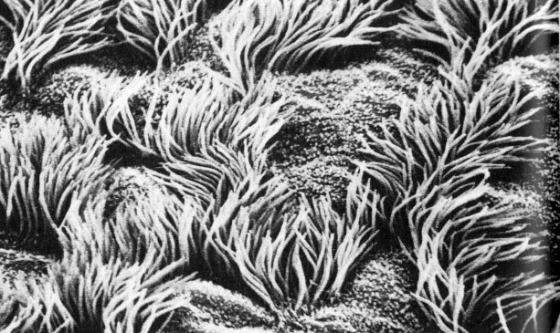
Normal Defense Mechanisms
Mucociliary Clearance
Air filtration and mucus trapping in upper airway
  Removes large particles
  Smaller particles still can reach the alveoli
Notes:
Of the particles which fail to deposit in the head, the larger ones will deposit in the tracheobronchial airway region
may later be eliminated by mucociliary clearance

Slide 12

Types of Respiratory Hazards
Livestock & Poultry confinements
Confined Animal Feeding Operations (CAFOS)
Pesticides
Grain Handling
Anhydrous Ammonia
Welding
Using gas or diesel engine indoors
Fumigation
Silo Entry
Paint (spraying)
Woodworking
Notes:
Sources of respiratory hazards are varied
What is a CAFO - Confined Animal Feeding Operation

Slide 13

Polling Question
How’s the pace of this webinar?
Answer choices:
Much too slow
A bit too slow
About right
A bit too fast
Much too fast

Slide 14

General Symptoms
Headache
Dizziness
Runny or sore eyes
Sore throat
Stuffy nose or sneezing
Cough
Wheezing or tightness in chest
Shortness of breath
Nausea or vomiting
Monday morning syndrome
Notes:
Monday morning syndrome – what is this – make sure to describe this
When an agricultural worker leaves the work environment for a brief period (perhaps a vacation or a weekend) symptoms subside or go away completely when gone but return when goes back into the work environment
Similar to Sick building syndrome– this is a name for when a person exhibits the listed general symptoms related to indoor air quality problems.

Slide 15
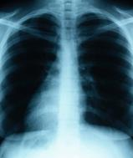
Respiratory Protection
Understand Respiratory Hazards
Engineering controls
Avoid High Risk Exposures if Possible
Baseline Testing of Lung Function
Protection
  -Right mask for the job
  -The right fit for the mask
  -Have masks available
  -Protective Equipment Storage Box
Notes:
Understand Respiratory Hazards
Engineering controls
Respiratory Protection is done in a variety of ways
Avoid High Risk Exposures if Possible
Baseline Testing of Lung Function
Protection
-Right mask for the job
-The right fit for the mask
-Have masks available
-Protective Equipment Storage Box

Slide 16
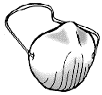
Inadequate Protection
Simple one-strap dust masks are not good enough
Not considered a respirator according to NIOSH
Notes:
One strap mask is not considered a Respirator by NIOSH
Mask only as good as the fit
Number of contact points on the face are key

Slide 17

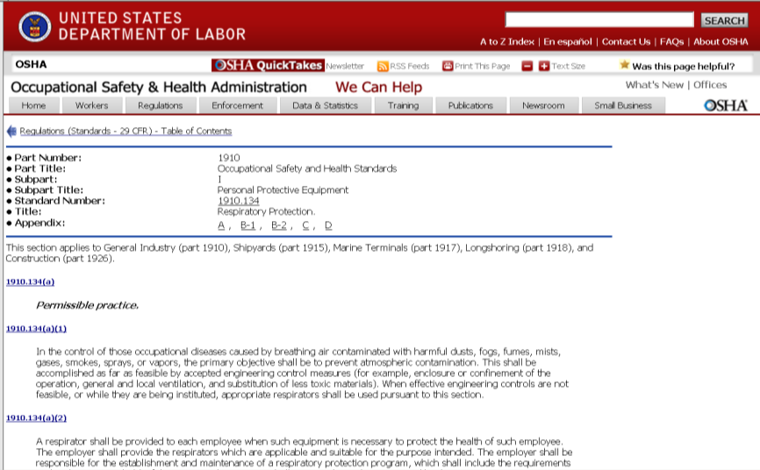
OSHA’s Respiratory Protection Standard
29 CFR 1910.134
SEARCH
Regulations
A- Z INDEX
Notes:
OSHA’s Respiratory Protection Standard is 29 CFR 1910.134
located on the OSHA website shown on this slide
Can get to this place 3 different ways
1- Search
2- Regulations
3- A-Z Index (respirators)
4- Google search

Slide 18
Types of Respirators
Air Purifying
Supplied Air
Notes:
Types of Respirators
Air – Purifying and Supplied Air

Slide 19
Air Purifying
Air Purifying:
    Filtering face piece
      N series = not for use in presence of oil mist
      R series = some resistance to oil mist
      P series = for use where oil present
    Half mask face piece
    Full face piece
    Powered air purifying
Notes:
Air Purifying:
Filtering face piece
N series = not for use in presence of oil mist
R series = some resistance to oil mist
P series = for use where oil present
Half mask face piece
Full face piece
Powered air purifying

Slide 20

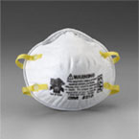
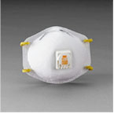
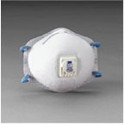
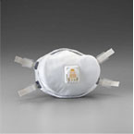
Two-Strap Disposable Masks
Filtering Face Piece Masks

Slide 21
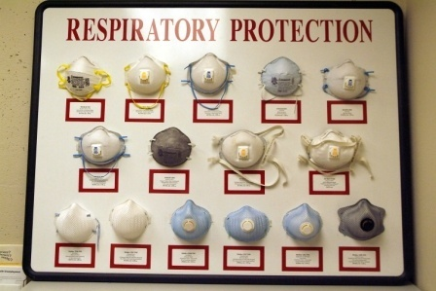
Filtering Face Piece Masks:
2 strap disposable
Notes:
Many types of 2-strap disposable masks
Respiratory board shows the variety and choices available for many types of exposuree

Slide 22

Filter Efficiency
Designation according to filter efficiency
  95 =moderate filtering efficiency (95%)
  99 = high filtering efficiency (99%)
  100 = highest filtering efficiency (99.97%)
Notes:
Air Purifying:
Filtering face piece
N series = not for use in presence of oil mist
R series = some resistance to oil mist
P series = for use where oil present
Half mask face piece
Full face piece
Powered air purifying
Valve assists to keep mask cool also helps prevent glasses from fogging

Slide 23

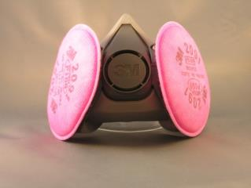

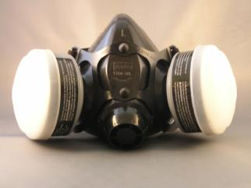
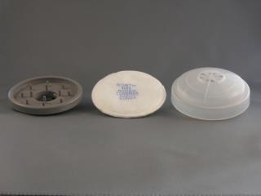
Half-Mask Respirator
Requires fit testing
Different brands and styles available
Several Cartridge choices
Support your wife, mother, sister, daughter for breast cancer
Notes:
Half Mask Respirators are still air pruifying
This mask requires fit testing in OSHA – employee/employer situation
Recommend fit testing for all producers but can be difficult or impossible in some circumstances
3 options shown.
Pancake filters are pink in color – good way to help men come to terms with the color is to discuss breast cancer.
Organic vapor (paint/pesticides)
Filter holder , filter , filter cover

Slide 24
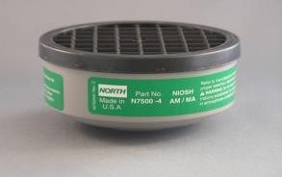
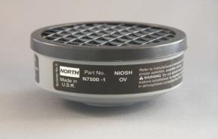
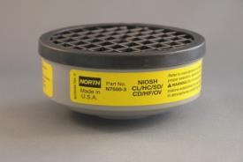
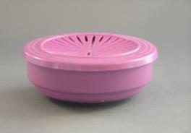
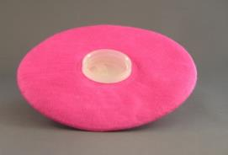
Half Mask Cartridges
Ammonia
Organic Vapor
Acid Gas
North Products
P100
P100
* Mention of any company name in our presentations does not constitute an endorsement by AgriSafe.
Notes:
Types of cartridges for canister respirator – photos property of AgriSafe Network

Slide 25

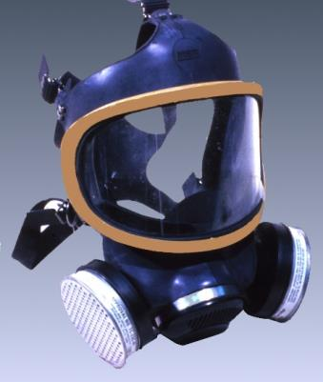
Air-Purifying Respirator
A respirator with an air-purifying filter, cartridge, or canister that removes specific air contaminants by passing ambient air through the air-purifying element.
Notes:
A respirator with an air-purifying filter, cartridge, or canister that removes specific air contaminants by passing ambient air through the air-purifying element.

Slide 26

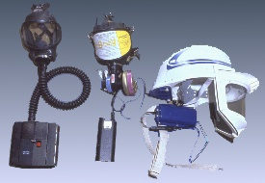
Powered Air-Purifying Respirator
An air-purifying respirator that uses a blower
to force the ambient air through air-purifying elements to the inlet covering.

Slide 27
Using a Powered Air-Purifying Respirator
When do you need to use a powered air-purifying respirator?
  If you have heart and lung conditions that prevent use of other types of respirators or if unable to get a good fit with other types.
Notes:
A respirator with an air-purifying filter, cartridge, or canister that removes specific air contaminants by passing ambient air through the air-purifying element.
Use of a powered air purifying respirator can be needed for certain circumstances.
If you have heart and lung conditions that prevent use of other types of respirators or if unable to get a good fit with other types.

Slide 28

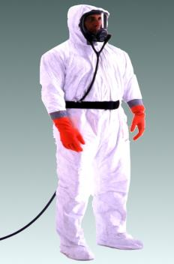
Supplied Air Respirator
An atmosphere-supplying respirator for which the source
of breathing air is not designed to be carried by the user.
Also called airline respirator.
When to use:
Manure pits or confinement buildings during pit agitation or pumping
Environments with poor ventilation creating high levels of carbon monoxide
Fumigation in enclosed areas
Notes:
When to use:
Manure pits or confinement buildings during pit agitation or pumping.
Environments with poor ventilation creating high levels of carbon monoxide
Fumigation in enclosed areas
When to use:
Manure pits or confinement buildings during pit agitation or pumping
Environments with poor ventilation creating high levels of carbon monoxide
Fumigation in enclosed areas

Slide 29
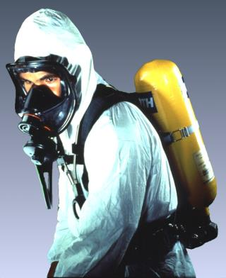
Self-Contained Breathing Apparatus
An atmosphere-supplying respirator for which
the breathing air source is designed to be carried by the user.
When to use:
Manure pits or confinement buildings during pit agitation or pumping.
Environments with poor ventilation creating high levels of carbon monoxide.
Fumigation in enclosed areas.
Silo entry that is oxygen limiting.

Slide 30

Respiratory Program
Must develop a written program with worksite-specific procedures when respirators are necessary or required by the employer.
Must update program as necessary to reflect changes in workplace conditions that affect respirator use.
Must designate a program administrator who is qualified by appropriate training or experience to administer or oversee the program and conduct the required program evaluations.
Must provide respirators, training, and medical evaluations at no cost to the employee.
Note: OSHA has prepared a Small Entity Compliance Guide that contains criteria for selection of a program administrator and a sample program – Publication OSHA 3384 - 09 2011
Notes:
A Respiratory Program that meets the OSHA standard must :
develop a written program with worksite-specific procedures when respirators are necessary or required by the employer
update program as necessary to reflect changes in workplace conditions that affect respirator use
designate a program administrator who is qualified by appropriate training or experience to administer or oversee the program and conduct the required program evaluations
provide respirators, training, and medical evaluations at no cost to the employee
Other resources:
CPL 02-00-120 OSHA Instruction for Inspection Procedures for the Respiratory Protection Standard 09/25/1998 - tells how OSHA enforces this standard (what OSHA expects)
Letters of Interpretation can be helpful –located on OSHA website

Slide 31
Respirator Program (cont’d)
Where Respirator Use is Not Required
Employer may provide respirators at employee’s request or permit employees to use their own respirators, if employer determines that such use in itself will not create a hazard.
If voluntary use is permissible, employer must provide users with the information contained in Appendix D.
Must establish and implement those elements of a written program necessary to ensure that employee is medically able to use the respirator and that it is cleaned, stored, and maintained so it does not present a health hazard to the user.
Exception: Employers are not required to include in a written program employees whose only use of respirators involves voluntary use of filtering face pieces (dust masks).
Notes:
When a Respirator is not required:
Employer may provide respirators at employee’s request or permit employees to use their own respirators, if employer determines that such use in itself will not create a hazard
If voluntary use is permissible, employer must provide users with the information contained in Appendix D. Employer should document that they provided this information. This is not a training. Can copy this and give it to them so be sure to document what you did. Document for each individual even if do a group session.
Must establish and implement those elements of a written program necessary to ensure that employee is medically able to use the respirator and that it is cleaned, stored, and maintained so it does not present a health hazard to the user.
Exception: Employers are not required to include in a written program employees whose only use of respirators involves voluntary use of filtering face pieces (dust masks).
Employer needs to be sure that the mask does not become the hazard. (For example the mask causing or contributing to a medical condition).

Slide 32
Medical Evaluation
Procedures
Must provide a medical evaluation to determine employee’s ability to use a respirator, before fit testing and use.
Must identify a PLHCP to perform medical evaluations using a medical questionnaire or an initial medical examination that obtains the same information.
Medical evaluation must obtain the information requested by the questionnaire in Sections 1 and 2, Part A of App. C.
Follow-up medical examination is required for an employee who gives a positive response to any question among questions 1 through 8 in Section 2, Part A of App. C or whose initial medical examination demonstrates the need for a follow-up medical examination.
Notes:
Must provide a medical evaluation to determine employee’s ability to use a respirator, before fit testing and use
Must identify a PLHCP to perform medical evaluations using a medical questionnaire or an initial medical examination that obtains the same information
Medical evaluation must obtain the information requested by the questionnaire in Sections 1 and 2, Part A of App. C
Follow-up medical examination is required for an employee who gives a positive response to any question among questions 1 through 8 in Section 2, Part A of App. C or whose initial medical examination demonstrates the need for a follow-up medical examination

Slide 33
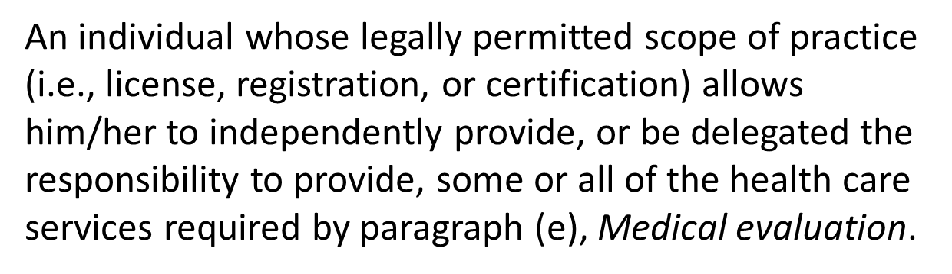
Physician or Other Licensed Health
Care Professional (PLHCP)
Notes:
This can be physician, nurse, nurse practitioner, physician assistant
Does not have to be a physican.

Slide 34
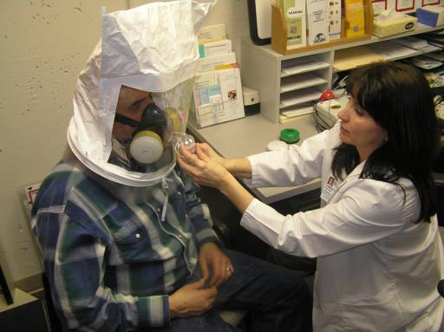
Fit Testing
Before an employee uses any respirator with a negative or positive pressure tight-fitting face piece, the employee must be fit tested with the same make, model, style, and size of respirator that will be used.
Notes:
Photo property of AgriSafe Network
Fit testing must be done for each employee prior to use of a respirator

Slide 35
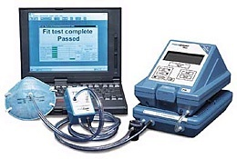
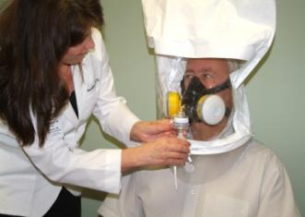
Type of Fit Testing
  Quantitative
  - Portacount test
Qualitative
- Bitrex, Saccharin.
  Use OSHA approved fit test protocols (Appendix A to § 1910.134: Fit Testing Procedures)
  Available on OSHA.gov website
Notes:
two

Slide 36
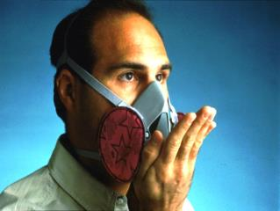
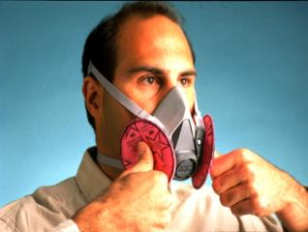
User Seal Check
An action conducted by the respirator user to determine if the respirator is properly fitted to
the face.
Positive Pressure Check
Notes:
User seal check is part of the fit test that is taught to the individual – this assists them each time they put the mask on
Assist in tightening straps – adjusting the face piece and helps determine need to replace headpiece (cradle)
the fit check the user does is in addition to the annual fit test required by OSHA
Make sure audience knows if a worker is required to wear a respirator, MUST also have fit test and a seal check is not the only thing the employer is required to do
Source of picture: OSHA Website
http://www.osha.gov/dte/library/respirators/presentation/slide55.html

Slide 37
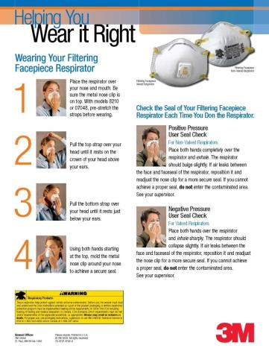
Filtering Face piece Fit Test
Fit Testing is required if:
the employer requires the use of respirators.
the employee is exposed above the OSHA permissible exposure levels (PELs).
If workers wear these respirators on a voluntary basis NO fit testing
is required.
Notes:
Filtering Face piece masks also require fit testing
Fit testing method is different for 2 strap filtering face pieces - see 3M poster that is available through 3M
OSHA requires fit testing of these respirators (filtering face pieces)
if the employer requires the use of respirators
or the employee is exposed above the OSHA permissible exposure levels - Permissible Exposure Limits (PELs)
NOTE: if workers wear these respirators on a voluntary basis, no fit testing is required.

Slide 38
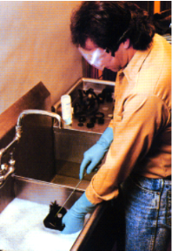
Maintenance and Care
Provide each user with a respirator that is clean, sanitary and in good working order.
Use procedures in Appendix B-2 or equipment manufacture’s recommendations.
Clean and disinfect at the following intervals.
  As often as necessary when issued for exclusive use
  Before being worn by different individuals when issued to more than one employee.
  After each use for emergency respirators and those used in fit testing and training.
Notes:
Photo from OSHA website
Maintenance and Care is a critical part of the respiratory program
Follow procedures in Appendix B-2 or by manufactures recommendations
Establish a cleaning procedure and guidelines

Slide 39

Maintenance and Care
Important to store the respirator properly.
Sometimes may throw away the 2 strap dust mask (filtering facepiece).
Notes:
Important to store the respirator properly.
Sometimes may throw away the 2 strap dust mask (filtering facepiece).

Slide 40
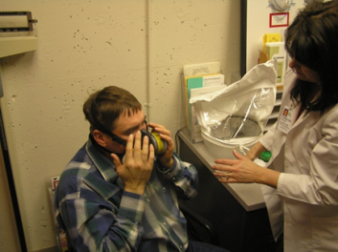
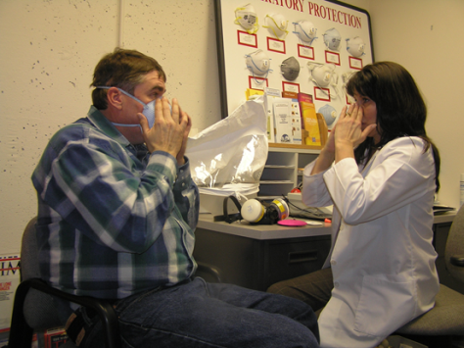
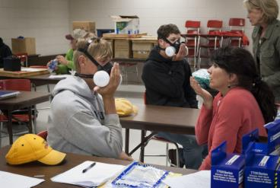
Demonstration - Education
Notes:
Education needs to include demonstration to be effective
Photos property of AgriSafe Network

Slide 41
Identification of Filters,
Cartridges, and Canisters
All filters, cartridges and canisters used in the workplace must be labeled and color coded with the NIOSH approval label.
The label must not be removed and must remain legible.
“TC number” is no longer on cartridges or filters (Part 84).
Marked with “NIOSH”, manufacturer’s name and part number, and an abbreviation to indicate cartridge or filter type (e.g., N95, P100, etc.).
Matrix approval label supplied, usually as insert in box.
Important to use same manufacture for cartridges as respirator facepiece.
Notes:
All filters, cartridges and canisters
used in the workplace must be labeled
and color coded with the NIOSH
approval label
The label must not be removed and must remain legible
“TC number” is no longer on cartridges or filters (Part 84)
Marked with “NIOSH”, manufacturer’s name and part number, and an abbreviation to indicate cartridge or filter type (e.g., N95, P100, etc.)
Matrix approval label supplied, usually as insert in box

Slide 42
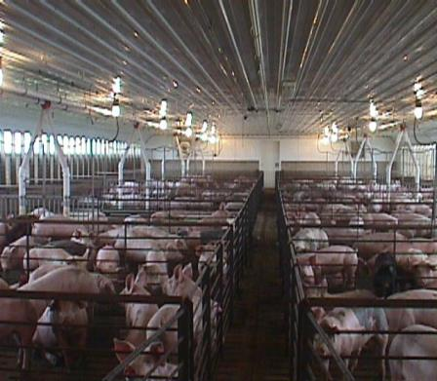
Symptoms of
Toxic Dust Organic Syndrome
Dry irritated cough
Fever
Muscle aches
Shortness of Breath
Occur 4 to 6 hours after exposure
Notes:
Symptoms of Toxic Dust Organic Dust Syndrome
Dry irritated cough
Fever
Muscle aches
Shortness of Breath
Occur 4 to 6 hours after exposure

Slide 43
Signs and Symptoms of Farmer’s Lung (Hypersensitivity Pneumonitis)
Fever – Occurs 4 to 6 hours after the exposure, along with other following symptoms
Cough w/ sputum
Chest tightness
Shortness of breath

Slide 44
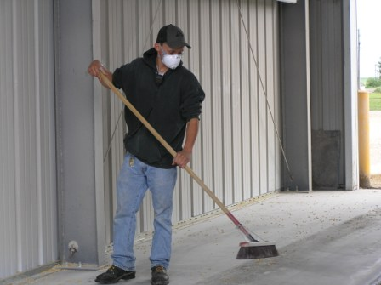
Preventing Toxic Organic Dust Syndrome or Farmer’s Lung
Half-mask respirators:
  Filtering face piece N series
  Half Mask face piece N or P series
  Full Face piece Nor P series
  P 100 filter
Powered air-purifying respirators.

Slide 45
Information Presentation
Activity
Exposure
Respiratory Protection:
  Air Purifying
  Supplied Air respirator

Slide 46

AgriAgricultural respirator Selection Guide

Slide 47
Respirator Selection Guide
Purpose of the guide is to assist trained Agricultural Health Professions to recommend appropriate respirators based on the clients agricultural exposure. Includes:
    General Information
    Selection Guide Logic
Available from AgriSafe Network Inc. cost is $35

Slide 48


Ooccupational History Quiestions
Notes:
This tool will be revised
Does not include all of the OSHA standards - reference OSHA standard 29CFR 1910. 134
One of the appendices' is the questionnaire (appendix C )

Slide 49
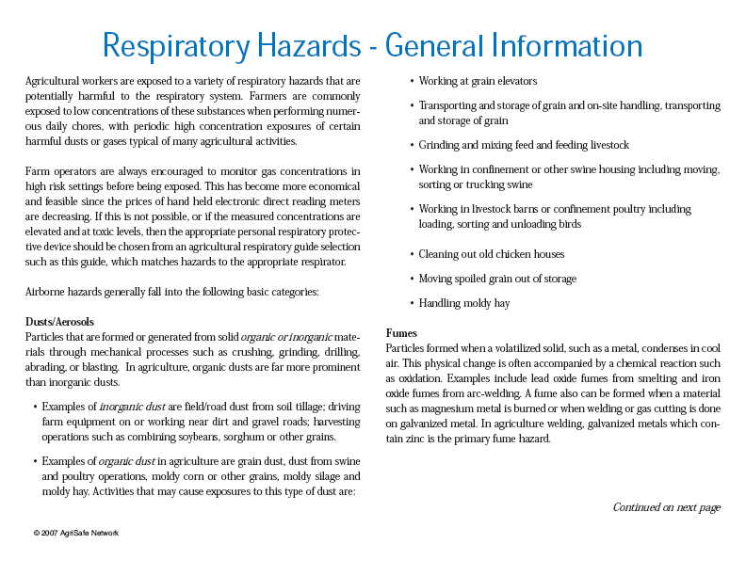
Respiratory Hazards General Info

Slide 50
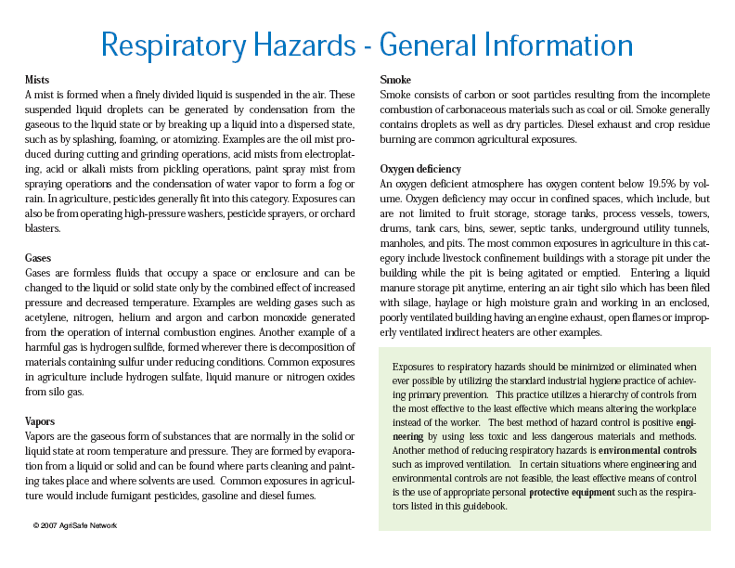
Respiratory Hazards cont.

Slide 51
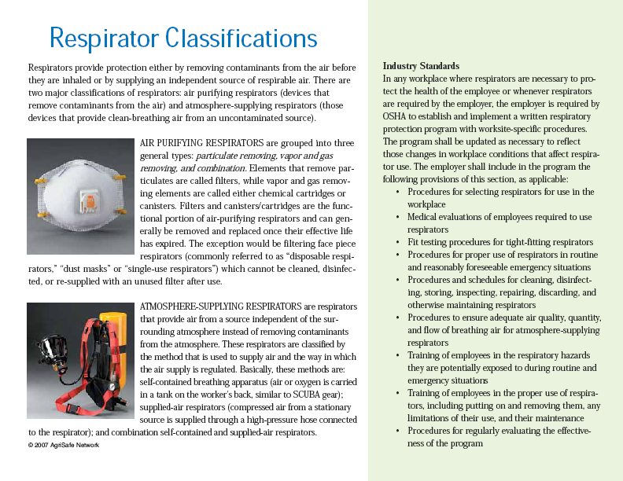
Respirator Classificaitons

Slide 52
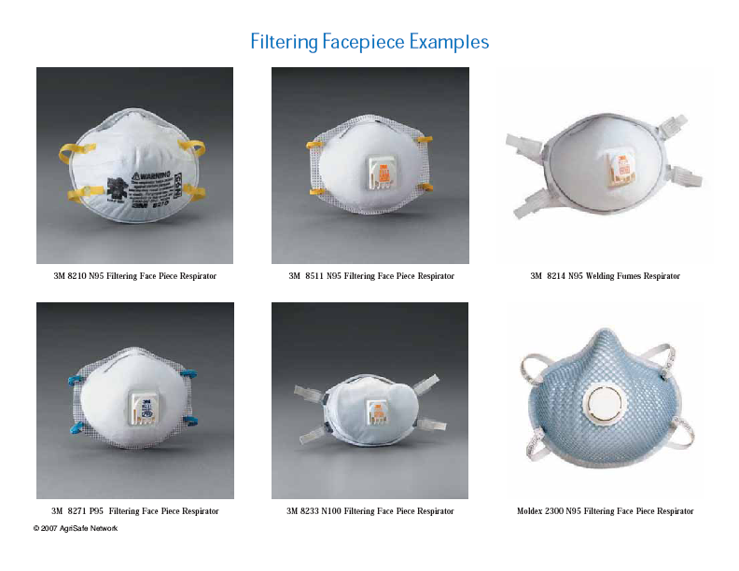
Filtering Facepiece Examples

Slide 53
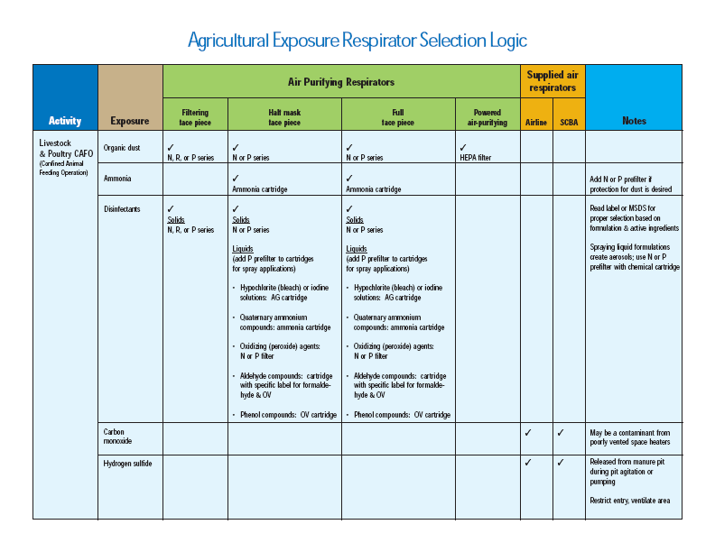
Agricultural Exposure Respirator Selection Logic

Slide 54
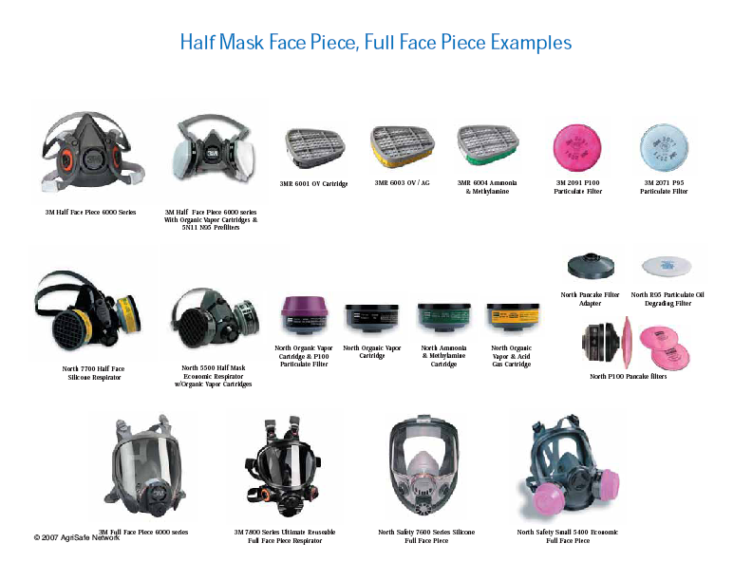
Half Mask Face Piece, Full Face Piece Examples

Slide 55
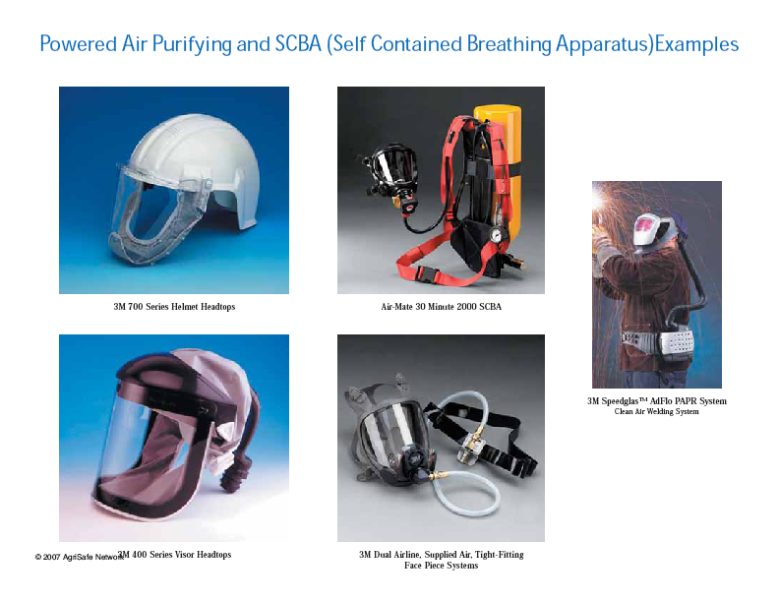
SCBA Examples

Slide 56
Hog or Poultry Confinement
Common exposure in Midwest.
Combination of hazards.
Different types of masks are appropriate.

Slide 57
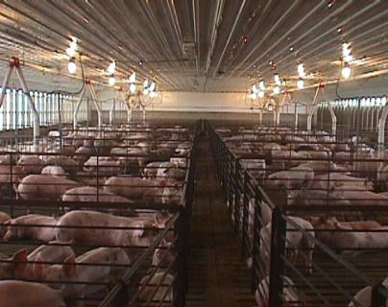
What’s in the air?
Particles of grain
Hog manure
Insect parts
Bacteria
Ammonia

Slide 58

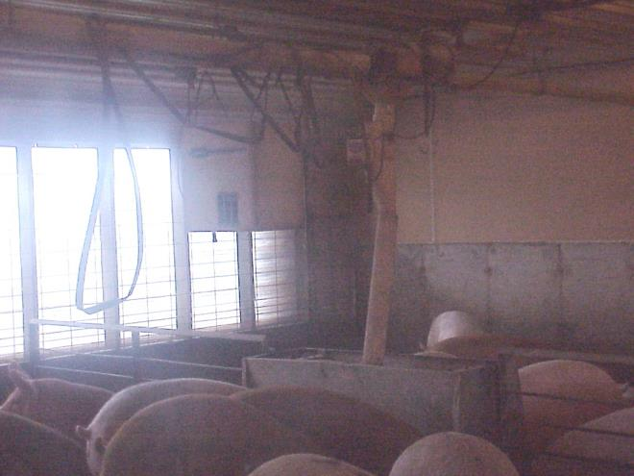
Airborne Dust

Slide 59

Hog or Poultry Confinement
Exposure = Respirator Recommendation
Organic Dust = Filtering face piece, disposable 2 strap mask or half mask with dust cartridge or HEPA filter
Examples: 3M 8210, 8511, 8271, 3M 8233 Moldex 2200 or 2300
Ammonia = Filtering face piece or if symptomatic or dislike ammonia smell use half or full face mask with ammonia cartridge and prefilter
Notes:
Ammonia – field application is different
Pre filter is important
Add picture with ammonia cartridge and prefilter

Slide 60
Hog or Poultry Confinement (cont)
Disinfectants = half mask with acid gas cartridge.
Carbon Monoxide = supplied air respirators.
Hydrogen Sulfate = supplied air respirators.

Slide 61
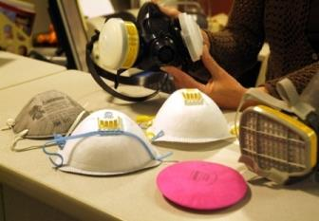
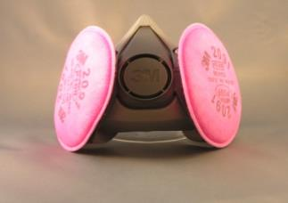
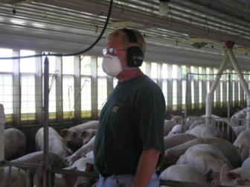
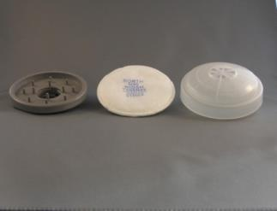
Choices and Comfort

Slide 62


Grain Dust
3M Half Mask
3M 8271
Hazard is organic dust (feed or grain dust, molds and spores).
Can cause Toxic Dust Organic Syndrome or Farmers Lung.
Corn, soybeans, peanuts , wheat, other.

Slide 63


Livestock
Cattle
Sheep
Goats
Hazards: feeding grain and storage of hay and bedding.

Slide 64



Hay
Can be organic dust
Hazard can be organic dust (molds and spores).
Can cause Toxic Dust Organic Syndrome or Farmers Lung.
Protection: Filtering face pieces.
3M 8511
3M HEPA

Slide 65
Prevention of Agricultural Respiratory Exposures
Engineering controls - Improve ventilation, especially in winter when buildings are more closed up.
Two-strap disposable respirator – NIOSH certified.
Half-face masks with filters for organic dust.
Powered air-purifying respirators.

Slide 66

Pesticides
Hazard is organic vapors and aerosols (solid and sprayed liquids).
Respirator selection:
  Solids – filtering face piece N,R, or P series.
  Liquids – Half mask face piece with Organic Vapor cartridge and P pre-filter.
  Can also use full face piece or powered air
  (purifying respirator).
Notes:
Appropriate filter and or cartridge related to Label and exposure

Slide 67

Pesticides
NOTE: Read Label or MSDS which provides information on respirator selection.

Slide 68

Welding
Hazard is metal fumes.
  Particulates
Respirator selection:
Air purifying respirator which is N100, R100,or P100.
Filtering face Piece, half mask face piece or full face piece.
3M 8233
3M 8214
Notes:
Welding – Specific for welding respirator is on the package
Add another example
N1000
8293?
Depends on what you are welding on

Slide 69
Gas or Diesel Indoors
Hazard: Carbon Monoxide
Respirator selection:
NO air purifying respirator is effective.
Ventilate area or use supplied air or SCBA.
NOTE: Using gas or diesel engines indoors such as power washers and skid loaders can create an oxygen deficient atmosphere which can cause death.

Slide 70
Hobbies - Off Farm Work
Painting: hazard is aerosol organic vapors and metal particulates
– metals can become vapors.
Recommended Respirators:
Air purifying filtering face piece N,P, or R series.
Half mask face piece or full face piece with Organic Vapor Cartridge and
P series prefilter.
NOTE: Isocyanate paints require supplied air respirators – read labels and SDS sheets.
Wood Working/ Remodeling: hazard is aerosols (wood, sheetrock, dusts) and organic vapors from lacquers, thinners, varnish and adhesives.
Recommended Respirators:
For aerosols or dusts:
  N, R,or P Filtering face piece,
  N or P Half mask
  Full face piece with N or P filter Or HEPA filters.
For organic vapors – use half mask with Organic Vapor Cartridges.
Notes:
Need prefilter and cartridge
Based on the paint
How are you applying
It can become a vapor

Slide 71
OSHA Resources
Respirators QuickCard™
(OSHA 3280 - 2005) (English: HTML PDF )
(OSHA 3280 - 2005) (Spanish: HTML PDF )
Respiratory Protection Standard: Small Entity Compliance Guide: (English: PDF )
Respiratory Protection: Assigned Protection Factors for the Revised Respiratory Protection Standard
(OSHA 3352 - 2009) (English: HTML PDF )
Respiratory Protection: Respiratory Infection Control - Respirators Versus Surgical Masks Fact Sheet
(English: HTML PDF)
Notes:
Applicable OSHA Resources located on OSHA.gov

Slide 72


Agriculture Operations
Safety and Health Topics Page
General Resources
Notes:
Agriculture Operations Safety and Health Topics Page has a General Recourses Tab

Slide 73

Agriculture Operations
Safety and Health Topics Page
Standards
Notes:
Agricultural Operations Safety and Health Topics Page on OSHA website

Slide 74



Oregon OSHA Resource
www.osha.oregon.gov
Oregon OSHA Resource Center and AV Library:
Phone: (503) 947-7453 or (800) 922-2689
tech.web@state.or.us
Notes:
Oregon OSHA resources include an agricultural specific respiratory protection guide for agricultural employers
This resource is located at Oregon OSHA

Slide 75
Employee Rights and Responsibilities
You have the right to:
  A safe and healthful workplace.
  Know about hazardous chemicals.
  Information about injuries and illnesses in your workplace.
  Complain or request hazard correction from employer
Notes:
Review Employee Rights

Slide 76
Employee Rights and Responsibilities
You have the right to:
  Training.
  Access to hazard exposure and medical records.
  File a complaint with OSHA.
  Participate in an OSHA inspection.
  Be free from retaliation for exercising safety and health rights.
Notes:
Review Employee Rights

Slide 77



OSHA Fact Sheet Whistleblower Protection Program
Whistle Blower Protection Program

Slide 78





Right PPE for the Job
Notes:
Each job has unique hazards.
It is important to have the right personal protective equipment for the job. Choices and comfort are critical to compliance.

Slide 79

Questions
Test Questions
1. Particulate matter larger than 15 microns stops in the trachea, bronchi and bronchioles.
2. The same respirator and filters is always appropriate for hog confinement and grain exposure.
3. Employers are not required to have a written respiratory program for voluntary use of filtering face piece respirators.
4. Use of an appropriate respirator is the best method of protection from agricultural respiratory exposures.
Notes:
Review contact information

