Slide 1

Personal Protective Equipment in Agriculture

Slide 2
Susan Harwood Training Grant
      This material was produced under a grant (SH23580SH2) from the Occupational Safety and Health Administration, U.S. Department of Labor. It does not necessarily reflect the views or policies of the U.S. Department of Labor, nor does the mention of trade names, commercial products, or organizations imply endorsement by the U.S. Government.

Slide 3
Objectives
Identify the appropriate use and selection of personal protective equipment for head to toe protection for agricultural hazards.
Describe cholinesterase protocol and algorithm for health care providers.
Identify the appropriate use and selection of respiratory personal protective equipment.
Identify OSHA standards related to personal protective equipment.

Slide 4
Opportunities for Exposures
    Variety of exposures in agriculture result in multiple risks
      Dusts (organic: bacteria, endotoxin, fungal spores; pesticide residues)
      Pesticides and chemicals
      Gases (Anhydrous ammonia, hydrogen sulfide, welding)
      Vapors (fumigants, gasoline, diesel)
      Confined space (oxygen deficient atmosphere)
      Flying objects (cutting, grinding, sawing, drilling, mowing)
      Noise (machinery, livestock, tools)
      Sun - Heat
      Hazardous equipment and machinery
      Livestock

Slide 5

What hazards are agricultural workers exposed to?
Farmworkers are exposed to numerous safety, health, environmental, biological, and respiratory hazards.
These include vehicle rollovers, heat exposure, falls, musculoskeletal injuries, hazardous equipment, grain bins, unsanitary conditions, pesticides, and many others.
https://www.osha.gov/dsg/topics/agriculturaloperations/hazards_controls.html
Notes:
OSHA’s agricultural standards

Slide 6

Agriculture Operations
Safety and Health Topics Page
General Resources
Notes:
OSHA’s agricultural standards

Slide 7
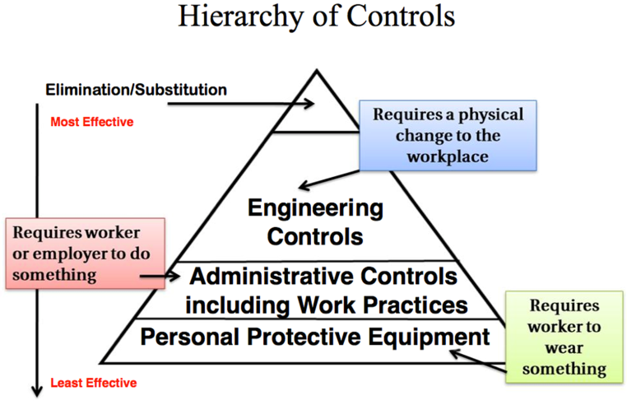
Where does PPE fit?
Diane Rohlman Prevention and Illness and Injury presentation
Notes:
Photo – Property of AgriSafe

Slide 8
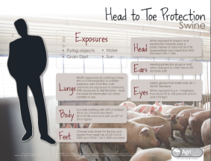
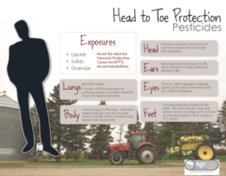
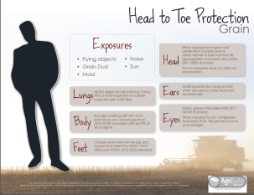
Head to Toe Protection
Head to Toe
  Scalp
  Face
  Eyes
  Ears
  Lungs
  Skin
  Feet

Slide 9
Sun Safety
Hats -wide brim of at least 3 inches made with a fabric that will block UV rays
Provide choices
Sun Screen – at least 15 sun protection factor (SPF) with UVA and UVB protection
spray on – greaseless - reapply
Wear clothing that covers your body and choose clothing with UV protection
Provide options
Limit the time you spend in the sun between 10am and 4pm
Fred Gerr presentation
Notes:
Photo property of AgriSafe Network

Slide 10
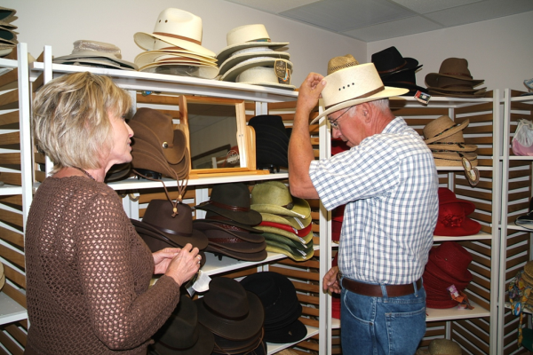
Sun Protection

Slide 11
Eye and Face Protection
Chemical Splashes and Flying objects = Safety Glasses and Goggles
  Must meet American National Standards Institute
  ANSI Z87.1
Sun damage = Sunglasses with UV absorbent material.
  ANSI UV requirements block at least 99% of UV radiation
Welding = exposure to visible, infrared (IR) and sometimes UV light
  Welding filter lenses rated from 2-14
  Depends on the welding operation and the materials
  NIOSH recommends at least a 4 rating
  Table in Standard 1910.133

Slide 12
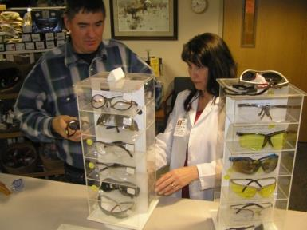
Eyes – OSHA Standard
29 CFR Occupational Health Standards, Personal Protective Equipment
1910.133(a) General requirements
1910.133(a)(1) The employer shall ensure that each affected employee uses appropriate eye or face protection when exposed to eye or face hazards from:
  flying particles
  molten metal
  liquid chemicals,
  acids or caustic liquids,
  chemical gases or vapors,
  or potentially injurious light radiation.
Notes:
Photo property of AgriSafe Network

Slide 13
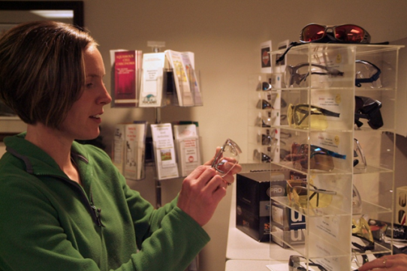
Eye Wear Fit
Be aware of proper fit, including workers who wear corrective vision.
Find a size and shape that fits your face
Notes:
Photo – Property of AgriSafe

Slide 14
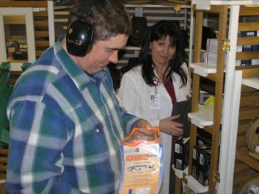
Hearing – OSHA Standard
In Industry - Personal hearing protectors must be provided and properly worn by workers whenever they are exposed to excessive noise and engineering or administrative controls are not available or effective at reducing noise levels.
In Agriculture the individual has the choice to wear or NOT to wear hearing protectors.
In both cases hearing protection may become ineffective without the appropriate knowledge of the wearer.
Notes:
Photo property of AgriSafe Network

Slide 15


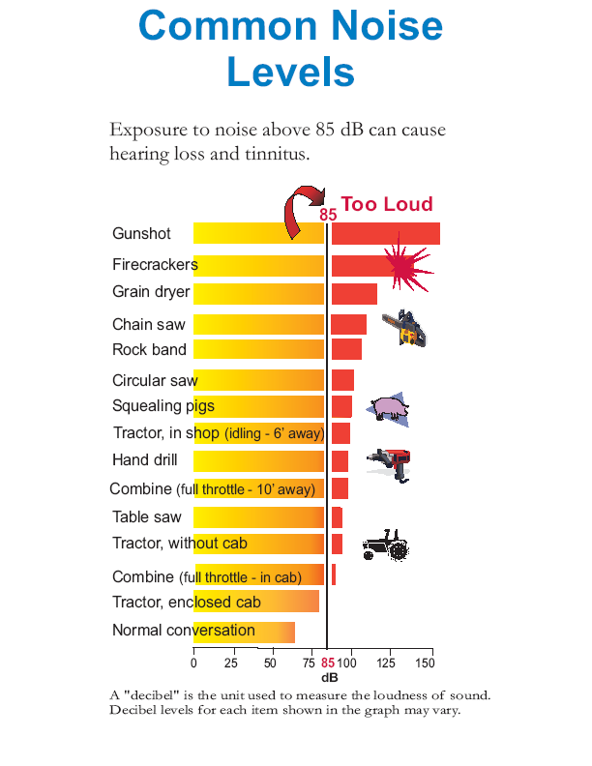
Common Noise Levels

Slide 16
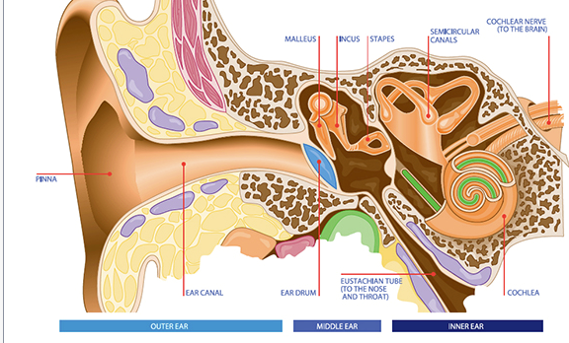
Anatomy of the Ear
Notes:
Review sound conduction pathway

Slide 17
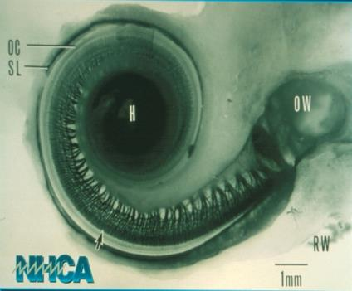
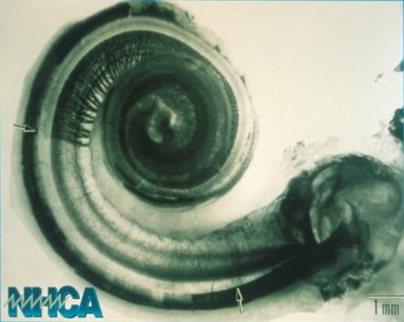
Ear Structure
Healthy Cochlea
Damaged Cochlea

Slide 18
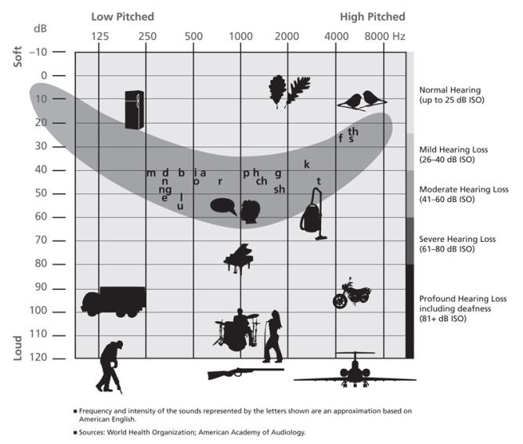
Speech Banana
The speech banana represents the intensity and frequency of sounds of speech or ‘phonemes’ in language, which when placed on the audiogram, form a banana like shape.
In adults hearing loss within the speech banana can have serious implications on the person's ability to follow what is being said to them (speech discrimination).

Slide 19
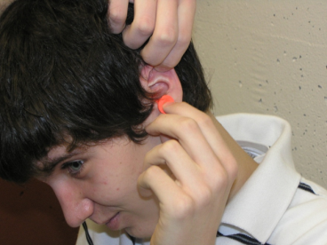

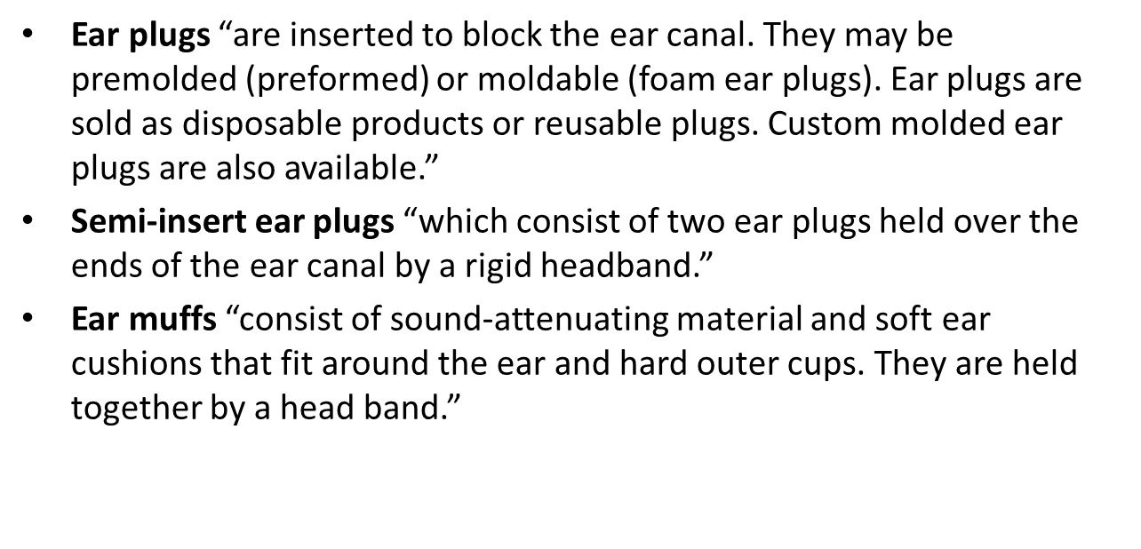

Types of hearing protection devices
Proper Insertion

Slide 20
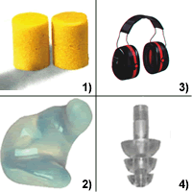

Noise Reduction Rating, NRR
The NRR is a single-number rating which is required by law to be shown on the label of each hearing protector sold in the US.
  40 CFR Part 211, Product Noise Labeling, Subpart B - Hearing Protective Devices.
1) foam earplugs 3) earmuffs
2) molded earplug 4) tapered earplug

Slide 21
Using the NRR
C-weighted measurements
A-weighted measurements
protected dBA = unprotected dBC – NRR
  “NIOSH recommends derating the NRR by a multiplicative factor of 75% for earmuffs, 50% for slow-recovery foam earplugs and custom earplugs, and 30% for all other earplugs.”
  In the real world, no controls exist, users may not be well motivated or trained, and the hearing protection devices are not consistently inserted.
protected dBA = unprotected dBA - [ NRR - 7 ]
  7 dB correction factor is used because of de-emphasis of low-frequency energy inherent to the A-weighting scale.
Wearing muff over plugs only adds 5-10 dB more protection

Slide 22
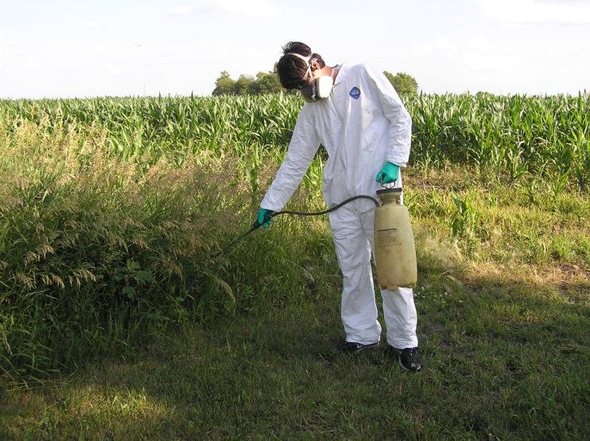
Reduce chemical risk
Notes:
Oregon is one of the states with its own program – they have excellent materials that can be found on their web page

Slide 23
Environmental Protection Agency
    Created in 1970
    Writes and enforces regulations for the purpose of protecting human health and the environment
    Conducts assessment, research and education
    Labeling requirements for pesticide products
    Responsible for development and enforcement of the Worker Protection Standard
    The EPA Worker Protection Standard for Agricultural Pesticides is a regulation aimed at reducing the risk of pesticide poisonings and injuries among agricultural workers and pesticide handlers.
    The WPS ‘How To Comply’ manual was last updated in 2005. Older versions are obsolete.
    Source: www.osha.gov/ and www.epa.gov

Slide 24
Toxic Pesticides
Some of the most toxic pesticides are insecticides
Some of the most toxic insecticides are cholinesterase inhibitors
  Organophosphates (OP) and N-methyl – carbamates are the insecticidal cholinesterase inhibitors
  Cholinesterase screening may be necessary
Notes:
Sources:
Furman J. Cholinesterase Monitoring for Agricultural Pesticide Handlers: Guidelines for Health Care Providers in Washington State. Olympia, Washington: Washington State Department of Labor and Industries, Division of Occupational Safety and Health; January, 2010.
Cholinesterase Health Monitoring Program for USDA Employees. (2004). Cholinesterase Testing Program. Washington, DC: U.S. Department of Agriculture: Animal, Plant and Health Inspection Service.
The Scientific Advisory Committee for Cholinesterase Monitoring formed under RCW 49.17.288. Cholinesterase Monitoring
of Pesticide Handlers in Agriculture: 2004 – 2006. Final Report to the Washington Department of Labor and Industries, November 1, 2006.

Slide 25
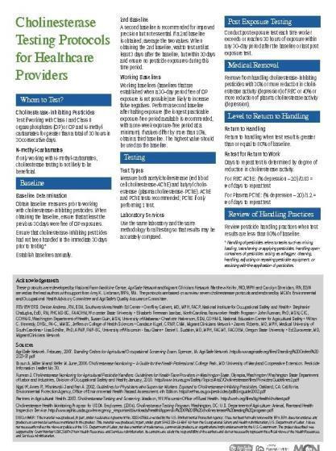
Cholinesterase Protocol for Healthcare Providers
Whom to Test?
Testing
Post Exposure Testing
Medical Removal
Level of Return to Handling
Review of Handling Practices
Archived Webinar
Notes:
We developed this protocol after review of 7 different protocols and came up with one standard protocol.

Slide 26
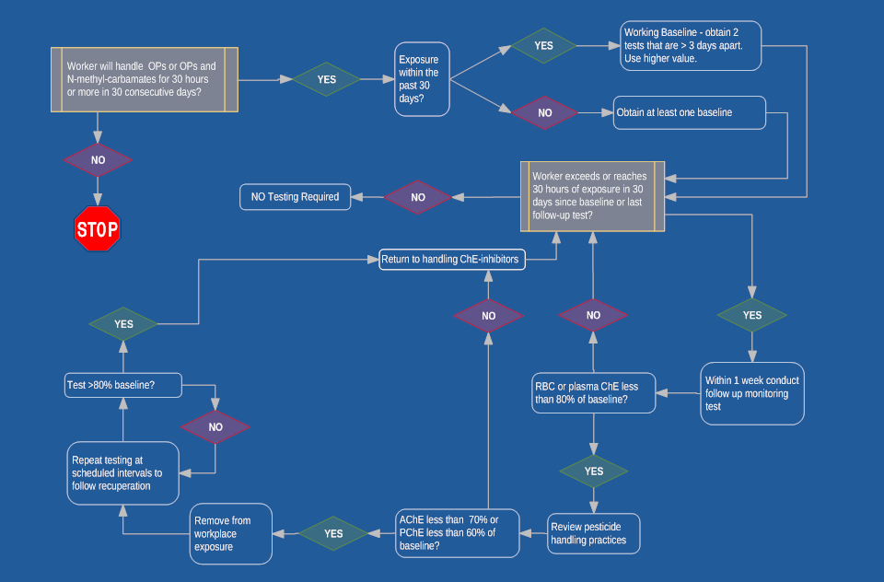
Cholinesterase Algorithm
Notes:
This is the cholinesterase algorthim
Handy map to guide you through the thinking of cholinesterase monitoring

Slide 27

Who to Monitor?
  Individuals who apply, load, or mix Class I or II Organophosphate pesticides or Organophosphates and N-methyl -
  Carbamates
  Working 30 or more hours within any 30-day period
Notes:
We monitor with some of the most toxic chemicals
Monitor when meet the level of working

Slide 28

What to Measure
Measure both acetylcholinesterase (red blood cell cholinesterase-AChE) and butyryl cholinesterase (plasma cholinesterase-PChE)
Use the same laboratory and the same methodology for all testing so that results may be accurately compared. Repeat baselines yearly

Slide 29

Action Levels
Evaluate Work Place
  >20% decrease from baseline in AChE or PChE = Evaluate work practices
Medical Removal
  >30% decrease in AchE or > 40% decrease in P C hE
  Remove worker from exposure to OPs and carbamates until levels return to within 80% of baseline
© earldotter.com
Notes:
MCN has permission to use photo

Slide 30

Return to Work
Level to Return to Work
  Return to work when test result is greater than or equal to 80% of baseline.
Retest for Return to Work
  Days to repeat test is determined by degree of ChE activity reduction.
  RBC: (% depression - 20) /0.83 = # of days to repeat test
  plasma: (% depression - 20) / 1.2 # of days to repeat test
Notes:
MCN has permission to use photo
30

Slide 31

Review Work Practices
Review work practices when test result is less than 80% of baseline.
  Reading and understanding label
  U se of personal protective equipment
  Pesticide handling practices
  Precautions taken with chemical spills
  Reporting symptoms
  Reporting exposures
© earldotter.com
Notes:
MCN has permission to use photo
An important part of the cholinesterase protocol is to Review work practices. The work practices that need to be evaluated and discussed are:
- Understanding the label – the label provides the information needed to wear appropriate personal protective equipment
Wearing the protective equipment recommended on the label including making sure the personal protective equipment is the right fit. (gloves, respirator)
- Pesticide handling practices to reduce risks of exposures
- when there are chemical spills - take the appropriate precautions
- report symptoms to employer and/or health care professional so appropriate follow can occur in a timely manner
- reporting exposure to employer/ health care provider and other agencies as appropriate

Slide 32
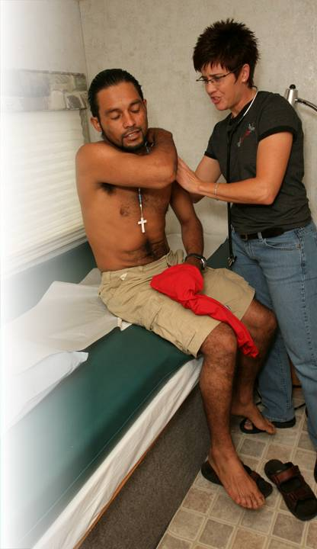
Role of Clinician
Monitor Cholinesterase levels
Understand signs and symptoms
Review protective measures with patient
Review protective measures with employer
Report
Remember – No need to be an expert
  Plenty of resources!
© earldotter.com
Notes:
MCN has permission to use photo
For the clinicians in the audience, let’s just review your role. One of the points we have not made thus far is that the clinician plays a critical role in making sure suspected and confirmed pesticide exposures are not only identified but also reported. In most cases you are the first line in the identification of symptoms and determining the appropriate course of treatment and follow up. Reporting is also an important role – in fact in over 30 states there is a law requiring clinicians to report suspected and confirmed pesticide exposures This has a very important impact on the kinds of pesticides that remain on the market. The good thing is there is no need to be expert on this topic and there are plenty of resources.

Slide 33
Prevent Exposures
Cannot change the inherent toxicity of pesticides …but
You can limit the possibility of poisoning by preventing and/or limiting exposure.

Slide 34
PPE for Chemicals
Read the Label – “The Label is the Law”
Pesticide product label instructions override WPS
  Three exceptions: PPE use in a closed system, restricted entry intervals, double notification (oral & posted)
Look for “precautionary statement” which describes how poisonous the product is and how to best protect yourself
Signal words include: Caution, Warning, Danger
If PPE information is not available, contact the manufacturer via website or phone; or purchase new equipment
Use of Restricted Pesticides requires specialized training and certification
Notes:
State by State for different pesticide restrictions and trainings
Often times the education comes from the Cooperative Extension

Slide 35
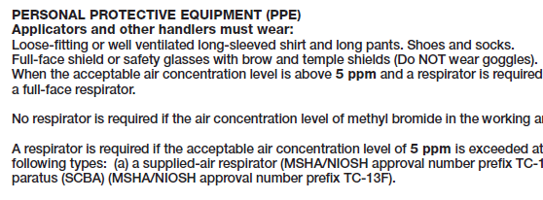
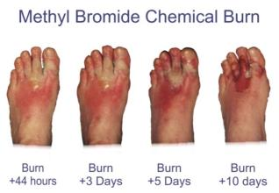
Labels – Proper PPE
Example: Chemical-resistant gloves and footwear should not be worn when handling certain fumigant gases, such as methyl bromide.
Methyl Bromide Label
PPE should be selected based on the requirements of a specific product label and how the product will be used
Notes:
While many pesticide labels require the use of chemical-resistant PPE, some fumigants prohibit the use of chemical-resistant PPE. Methyl bromide and other fumigant gases can become trapped inside chemical protective gloves or boots and can cause chemical burns to the skin. Since some pesticide handling activities increase the chance of exposure, such as mixing and loading, the label may require higher levels of protection during these activities. Levels of respiratory protection also vary among different pesticides and different levels of exposure for a single pesticide.
Wearing inappropriate PPE can lead to overexposure. Adequate training is needed to ensure pesticide handlers properly select the PPE that must be worn with each product and each product use.

Slide 36
Selecting Dermal Protection or Chemical Protective Clothing
Material Safety Data Sheet should identify chemical protective material (e.g., neoprene, butyl rubber).
If missing, contact the supplier or manufacturer of the Chemical.
Protective clothing manufacturers can also be contacted and offer appropriate choices.

Slide 37
Important Terms for Protective Clothing
Permeation rate - rate chemical moves through the material.
Breakthrough time - time a chemical takes to permeate through the material.
Degradation - measurement of material’s physical deterioration from the chemical.
Notes:
Degradation is a measurement of the physical deterioration of the material due to contact with a chemical. The material may get harder, stiffer, more brittle, softer, weaker or may swell. The worst example is that the material may actually dissolve in the chemical.

Slide 38
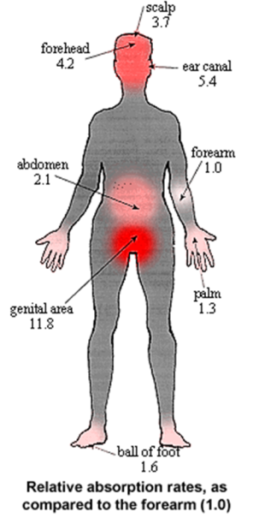
Head to Toe Protection
Absorption rates of body - why PPE is important
Donning and Doffing: proper methods of putting PPE on and taking PPE off
Practical use
  Long sleeve, long pants
  when is that okay?
Notes:
Interesting note : not on this particular chart. The top of the hand has an absorption rate of 2.3 – twice that of the palm of the hand.

Slide 39
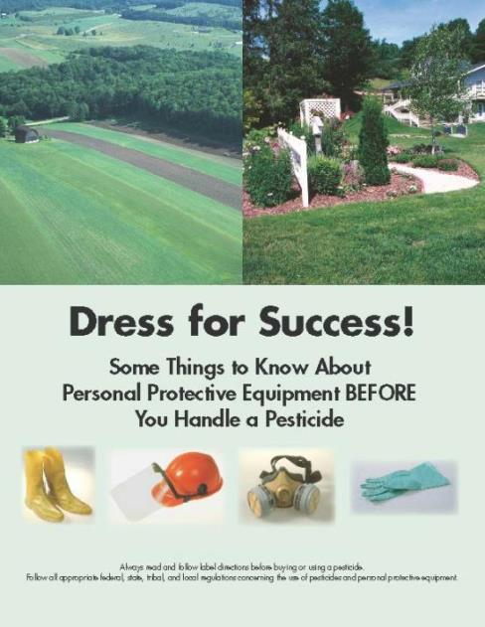
Dress for Success
National Pesticide PPE Training Solutions Committee
Source: National Association of County Agricultural Agents: nacaa.com
Source: Pesticide Environmental Stewardship: pesticidestewardship.org
Source: Syngenta Environmental Stewardship: syngentacropprotection.com/
Env_Stewardship
Notes:
Brochure focuses on some of the basics of PPE but does not substitute for following the pesticide label, the PPE user instructions, and all applicable government regulations to reduce exposure, the required PPE must be handled properly from purchase through disposal, whether you apply a pesticide at home, or work in an agricultural or non-agricultural occupation.
The plan is to use it as a template for creating the comprehensive brochure with the committee.
1) Anyone can order quantities of the actual brochure from me for their pesticide safety/stewardship outreach efforts. The brochures are free.
2) The PDF version of the brochure will be available on the Pesticide Environmental Stewardship (PES) website, the NACAA website, and the Syngenta website. Any other organization desiring to post the brochure or link to it is welcome to do so.
3) With the addition of this brochure, there will now be seven general pesticide stewardship brochures on the PES website (http://pesticidestewardship.org/Pages/Resources.aspx). Anyone can view or download these brochures from PES, or order quantities for pesticide stewardship outreach. PES also welcomes new partners that provide content, editorial assistance, or financial support, so any organization that assisted with the PPE brochure is already eligible to join!
4) All of the partners on these seven brochures have also agreed to provide the Word versions to any organization desiring to modify or extract content, and/or put their own logo on the brochure. The goal is widespread distribution of basic messages related to pesticide stewardship and safety.
It was a pleasure working with the National Pesticide PPE Training Solutions Committee. After committee members review the PPE brochure, we would welcome opinions on whether it should be translated to Spanish “as is�, or used to prepare a two-sided handout at the 6-8th grade reading level in English and Spanish. These were previous requests from members of the Committee.

Slide 40
Coveralls
Some pesticides will require long sleeved shirts and long pants – look for good quality woven fabrics (adhere to laundering directives)
Several pesticides will require coveralls over shirts and pants of a woven or bonded fabric
A smaller number of pesticides require chemical resistant suits with sealed seams (neoprene, PVC, coated polyethylene, others)

Slide 41
Layered Clothing
Layer coveralls over other clothing when the pesticide label requires it – be certain this is adequate protection and follow the label
Put on a chemical resistant apron when mixing and/or loading and when cleaning equipment
Hoods, wide brimmed hats, and chemical resistant sleeve guards are smart additions to the PPE wardrobe

Slide 42
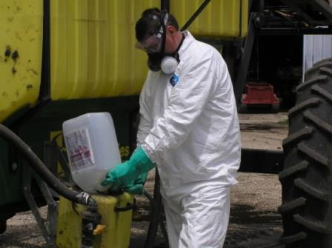
What is appropriate use of PPE for pesticide exposure
Notes:
Photo property of AgriSafe Network

Slide 43

Laundering
  Discard clothing if thoroughly soaked
  Remove work clothes and gear immediately after handling pesticides
  Wash work clothes as soon as possible after each day’s use:
    Keep pesticide work clothes separated from other family clothing
    Clean washer before laundering other clothes
    Line dry clothes
    Keep pesticides, personal protective equipment and contaminated clothing out of reach of children and pets

Slide 44

Gloves
No flocked lining for Chemical resistant gloves
Water proof does not equal chemical resistant
Read labels for A – H category
Proper size and fit
Use gloves that fit to mid forearm at a minimum
Notes:
A- H category designation refers to the amount of time a chemical resistant glove can be worn while using a specific product. Categories are measured against a standard 14 ml glove

Slide 45
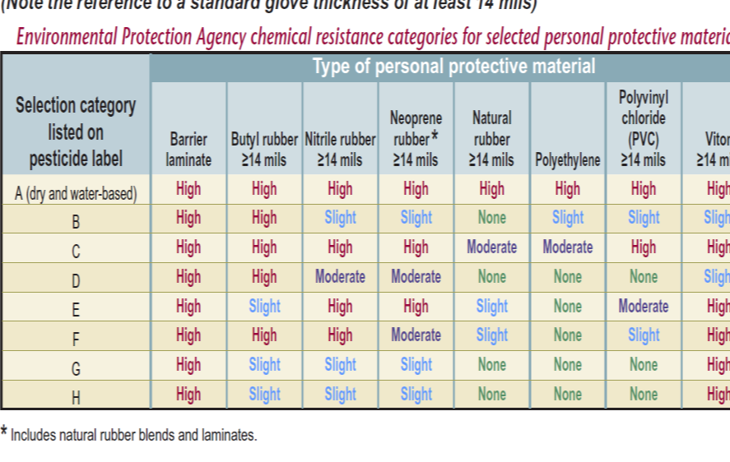
Chemical Resistant Gloves
Source: Oregon OSHA; Pesticide use and your personal protective equipment
Notes:
Source: Oregon OSHA
A- H

Slide 46
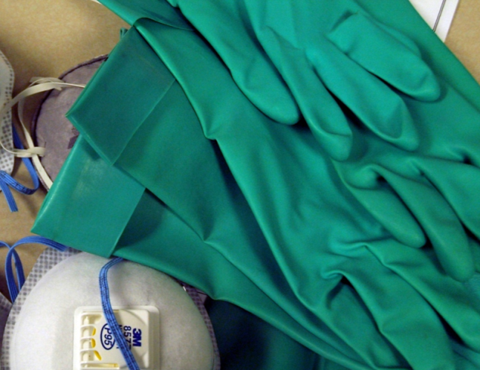
Unlined Gloves

Slide 47

Eyewear
Suitable eyewear
  may be goggles
  face shield
  safety glasses with brow protection.
Read product label for chemical splash resistant information
Goggles that are vented may not provide the adequate level of protection
Indirect vented goggles can be used
Goggle/safety glass straps should be worn under required protective headgear

Slide 48
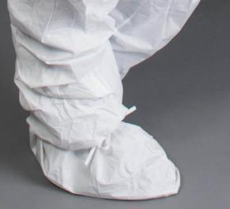
Footwear
Do not use leather or fabric footwear
Use chemical resistant boots or shoe covering
Wear proper size/ fit of chemical resistant footwear
Do not tuck pant legs inside (spray may run down into boot)
If pants must be tucked in -seal with duct tape

Slide 49
Care & Maintenance of PPE
Store personal protective equipment separately from other clothing
Store respiratory and eye protection in a clean and safe place away from children
Label storage units appropriately
Check all straps, filters, face pieces, lenses, footwear, gloves, etc. daily for tears, leaks, signs of wear and replace immediately if needed
Follow federal, state, and/or local laws for PPE disposal
Notes:
The “How to Comply with the Worker Protection Standard for Agricultural Pesticides is an excellent resource

Slide 50
Respiratory Protection
Respirator requirements for pesticide exposures on the product label
Use only respirators certified by the National Institute for Occupational Safety & Health (NIOSH)
Be familiar with the NIOSH categories for respiratory protection(N,P,R and 97,99,100)
Know if a respirator program and medical evaluation is required for your business
Notes:
The pesticide label will usually state a dust/mist filtering face piece or a cartridge respirator (eg:,OV with dust pre-filter).

Slide 51
Respiratory Protection in Agriculture
Notes:
Photo property of AgriSafe Network

Slide 52

Appropriate Respiratory Protection
Understand Respiratory Hazards
Engineering controls- what is feasible
Avoid High Risk Exposures if Possible
Protection – how can you help?
  Right mask for the job
  The right fit for the mask (fit testing)
  Are masks available? (where)
  Education on care and storage
Types of Respiratory Hazards:
Livestock & Poultry confinements
Industrial livestock production (CAFO)
Pesticides
Grain Handling
Anhydrous Ammonia
Welding
Using gas or diesel engine indoors
Fumigation
Silo Entry
Paint (spraying)
Woodworking
Notes:
Decision 2 – if you do need a Respirator then you need to decide this
Right mask for the job
The right fit for the mask
Have masks available
Choices can be expensive
Compliance can be an issue – going to discuss the Respiratory Standard and Respirator Program

Slide 53
Types of Respiratory Hazards
Livestock & Poultry confinements
Industrial livestock production (CAFO)
Pesticides
Grain Handling
Anhydrous Ammonia
Welding
Using gas or diesel engine indoors
Fumigation
Silo Entry
Paint (spraying)
Woodworking
Notes:
Sources of respiratory hazards are varied
What is a CAFO - Confined Animal Feeding Operation

Slide 54
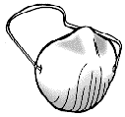
Inadequate Protection
Simple one-strap dust masks are not good enough

Slide 55
Types of Respirators
Air Purifying
Supplied Air
Notes:
Types of Respirators
Air – Purifying and Supplied Air

Slide 56
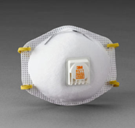
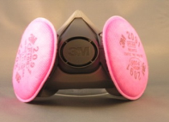
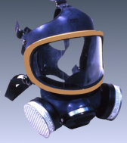
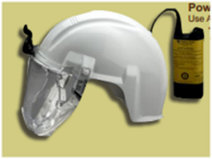
Air Purifying
Air Purifying
    Filtering face piece
      N series = not for use in presence of oil mist
      R series = some resistance to oil mist
      P series = for use where oil present
    Half mask face piece
    Full face piece
    Powered air purifying

Slide 57
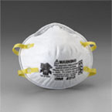
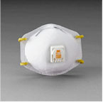
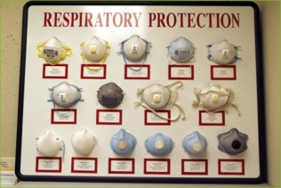
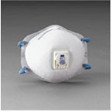
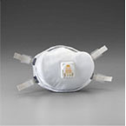
Two-strap disposable respirators
Filtering Face piece

Slide 58
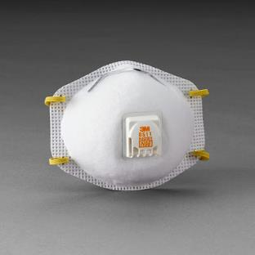

Filter Efficiency
Designation according to filter efficiency
  95 =moderate filtering efficiency (95%)
  99 = high filtering efficiency (99%)
  100 = highest filtering efficiency (99.97%)

Slide 59
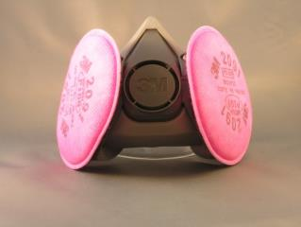

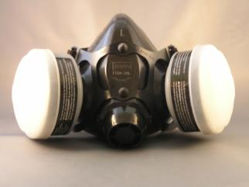
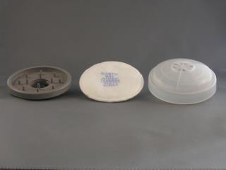
Half-mask respirator
Requires fit testing
Different brands and styles available
Several Cartridge choices
Support your wife, mother, sister, daughter for breast cancer

Slide 60
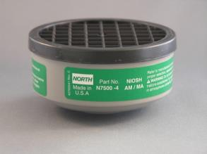
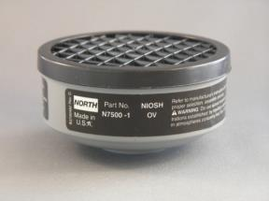
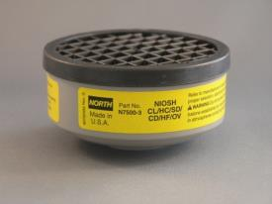
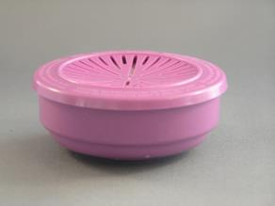
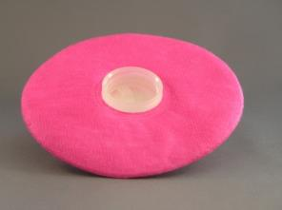
Half Mask Cartridges
Ammonia
Organic Vapor
Acid Gas
North Products
P100
P100
Mention of any company name in our presentations does not constitute an endorsement by AgriSafe
60
Notes:
Types of cartridges for canister respirator – photos property of AgriSafe Network

Slide 61

Air-purifying Respirator
A respirator with an air-purifying filter, cartridge, or canister that removes specific air contaminants by passing ambient air through the air-purifying element

Slide 62
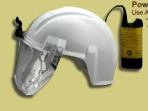
Powered Air-Purifying Respirator
An air-purifying respirator that uses a blower to force the ambient air through air-purifying elements to the inlet covering.
When do you need to use a powered air-purifying respirator?
  Heart and lung conditions that prevent use of other types of respirators
  Unable to get a good fit with other types
  Need higher protection factor

Slide 63
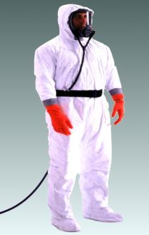
Supplied Air Respirator
An atmosphere-supplying respirator for which the source of breathing air is not designed to be carried by the user. Also called airline respirator.
When to use
Manure pits or confinement buildings during pit agitation or pumping
Environments with poor ventilation creating high levels of carbon monoxide
Fumigation in enclosed areas
Special training and regulations apply

Slide 64
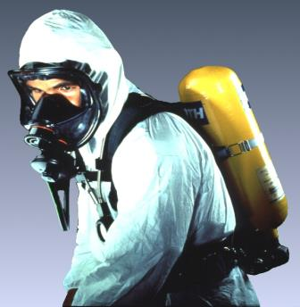
Self-contained Breathing Apparatus (SCBA)
An atmosphere-supplying respirator for which the breathing air source is designed to be carried by the user.
When to use:
  Manure pits or confinement buildings during pit agitation or pumping
  Environments with poor ventilation creating high levels of carbon monoxide
  Fumigation in enclosed areas
  Silo entry that is oxygen limiting

Slide 65

OSHA’s Respiratory Protection Standard - 29 CFR 1910.134
SEARCH
Regulations
A- Z INDEX
Notes:
OSHA’s Respiratory Protection Standard is 29 CFR 1910.134
located on the OSHA website shown on this slide
Can get to this place 3 different ways
1- Search
2- Regulations
3- A-Z Index (respirators)
4- Google search

Slide 66
Respiratory Program Elements
1. Selection
2. Medical evaluation
3. Fit testing
4. Use
5. Maintenance and care
6. Breathing air quality and use
7. Training
8. Program evaluation
Notes:
Section C of the Standard is the Respiratory Program
includes the following 8 elements
1. Selection
2. Medical evaluation
3. Fit testing
4. Use
5. Maintenance and care
6. Breathing air quality and use
7. Training
Program evaluation
Who can manage your program?
Someone who has appropriate training, knowledge and experience about respirators
Certification is not necessary
Program manager can delegate sections of program such as fit testing, maintenance, as long as over see that individual

Slide 67
Respiratory Program
Must develop a written program with worksite-specific procedures when respirators are necessary or required by the employer
Must update program as necessary to reflect changes in workplace conditions that affect respirator use
Must designate a program administrator who is qualified by appropriate training or experience to administer or oversee the program and conduct the required program evaluations
Must provide respirators, training, and medical evaluations at no cost to the employee
Note: OSHA has prepared a Small Entity Compliance Guide that contains criteria for selection of a program administrator and a sample program – Publication OSHA 3384 - 09 2011
Notes:
A Respiratory Program that meets the OSHA standard must :
develop a written program with worksite-specific procedures when respirators are necessary or required by the employer
update program as necessary to reflect changes in workplace conditions that affect respirator use
designate a program administrator who is qualified by appropriate training or experience to administer or oversee the program and conduct the required program evaluations
provide respirators, training, and medical evaluations at no cost to the employee
Other resources:
CPL 02-00-120 OSHA Instruction for Inspection Procedures for the Respiratory Protection Standard 09/25/1998 - tells how OSHA enforces this standard (what OSHA expects)
Letters of Interpretation can be helpful –located on OSHA website

Slide 68
Respirator Program (cont’d)
Where Respirator Use is Not Required
Employer may provide respirators at employee’s request or permit employees to use their own respirators, if employer determines that such use in itself will not create a hazard
If voluntary use is permissible, employer must provide users with the information contained in Appendix D
Must establish and implement those elements of a written program necessary to ensure that employee is medically able to use the respirator and that it is cleaned, stored, and maintained so it does not present a health hazard to the user
Exception: Employers are not required to include in a written program employees whose only use of respirators involves voluntary use of filtering face pieces (dust masks).
Notes:
When a Respirator is not required:
Employer may provide respirators at employee’s request or permit employees to use their own respirators, if employer determines that such use in itself will not create a hazard
If voluntary use is permissible, employer must provide users with the information contained in Appendix D. Employer should document that they provided this information. This is not a training. Can copy this and give it to them so be sure to document what you did. Document for each individual even if do a group session.
Must establish and implement those elements of a written program necessary to ensure that employee is medically able to use the respirator and that it is cleaned, stored, and maintained so it does not present a health hazard to the user.
Exception: Employers are not required to include in a written program employees whose only use of respirators involves voluntary use of filtering face pieces (dust masks).
Employer needs to be sure that the mask does not become the hazard. (For example the mask causing or contributing to a medical condition).

Slide 69
Selection of Respirators (cont’d)
Select a NIOSH-certified respirator that shall be used in compliance with the conditions of its certification
Identify and evaluate the respiratory hazards in the workplace, including a reasonable estimate of employee exposures and identification of the contaminant’s chemical state and physical form
Where exposure cannot be identified or reasonably estimated, the atmosphere shall be considered Immediately Dangerous to Life or Health (IDLH)
Select respirators from a sufficient number of models and sizes so that the respirator is acceptable to, and correctly fits, the user
Notes:
Select a NIOSH-certified respirator that shall be used in compliance with the conditions of its certification
Identify and evaluate the respiratory hazards in the workplace, including a reasonable estimate of employee exposures and identification of the contaminant’s chemical state and physical form
Where exposure cannot be identified or reasonably estimated, the atmosphere shall be considered Immediately Dangerous to Life or Health (IDLH)
Select respirators from a sufficient number of models and sizes so that the respirator is acceptable to, and correctly fits, the user

Slide 70
Medical Evaluation Procedures
Must provide a medical evaluation to determine employee’s ability to use a respirator, before fit testing and use
Must identify a PLHCP to perform medical evaluations using a medical questionnaire or an initial medical examination that obtains the same information
Medical evaluation must obtain the information requested by the questionnaire in Sections 1 and 2, Part A of App. C
Follow-up medical examination is required for an employee who gives a positive response to any question among questions 1 through 8 in Section 2, Part A of App. C or whose initial medical examination demonstrates the need for a follow-up medical examination
Notes:
Must provide a medical evaluation to determine employee’s ability to use a respirator, before fit testing and use
Must identify a PLHCP to perform medical evaluations using a medical questionnaire or an initial medical examination that obtains the same information
Medical evaluation must obtain the information requested by the questionnaire in Sections 1 and 2, Part A of App. C
Follow-up medical examination is required for an employee who gives a positive response to any question among questions 1 through 8 in Section 2, Part A of App. C or whose initial medical examination demonstrates the need for a follow-up medical examination

Slide 71

Physician or Other Licensed Health Care Professional (PLHCP)
Notes:
This can be physician, nurse, nurse practitioner, physician assistant
Does not have to be a physican.

Slide 72
Medical Evaluation
Additional Medical Evaluations
Annual review of medical status is not required
At a minimum, employer must provide additional medical evaluations if:
  Employee reports medical signs or symptoms related to the ability to use a respirator
  PLHCP, supervisor, or program administrator informs the employer that an employee needs to be reevaluated
  Information from the respirator program, including observations made during fit testing and program evaluation, indicates a need
  Change occurs in workplace conditions that may substantially increase the physiological burden on an employee
Notes:
Annual review of medical status is not required- depends on each person
At a minimum, employer must provide additional medical evaluations if:
Employee reports medical signs or symptoms related to the ability to use a respirator
PLHCP, supervisor, or program administrator informs the employer that an employee needs to be reevaluated
Information from the respirator program, including observations made during fit testing and program evaluation, indicates a need
Change occurs in workplace conditions that may substantially increase the physiological burden on an employee

Slide 73

Fit Testing
Before an employee uses any respirator with a negative or positive pressure tight-fitting face piece, the employee must be fit tested with the same make, model, style, and size of respirator that will be used.
Notes:
Photo property of AgriSafe Network
Fit testing must be done for each employee prior to use of a respirator

Slide 74
User Seal Check
An action conducted by the respirator user to determine if the respirator is properly seated to the face.
Positive Pressure Check
Negative Pressure Check
Notes:
Photos from OSHA Website
User Seal check is part of teaching user to determine proper fit test when using respiratory protection

Slide 75



Demonstration - education
Notes:
Education needs to include demonstration to be effective
Photos property of AgriSafe Network

Slide 76


Maintenance and Care
Notes:
Photo from OSHA website
Maintenance and Care is a critical part of the respiratory program
Follow procedures in Appendix B-2 or by manufactures recommendations
Establish a cleaning procedure and guidelines

Slide 77
Identification of Filters,
Cartridges, and Canisters
All filters, cartridges and canisters used in the workplace must be labeled and color coded with the NIOSH approval label
The label must not be removed and must remain legible
“TC number” is no longer on cartridges or filters (Part 84)
Marked with “NIOSH”, manufacturer’s name and part number, and an abbreviation to indicate cartridge or filter type (e.g., N95, P100, etc.)
Matrix approval label supplied, usually as insert in box
Important to use same manufacture for cartridges as respirator facepiece
Notes:
All filters, cartridges and canisters
used in the workplace must be labeled
and color coded with the NIOSH
approval label
The label must not be removed and must remain legible
“TC number” is no longer on cartridges or filters (Part 84)
Marked with “NIOSH”, manufacturer’s name and part number, and an abbreviation to indicate cartridge or filter type (e.g., N95, P100, etc.)
Matrix approval label supplied, usually as insert in box

Slide 78



Respiratory Exposures
To determine appropriate respiratory protection:
  Known the activity
  Understand the exposure
  Determine appropriate respirator
Notes:
Multiple types of operations and exposures
Ag Industry has several types of Respiratory Hazards

Slide 79



Hog or Poultry Confinement
Combination of hazards. (particles of grain, feces, insect parts, bacteria, ammonia)
Different types of masks are appropriate.

Slide 80



Hog or Poultry Confinement
Hazard: Organic Dust - Ammonia - Disinfectant – Carbon Monoxide- Hydrogen Sulfate
Respirator Selection :
Organic Dust: Filtering face piece, disposable 2 strap mask or half mask with dust cartridge or HEPA filter ( Examples: 3M 8210, 8511, 8271, 3M 8233 or Moldex 2200, 2300)
Ammonia = Filtering face piece or if symptomatic or dislike ammonia smell use half or full face mask with ammonia cartridge and prefilter
Disinfectants = half mask with acid gas cartridge.
Carbon Monoxide = supplied air respirators.
Hydrogen Sulfate = supplied air respirators.
Notes:
Ammonia – field application is different
Pre filter is important
Add picture with ammonia cartridge and prefilter

Slide 81


Livestock
Cattle
Sheep
Goats
Hazards: feeding grain and storage of hay and bedding.

Slide 82



Grain Dust
Can cause Toxic Dust Organic Syndrome or Farmers Lung
Corn, soybeans, peanuts , wheat, other.
Hazard: Organic dust (feed or grain dust, molds and spores).
Respirator Selection:
  N95 or N100 Filtering face piece
  3M 8210
  3M 8511
  3M 8271
  Half Mask with N95 or N100 pancake filters

Slide 83




Hay
Hazard can be organic dust (molds and spores).
Can cause Toxic Dust Organic Syndrome or Farmers Lung.
Protection: N95 – N100 Filtering face pieces – many options .
3M 8271 good seal
3M 8511
3M P100

Slide 84

Pesticides
Hazard is organic vapors and aerosols (solid and sprayed liquids).
Respirator selection:
  Solids – filtering face piece N,R, or P series.
  Liquids – Half mask face piece with Organic Vapor cartridge and P pre-filter.
  Can also use full face piece or powered air purifying respirator.
Notes:
Appropriate filter and or cartridge related to Label and exposure

Slide 85

Pesticides
Read Label or MSDS which provides information on respirator selection.

Slide 86
Demonstration Education
Notes:
Education needs to include demonstration to be effective
Photos property of AgriSafe Network

Slide 87


Storage
We recommend a central location on the farm or work place for storing most PPE supplies.
This could be a cabinet in the office or machine shed or a tackle box or rubber maid container – the main thing is that PPE is clean and easily accessible.

Slide 88




Choice and Comfort
Use of Appropriate Personal
Protective Equipment

Slide 89


Whistle Blower Protection Program
OSHA.gov
Whistle Blower Fact Sheet (FS 3638)
Notes:
Within OSHA is the whistle blower program
Website resources
22 statutes
-

Slide 90
Employee Rights and Responsibilities
You have the right to:
  A safe and healthful workplace
  Know about hazardous chemicals
  Information about injuries and illnesses in your workplace
  Complain or request hazard correction from employer
Notes:
Review Employee Rights

Slide 91
Employee Rights and Responsibilities
You have the right to:
  Training
  Access to hazard exposure and medical records
  File a complaint with OSHA
  Participate in an OSHA inspection
  Be free from retaliation for exercising safety and health rights
Notes:
Review Employee Rights

