Slide 1
Fall Prevention in Agriculture
This material was produced under a grant (SH20836SHO) from the Occupational Safety and Health Administration, U.S. Department of Labor. It does not necessarily reflect the views or policies of the U.S. Department of Labor, nor does the mention of trade names, commercial products, or organization imply endorsement by the U.S. Government.
Notes:
Title page and credits for OSHA and NECAS.

Slide 2
Statistics:
Involvement in Farming in the U.S.
2.1 Million farmers
2% of the population
Notes:
5
Here in the US it include about 2% of the population and we are seeing a shift from the family farm to larger production units.
The wife is working off the farm to bring revenue and insurance back to the farm

Slide 3
Statistics of Injury/Mortality:
U.S.
70,000 Disabling Injuries
479 Fatalities (2013)
40% are tractor related
22.2 deaths per 100,000 workers
Notes:
7
Here in the US are injuries and fatality numbers are getting better but
Voluntary standard for tractor manufactures to install ROPS since 1985
22.2 deaths per 100,000 workers

Slide 4
Fall Prevention & Protection
In this section, you will learn about:
  The Hierarchy of Hazard Controls
  Fall Protection Systems
  Selection of Proper Fall Protection Systems
  Rescue
Notes:
The hierarchy of controls gets the participants to think about processes they have at their job site and identify the best way to prevent if not eliminate the hazard entirely.
We will discuss the remainder of the information later in the module.

Slide 5

The Hierarchy of Hazard Controls
The following are arranged from most effective to least effective:
1. Engineering Controls
  Elimination
  Substitution
2. Administrative Controls
3. Personal Protective Equipment
Notes:
This slide is intended to show the participants all of the hazard controls from most effective to least effective. They will all be discussed later in the module.

Slide 6

The Hierarchy of Hazard Controls
Engineering Controls are changes to the environment to prevent employee exposure to potential hazards.
There are two types of engineering controls we will discuss:
  Elimination
  Substitution
Notes:
Engineering controls are important for the employee to understand. By simply changing the environment, hazard prevention is beginning to occur.

Slide 7
The Hierarchy of Hazard Controls
Elimination – Remove/Eradicate
Elimination is by far the best way to control a hazard.
  An example of eliminating a hazard would be to complete work at ground level instead of working at heights.
Notes:
The definition of elimination was taken from the Merriam-Webster Dictionary, New Edition.

Slide 8
The Hierarchy of Hazard Controls
Substitution – To put or use in place of another.
Substitution is also a very good method of controlling hazards.
  An example of substitution would be to use a lift to get into a position to work at heights instead of physically climbing.
Notes:
The definition of substitution was taken from the Merriam-Webster Dictionary, New Edition.

Slide 9
The Hierarchy of Hazard Controls
Administrative Controls directly effect workplace policies and procedures.
  An example of administrative controls would be employee training with RF radiation.
Administrative Controls include the following (but are not limited to):
  Employee Training
  Alarms
  Job Rotation
Notes:
Training and other administrative controls are what most employers rely on for safety. By informing the participant of the hierarchy of controls, the participant gains an understanding of the most effective controls in regards to hazards.

Slide 10
The Hierarchy of Hazard Controls
Personal Protective Equipment (PPE) is the last level of protection for employees.
There are many forms of PPE. The many different forms protect different areas of the body such as (not limited to):
  Head
  Foot
  Hand
  Hearing
  Eye
Notes:
PPE is the last level of control because the hazard is still present. The participants will discuss the different types of PPE. The discussion will help the participants to understand that the hazards are still present even if PPE is being used.

Slide 11
Fall Protection Systems
Types of fall protection
  Guardrails
  Personal Fall Arrest System or PFAS
  Safety Nets
Notes:
The types of fall protection listed above will be discussed later in the module. These types of fall protection are recognized by OSHA and listed in Subpart M of the CFR.

Slide 12
Guardrails
Guardrails provide workers with fall protection in the form of fall restraint.
  Fall restraint is a system that, because of design, does not allow an employee to experience a fall.
Notes:
Guardrail systems are a form of fall restraint. The participants will discuss the differences between fall restraint and fall arrest. This discussion is intended to inform the participants that there are different types of protection: fall restraint and fall arrest. Guardrails are forms of engineering controls, discuss why.

Slide 13
Guardrails
OSHA requires a guardrail to meet the following criteria:
Height
  Top Rail – 39 to 45 inches in Construction (42 inches in General Industry)
  Mid Rail – between the top rail and the surface in Construction
  (21 inches in General Industry)
  Toe Board – 3 ½ inches tall in Construction (4 inches in General Industry)
Notes:
1926.502(b)(1)
Top edge height of top rails, or equivalent guardrail system members, shall be 42 inches (1.1 m) plus or minus 3 inches (8 cm) above the walking/working level. When conditions warrant, the height of the top edge may exceed the 45-inch height, provided the guardrail system meets all other criteria of this paragraph.
1926.502(b)(2)
Midrails, screens, mesh, intermediate vertical members, or equivalent intermediate structural members shall be installed between the top edge of the guardrail system and the walking/working surface when there is no wall or parapet wall at least 21 inches (53 cm) high.

Slide 14
Guardrails
Load Rating
  Must be able to withstand a minimum force of 200 pounds in a downward, outward motion.
Notes:
1926.502(b)(4)
When the 200 pound (890 N) test load specified in paragraph (b)(3) of this section is applied in a downward direction, the top edge of the guardrail shall not deflect to a height less than 39 inches (1.0 m) above the walking/working level. Guardrail system components selected and constructed in accordance with the Appendix B to subpart M of this part will be deemed to meet this requirement.

Slide 15
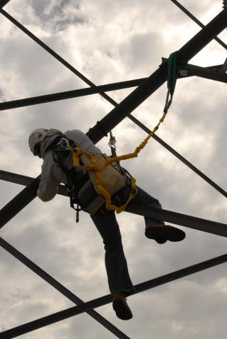
Personal Fall Arrest Systems (PFAS)

Slide 16
Personal Fall Arrest Systems (PFAS)
A PFAS consists of the following components:
  Anchorage Point
  Body Harness
  Connector
  A+B+C=PFAS
Notes:
The A+B+C=PFAS equation is intended for the participant to understand all three components must be used in order to have a true PFAS.

Slide 17
Personal Fall Arrest Systems (PFAS)
Anchorages used for attachment of personal fall arrest equipment shall be independent of any anchorage being used to support or suspend platforms and capable of supporting at least 5,000 pounds (22.2 kn.) per employee attached
Notes:
1926.502(d)(15)
Anchorages used for attachment of personal fall arrest equipment shall be independent of any anchorage being used to support or suspend platforms and capable of supporting at least 5,000 pounds (22.2 kN) per employee attached.
This standard is very important for the participants to understand. A 5,000 lb. anchorage point is vital in when being used with a personal fall arrest system or PFAS.

Slide 18
Personal Fall Arrest Systems (PFAS)
A body harness is defined by OSHA as: “straps which may be secured about the employee in a manner that will distribute the fall arrest forces over at least the thighs, pelvis, waist, chest and shoulders with means for attaching it to other components of a personal fall arrest system”
Notes:
A body harness is defined by OSHA as: “straps which may be secured about the employee in a manner that will distribute the fall arrest forces over at least the thighs, pelvis, waist, chest and shoulders with means for attaching it to other components of a personal fall arrest system”

Slide 19
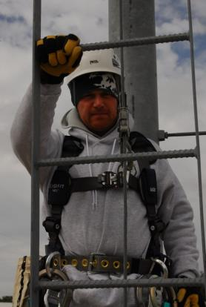
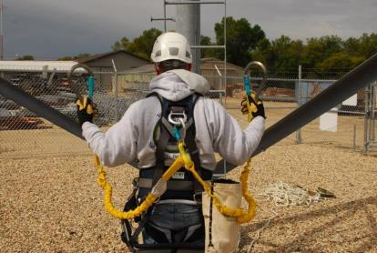
Personal Fall Arrest Systems (PFAS)
Back view of a full body harness.
Front view of a full body harness.
Notes:
The intent of this picture is to familiarize the participant with what a properly fit harness looks like as well as the different components that can be used in fall protection. The different components will be discussed throughout the module.

Slide 20
Personal Fall Arrest Systems (PFAS)
Connectors are devices used to connect the body harness to the anchorage point.
Examples of connectors are:
  Carabiners
  Buckles
  Dee-rings
  Snap-hooks
Notes:
Connectors are defined by OSHA as: “A device which is used to couple (connect) parts of the PFAS and positioning device systems together. It may be an independent component of the system, such as a carabiner, or it may be an integral component of part of the system (such as a buckle or dee-ring sewn into a body belt or body harness, or a snap-hook spliced or sewn to a lanyard or self-retracting lanyard.)

Slide 21
Selection of Proper Fall Protection Systems
When selecting fall protection systems, you must first determine the most feasible form of fall protection possible.
The only form of feasibility that must be considered is technical feasibility.
Economic feasibility, when discussing safety, is prohibited.
Notes:
Example of technical feasibility:
If you are unloading material off a flatbed semi trailer, you do not need fall protection. However, if you stand on material on that same flatbed fall protection is required. How feasible is fall protection on a flatbed semi trailer?
Example of economic feasibility:
If the safety equipment costs too much to implement, the employees remain at high risk of injury because the employer did not spend the money on the equipment.

Slide 22
Safety Nets
Safety Nets must meet the following criteria:
  Installed a maximum of 30' below working level
  400 pound drop test or certified by employer or Competent Person
  Extends sufficiently from outer edge
  Inspected weekly
  Objects removed from net within shift
  Border rope strength of 5000 pounds
Notes:
1926.502(c)(1)
Safety nets shall be installed as close as practicable under the walking/working surface on which employees are working, but in no case more than 30 feet (9.1 m) below such level. When nets are used on bridges, the potential fall area from the walking/working surface to the net shall be unobstructed.
1926.502(c)(4)(i)
Except as provided in paragraph (c)(4)(ii) of this section, safety nets and safety net installations shall be drop-tested at the jobsite after initial installation and before being used as a fall protection system, whenever relocated, after major repair, and at 6-month intervals if left in one place. The drop-test shall consist of a 400 pound (180 kg) bag of sand 30 + or - 2 inches (76 + or - 5 cm) in diameter dropped into the net from the highest walking/working surface at which employees are exposed to fall hazards, but not from less than 42 inches (1.1 m) above that level.
1926.502(c)(5)
Defective nets shall not be used. Safety nets shall be inspected at least once a week for wear, damage, and other deterioration. Defective components shall be removed from service. Safety nets shall also be inspected after any occurrence which could affect the integrity of the safety net system.
1926.502(c)(8)
Each safety net (or section of it) shall have a border rope for webbing with a minimum breaking strength of 5,000 pounds (22.2 kN).
1926.32(f)
Competent person means one who is capable of identifying existing and predictable hazards in the surroundings or working conditions which are unsanitary, hazardous, or dangerous to employees, and who has authorization to take prompt corrective measures to eliminate them.

Slide 23
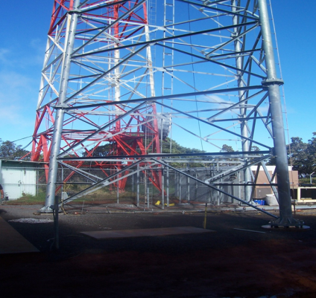
Selection of Proper Fall Protection Systems
For example:
  If your job was to climb a lattice tower, what form of fall protection would be the most feasible?
Notes:
In the picture above, a Personal Fall Arrest System (PFAS) would be the most feasible form of fall protection to use.

Slide 24
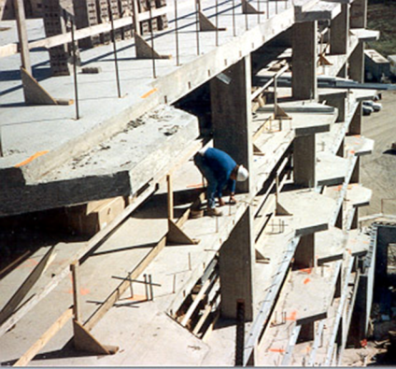
Selection of Proper Fall Protection Systems
For Example:
  If you were building a multi-story building, what form of fall protection would be the most feasible?
Notes:
The picture in this slide was taken from the OSHA website. http://www.osha.gov/dte/outreach/construction_generalindustry/const_outreach_tp.html
In the picture above, there is a guardrail but the employee is on the wrong side of it. The guardrail is the most feasible in this case.

Slide 25
Rescue
OSHA states that, “The employer shall provide for prompt rescue of employees in the event of a fall or shall assure that employees are able to rescue themselves.”
Notes:
1926.502 (d)(20)
The employer shall provide for prompt rescue of employees in the event of a fall or shall assure that employees are able to rescue themselves.
The participants must be made aware that if they are exposed to fall hazards, they also will be provided with a means to be rescued or rescue themselves.

Slide 26
Fall Prevention & Protection
We learned about the different hazard controls to reduce or eliminate the hazard of a fall:
  Engineering Controls
  Administrative Controls
  Personal Protective Equipment
We learned about the different types of fall prevention and protection systems:
  Guardrails
  Personal Fall Arrest System
  Safety Nets
Notes:
Summary of the items discussed during this module. Review with participants to ensure retention.

Slide 27
Agriculture Exemption
Enforcement Guidance for Small Farming Operations
The Appropriations Act exempts small farming operations from enforcement of all rules, regulations, standards or orders under the Occupational Safety and Health Act. A farming operation is exempt from all OSHA activities if it:
Employs 10 or fewer employees currently and at all times during the last 12 months; and
Has not had an active temporary labor camp during the proceeding 12 months.
  Note: Family members of farm employers are not counted when determining the number of employees.
  Important to check with your state OSHA since there are 25 states that match or exceed this OSHA Instruction
Source: OSHA Instruction CPL 02-00-051
Notes:
Agricultural Exemption - Appropriations Act
Enforcement Guidance for Small Farming Operations. The Appropriations Act exempts small farming operations from enforcement of all rules, regulations, standards or orders under the Occupational Safety and Health Act.
A farming operation is exempt from all OSHA activities if it:
Employs 10 or fewer employees currently and at all times during the last 12 months; and
Has not had an active temporary labor camp during the proceeding 12 months.
Note: Family members of farm employers are not counted when determining the number of employees.
Important to check with your state OSHA since there are 25 states that match or exceed this OSHA Instruction
Consider giving an example from a state – California is typically more stringent
Source: OSHA Instruction CPL 02-00-051

Slide 28
Employee Rights and Responsibilities
You have the right to:
  A safe and healthful workplace
  Know about hazardous chemicals
  Information about injuries and illnesses in your workplace
  Complain or request hazard correction from employer
Notes:
28

Slide 29
Employee Rights and Responsibilities
You have the right to:
  Training
  Access to Hazard exposure and medical records
  File a complaint with OSHA
  Participate in an OSHA inspection
  Be free from retaliation for exercising safety and health rights
Notes:
29

Slide 30
Employee Rights and Responsibilities
OSHA website: www.osha.gov and OSHA offices: Call or Write (800-321-OSHA)
Compliance Assistance Specialists in the area offices
National Institute for Occupational Safety and Health (NIOSH) – OSHA’s sister agency
OSHA Training Institute Education Centers
Doctors, nurses, other health care providers
Public libraries
Other local, community-based resources
Notes:
30

Slide 31


Disclaimers
This material was produced under a grant (SH23598SH2) from the Occupational Safety and Health Administration, U.S. Department of Labor. It does not necessarily reflect the views or policies of the U.S. Department of Labor, nor does the mention of trade names, commercial products, or organization imply endorsement by the U.S. Government.
Notes:
Material possible from
US Dept of Health and Human Services
EPA
OSHA

Slide 32
Summary
Confined spaces are entered safely every day. However, for them to be entered safely, specific procedures must be followed.
It is hoped that the information provided in this program gives you the information needed to enter the spaces that you may encounter safely.

Slide 33

Whistleblower Fact Sheet
(FS 3638)
Notes:
Review Employee Rights – OSHA Publication Fact Sheet (FS) 3638

Slide 34

Whistle Blower Protection Program
Notes:
With in OSHA is the whistle blower program
Website resources
22 statutes

Slide 35
Fall Protection In Agriculture Questions
1) Select the correct order in the Hierarchy of Fall protection:
  A) Administrative Controls, Engineering Controls, Personnel Protective Equipment
  B) Personnel Protective Equipment, Administrative Controls, Engineering Controls
  C) Engineering Controls, Administrative Controls, Personnel Protective Equipment
  D) None of the above
  2) With Engineering Controls, which is the best way to control a hazard?
  a) Elimination
  b) Substitution
3) If there is not an Agricultural Standard, OSHA will apply according to
  a) Construction
  b) General Duty Clause
  c) Utilities
  d) Manufacturing
4) Guardrails must be able to withstand a minimum force of _______ pounds in a downward, outward motion
  a) 200
  b) 250
  c) 275
  d) 300

Slide 36
Fall Protection In Agriculture Questions page 2
5) The height of handrails shall not be more than
  a) 37 inches
  b) 42 inches
  c) 45 inches
  d) 50 inches
6) Anchorages used for attachment of Personnel Fall Arrest equipment needs to be capable of supporting at least
  a) 3000 pounds
  b) 4000 pounds
  c) 5000 pounds
  d) 6000 pounds
7) When selecting fall protection systems, what should you consider?
  a) Technical Feasibility
  b) Economic Feasibility
  c) Both of the above
  d) Neither of the above
8 ) When selecting fall protection systems, what should you consider?
  a) Technical Feasibility
  b) Economic Feasibility
  c) Both of the above
  d) Neither of the above

Slide 37
Fall Protection In Agriculture Questions - page 3
9) Every pit or trap door floor opening, when not covered shall
  a) Be constantly attended by someone
  b) Be protected on all exposed sides by removable standard railing
  c) Both A and B
  d) None of the above
10) Falls accounted for 699 deaths in the United States in 2013, Falls in Agriculture accounted for how many number of deaths?
  a) 10
  b) 15
  c) 23
  d) 27
          Answers
          1) C
          2) A
          3) B
          4) A
          5) B
          6) C
          7) A
          8) C
          9) C
          10) A

