Slide 1

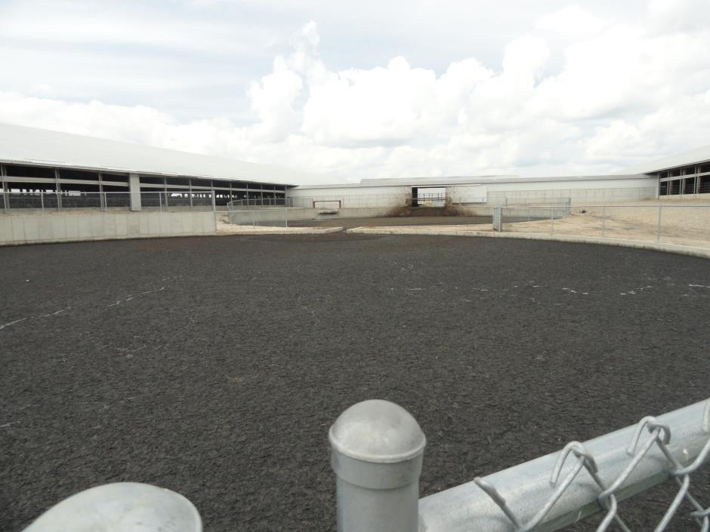
Manure Pit Safety
Manure Pit Safety
The National Education Center for Agricultural Safety (NECAS) 888-844-6322
Notes:
Picture is from the National Education Center for Agricultural Safety. Permission given to use photo

Slide 2
Program Objectives
At the conclusion of this presentation, participants will:
  Be able to identify hazards associated with confined space work associated with manure pits
  Understand the process for confined space entry and lock out/tag out procedures
  Know where to look for OSHA references and resources related to confined space entry in the agricultural industry

Slide 3
Statistics:
Involvement in Farming in the U.S.
2.1 Million farmers
2% of the population
Notes:
5
Here in the US it include about 2% of the population and we are seeing a shift from the family farm to larger production units.
The wife is working off the farm to bring revenue and insurance .back to the farm

Slide 4
Statistics of Injury/Mortality:
U.S.
70,000 Disabling Injuries
500 Fatalities (2013)
40% are tractor related
23.2 deaths per 100,000 workers
Notes:
7
Here in the US are injuries and fatality numbers are getting better but
Voluntary standard for tractor manufactures to install ROPS since 1985
21.2 deaths per 100,000 workers

Slide 5
Manure Produced
Livestock type | Total manure | Nitrogen | Phosphorus
 | ------- lbs/day/1000-lb animal unit -------
Beef¹ | 59.1 | 0.31 | 0.11
Dairy² | 80.0 | 0.45 | 0.07
Hogs and pigs³ | 63.1 | 0.42 | 0.16
Chickens (layers) | 60.5 | 0.83 | 0.31
Chickens (broilers) | 80.0 | 1.10 | 0.34
Turkeys | 43.6 | 0.74 | 0.28
¹High forage diet. ²Lactating cow. ³Grower.
Notes:
USDA Animal Manure Management.

Slide 6
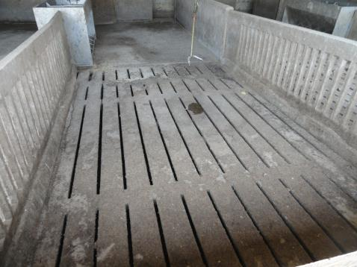
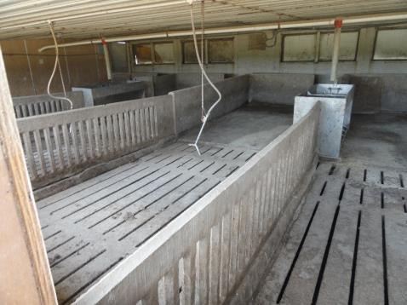
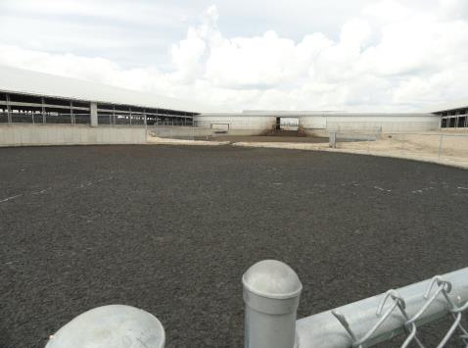
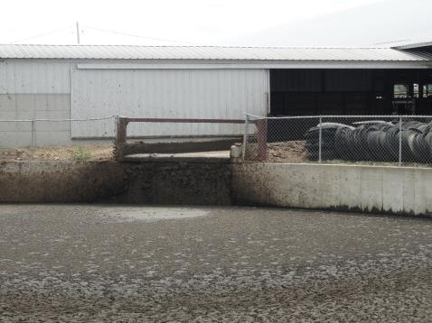
Manure operations
Notes:
Picture is from the National Education Center for Agricultural Safety. Permission given to use photo

Slide 7
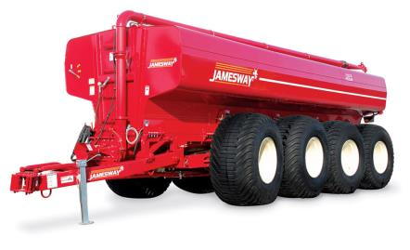
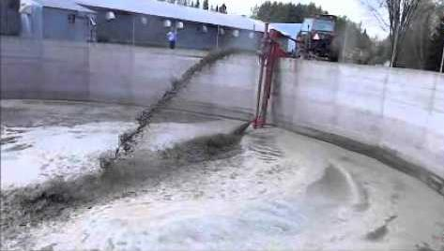
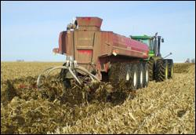
Farm Machinery
4500-9600 gallons. 51,150-106,500 lbs.
Notes:
Permission granted from Jamesway Farm Equipment
12 Route 249
St-Francois-Xavier QC
Canada J0B 2V0

Slide 8
Units of Instruction
Permit required confined space.
Lock out/Tag out
Air quality testing
PPE & Harnesses
Other Hazards
Entry/Exit
Rescue

Slide 9
Confined Space Entry
OSHA Regulation 29 CFR 1910.146
"Confined space" means a space that:
(1) Is large enough and so configured that an employee can bodily enter and perform assigned work; and
(2) Has limited or restricted means for entry or exit (for example, tanks, vessels, silos, storage bins, hoppers, vaults, and pits are spaces that may have limited means of entry.); and
(3) Is not designed for continuous employee occupancy.
Notes:
OSHA Regulation 29 CFR 1910.146
General Industry Standards, such as 1910.146, 1910.147 and 1910.134, are not applicable to agriculture. Depending on the establishments business classification [Standard Industrial Classification (SIC) or North American Industry Classification System (NAICS) codes], these standards may or may not apply. However, OSHA could cite the General Duty Clause using the general industry standard, consensus standard, and/or industry practice as a reference, for an agriculture business if appropriate. In addition the employer could be liable in a court of law.

Slide 10
Permit-Required Confined Space
By definition, a permit-required confined space has one or more of these characteristics:
Contains or has the potential to contain a hazardous atmosphere
Contains a material with the potential to engulf someone who enters the space
Has an internal configuration that might cause an entrant to be trapped or asphyxiated by inwardly converging walls or by a floor that slopes downward and tapers to a smaller cross section; and/or
Contains any other recognized serious safety or health hazards.
Notes:
A Manure pit or lagoon fits the criteria for Permit required

Slide 11
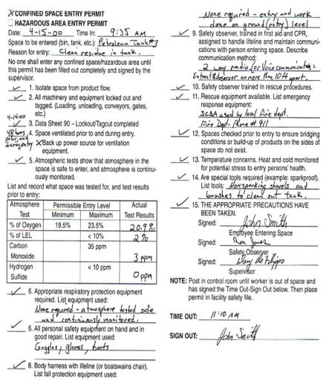
Complete Entry Permit Form
Permit must be correctly and completely filled out prior to entry.
Permit must be activated by Entry Supervisor’s signature to be valid.
No entry is allowed without a valid permit.
When work is completed, permit and evaluation form should be returned to your Safety Dept.
Cancelled permits must be kept on file for at least one year.
Notes:
146

Slide 12
Entry Permits
Permit space to be entered
Purpose of entry
Date & authorized duration of permit
Authorized entrants
Authorized attendants
Name & signature of entry supervisor
Hazards of permit space to be entered
Isolation of hazard control measures
Acceptable entry conditions
Results of initial & periodic atmospheric monitoring
Rescue & emergency services
Communications procedures
Equipment required for entry & rescue operations
Other necessary information & other required permits

Slide 13
Conduct a Pre-Entry Briefing
Entire crew must attend
  Attendants, entrants, entry supervisor
Review hazards of entry and work
Review PPE
Review procedure for contacting rescue
  verify rescue is available
Complete permit

Slide 14
Enter the Space and Proceed with work:
An attendant shall be posted near the entrance for the duration of the work. They shall be in constant communication with the entrants while the job is in progress.
All entrants shall sign a sign-in-log when entering the space and sign out when exiting.
The attendant shall maintain the permit and sign in log for the duration of the work.

Slide 15
When the Job is Done:
Remove all personnel, tools, and debris from the space. Sign off the permit.
Close the space.
Cancel the permit.
Review the job with all personnel (hazards, problems, etc.)

Slide 16
General Requirements
The atmosphere within a pit or tank shall be tested for oxygen content.
Additionally the atmosphere within a pit or tank shall be tested for the presence of combustible gases, vapors and toxic agents when the employer has reason to believe they may be present.
Notes:
272
Still will want to test oxygen level during your time in the space

Slide 17
General Requirements
If the oxygen level is less than 19.5% or if combustible gas or vapor is detected in access of 10% of the lower flammable limit, or if toxic agents are present in excess of ceiling limits or present in concentrations that will cause health effects which prevent employees from effecting self-rescue or communication to obtain assistance then the following apply:

Slide 18
General Requirements
A - Ventilation shall be provided until the unsafe condition or conditions are eliminated, and the ventilation shall be continued as long as there is a possibility of recurrence of the unsafe condition while the tank is occupied by employees.
B - If toxic or oxygen deficiency cannot be eliminated by ventilation, employees entering the tank shall wear an appropriate respirator. Respirator use shall be in accordance with the requirements of 29 CFR.1910.134.
Notes:
CFR.1910.134
Respirator standard is part of the General industry standard, however in a Agricultural establishment, OSHA would cite the General Duty Clause referencing the General Duty Standard.
General Industry Standards, such as 1910.146, 1910.147 and 1910.134, are not applicable to agriculture. Depending on the establishments business classification [Standard Industrial Classification (SIC) or North American Industry Classification System (NAICS) codes], these standards may or may not apply. However, OSHA could cite the General Duty Clause using the general industry standard, consensus standard, and/or industry practice as a reference, for an agriculture business if appropriate. In addition the employer could be liable in a court of law.

Slide 19
Lockout/Tagout
OSHA Regulation 29 CFR 1910.147
“Lockout” To physically insure that all mechanical or electrical systems, that can be energized or started up, or release stored energy, are secured, isolated, disabled, or rendered inoperative.
“Tagout” The placement of a device to indicate that the energy isolating device and the equipment being controlled may not be operated until the tagout device is removed.
Notes:
This is the OSHA regulations to Lock out Tag out
OSHA Regulation 29 CFR 1910.147

Slide 20
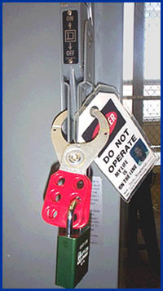
General Requirements
All mechanical, electrical, hydraulic and pneumatic which presents a danger to employees inside of the storage structures shall be de-energized and shall be disconnected, locked-out and tagged, blocked off, or otherwise prevented from operating from other equally effective means or methods.
Notes:
272
This would prevent the movement of manure
Picture from OSHA Lockout/Tagout ttps://www.osha.gov/dts/osta/lototraining/hottopics/ht-relche-1-4.html

Slide 21
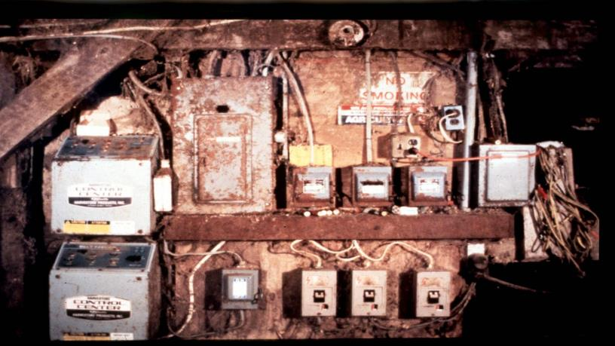
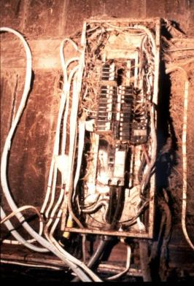
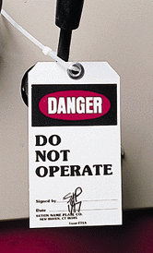
Lockout / Tagout
Where? How?
Notes:
Most farm electrical systems are not what you would call up to code. You may have to shut off power to the farm to be sure the pit is off.
OSHA Regulation 29 CFR 1910.147

Slide 22
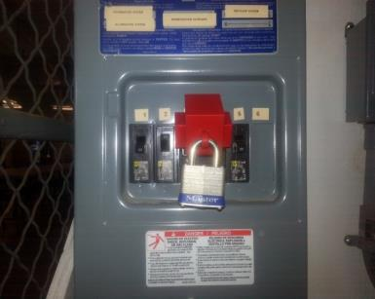
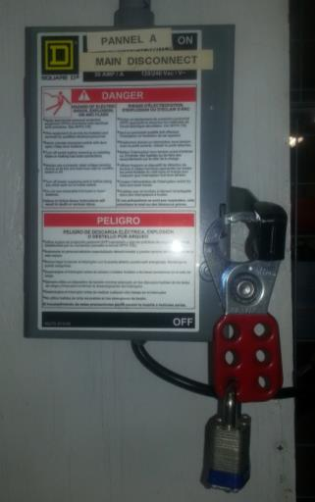
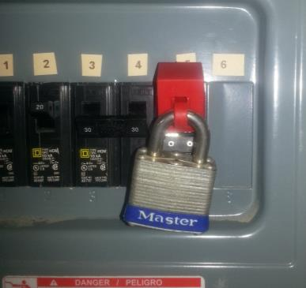
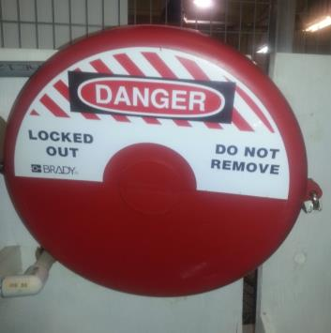
Electrical & Valves Lockout /Tag out
Notes:
Picture is from the National Education Center for Agricultural Safety. Permission given to use photo

Slide 23
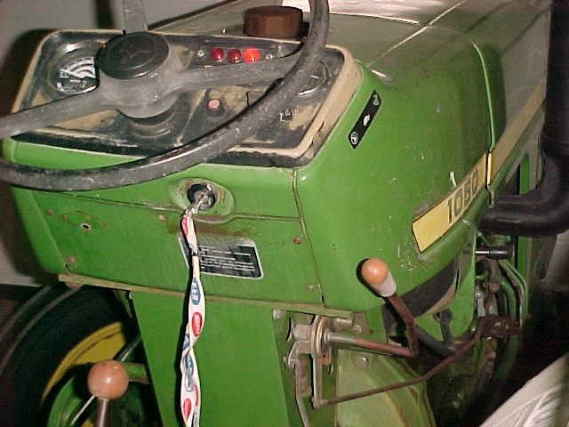
Shut off the tractor and power equipment.
Shut off the tractor and power equipment.
Keep ventilation fans operating.
Notes:
Picture is from the National Education Center for Agricultural Safety. Permission given to use photo

Slide 24
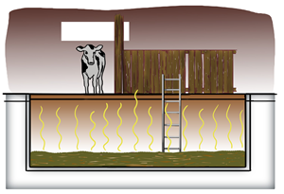
Atmospheric Hazards
Oxygen Deficiency
Presence of Combustible Gases
Presence of Hazardous Gases
None of these conditions can be seen!
Notes:
Permission granted to use slide. Davis E Hill, EMT-P, Sr. Extension Associate, The Pennsylvania State University, www.agsafety.psu.edu

Slide 25
Confined Space - Hazards
Oxygen deficiency can be caused by several different processes:
Consumption: oxygen is used up by the person who is in the confined space and is turned into carbon dioxide.
Displacement: denser materials push the oxygen out of the confined space.
Reaction: oxygen reacts with other materials to make other compounds.
  Work Performed in a confined space.
      Welding, cutting, painting, scraping, sanding, etc.

Slide 26
Confined Space – Hazards
O2
All living creatures require oxygen to live. One of the primary hazards of entering confined spaces is oxygen deficiency.
When oxygen is present in concentrations less than 19.5% the atmosphere is said to be oxygen deficient.
O2

Slide 27
IDLH
IMMEDIATELY DANGEROUS TO LIFE OR HEALTH
Any condition which poses an immediate threat to the life of an entrant, or;
Would cause irreversible adverse health effects, or;
Would interfere with an individual’s ability to escape unaided from a permit space.
Notes:
Source: NIOSH

Slide 28
IDLH
No person shall:
Enter – Work – or Remain
in an IDLH condition until such time that the condition has been eliminated or controlled.
Source: CDC/NIOSH
Notes:
Source: NIOSH

Slide 29
Toxic Atmospheres
Toxic atmospheres can be caused by:
  Product stored in a confined space.
      Gases released by decomposing manure.
      Decomposition of materials stored.
      Gases released when cleaning.
      Oxidation of metals
  Work Performed in a confined space.
      Welding, cutting, painting, scraping, sanding, etc.
    Toxic materials adjacent to a confined space.
Notes:
Davis E Hill, EMT-P, Sr. Extension Associate, The Pennsylvania State University, www.agsafety.psu.edu

Slide 30
Temperature Extremes
Extremely hot or cold outside temperatures can magnify the temperature inside the confined space.
Steam cleaning & working can increase temperatures within a confined space.
Humidity factors & wearing PPE can affect workers.
Attendant needs to keep watch on the entry worker & have them take frequent breaks with rest and water.

Slide 31
Oxygen Deficient Atmospheres
19.5% Minimum acceptable oxygen level.
15 –19% Decreased ability to work strenuously.
Impaired coordination.
12 –14% Respiration increases - Poor Judgment.
10 –12% Respiration increases – Lips Blue.
8 –10% Mental failure – Fainting, Nausea, Unconscious, Vomiting.
6 – 8% Possible recovery 4-5 minutes, 50 percent fatal after 6 minutes, fatal after 8 minutes
4 – 6% Coma in 40 seconds – Death.
Source: NIOSH Datasheet
Notes:
Source: NIOSH Datasheet

Slide 32
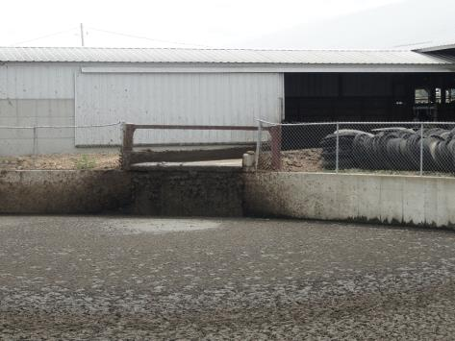
Oxygen Deficient Atmospheres
Hydrogen Sulfide
Carbon Dioxide
Ammonia
Carbon Monoxide
Methane
Notes:
Davis E Hill, EMT-P, Sr. Extension Associate, The Pennsylvania State University, www.agsafety.psu.edu
Picture is from the National Education Center for Agricultural Safety. Permission given to use photo

Slide 33
Hydrogen Sulfide
Hydrogen sulfide (H₂S) is a highly toxic gas with a "rotten egg" odor at low concentrations [NIOSH/OSHA 1981]. At high concentrations, hydrogen sulfide can paralyze the olfactory senses [NIOSH 1979]. Because this gas is heavier than air, it can settle near the bottom of the manure pit. Hydrogen sulfide is a severe eye irritant and may cause tissue damage [NIOSH/OSHA 1981]. At low concentrations, gas can cause dizziness, headache, nausea, and irritation of the respiratory tract. At high concentrations, hydrogen sulfide can cause unconsciousness, respiratory failure, and death within minutes. In addition, hydrogen sulfide may be explosive at a wide range of concentrations in air--4.3% to 46% by volume [NIOSH 1985a].
Notes:
NIOSH Alert / CDC: Preventing Deaths of Farm Workers in Manure Pits.

Slide 34
Carbon Monoxide
Odorless, cannot see or taste
By-product of combustion
Found in gas/oil furnaces, engines and small motors.
Notes:
Think about shutting off tractors and other fuel powered equipment around the area. Wind direction.

Slide 35
Carbon Monoxide
IDLH: 1200 ppm
Exposure Limits: NIOSH REL- TWA 35 ppm, OSHA PEL- TWA 50 ppm
Physical Description: Colorless, odorless gas
Exposure Routes: Inhalation, skin &/or eye contact
Symptoms: Headache, Tachypnea, Nausea, Weakness, Exhaustion, Dizziness, Confusion, Hallucinations, Cyanosis, Depressed S-T segment of electrocardiogram, Angina, Syncope
Notes:
NIOSH Pocket Guide to Chemical Hazards

Slide 36
Methane
Methane (CH₄), is an odorless gas that is flammable or explosive at concentrations of 5% to 15% by volume of air [NIOSH 1985b]. At high concentrations, methane can displace enough oxygen to cause death by suffocation. Because this gas is lighter than air, it occurs near the top of the pit. Methane should be expected to be present in manure pits.
Notes:
NIOSH Alert / CDC: Preventing Deaths of Farm Workers in Manure Pits.

Slide 37
Ammonia (NH₃)
Ammonia (NH₃) has the sharp odor characteristic of household ammonia [NIOSH/OSHA 1981]. This gas can severely irritate the eyes, nose, throat, and lungs. Exposure to high concentrations can be fatal.
Notes:
NIOSH Alert / CDC: Preventing Deaths of Farm Workers in Manure Pits.

Slide 38
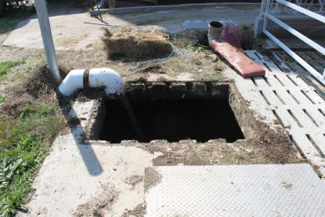
Carbon Dioxide (CO₂)
Product of decomposition
Common in manure storages.
Odorless, colorless.
Difficult to measure.
Displaces oxygen.
Notes:
Davis E Hill, EMT-P, Sr. Extension Associate, The Pennsylvania State University, www.agsafety.psu.edu

Slide 39
Carbon Dioxide
Carbon dioxide (CO₂) is an odorless that is normally in the atmosphere [NIOSH/OSHA 1981]. Because this gas is heavier than air, it can settle near the bottom of the manure pit. At low concentrations, carbon dioxide can result in labored breathing, drowsiness, and headache. At high concentrations, carbon dioxide can displace enough oxygen to cause death by suffocation.
Notes:
NIOSH Alert / CDC: Preventing Deaths of Farm Workers in Manure Pits.

Slide 40
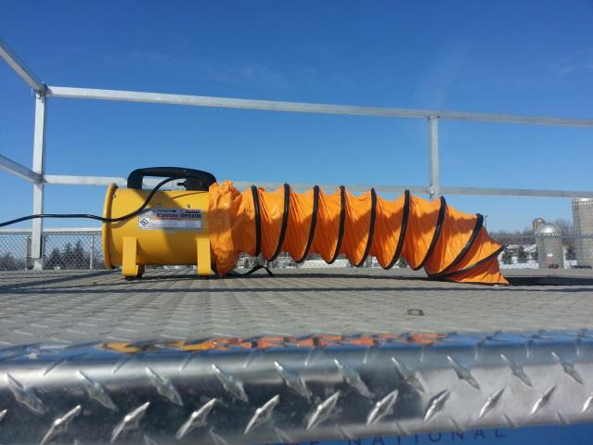
Ventilate the Space
Use mechanical ventilation
  Fans
Ventilate at the rate of at least four (4) volumes per hour
  Larger spaces require more ventilation
Make sure air supply is not contaminated
  Ventilation air supply must be from fresh air uncontaminated with flammables, toxins, etc.
  Gas powered fans can be Dangerous
Notes:
Picture is from the National Education Center for Agricultural Safety. Permission given to use photo

Slide 41
Air quality
Always test the air at different levels of the structure to make sure it is safe. The air might be clear at the top and deadly at the bottom.
GOOD AIR
BAD AIR
DEADLY AIR
Notes:
Picture is from the National Education Center for Agricultural Safety. Permission given to use photo

Slide 42
Atmosphere Testing Shall Be Performed:
Prior to every entry when the space is vacant;
At least hourly for permit-required confined spaces.
More frequently, if conditions or suspicions warrant.
Notes:
Even if you exit the space for lunch or a break you need to retest before entry.

Slide 43
Test the Atmosphere
In this order:
Check for Oxygen Content:
  At least 19.5% and less than 23.5%
Check for Combustibles:
  Less than 10% of the LEL
Check for Toxic Gases:
  Most commonly carbon monoxide (PEL 50 ppm)
  or any other hazardous materials as determined by the use of the space.
Notes:
The 4 gas detector needs to be tested regularly. Bump test (Calibration) before every use. Follow manufactures recommendation.

Slide 44







Personal Protective Equipment
Hard Hats
Eye Protection
Hearing Protection
Respirator
Protective Coveralls
Gloves
Footwear
Safety Harness
Once all the hazards are identified, the space has been ventilated and the atmosphere checked, determine what personal protective equipment will be necessary.
Notes:
Picture is from the National Education Center for Agricultural Safety. Permission given to use photo

Slide 45
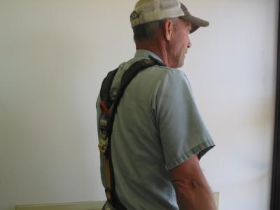
Personal Protective Equipment
Each entrant shall use a chest or full body harness or a boatswain’s chair, with a retrieval line attached to assist in removal.
Exception – Where the employer can demonstrate that the protection required is not feasible or creates a greater hazard, the employer shall provide an alternative means of protection which is demonstrated to prevent the employee from sinking further than waist-deep in the grain.
Notes:
Picture is from the National Education Center for Agricultural Safety. Permission given to use photo

Slide 46
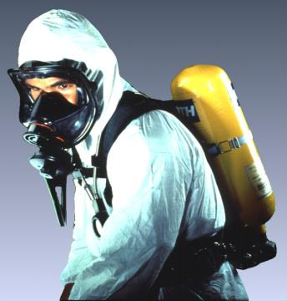
Self-contained Breathing Apparatus (SCBA)
An atmosphere-supplying respirator for which the breathing air source is designed to be carried by the user.
When to use:
- Manure pits or confinement buildings during pit agitation or pumping
- Environments with poor ventilation creating high levels of carbon monoxide
- Fumigation in enclosed areas
- Silo entry that is oxygen limiting

Slide 47
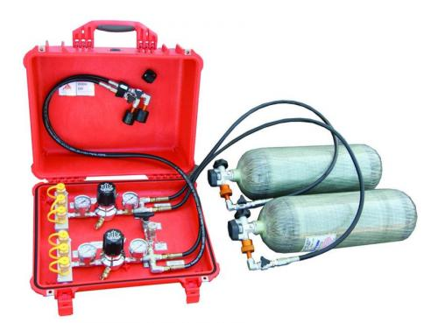
Supplied Air Unit
Notes:
Permission granted to use photo;
http://www.airsystems.cc/index.php/fire-rescue/multi-air-command-kits
Air Systems Inc.
829 Juniper Crescent
Chesapeake, VA 23320

Slide 48
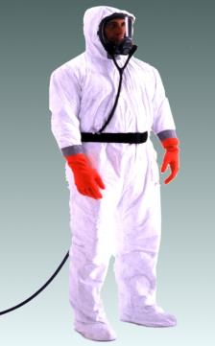
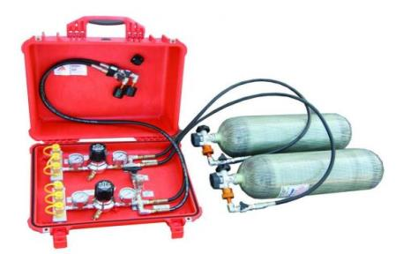
Supplied Air Respirator
When to use
Manure pits or confinement buildings during pit agitation or pumping
Environments with poor ventilation creating high levels of carbon monoxide
Fumigation in enclosed areas
An atmosphere-supplying respirator for which the source of breathing air is not designed to be carried by the user. Also called airline respirator.
Notes:
Need to make sure that it is clear on airline type versus tank – clarify these two
Airline versus tank
Problems with these related to hose – cutting off air supply etc

Slide 49
Fit Testing
Mandatory
Initially
Annually thereafter
Employer - employee relationship
If employer requires respirator
Exposure is above recommended
Permissible Exposure Limits (PEL)
Follow-up testing
Periodically as warranted to determine employees continued fitness to wear respirators. 1910.134(f)(3)
The employer shall conduct an additional fit test whenever the employee reports, or the employer, PLHCP, supervisor, or program administrator makes visual observations of, changes in the employee's physical condition that could affect respirator fit. Such conditions include, but are not limited to, facial scarring, dental changes, cosmetic surgery, or an obvious change in body weight.
Notes:
OSHA requires fit testing performed annually [in 29 CFR 1910.134(f)(2)] if the employee is required to wear the respirator by the employer or is exposed above the PELs.
General Industry Standards, such as 1910.146, 1910.147 and 1910.134, are not applicable to agriculture. Depending on the establishments business classification [Standard Industrial Classification (SIC) or North American Industry Classification System (NAICS) codes], these standards may or may not apply. However, OSHA could cite the General Duty Clause using the general industry standard, consensus standard, and/or industry practice as a reference, for an agriculture business if appropriate. In addition the employer could be liable in a court of law.

Slide 50
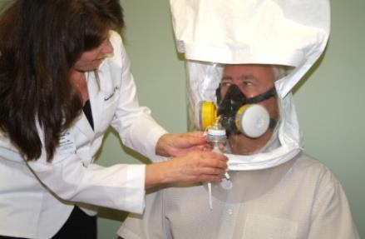
Type of Fit Testing
  Quantitative
  - Portacount test
Qualitative
- Bitrex, Saccharin,
  Use OSHA approved fit test protocols (Appendix A to § 1910.134: Fit Testing Procedures)
  Available on OSHA.gov website

Slide 51
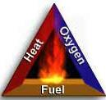
Combustible Gas Hazards
Components must be present at once
Fuel (combustible gas)
  Methane
Air (oxygen)
Heat (some source of ignition)
  Cutting torch, spark from electric equipment or cell phone, scraping, smoking etc.
Notes:
Davis E Hill, EMT-P, Sr. Extension Associate, The Pennsylvania State University, www.agsafety.psu.edu
Picture from OSHA Evacuation Plans and Procedures.

Slide 52
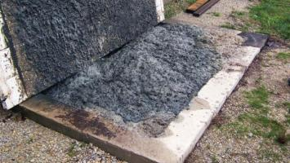
Foaming Pit’s
Agitating the foam may release methane which is explosive
Notes:
Used with permission: David Schmidt, University of Minnesota

Slide 53
Explosive Limits
Too Rich
LEL
Combustible
UEL
Too Lean
Notes:
Picture is from the National Education Center for Agricultural Safety. Permission given to use photo

Slide 54
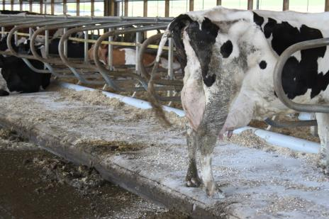
Gypsum Bedding
Pros
  Economical
  Raises pH
  Adds Sulfur
  Lower somatic cell counts
Cons
  Increased sulfur leads to increased H₂S
Notes:
Permission from Dave Hill

Slide 55
Gypsum bedding
Construction debris
  Drywall
  Not from scrubber material
Used straight or mixed with other bedding sources (sawdust, straw, etc.)
Anecdotal evidence
  People (haulers)nearly overcome
    Dizziness/burning eyes
    Drop to knees x2
  Dead animals x 4
  Gypsum used on farms involving manure related deaths in 3 separate incidents (9 deaths)
  REALLY strong smell
Notes:
Permission from Dave Hill

Slide 56
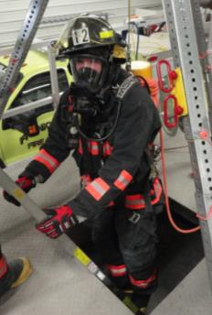
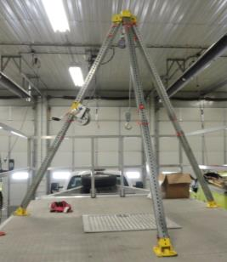
Definitions
Retrieval system
  Equipment (including retrieval line, chest or full-body harness, wristlets, if appropriate, & lifting device or anchor) used for non-entry rescue of persons from permit spaces
Notes:
Picture is from the National Education Center for Agricultural Safety. Permission given to use photo

Slide 57
Definitions
Attendant
  Individual stationed outside one or more permit spaces who monitors authorized entrants & performs all attendant’s duties assigned in employer’s permit space program

Slide 58
Duties of Attendants
Knows hazards that may be faced during entry
Aware of possible behavioral effects of hazard exposure in authorized entrants
Continuously maintains accurate count of authorized entrants
Remains outside permit space during entry operations until relieved by another attendant

Slide 59
Duties of Attendants
Communicates with authorized entrants
Monitors activities inside & outside space
Summons rescue & other emergency services
Performs non-entry rescues as specified by employer's rescue procedure
Performs no duties that might interfere with primary duty to monitor & protect authorized entrants

Slide 60
Medical Symptoms to watch for.
Falls
Shortness of Breath
Cardiac Emergencies
Headaches
Nervous system depression
Eye, nose, throat
irritation.
Nausea/Vomiting
Narcotic Effect
Convulsions
Impaired mental ability
Fluid on the lungs
Dizziness
Unresponsive
Fatigue
Notes:
NECAS

Slide 61
ENTRY
The act by which a person intentionally passes through an opening into a confined space.
Any part of the body passing through the opening is considered entry.
Notes:
From OSHA General Industry standard 29 CFR 1910.146
Picture
Penn State University
www.agsafety.psu.edu
Used with permission:
Reducing Risk of Entry Into
Confined Space Manure Storages

Slide 62
Enter the Space and Proceed with work:
An attendant shall be posted near the entrance for the duration of the work. He shall be in constant communication with the entrants while the job is in progress.
All entrants shall sign a sign-in-log when entering the space and sign out when exiting.
The attendant shall maintain the permit and sign in log for the duration of the work.

Slide 63
Dairy Farmer’s Boys Have Close Call With Manure Gas
Dairy Farmer’s Boys Have Close Call With Manure Gas
9/22/2012 7:00 AM
By Chris Torres Staff Writer
DANVILLE, Pa. — Monday was a harrowing day for dairy farmer Dennis Beachel of Danville, Montour County.
Just as he was starting to stir his 124-foot-wide, 12-foot-deep, 1.2-million-gallon concrete manure pit late Monday morning, he saw something no parent would ever want to see.
“We had just started to stir the pit and within two to three minutes, I turned around and both of the boys laid beside their bicycles,” Beachel said.
The boys, 4-year-old Denyn and 2-year-old Denallen, who had just celebrated his birthday the week before, were found face up and unresponsive. The younger boy’s face had turned blue, and his eyes had rolled back into his head.
The boys were playing next to the large manure pit when Beachel and his father starting prepping it to be emptied.
Aware of past accidents involving manure gas on dairy farms, Beachel feared the worst.
“They looked like they were dead. I feared they were when I first picked them up,” he said.

Slide 64
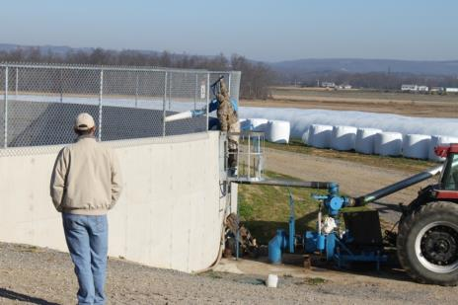
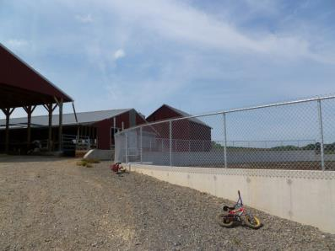
Unresponsive but breathing
Unresponsive but breathing 500-600 PPM
150 PPM
Notes:
Davis E Hill, EMT-P, Sr. Extension Associate, The Pennsylvania State University, www.agsafety.psu.edu

Slide 65
Confined Space Rescue
Means of emergency rescue
must be readily available
to the confined space
entry attendant for
emergency
extrication of
entrants.

Slide 66
Standby/Rescue Personnel
A worker who is assigned to remain outside a confined space must be:
In constant contact with the workers inside.
Know emergency procedures.
Be trained in the use of emergency rescue equipment and PPE.
60% of workers who die in confined spaces are would-be rescuers.
Notes:
NIOSH

Slide 67
Confined Space Rescue
The attendant should
attempt to remove the
entrant from the confined
space using tripods, hoist, and
lifelines. Attendants are NOT
TO ENTER CONFINED
SPACES. Lethal hazards may
be present within the confined
space. Only properly equipped
and trained emergency rescue
personnel may enter confined
spaces to make rescues.

Slide 68
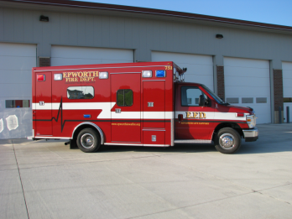
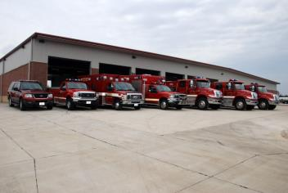
Confined Space Rescue
- Who Will Respond -
In House Rescue?
Fire Department?
Rescue Squad?
Prior to confined space entry, rescue services must be identified.
Notes:
Picture is from the National Education Center for Agricultural Safety. Permission given to use photo

Slide 69
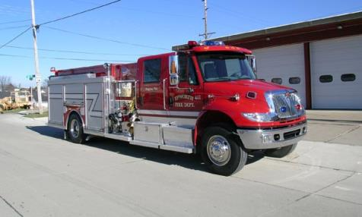
Confined Space
Rescue Services
Must evaluate your confined spaces.
Be provided access for training at your facilities and …
If they don’t have the proper rescue equipment then you must provide it.
Notes:
Picture is from the National Education Center for Agricultural Safety. Permission given to use photo

Slide 70
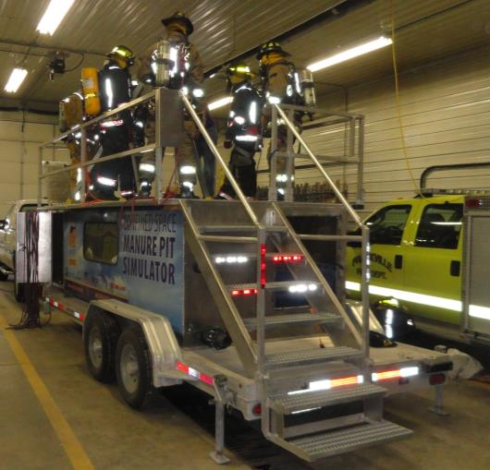
Confined Space Rescue
REMEMBER
Proper planning and training for confined space rescue can make the difference between rescue or recovery.
Notes:
Picture is from the National Education Center for Agricultural Safety. Permission given to use photo. Frankville Iowa training.

Slide 71
Agriculture Exemption
Enforcement Guidance for Small Farming Operations
The Appropriations Act exempts small farming operations from enforcement of all rules, regulations, standards or orders under the Occupational Safety and Health Act. A farming operation is exempt from all OSHA activities if it:
Employs 10 or fewer employees currently and at all times during the last 12 months; and
Has not had an active temporary labor camp during the proceeding 12 months.
  Note: Family members of farm employers are not counted when determining the number of employees.
  Important to check with your state OSHA since there are 25 states that match or exceed this OSHA Instruction
Source: OSHA Instruction CPL 02-00-051
Notes:
Agricultural Exemption - Appropriations Act
Enforcement Guidance for Small Farming Operations. The Appropriations Act exempts small farming operations from enforcement of all rules, regulations, standards or orders under the Occupational Safety and Health Act.
A farming operation is exempt from all OSHA activities if it:
Employs 10 or fewer employees currently and at all times during the last 12 months; and
Has not had an active temporary labor camp during the proceeding 12 months.
Note: Family members of farm employers are not counted when determining the number of employees.
Important to check with your state OSHA since there are 25 states that match or exceed this OSHA Instruction
Consider giving an example from a state – California is typically more stringent
Source: OSHA Instruction CPL 02-00-051

Slide 72
Employee Rights and Responsibilities
You have the right to:
  A safe and healthful workplace
  Know about hazardous chemicals
  Information about injuries and illnesses in your workplace
  Complain or request hazard correction from employer
Notes:
72

Slide 73
Employee Rights and Responsibilities
You have the right to:
  Training
  Access to Hazard exposure and medical records
  File a complaint with OSHA
  Participate in an OSHA inspection
  Be free from retaliation for exercising safety and health rights
Notes:
73

Slide 74
Employee Rights and Responsibilities
OSHA website: www.osha.gov and OSHA offices: Call or Write (800-321-OSHA)
Compliance Assistance Specialists in the area offices
National Institute for Occupational Safety and Health (NIOSH) – OSHA’s sister agency
OSHA Training Institute Education Centers
Doctors, nurses, other health care providers
Public libraries
Other local, community-based resources
Notes:
74

Slide 75
Summary
Confined spaces are entered safely every day. However, for them to be entered safely, specific procedures must be followed.
It is hoped that the information provided in this program gives you the information needed to enter the spaces that you may encounter safely.

Slide 76
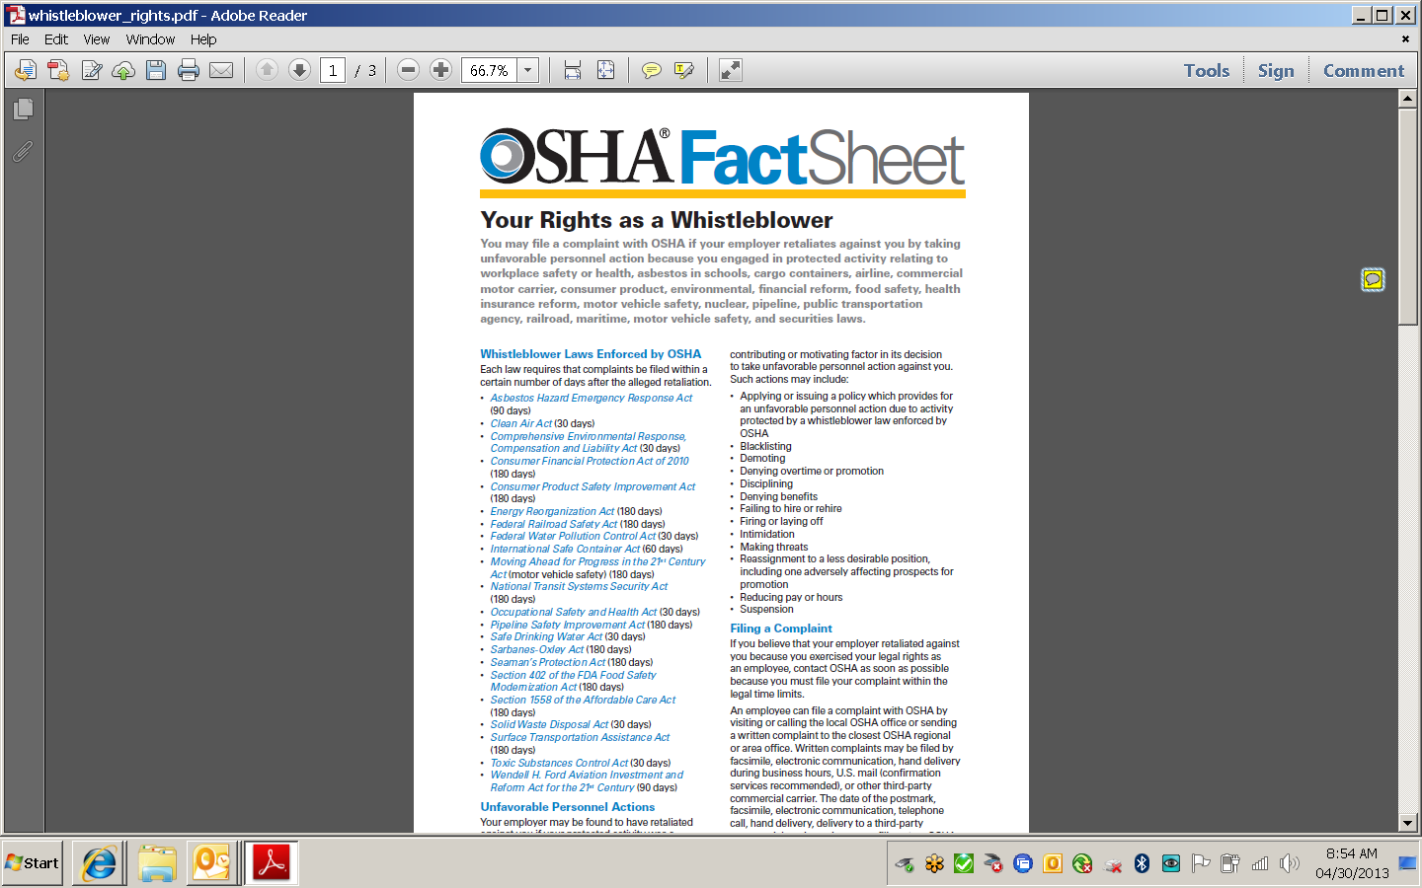
Whistleblower Fact Sheet
(FS 3638)
Notes:
Review Employee Rights – OSHA Publication Fact Sheet (FS) 3638

Slide 77

Whistle Blower Protection Program
Notes:
With in OSHA is the whistle blower program
Website resources
22 statutes

Slide 78
Confined Space Safety – Manure Pit Entry
Test Questions:
Which one of the definitions is not for a “Confined Space”?
What is the minimum acceptable oxygen level?
Which gas is one of the 5 gases that may be found in or around a manure pit?
For respiratory protection in confined space, OSHA requires fit testing annually.
Hydrogen Sulfide is heavier that air.
What gas smells like rotten eggs?
What position is in charge of “ Calling rescue and other emergency services”?
What gas in produced from combustion?
Which pit gas can paralyze the olfactory senses of the body?
Methane is explosive at what concentration?

