Slide 1
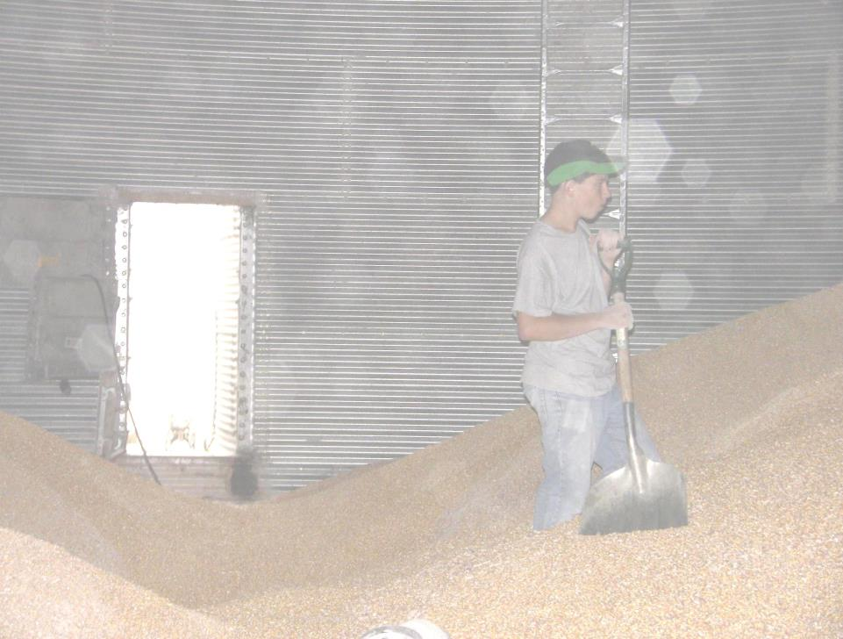
Title Page
Against the Grain
Safe Grain Storage and Handling for Young and Beginning Workers
Unit 4 – Working Safely Around Grain Storage and Handling Facilities
Developed by:
  Purdue University
  Agricultural Safety and Health Program
  Department of Agricultural and Biological Engineering
  West Lafayette, IN
This material was produced under grant number SH23575SH3 from the Occupational Safety and Health Administration, U.S. Department of Labor. It does not necessarily reflect the views or policies of the U.S. Department of Labor, nor does mention of trade names, commercial products, or organizations imply endorsements by the U.S. Government.
Notes:
Instructor Notes:
This unit is the fourth in the Against the Grain curriculum on safe grain storage and handling. It addresses safe work practices that should be followed, especially by young and beginning workers. The characteristics of a safe and productive worker, how a worker should come dressed to work, use of appropriate personal protective equipment and the rights of workers under the provisions of OSHA are covered.
As in previous units, participants need to be reminded that knowing what the appropriate and safe work practices are around grain storage and agricultural confined spaces is not enough these practices need to be followed. Far too many deaths and injuries are caused when safe work practices are ignored or circumvented for the sake of convenience or to save money.

Slide 2
Objectives
Describe the characteristics of a safe and productive worker
Describe the characteristics of a worker that increases the risk of injury
Describe the appropriate dress for a safe worker
Identify the types and uses of basic PPE used in the grain industry
Explain the rights of workers under the provisions of OSHA
Notes:
Instructor Notes:
Briefly review each of the lesson objectives.
At the completion of this unit participants should be able to describe the characteristics of a safe and productive worker. Ask participants who, if he or she was the boss, would they prefer to hire, a safe worker or one who shows disregard for his or her own safety and the safety of others?
Participants will be able to identify the characteristics of a worker, or even those found in their own lives, that could increase the risk of injury. Ask one participant to identify one characteristic that could make a person more likely to have an injury.
When completed, the lesson will provide participants information on how they should show up for work, dressed appropriately and ready to work safely.
The basic type of personal protective equipment will be covered along with the responsibilities of the employer to provide the needed safety equipment to each employee exposed to workplace hazards.
The rights of workers to be provided a safe and healthy workplace will be explained along with their rights to file a complaint if asked to perform work in unsafe conditions or without the appropriate personal protective equipment.

Slide 3
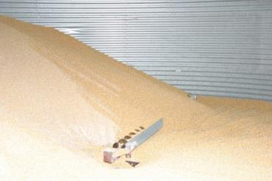
Introduction
The leading cause of death for those under 26 is traumatic injuries
  Motor vehicle crashes
  Drowning's and suffocation
  Fires and burns
  Other machines
Working in the grain industry exposes youth to all of these hazards and more
Notes:
Instructor Notes:
The leading cause of death for those under the age of 26 is traumatic injuries. For many of the participants this will come as a surprise, because many see themselves as invincible, indestructible, too young to give death any serious consideration. To convince young people, especial young males, that they are at high risk of injury is no easy task. To have them consider adopting a safety mindset is almost counter to their natural bent towards risk taking.
Briefly review some of the leading causes of fatal injuries to those under 26.
Motor vehicle crashes
Drowning and suffocation
Fires and burns
Other incidents involving machines such as dirt bikes, snowmobiles, ATVs, and farm machinery
When young workers are employed to work around grain storage and handling operations, the risk of injury or death can increase. In some cases, a young worker at a grain operation are exposed to all of the hazards listed above.

Slide 4
Who Can Remember Why Young Workers Are More Vulnerable to Injury?
Lack of training and experience
Lack of knowledge about hazards
Don’t have the ability to asses risk
Natural risk takers
Lack coordination and physical strength
Lack of maturity
Impatient
More emotional
Notes:
Instructor Notes:
Back in Unit 1, the participants were introduced to the reasons that young and beginning workers are at greater risk of work-related injuries. Because these factors are so important, they are presented again.
Take time to review the characteristics of young people that make them vulnerable to injury. Don’t spend a lot of time reviewing, but attempt to reinforce why young and beginning workers need to be given special consideration in most workplaces.

Slide 5

Characteristics of a Safe Worker
Commitment to a safe and productive workplace
Knowledge of workplace hazards
Patience
Civility and courtesy
Self control
Confidence
Consideration towards others
PICTURE
Notes:
Instructor Notes:
What makes a good worker? Is it the same as a safe worker? Is a good worker blindly loyal to his or her employer regardless of the risks being taken? Is a good worker only interested in the “bottom line”
A good worker is one who sees the bigger picture, who recognizes that to have a job is a privilege to be earned, not a right. A good worker is one who arrives at the worksite each day with a commitment to making the workplace both safe and productive. He or she has been trained to do the job efficiently and safely. He or she demonstrates patience, civility, courtesy and self control towards others knowing that there are consequences for unsafe behavior that go beyond himself or herself. A good worker has developed a confidence in his or her work because he or she knows what needs to be done, even if the unexpected takes place. A good worker always considers those around him or her with respect and contributes to their productivity and well-being.

Slide 6
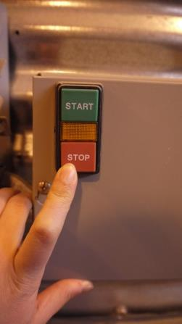
Worker Characteristics That Increase the
Risk of Injury
Unmanaged emotions – fears, anger, resentment
Influenced by drugs or alcohol
Fatigue – lack of sleep
Preoccupation
Notes:
Instructor Notes:
Now we know what makes a safe and productive worker. Let’s explore characteristics that a young worker may exhibit that could increase his or her risk of injury. Some of these, as noted before, are not easily modified, while others are the result of external influences on his or her life. Some of the characteristics that employers may have to deal with include:
Workers who arrive at work with unresolved situations that can result in unmanaged emotions such as fear, anger, resentment. Employees can bring a lot of emotional baggage to the workplace that can easily translate into unsafe behaviors.
Drugs and alcohol in the workplace can contribute to serious lapses in judgment and unsafe behaviors. Many employers have zero tolerance for drugs and alcohol in the workplace that, if violated, can result in termination. In some cases, employers conduct mandatory drug testing of those involved in a reportable incident. Drugs, even some legally used, and alcohol do not contribute to a safe workplace.
A fatigued or tired worker is an unsafe worker. For some young workers who fail to get enough sleep, the risk of injuries increases, especially when operating motor vehicles. Remind participants that their father and mother went to bed early for a reason – they needed to work the next day.
Lots of external influences can cause a young worker to become pre-occupied. These include distractions in the workplace, receiving and sending text messages, and phone calls. When at work keep distractions to minimum. You are less likely to have an injury and you’ll make your employer or supervisor a lot happier.

Slide 7
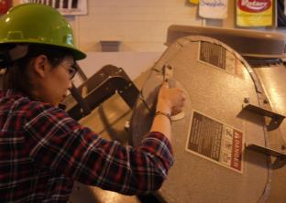
Coming Dressed to Work
The right clothes for the job
  Close fitting, durable clothing
  No loose strings or hair
  Temperature appropriate
  Protection from the sun
  Sturdy footwear – steel toed shoes
  Personal identification
Your appearance is a reflection on your employer
Picture of guy ready to work
Notes:
Instructor Notes:
How young and beginning workers show up to work is a good indicator of their attitude towards work and their commitment to a safe and productive worksite. Employers in the grain industry have reported sending new workers back home to dress appropriately before returning to work. In most work places, dirty clothes, tank tops, cut off jeans, flip flops and long pony tails just don’t cut it. Each of these can contribute to an unnecessary injury.
The right clothing for a job in the grain industry includes:
Close fitting; durable clothing
No loose strings or hair
Temperature appropriate
Protection from the sun
Sturdy footwear
Personal identification
Remind participants that their appearance is not only a reflection on themselves, but also of their employer.

Slide 8


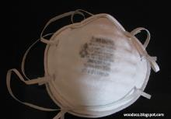

Personal Protective Equipment
Head
Eyes
Hearing
Respiratory
Skin
Feet
Fall protection
Notes:
Instructor Notes:
Have the participants consider their most popular sport and list the types of personal protective equipment that players are required to wear or wear voluntarily to protect themselves during competition. The list could look something like the following:
Helmet (football, baseball, hockey, auto racing)
Eye protection (football, hockey, skiing)
Teeth protection (football, basketball)
Hand protection (hockey)
Shin protection (baseball, hockey, soccer)
Hearing protection (skeet shooting, auto racing)
Knee protection (football, hockey, volleyball)
A worker in the grain industry also needs to have access to and wear various types of personal protective equipment to prevent injury and in some cases death.
If possible, have an example of each type of personal protective equipment available to have on display and pass around.

Slide 9
Employers Are Required to Provide Necessary Personal Protective Equipment
Employees have a right to the PPE required to perform a job safely
Employers are responsible to provide the PPE at no cost to the employee, conduct training on its use and care, and ensure that employees use it
Notes:
Instructor Notes:
The use of many types of personal protective equipment is so important to the safety and well being of workers, that employers are required by federal law to provide it to employees assigned to perform certain hazardous tasks. For example, if a worker is assigned to operate a metal cutting wheel to fabricate components or make repairs at a grain facility, the employer is required to make safety eye wear and hearing protection available to the worker. The worker then has the responsibility to wear the protective gear, even when the employer or supervisor is not immediately present.
Standard protective gear at most commercial grain operations include:
Hard hat
Safety glasses
Steel toed footwear
Gloves
Dust mask
Fall protection
Young and beginning workers should not be charged for the safety equipment they are required to use.

Slide 10
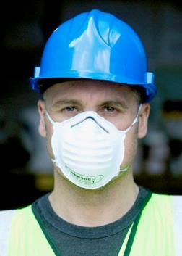
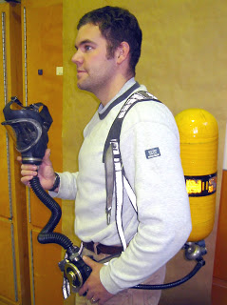
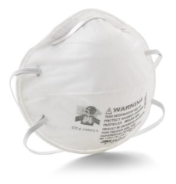
Respiratory Protection
N95 mask
Self-Contained Breathing Apparatus
Notes:
Instructor Notes:
Participants need to be aware that the dust generated during handing grain or cleaning out bins can make them very sick, especially if they are already hypersensitive to certain biological agents such as pollen or certain types of mold spores. Respiratory protection is essential when handling grain, especially out-of-condition grain.
The most basic approach of respiratory protection is an N-95 dust mask that should be available locally or in stock at commercial facilities. These masks provide only short-term protection from airborne dust. They cannot be used to protect workers from toxic fumes or insufficient oxygen. In heavy dust conditions these masks need to be replaced frequently.
Battery powered respirators are also used in the grain industry. They use a blower fan to draw air through a filter. Again, they can only provide protection from airborne dust.
If there is any concern regarding the presence of hazardous vapors or gases, the space must not be entered. Specialized self-contained breathing operation are required in these circumstances.
Photo credit:
N95 mask: http://www.3m.com/3M/en_US/country-us/
Penn State Cooperative Extension Service
http://kyagextension3.blogspot.com/2012/08/protect-those-lungs-respiratory.html

Slide 11
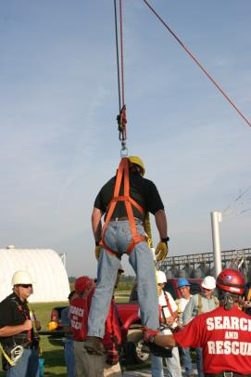
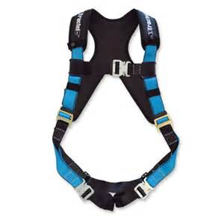
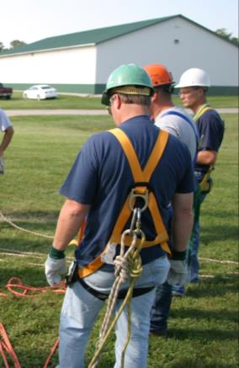
Fall Protection
Notes:
Instructor Notes:
The use of fall protection equipment requires special training to use safely. No young or beginning worker should be allowed to use fall protection equipment without adequate training.
This training does not address the selection or safe use of fall protection equipment. Participants, however, need to know that the use of such equipment is not in compliance with OSHA standards without appropriate training.
To communicate why training is needed, have one or two participants attempt to put on a full body harness without receiving any instructions. It will become very clear that without the training, somebody can get hurt.

Slide 12



Communication Equipment
Notes:
Instructor Notes:
Every worker in and around a grain storage and handling facility should be able to communicate with co-workers, especially in the event of an emergency. They also help make workers more efficient.
No one should ever enter any confined space in an emergency situation without the ability to communicate or be directly observed by an attendant outside the structure.
In some cases, standard wireless communication devices have been found to not function inside a steel storage bin.

Slide 13


Air Quality Monitoring Equipment
Single gas air quality monitors
Multi gas air quality monitor
Notes:
Instructor Notes:
Having access to an air monitoring device can allow for assessing the atmospheric hazards and allow for safe access to a grain storage structure where there is a concern over air quality. Young workers should not be expected to know how to operate air quality monitoring equipment without the appropriate training.
Most commercial grain storage and handling operations have access to air quality monitoring equipment and personnel trained to use it.

Slide 14

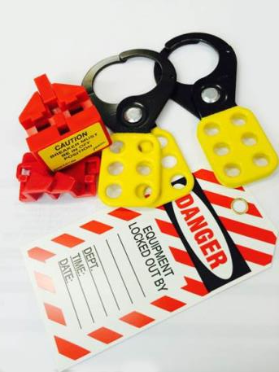
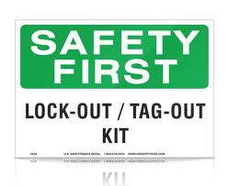
Lockout/Tagout
Notes:
Instructor Notes:
Every young and beginning worker in the grain industry needs to become aware of the importance of “Lockout/Tagout” procedures. Failure to use these procedures can lead to entrapment, engulfment, asphyxiation, entanglement, and electrocution during grain storage and handling operations.
The basic principle behind Lockout/Tagout procedures is the prevention of intentional or unintentional start up of any equipment of process while a worker is exposed to it. This is accomplished by use of individually keyed locks and signage that alerts co-workers that someone is exposed to the equipment or process and prevents him or her from energizing the equipment or starting up a process such as grain flow.
For example, a Lockout/Tagout procedure should be used anytime a worker enters a grain bin or attempts to unplug an inflow auger. This practice will prevent a co-worker arriving on the scene and energizing the unloading system exposing the worker inside the bin, and not visible, to be exposed to the energized equipment.
Having a Lockout/Tagout kit available for examination would be helpful.

Slide 15
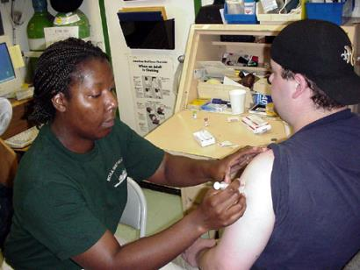
Importance of an Up-to-Date Tetanus Vaccination
Workers are exposed to sharp objects that can cause puncture wounds which can become infected with tetanus
Tetanus germ in soil, dust, & manure
Tetanus toxin is one of the most potent poisons
Life threatening
Notes:
Instructor Notes:
All workers at grain storage and handling facilities should have an updated tetanus vaccination due to the potential for cuts and puncture wounds that would allow for exposure to tetanus, a bacteria found in and around most agricultural settings. Participants should be encouraged to get vaccinated prior to being employed.
The use of sturdy gloves can help prevent injuries to the hands that can lead to infection.

Slide 16

Smoking Around Grain Storage and Handling Facilities is Not Allowed
Notes:
Instructor Notes:
Smoking is not only unhealthy for the smoker, it can lead to disastrous fires and explosions at grain storage and handling facilities. Smoking at these operations is not only prohibited by most employers, it is prohibited by OSHA in some locations.
For the safety and health of the participants encourage them to give up smoking or, at least, leave their tobacco products at home.

Slide 17
Worker Rights
Workers are entitled to working conditions that do not pose a risk of serious harm.
To help ensure a safe and healthful workplace, OSHA also provides workers with other rights including:
  Using their rights under the law without retaliation and discrimination;
  Access to information and training about hazards, methods to prevent harm, and the OSHA standards that apply to their workplace. The training must be in a language they can understand;
  Review records of work-related injuries and illnesses;
  For more information, visit the Workers’ page.
Notes:
Instructor Notes:
Under OSHA, workers have a right to a safe and healthy workplace. These rights include:
Asking OSHA to inspect their workplace;
Using their rights under the law without retaliation and discrimination;
Receiving information and training about hazards, methods to prevent harm, and the OSHA standards that apply to their workplace. The training must be in a language they can understand;
Getting copies of test results done to find hazards in the workplace;
Access to records of work-related injuries and illnesses;
Accessing copies of their medical records.
In most cases, young and beginning workers are fearful of exercising their rights to address unsafe work conditions. They are excited about having a job and are reluctant to do anything that would threaten their standing with their supervisor or employer. As noted in an earlier unit, these workers need to be encouraged to say no to performing unsafe work, and realize that they have a legal standing to do so.

Slide 18
Complaint Filing Options
You have these options to file your safety and health complaint:
Online - Go to the Online Complaint Form at www.OSHA.gov
Download and Fax/Mail - Download the OSHA compliant form* [En Espanol*]
Telephone - your local OSHA Regional or Area Office. OSHA staff can discuss your complaint and respond to any questions you have. If there is an emergency or the hazard is immediately life-threatening, call your local OSHA Regional or Area Office or 1-800-321-OSHA.
Notes:
Instructor Notes:
Participants should be instructed on how they can file a complaint regarding unsafe working conditions. This can be accomplished as follows:
Online - Go to the Online Complaint Form Written complaints that are signed by workers or their representative and submitted to an OSHA Area or Regional office are more likely to result in onsite OSHA inspections. Complaints received on line from workers in OSHA-approved state plan states will be forwarded to the appropriate state plan for response.
Download and Fax/Mail - Download the OSHA complaint form* [En Espanol*] (or request a copy from your local OSHA Regional or Area Office), complete it and then fax or mail it back to your local OSHA Regional or Area Office. Written complaints that are signed by a worker or representative and submitted to the closest OSHA Area Office are more likely to result in onsite OSHA inspections. Please include your name, address and telephone number so we can contact you to follow up. This information is confidential.
Telephone - your local OSHA Regional or Area Office. OSHA staff can discuss your complaint and respond to any questions you have. If there is an emergency or the hazard is immediately life-threatening, call your local OSHA Regional or Area Office or 1-800-321-OSHA.

Slide 19

Questions?
Notes:
Instructor Notes:
Answer any questions anyone has from this unit before moving on

