Slide 1

Developing an internal traffic control plan for roadway construction
Developing An Internal TC Plan
PREVENTING RUNOVERS AND BACKOVERS IN ROADWAY CONSTRUCTION
Developing An
for Roadway Construction
Internal Traffic
Control Plan

Slide 2
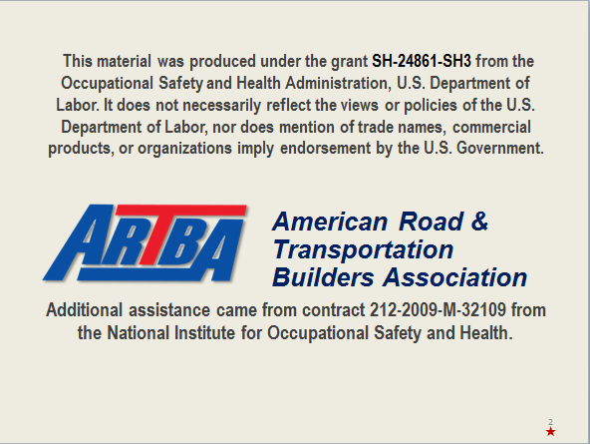
Course disclaimer
Contact ARTBA for information about Student Handbooks.

Slide 3

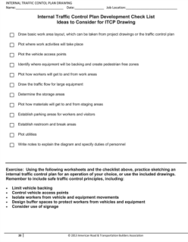

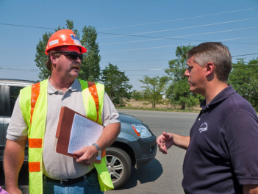
Course goals
Developing An Internal TC Plan
PREVENTING RUNOVERS AND BACKOVERS IN ROADWAY CONSTRUCTION
At the end of this module, you will know
  When the ITCP should be developed
  What ITCP aspects are developed during each project phase
  How to create the ITCP
  How to use TCDs in the ITCP
  How to enforce an ITCP
The ITCP affects everyone in the work zone.

Slide 4
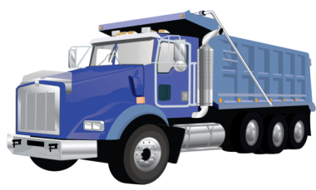
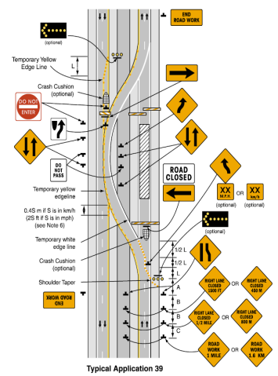
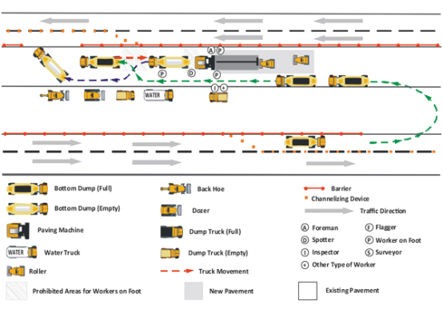

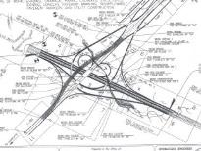
What is internal traffic control
Developing An Internal TC Plan
PREVENTING RUNOVERS AND BACKOVERS IN ROADWAY CONSTRUCTION
What Is Internal Traffic Control?
ITC coordinates construction traffic
inside activity area of a temporary
traffic control zone (TTCP)
*
Goal is a plan to separate construction
vehicles/equipment from workers on foot
ITC plan details how construction traffic
should flow inside area marked by
hatched box on TTCP
*
TTCP
Temporary Traffic
Control Plan for facilitating
road users through a work zone
Notes:
So what is an internal traffic control plan, or an ITCP? We are all familiar with the cones, barrels and signs that are guide motorists so that they can safely travel through work zones. The internal traffic control plan (ITCP) is a process that project managers and others who have production responsibility for roadway construction projects can use to coordinate and control the flow of construction vehicles, equipment, and workers operating in close proximity within the work space to ensure the safety of workers.
The ITCP organizes work activity inside the work zone to minimize the risk of workers being struck by operating equipment. The area where construction work takes place is shown on temporary traffic control plans and MUTCD “typical applications” as a hatched box. Internal traffic control plans fill in the details on how construction traffic should be set up inside this hatched box.

Slide 5

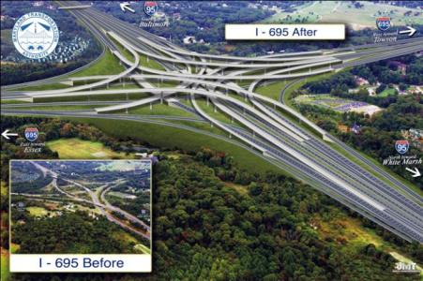
When should an ITCP be developed
Developing An Internal TC Plan
PREVENTING RUNOVERS AND BACKOVERS IN ROADWAY CONSTRUCTION
When Should an ITCP be Developed?
Different aspects of ITCP will be
identified and developed during
various construction phases of
a project
Depending on the phase,
different people will be
involved in process
The ITCP should be considered from the very beginning of a project.
Notes:
The ITCP should be considered from the very beginning of a project because some important elements--such as the size of the work space--will be dictated by the amount of right-of-way, number of lane closures, etc. To facilitate proper separation between workers on foot and mobile equipment, adequate space is necessary. If such considerations are not anticipated from the beginning, it will be more difficult to organize a complete ITCP.
The first phase (design) is when the project is first bid and won, a general plan should be created at that point. The second phase (planning) takes place when projects are being laid out, the original plan is flushed out into phases and plans are developed for those phases. The third phase (pre-construction) is the week before the work begins. In that phase any additional modification should be added to that plan like other activities on site or changes to internal traffic in the plan. The final phase (construction) begins the day of construction, any final changes need to be communicated to everyone on site that day. Phase 1 involves the DOT traffic engineer, site superintendent, safety professional, and other project managers. The second phase involves the DOT inspector (optional), site superintendent, safety professional, foreman, truck boss (optional), and other management personnel on site. The third phase involves the DOT inspector, safety professional, foreman, truck boss, key truck drivers, key workers, and QA/QC. The final phase involves everyone on site that day.

Slide 6
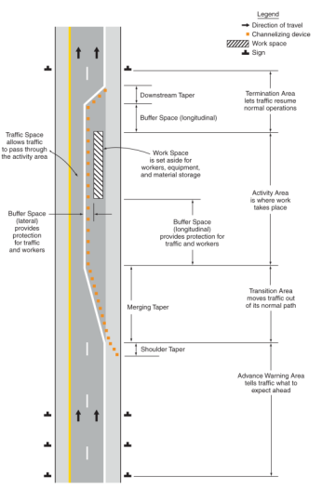
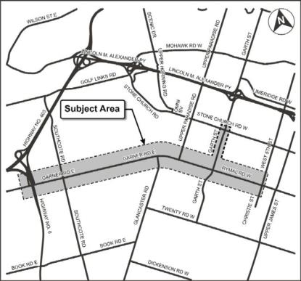
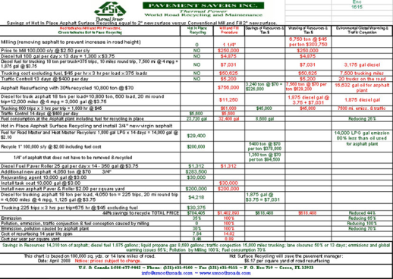
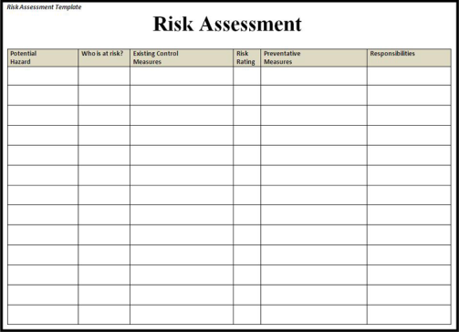
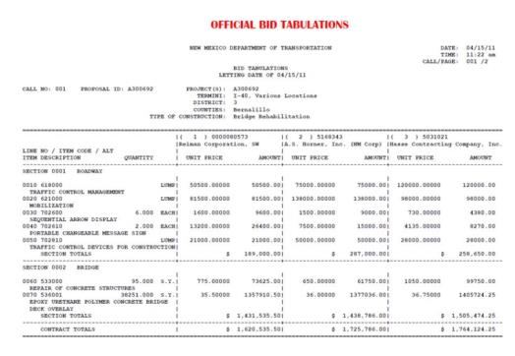
Bidding and planning stages
Developing An Internal TC Plan
PREVENTING RUNOVERS AND BACKOVERS IN ROADWAY CONSTRUCTION
Bidding and Planning Stages
  Right of Way
  Temporary Traffic Control
  Risk Assessment
  Equipment Selection
  and Identification
  Subcontractor Selection
  and Coordination
Notes:
State and local agencies have significant influence on decisions made during early planning of a project that impact the options available to the contractor when developing an ITCP. For example, planners can ensure the project has access and egress points that are not encumbered by roadway geometry or structures such as bridges. Forethought to ITCP needs will impact the amount of right-of-way obtained for acceleration/deceleration lanes, access/egress points, and parking and staging of vehicles. Some consideration may be allowed for contractor selection based on past safety performance.
Such consideration during the planning phase is being encouraged by OSHA and other organizations under the concept of “Prevention through Design.” It should be noted, however, it is NEVER too late to set up and ITCP. Even if such a plan is conceived when construction is underway, many ITCP concepts can be employed to improve worker safety.

Slide 7
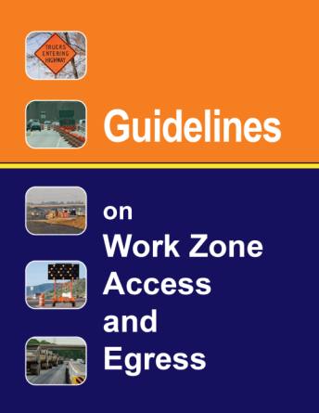

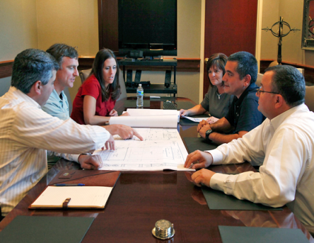
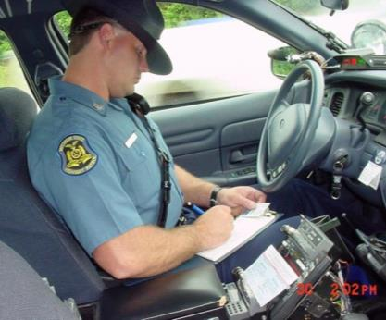
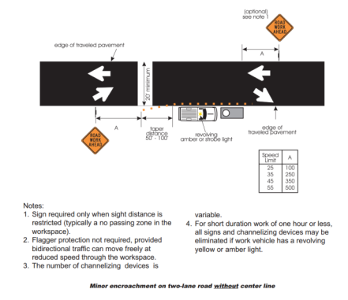

Contractor planning phase
Developing An Internal TC Plan
PREVENTING RUNOVERS AND BACKOVERS IN ROADWAY CONSTRUCTION
Contractor Planning Phase
  Negotiation of Responsibilities
  Assignment of Duties
  Meeting participation
  Use of law enforcement
  Location of access/egress points
  Lane encroachments
Notes:
The Contractor Planning Phase is an ideal time to negotiate responsibility for executing certain elements of the ITCP. Duties can be allocated to the roadway owner, project engineer, superintendent, foremen and other personnel. Risk can be properly allocated and process can be assigned such as participation in safety meetings, how and if law enforcement will be used, location of access and egress points, and the amount of lane encroachments.

Slide 8
Construction phase
Developing An Internal TC Plan
PREVENTING RUNOVERS AND BACKOVERS IN ROADWAY CONSTRUCTION
Construction Phase
  Responsibilities
  Safety professional – assists
  in developing ITCP, performs audits
  Site supervisor – assists
  in developing ITCP
  Fore/lead person – develops and
  implements ITCP
Notes:
The ITCP is implemented during the construction phase. The ITCP should be part of the project’s safety plan. The site supervisor/foreman should oversee implementation and will likely develop the site plan. As noted, foremen, supervisors, lead persons and others are crucial for plan implementation and should be taught the principles of safe construction traffic control. They will be in charge of daily set-up and monitoring of the ITCP. Responsibilities for key personnel are assigned and any remaining training is conducted during this phase. Onsite workers are provided training in both overall ITCP concepts and specific implementation elements at their assigned work area. To function properly, the ITCP must be reviewed and modified each day before the beginning of each shift so employees can receive instruction on how it will be implemented that day. In addition, ITCPs may be modified more frequently as conditions change throughout the day.

Slide 9
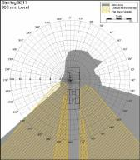

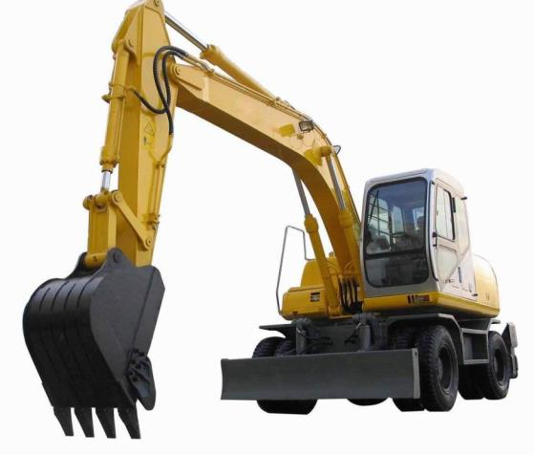

Construction phase continued
Developing An Internal TC Plan
PREVENTING RUNOVERS AND BACKOVERS IN ROADWAY CONSTRUCTION
Construction Phase (continued)
  Subcontractor selection,
  buy-in, communications
  (e.g. trucking, excavation, etc.)
  Owner/agency coordination
  and communications
  Selection of equipment
  Smaller blind spots
  Adding cameras/
  proximity warning
Notes:
A good communications plan is essential during the construction phase. A process must be engaged to coordinate the ITCP and site conditions among all those who will enter the work space. At this point, subcontractors will need to be engaged as their operations will be impacted by the creation and implementation of the ITCP. When seeking to identify all those impacted by the ITCP, it is imperative that all subcontractors and their operations are considered and educated about the program. A failure by one subcontractor can impact the safety and production of the entire site.

Slide 10

What are the ITCP elements
Developing An Internal TC Plan
PREVENTING RUNOVERS AND BACKOVERS IN ROADWAY CONSTRUCTION
What Are the ITCP Elements?
  ITCP Diagram(s)
  ITCP Notes
  Injury Reduction Measures
  Site Specific Conditions/Provisions
  Duties
  Equipment/Personnel List
  Notes on Safety Points
Notes:
The notes are critical to execution of the plan. They should include specific elements such as vehicle speed limits in the work space, near workers; how to identify and locate employees taking tickets; requirements for drivers to keep their window down (when appropriate) so they can hear site sounds and warnings. These notes become site audit tools that will assist supervisors in auditing the success of their safety program.

Slide 11
What are the ITCP elements continued
Developing An Internal TC Plan
PREVENTING RUNOVERS AND BACKOVERS IN ROADWAY CONSTRUCTION
What Are the ITCP Elements? (continued)
  ITCP Key (Legend) – symbols based on MUTCD
= Worker-Free Zone
= Paver
= Construction Barrel
= Roller
= Grader
= Tack Truck
= Full Truck
= Water Truck
= Empty Truck
= Car
Notes:
The legend explains the symbols used on the ITCP diagram. Standard symbols are based on those used in the MUTCD. However, additional details on classes of personnel and vehicle types are needed in developing an ITCP for a paving operation. In this example, the orange hatched area is a worker-free zone which we will go over later. The orange circle is a construction barrel; the icon below that is a grader. A dump truck with a black bed is a full truck, while the dump truck with a yellow bed is an empty truck. The icon up in the right corner is a paver and the icon below that is the roller. The other icons on this slide are a tack truck, a water truck and a passenger car. The key may also be hand drawn. The important thing is that you provide a key so someone reading the diagram understands the symbols you have used.

Slide 12
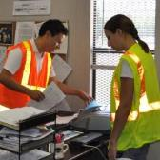


Creating the plan
Developing An Internal TC Plan
PREVENTING RUNOVERS AND BACKOVERS IN ROADWAY CONSTRUCTION
Creating the Plan
  Identify project scope and plan scope –
  as these vary from job to job
  Identify the operation to take place
  (paving, trenching, earthmoving, etc.)
  Identify the individuals who will be involved
  (safety professional, foreman, superintendent,
  truck boss, DOT inspector, visitors)
Notes:
The first step is to recognize the scope of the operation and each of the tasks that will be performed. Based on these planned operations, the contractor will identify personnel who will be involved.

Slide 13
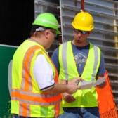
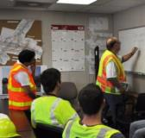

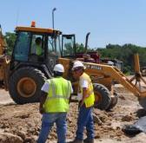
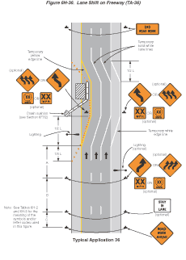
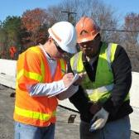

Creating the plan continued
Developing An Internal TC Plan
PREVENTING RUNOVERS AND BACKOVERS IN ROADWAY CONSTRUCTION
Creating the Plan (continued)
  Review the site plan:
  Where will the operation take place?
  What equipment will be involved?
  Where will workers on foot need to be located?
  What is the traffic
  control plan (TTC)?
  Where are the access/egress points?
  How often will deliveries be made or loads removed?
  How quickly will the work progress?
Notes:
The next step is to review the site plan. Identify what will take place and where. Is there space for workers to park cars and safely access the work area? Where will restrooms, water coolers and break areas be located? What equipment will be on sight? How many workers are needed to operate the equipment? What work will be done by workers on foot? Can they be physically separated from equipment operating areas and vehicle travel paths? How is the TTCP organized? Are workers sufficiently protected by the TTCP? By asking and answering these questions, you will begin to formulate your internal traffic control plan.
Next, you will need to assess how your work will proceed once operations begin. How quickly will the operation move? For example, earth moving and site preparation work may remain in the same location for weeks, even months. Paving operations, particularly resurfacing, will move down the road more quickly. How often will access and egress points need to be relocated? How frequently will asphalt, aggregate or other materials be delivered to- or removed from the site? By addressing these questions you will begin to understand how frequently your ITCP will need to change or be updated.

Slide 14

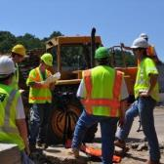
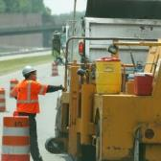
Creating the Plan (continued)
Developing An Internal TC Plan
PREVENTING RUNOVERS AND BACKOVERS IN ROADWAY CONSTRUCTION
  Implement Communications Plan
  Who will develop the ITCP? Who will review/approve it?
  Who will execute the ITCP?
  Who will instruct project leaders?
  Site employees? Operators?
  How will your communications feedback loop work?
  Who will evaluate it?
  Once communications are in order,
  then your plan is complete
Notes:
The final phase in ITCP development is implementing the communications plan--including training. Who will update the plan and stay in constant communication with site supervisors, foremen, subcontractors, workers, operators, etc. The most challenging part of ITCP implementation will be communicating with drivers of delivery trucks (dump trucks) and other site visitors who are not direct employees of the contractor. These communications can be difficult and require constant monitoring.

Slide 15


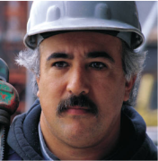
Creating the Plan (continued)
Developing An Internal TC Plan
PREVENTING RUNOVERS AND BACKOVERS IN ROADWAY CONSTRUCTION
  Identify suboperations – examples
  Asphalt sampling
  Watering rollers
  Loading/off loading equipment
  Equipment maintenance
Notes:
When developing your plan, take into consideration activities that support the main operation. For example, if the operation is laying asphalt, consider how rollers will be watered, asphalt will be sampled, etc. The key element to consider is the coordination of worker and equipment movements during these support operations.

Slide 16

Site specific ITCP
Developing An Internal TC Plan
PREVENTING RUNOVERS AND BACKOVERS IN ROADWAY CONSTRUCTION
Site Specific ITCP
  Plot all
  Locations for workers on foot
  Locations of equipment/vehicles
  Vehicle and equipment paths
  such as access/egress points
  for dump trucks
  and other site visitors
  Location of utilities,
  storage areas, other
  obstacles or hazards –
  if any
Create worker-free and equipment-free zones
Notes:
Once you have the basic work area drawn out, plot where workers on foot and construction equipment will operate. Next plot the path of vehicles approaching and leaving the operation. Show on the drawing areas where ground workers are to avoid (worker-free-zones) and the path workers will take to complete their duties, check on materials, etc. Finally, plot the location of overhead and underground utilities, storage and staging areas, and any other known obstacle or hazard. This process creates the ITCP diagram, which can be used to show workers, equipment operators, dump truck drivers, and others how workers on foot and equipment will move about the site.
Remember, the main goal of the ITCP --- to the extent possible—is to remove workers from the risk of being struck by construction vehicles and equipment. To do this, layout on the ITCP diagram equipment paths and worker free zones.

Slide 17

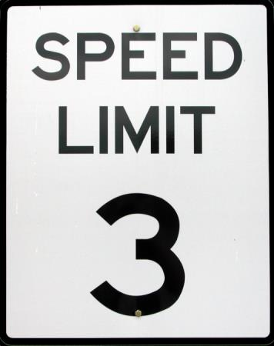

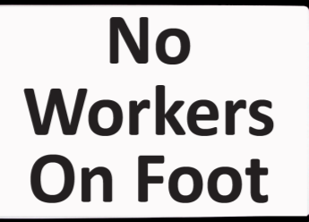
Site specific ITCP
Developing An Internal TC Plan
PREVENTING RUNOVERS AND BACKOVERS IN ROADWAY CONSTRUCTION
  Create plan ‘notes’ to explain diagram
  Specify duties of all involved personnel
  Consider posting signs indicating
  - worker free zones
  - equipment free zones
  Consider posting speed limits
  inside the work space
  Include other injury-reducing measures
Notes:
Now that the ITCP diagram is drawn up, create plan notes to explain important aspects of the diagram (such as worker-free zones) and any other site-specific safety points (such as on-site speed limits, spotting instructions for overhead power lines, or instructions for the ticket taker to stay on the driver’s side of dump trucks). Explain in the notes if special signage will be used to direct construction vehicles inside the work space.

Slide 18
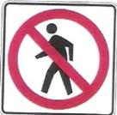

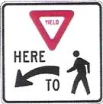

Can TCDs be used in an ITCP
Developing An Internal TC Plan
PREVENTING RUNOVERS AND BACKOVERS IN ROADWAY CONSTRUCTION
Can TCDs Be Used in an ITCP?
  No specific devices or signs are needed in an ITCP – though some
  may be useful
Notes:
There are no specific ITCP signs. Any type of signage that displays direction to workers on foot or vehicles can be used, however. Before a new path, walkway, detour or temporary route is opened, intended signage should be in place. Signs required by road conditions or restrictions should be removed when those conditions are no longer necessary. If signs are used, care must be given to ensure ITCP signs do not confuse passing motorists for whom the signs are not intended. Signs should only be used where justified and should not be seen by passing motorists.

Slide 19


Internal traffic control diagram example
Developing An Internal TC Plan
PREVENTING RUNOVERS AND BACKOVERS IN ROADWAY CONSTRUCTION
Internal Traffic Control Diagram Example
QC Truck
Foreman Truck
GW Truck
QC
SI
SO
SP
SI
Worker Area
Staging Area
Lane 1 10’
Enter
Exit
Lane 2 10’
GW
SI Truck
Breakdown Lane 10’
This example uses graphics, but an ITCP can be created
with simple drawings on a piece of paper
Notes:
This sample site diagram. The drawing shows an asphalt paving operation. The delivery trucks enter the job site, then approach the work site from behind the paving operation, drive along side the operation until they are in front. The dump truck then crosses in front of the paver and other dump trucks waiting for its turn in the queue. When the space is clear between the paver and dump truck, the truck backs a minimum distance and unloads its asphalt into the hopper. Trucks leaving the paver use the middle lane to a turn-around point, then came back using the right hand (lowest lane on slide) lane.
Though this drawing uses graphics, an ITCP can be created with simple drawings on a piece of paper. In fact, because conditions change on a daily basis, and even several times during the day, site diagrams need to be simple to understand and easy to modify.

Slide 20


Basic model for earth moving without an ITCP
Developing An Internal TC Plan
PREVENTING RUNOVERS AND BACKOVERS IN ROADWAY CONSTRUCTION
Basic Model for Earth Moving without an ITCP
2
1
Without a designated path, the worker cuts through the activity.
Notes:
Here is another simple example of how internal traffic control might be set up. This is a fairly common situation where there would be a need to move material from a pile into a dump truck. The loader picks up a load, backs up, then goes forward to dump it into the truck. The idea here is of course to keep workers on foot out of the path of the loader.

Slide 21
Basic model for earth moving with an ITCP
Developing An Internal TC Plan
PREVENTING RUNOVERS AND BACKOVERS IN ROADWAY CONSTRUCTION
Basic Model for Earth Moving with an ITCP
2
1
With a designated path, the worker takes the safe route.

Slide 22



Basic model for earth moving
Developing An Internal TC Plan
PREVENTING RUNOVERS AND BACKOVERS IN ROADWAY CONSTRUCTION
Basic Model for Earth Moving
Roller
Spotter
Traffic Direction
Notes:
This is an example of a very basic paving operation. In this situation, workers on foot are working around a paving machine, followed by a roller. The truck carrying asphalt enters the work space from the traffic space, backs up to the paver, empties its load, then exits the work space. What are the critical/dangerous tasks during this operation that are most likely to place workers on foot in an hazardous situation? What changes can be implemented to improve safety?

Slide 23
Internal traffic control diagram
Developing An Internal TC Plan
PREVENTING RUNOVERS AND BACKOVERS IN ROADWAY CONSTRUCTION
Example
Safety Notes
Stay in trucks except at lunch
Wear your vest on site
Reduce speed near paver and rollers to 15 mph, never enter high range
Caution entering and exiting site on to active traffic
Ticket taker shall wait until the truck is at the windrow to take the load ticket
When possible, stay on the driver’s side of the vehicle
Park pick-up trucks out of active truck travel lane, or equipment path, if possible on the shoulder
Park behind the operation
Place samples off the side of the road
Equipment l List
2 Rollers
1 Paver/Pick-up Machine
1 Tack Truck
1 Water Truck
1 Mechanic Truck
1 Broom
2 Quality Trucks
2 State Trucks
8 Dump Trucks
Personnel List
2 Roller Operators
1 Paver Operator
1 Screed Operator
1 Ground Worker
1 Foreman
2 Quality Control
2 State Inspector
M

Slide 24
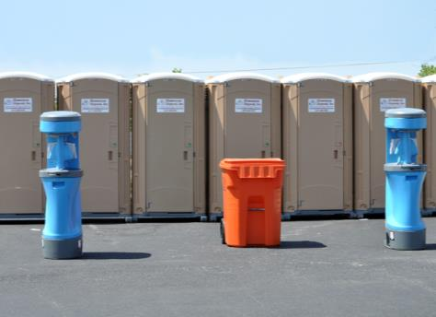
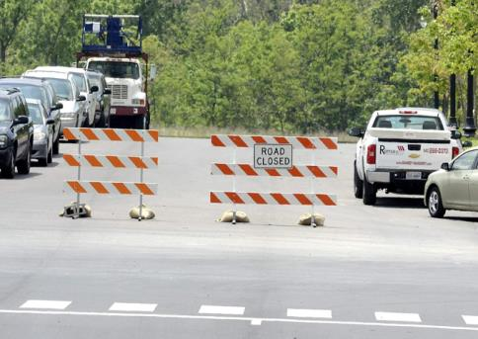
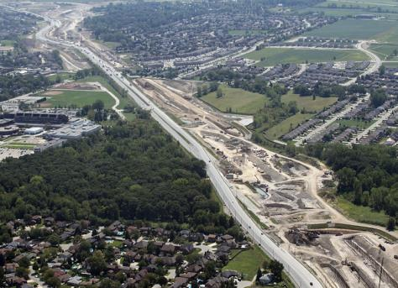
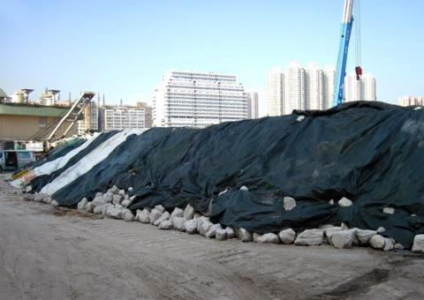
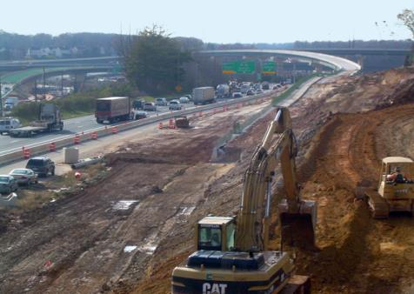
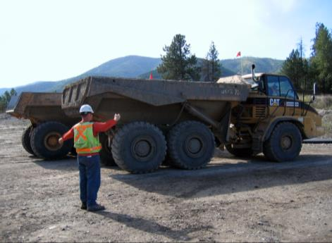
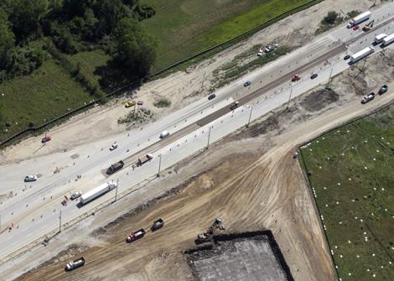
Creating an ITCP
Developing An Internal TC Plan
PREVENTING RUNOVERS AND BACKOVERS IN ROADWAY CONSTRUCTION
Creating an ITCP
Determine locations for equipment and personnel
Determine where workers on foot are likely to face hazards
  Backing Zones
  Access/Egress Points
  Work Activity Sites
  Worker Paths to Rest Areas
  Large Equipment Paths
  Utilities
  Site Visitors/Parking
  Material Storage
  Locations and Movement

Slide 25

Class activity
Developing An Internal TC Plan
PREVENTING RUNOVERS AND BACKOVERS IN ROADWAY CONSTRUCTION
Class Activity
  Draw an ITCP for a simple paving operation
Notes:
Break the class into groups of up to 6 students. Provide the paper exercise to each group. Provide additional blank pages and a Sharpie marker. Explain to the groups that each group will create an ITCP for the work project in the example or for another project of their choice. Tell them to draw a legible plan because you will scan it for presentation to the class. As the groups finish, scan each ITCP in turn. Using the scanned image on the screen, have a member of each group come to the front and explain the ITCP to the class. The class can ask questions and critique each plan.

Slide 26


Enforcing an ITCP
Developing An Internal TC Plan
PREVENTING RUNOVERS AND BACKOVERS IN ROADWAY CONSTRUCTION
Enforcing an ITCP
ITCP should be a team effort
  Safety Officers
  Site Supervisors
Discipline should be given
for violations
Should be treated as a violation
of company safety policy (and
possible state/federal regulations)
Notes:
The safety officer, foremen and supervisors are all responsible for maintaining work zone work zone compliance and should be able to warn workers on foot or vehicle operators of violations concerning the ITCP. ITCP notes become site audit tools that will assist supervisors in auditing the success of their safety program. Warning should be given to workers who stray from assigned positions, vehicle operators in pedestrian worker zones or truck drivers moving at speeds over the site speed limit. Violations should be treated as violations of other company safety policies.

Slide 27
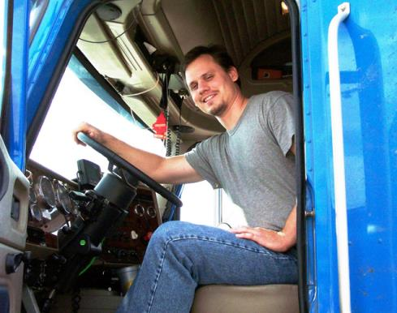
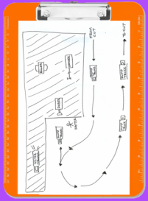
Enforcing an ITCP
Developing An Internal TC Plan
PREVENTING RUNOVERS AND BACKOVERS IN ROADWAY CONSTRUCTION
Inspectors, Truck Drivers, Site Visitors
  All who enter work space
  should be given instructions
  in the ITCP
  Instructions should include
  parking, staging, pedestrian
  work areas as well as vehicle
  paths and speed limits
Notes:
When access points can be controlled, truck drivers and site visitors should be briefed or given and ITCP map showing how to enter the project site, paths to follow, where to stop for staging, and how the spotter will guide them. Truck drivers should also be briefed on procedures for leaving the work space and re-entering the traffic stream. A basic set of guidelines and rules should be developed for all truck drivers to follow when on-site. This would be supplemented with daily updates.

Slide 28
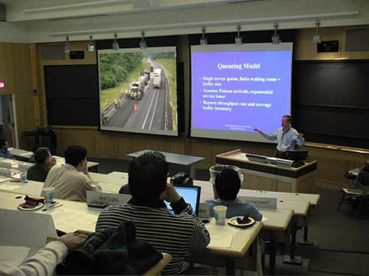
ITCP video
Developing An Internal TC Plan
PREVENTING RUNOVERS AND BACKOVERS IN ROADWAY CONSTRUCTION
ITCP Video
Watch the video to review major ITCP concepts
  Make notes of anything you
  missed or forgot during the
  training program
  After the video, we will have
  a Q&A session

Slide 29
Course video
Blind Spots.wmv

Slide 30
Discussion and questions
Developing An Internal TC Plan
PREVENTING RUNOVERS AND BACKOVERS IN ROADWAY CONSTRUCTION
Discussion
and
Questions

