Slide 1
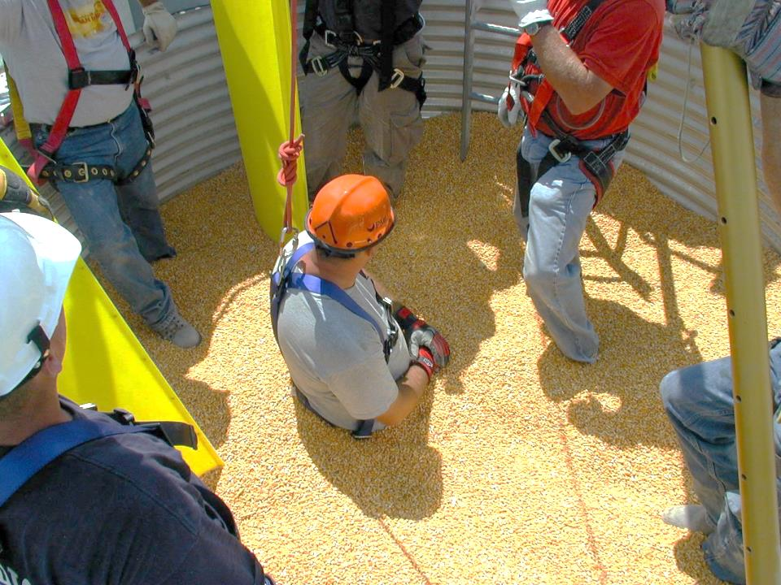
Title page
Basic First Responder Training
For Incidents Involving
Grain Storage and Handling Facilities
Unit 3 – Preplanning/Training/
Rescue Equipment for Emergencies at Grain Storage and Handling Facilities
Developed by:
  Purdue University
  Agricultural Safety and Health Program
  Department of Agricultural and Biological Engineering
  West Lafayette, IN
This material was produced under grant number SH23575SH2 from the Occupational Safety and Health Administration, U.S. Department of Labor. It does not necessarily reflect the views or policies of the U.S. Department of Labor, nor does mention of trade names, commercial products, or organizations imply endorsements by the U.S. Government.
Notes:
Instructor Notes:
This unit is the third of four that will be presented during the first half of the training. It provides instruction needed to understand the importance of preplanning and training, and the different types of rescue equipment that may be needed at the scene of grain storage and handling incidents.
Since time is limited the amount of time devoted to preplanning and training is brief. It is assumed that the participants’ experience with emergency management and their attendance at this training demonstrates their commitment to preplanning and training. There are substantial resources available on critical aspects of preplanning such as NFPA 1600, FEMA, Red Cross, OSHA, and many online sources.

Slide 2
Objectives
Discuss the importance of preplanning for emergencies at grain storage and handling facilities
Emphasize the importance of ongoing training that addresses the types of grain storage and handling facilities located in the community
Describe the type of rescue equipment that is needed and potential hazards associated with its use
Describe different types of grain containment systems
Notes:
Instructor Notes:
Briefly review each of the learning objectives for this unit.
Please note that the items listed relate specifically to the minimum core competencies discussed earlier.

Slide 3
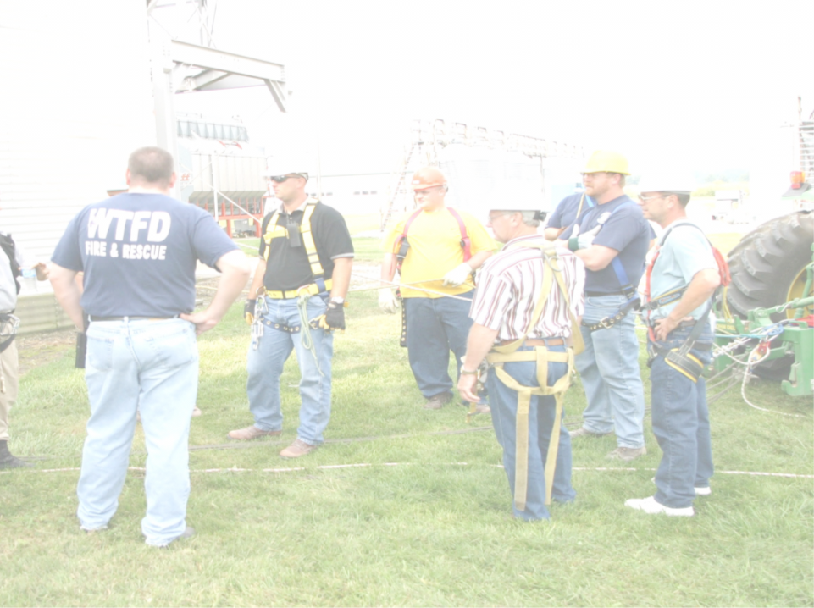
Preplanning
Preplanning is an essential ingredient inbeing able to effectively and safely respond to emergencies, regardless of their nature. Preplanning:
    reduces response time
    reduces potential risks to first responders at the scene
    reduces frustration
    better utilizes resources
    saves lives
Notes:
Instructor Notes:
Emphasize clearly the importance of preplanning for emergencies that could potentially occur in each participant’s workplace or community.
It is too late to discover that certain rescue equipment is unavailable or unsuitable for a particular rescue after the 911 call has been received.
The lack of preplanning can lead to damaged equipment, violation of established best practices for conducting rescues, increased risk to first responders, added injury to initial victims and potential loss of life.
Emphasize that as with most events with serious injuries or entrapment there is a “Golden Hour” that can significantly determine the outcome of the response.

Slide 4
Preplanning Involves
Identification of types and locations of grain storage and handling facilities in the service area
Assessment of primary hazards and risks at each location
Assessment of first response capabilities
Identification of available resources – both public and private
Development of mutual aid agreements to cover gaps in capabilities
Conducting periodic on-site training
Develop Standard Operating Procedures that reflect capabilities
other?
Notes:
Instructor Notes:
There are numerous approaches to conducting preplanning for emergencies involving grain storage and handling facilities.
Review the list of key components and encourage participants to identify other steps that would enhance preparedness for an emergency at a grain storage and handling facility.
Emphasize the need to conduct a careful assessment of first response capabilities in order to identify those incidents that participants are able to safely respond to and those that require higher levels (operational or technical) of response capabilities.
It is unlikely that any one fire/rescue organization will have all of the equipment or personnel needed to conduct a complex extrication from a grain entrapment. Having mutual agreements in place and knowing the capabilities of those involved in these agreements is extremely important.

Slide 5
Training
Training is a core requirement of those who are called upon to respond to emergencies involving grain storage and handling facilities. It should be:
Evidence-based
Performance-based
Designed to meet potential response needs
Realistic and on-site if possible
Repeated on a periodic basis
Designed to do no harm
Notes:
Instructor Notes:
Every credible work place safety program, safety regulation, and professional safety standard identifies the critical need for training to reduce the potential for injury or death while performing hazardous tasks. No one, including first responders, should be assigned or directed to conduct a hazardous task for which they have not been trained or properly equipped. However, each year numerous emergency first responders are injured or killed while attempting to conduct a rescue that they were not adequately prepared to perform.
First responders being called on to respond to incidents involving grain storage and handling facilities need training that is:
based on the best information available concerning the hazards involved.
performance-based to ensure that the responder not only knows the subject matter, but is able to demonstrate it.
designed to meet the needs and hazards that could be faced at sites in their service area. It needs to be relevant.
as realistic as possible and conducted on the actual sites where an emergency could occur.
repeated on a regular basis to allow for reinforcement of critical skills and knowledge.
designed to minimize the risk to both the victim and the first responder.

Slide 6
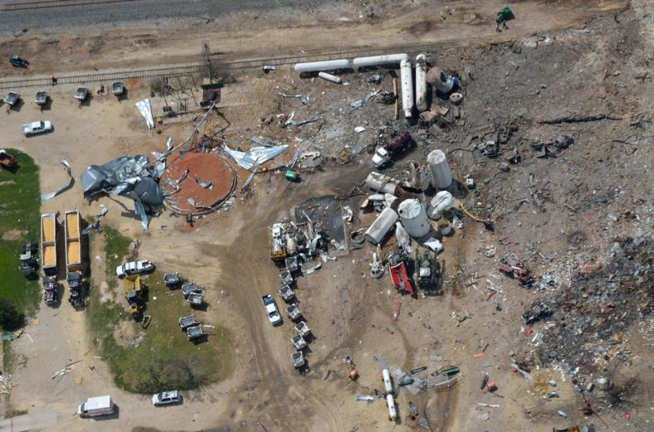
Would training have made a difference?
Notes:
Instructor Notes:
On April 17,2013 something went terribly wrong during a response to a fire at a fertilizer plant in West, Texas. The result was the death of 12 first responders.
Have participants consider the following:
How would preplanning have reduced the likelihood of the loss?
Were the first responders aware of the hazards involved?
Were the first responders trained to respond to this type of incident?
You may wish to review online sources regarding this incident to identify other contributing factors.

Slide 7
Equipment Needed to Conduct Grain Entrapment Rescues
Personal Protective Equipment (PPE)
Communications equipment
Cutting equipment
Air quality monitoring equipment
Grain handling equipment
Ventilation systems
Lockout/Tagout equipment
Retrieval system/anchor point
Lighting systems
Grain containment devices
Notes:
Instructor Notes:
Many rural volunteer fire departments that serve the majority of grain storage facilities in the country are not equipped to conduct a complex rescue from a grain storage structure. Consequently, incidents of this type require intentional preplanning and collaboration with other community resources, both public and private, to bring together the needed equipment.
This section will briefly review the various types of equipment that have been found useful at the scene of past grain entrapments, engulfments, asphyxiations, entanglements, falls, and electrocutions.

Slide 8
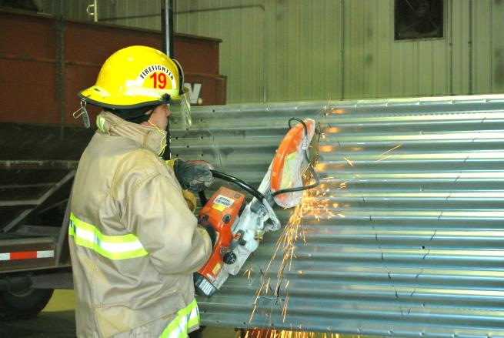
Personal Protective Equipment
Respiratory
Eye
Hearing
Hand
Head
Notes:
Instructor Notes:
Every first responder in close proximity tithe incident should be required to be equipped with the appropriate personal protective equipment. This includes, but is not limited to:
Respiratory protection – to reduce the exposure to toxic dust caused by disturbed grain.
Eye protection – to reduce the potential of eye injury due to flying sparks and debris from cutting equipment and excessive dust.
Head protection – to reduce the potential of head injuries from falling equipment.
Hearing protection – to protect operators and bystanders near loud cutting tools.
Hand protection – to prevent cuts from sharp edges on bin components and cut steel panels.
In most cases fire/rescue personnel will arrive with full fire service bunker gear. However, this gear may be too bulky for some activities, such as accessing the openings on a standard bin. The standard bin hatch is 24-25”.
The best solution is to minimize the level of exposure to physical hazards by reducing the number of people in the immediate area. Maintaining a protective perimeter will greatly reduce unnecessary exposure to any potential site hazards.

Slide 9



Communications Equipment
Notes:
Instructor Notes:
Every first responder in and around a grain storage and handling facility should be able to communicate with others on the first response team.
No one should ever enter any confined space in an emergency situation without the ability to communicate or be directly observed by an attendant outside the structure.
In some cases, standard wireless communication devices have been found to not function inside a steel storage bin.

Slide 10

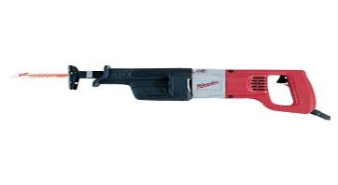
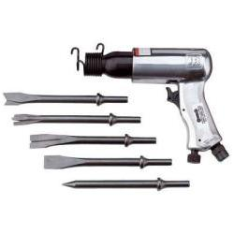
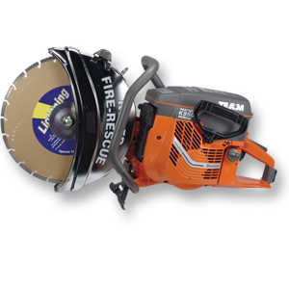
Cutting Equipment
Cutting Equipment
Battery Operated Saws All
110 Volt Saws All
Air Chisel
K12 Rescue Saw with Abrasive Blade
Notes:
Instructor Notes:
Most fire fighters will be familiar with the use of these cutting tools since they are widely used in other rescue situations. Due to the speed of operation and the amount of flying particles discharged by these tools adequate personal protective equipment is necessary.
Sawsalls: 110 volt and battery operated saws are used in the same way. Start with a new 18 tooth bi-metal blade (other blades will also work). It may be difficult to establish the initial opening to begin cutting. Another cutting tool may be needed to make the first cut.
Air Chisel: Can be used in cutting grain bin panels but you will need an air supply of 90 psi and 50-100’ of hose. When using this equipment all first responders will also need to have hearing protection, eye protection and gloves.
The K12 rescue saw is widely available and has been shown to be effective at cutting grain bin steel panels. It will be discussed further on the next slide.
These tools can all be used to cut openings in most corrugated steel bins and will be demonstrated in the afternoon training session.
Most corrugated steel bins range from 8 gauge for the bottom panels to 26 gauge thickness for the roof panels. The lower the gauge, the thicker the panel. Panels on larger bins also become thinner towards the top of the bin. On some new larger bins, manufacturers are bolting multiple panels together at the bottom to increase bin strength. Cutting into these structures can be extremely difficult due to the wall thickness.

Slide 11
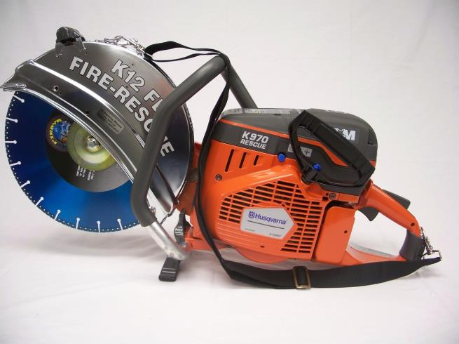
Cutting Equipment (Continued)
K12 Rescue Saw
Notes:
Instructor Notes:
Since the K12 saw will be demonstrated later in the class, a more detailed description of its use is provided.
The K12 rescue saw is one of the most readily available rescue cutting tools. It can be used to make an opening in corrugated steel bins. Full turn-out gear will be required. There will be a large amount of sparks and also a large amount of flying steel chips.
Use the buddy system to operate the saw since it has a tendency to kick back similarly to using it in a roof ventilation procedure.
The saw can be used at different levels on the bin to allow for a more controlled release of grain. A saw should not be operated off of an extension ladder due to the forces involved which may cause operator instability. A high lift or ariel platform fire truck would provide the safest platform.
Multiple blades will need to be available. A steel abrasive, carbide tip, or diamond tip blade is recommended.
Make sure all safety gear is in place before using saw.
This rescue saw is heavy to hold for long periods of time multiple operators may be needed to provide relief.
Make sure not to exceed the capacity of the tool and provide recommended cool-down periods.
A pre starting saw (a concrete saw can also be used).
Photo credit: http://www.teamequipment.com/index.php?View=products&SYS_CC2_index=0&SYS_PRP03_00_ID=500

Slide 12
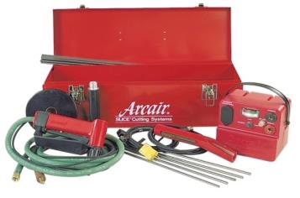
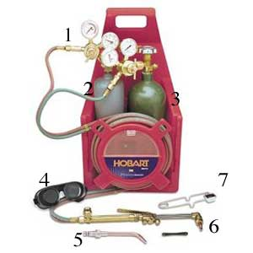
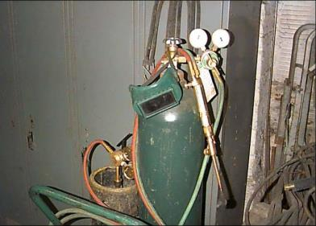
Cutting Equipment (Cont)
Cutting Equipment (cont.)
Notes:
Instructor Notes:
Historically, a typical means of cutting open grain storage structures to allow for rapid evacuation of the grain has been the use of heat-generating tools. Even though this equipment raises concerns over fire and explosion, they have proven to be safe and effective.
Portable slice pack allows for rapid cutting of corrugated steel panels. Training on the use of this equipment before it is used in an actual rescue is essential.
Portable and wheeled oxygen/acetylene torch may already be available at most sites. This equipment has been used in literally hundreds of rescue attempts.
Note: It is recommended that a charged hose line be made available during the cutting process. It should be noted that cutting a hole in a corrugated steel bin will not cause a fire or explosion. There have been no cases where a steel bin exploded or caught on fire during a rescue attempt. It takes a lot of heat over a long period of time to make grain burn. Using these tools will not generate that much heat.

Slide 13
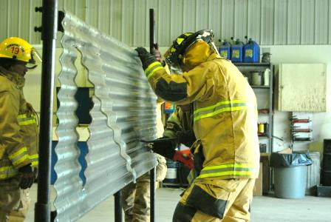
Hazards Associated with
Cutting Tools
Flying debris
Contact with sharp edges and tool blades
Respiratory hazards from airborne dust and fumes
High sound levels
Notes:
Instructor Notes:
The following potential hazards associated with using cutting equipment should be identified:
Only essential personnel should be in close proximity to the cutting operation and each should be equipped with appropriate personal protective equipment.
Flying debris is a very real hazard. There is need for face shield, safety glasses, goggles and turn out gear.
Contact with sharp edges and tool blades can cause serious lacerations and burns. Turn out gear, and rescue gloves should be used. The blades will be very hot and can cause a burn when changing to a new blade.
Respiratory hazards from airborne dust and fumes will need to be addressed. M-95 paper dust masks, at minimum, should be available in quantities to allow for frequent replacement by all personnel. If a torch is used to cut standard galvanized corrugated steel panels, full respiratory protection should be used to prevent inhalation of the zinc fumes that will burn off the steel.
High sound levels of cutting equipment will require the use of hearing protection such as muffs and earplugs.

Slide 14

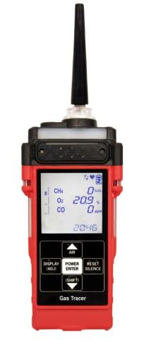
Air Quality Monitoring Equipment
Single gas air quality monitors
Multi gas air quality monitor
Notes:
Instructor Notes:
It was determined that many rural volunteer fire departments do not have access to air quality monitoring equipment to check for reduced oxygen levels or presence of carbon dioxide or carbon monoxide.
Having access to an air monitoring device can allow for assessing the atmospheric hazards and allow for safe access to a grain storage structure where there is a concern over air quality.
In most commercial grain storage and handling operations there is access to air quality monitoring equipment and personnel trained to use it.
If there is any doubt about the quality of the air inside of the structure, access should be limited to only those with self-contained breathing apparatus.
Photo credit:
http://www.gasonic.com/Portable-Multi-Gas/gas-tracer.html

Slide 15
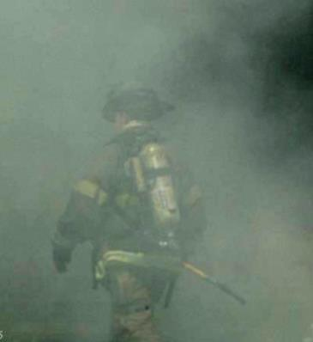
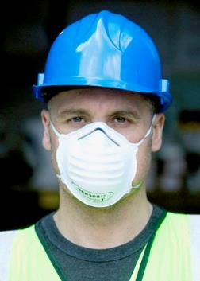
Respiratory Protection
Self-Contained Breathing Apparatus
N95 mask
Notes:
Instructor Notes:
First responders need to be aware that the dust generated during a rescue can make them very sick, especially if they are already hypersensitive to certain biological agents such as pollen or certain types of mold spores. Respiratory protection is essential during rescue attempts, especially in out-of-condition grain.
The most basic approach is an N-95 dust mask that should be locally available or in stock at commercial facilities. These masks provide only short-term protection from airborne dust. They cannot be used to protect from toxic fumes or insufficient oxygen. In heavy dust conditions these masks need to be replaced frequently.
Battery powered respirators are also used in the grain industry. They use a blower fan to draw air through a filter. Again, they can only provide protection from airborne dust.
If there is any concern regarding the presence of hazardous vapors or gases, a self-contained breathing apparatus (SCBA) should be used by anyone entering the space.

Slide 16
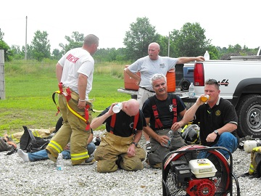
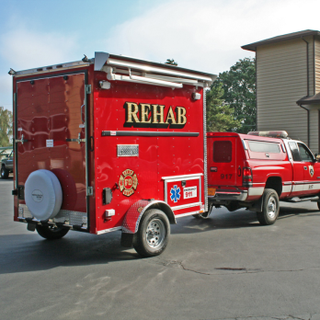
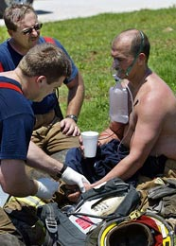
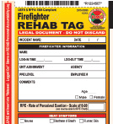
Heat Exposure Rehabilitation
Notes:
Instructor Notes:
Events that occur in summer can expose first responders to extremely high temperatures within a grain storage structure. There have been well documented cases of heat-related illness and dehydration among first responders working aggressively inside a storage structure to extricate a victim.
The safety officer at the scene needs to be able to recognize the symptoms of overheating and dehydration and ensure that responders are removed and treated if necessary to ensure their safety.
Use of cooling fans, sufficient sources of drinking water, or cooling site should be considered if the incident occurs in hot weather. More information on preventing heat-related illnesses can be found at www.OSHA.gov. A copy of the OSHA Fact Sheet – Protecting Workers from the Effects of Heat is included in the Instructor’s Guide as Attachment 8.

Slide 17
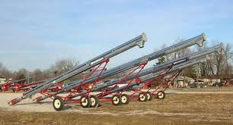
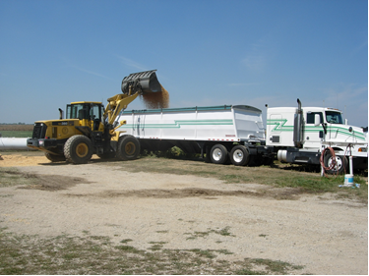
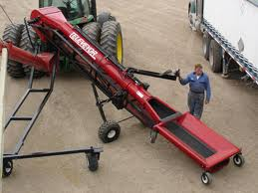
Grain Handling Equipment
Notes:
Instructor Notes:
Most rescue attempts involving an entrapped or engulfed victim will require the removal of large quantities of grain. In some cases this has involved tens of thousands of bushels. This need should be anticipated when the initial call for assistance is received and the call should go out for multiple scoop shovels, skid steer loaders, semi-trucks and grain vacuum machines. Sources of this equipment include:
Neighboring grain operations
Farm equipment dealers
County highway departments
Local trucking companies
Organizing the needed equipment can be made much easier by having in place formal mutual or material aid agreements with local contractors, truckers, and others with access to material handling equipment.

Slide 18
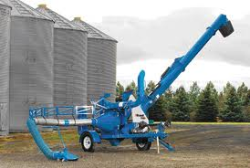
Grain Vacuum Equipment
There has been an increased use of grain vacuum equipment in grain rescues
This equipment is found at most commercial grain storage facilities and on some larger farms
This equipment can
move 1,000-2,000
bushels per hour of
continuous use
Presents the risk of
first responder
entrapment
Generates large
amounts of dust
Notes:
Instructor Notes:
Grain vacuum equipment can be beneficial in moving grain out of the way very quickly. However emergency responders need to be trained in using this equipment or others trained in its use should be called in.
If grain vacuum equipment is used make sure it is part of the preplanning process. Make sure commercial grain operators and local farmers play a part in the preplanning process to make sure the equipment is accessible and that there are qualified operators who know how to use it safely.
There was a case where a commercial elevator was removing beans from a 90’ concrete silo when an employee became trapped. Local paid and volunteer fire departments arrived on the scene to find the victim pinned against the inside wall with one leg sticking out of an opening in the silo. The fire department requested grain vacuum equipment from the commercial grain operator and local farmers in order to place a rescue tube around the victim and remove the grain with the vacuum system. The victim was becoming hypothermic. A local farmer supplied two grain vacuum systems and the fire department would not allow the owner to assist with the machine’s operation. The fire department was using blankets to keep the victim warm and unintentionally got too close to the blanket with the vacuum inlet system clogging the vacuum tube. They then got the second vacuum system the farmer brought and began using it and again got a blanket caught in the grain vacuum system destroying the pump and making it inoperable. They were able to use a grain vacuum system from another local farmer to finish the rescue and free the victim. The important message to remember from this case is that training is essential and if the fire departments are not trained on the equipment they need to allow the owner of the vacuum system to train them and assist them with the process.

Slide 19
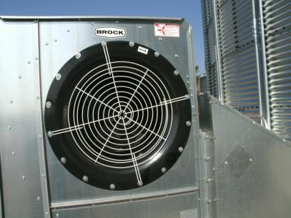
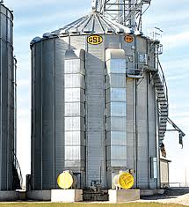
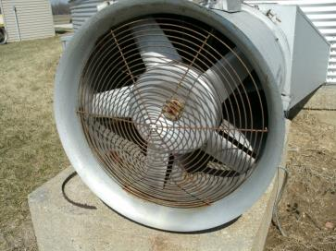
Ventilation Systems
Notes:
Instructor Notes:
To enhance air quality or remove grain dust from inside the structure, having access to ventilation systems may be needed.
Because of the size of most grain storage structures, it would be very difficult to completely ventilate the structure with a standard fire smoke ejector or ventilation van.
In some cases, grain storage structures are equipped with large aeration fans that could be turned on to move air to the victim. Cases have been documented in which a completely engulfed victim claimed that the flow of air around them, while under the grain, enabled them to breathe. Consequently, turning on the aeration fans has been identified as an initial action step when the victim is completely engulfed.

Slide 20
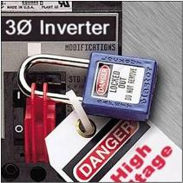
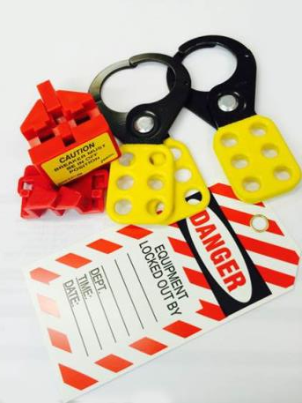
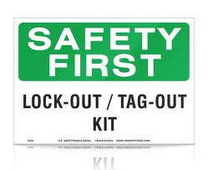
Lockout/Tagout
Notes:
Instructor Notes:
One of the first steps that should be taken when arriving at the scene of an entrapment, engulfment, asphyxiation, entanglement, fall or electrocution at a grain storage and handling facility is to lockout and tagout all power sources that could be energized intentionally or unintentionally. (The only exception that should be considered is the aeration fan.) First responders cannot assume that lockout/tagout kits are available at these sites and should arrive with one. In some cases the controls are not designed to accommodate a lockout/tagout device. A first responder needs to be assigned to guard the deactivated control to ensure that they are not turned on.
If the facilities are complex and location of all controls cannot be confirmed, having the power provider de-energize the entire facility should be considered, if doing so doe not present other potential hazards.

Slide 21
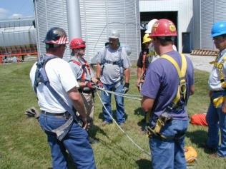
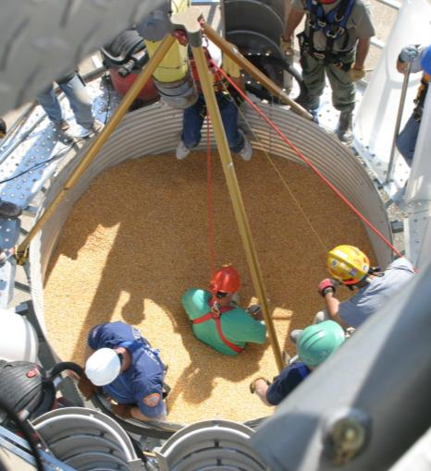
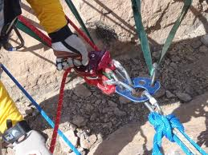
Retrieval Systems
Notes:
Instructor Notes:
At the awareness level of capabilities, first responders should not be called upon to use retrieval systems, lifelines, harnesses, and anchor points to execute a rescue. This is the responsibility of someone with a technician level capability. However, first responders at the awareness level can be called upon to assist and should be aware of these systems.
A significant issue arises when the incident occurs in an isolated location and the nearest tactical rescue team is 1-2 hours away, if not committed to another situation. Historically, most grain entrapment rescues have been conducted by volunteer first responders who used the resources at their disposal to conduct the extrication.
These dilemmas are not unique to grain rescue and need to be discussed as part of the pre-planning exercises.

Slide 22
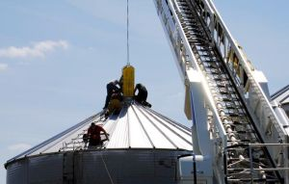
Overhead Lift Point
If rescuers need to be lowered into the structure, approved anchor points or overhead lift points will be needed, along with trained
personnel to
use them.
This could
include:
  Ladder or
  boom fire truck
  Utility boom
  truck
Notes:
Instructor Notes:
Again, high angle rescue operations require specialized training and equipment. Not every first response agency is prepared to handle these rescues and input from special tactical teams should be considered. Also, consider:
First responders must understand the engineering of the corrugated steel bin they are working with the roof of the bin is light weight metal and not designed for a large amount of excess weight, including multiple first responders or retrieval systems. Preplanning and training at facilities in your area is important to understanding the structures you may be working with. Aerial platform trucks positioned over the top access of a bin have been used as an anchor point to lower a rescuer into the structure. However, if the structure is equipped with a grain spreader mechanism it will be very difficult or impossible to drop down through the top hatch. In most cases the first responders have entered the bin through the top access hatch which is generally located at the base of the roof next to the access ladder.
Photo credit: http://www.myjournalcourier.com/news/local/man-rescued-from-grain-bin/article_1ca050ac-b2e1-11e2-b2bf-001a4bcf6878.html

Slide 23
Lack of Anchor Points
Most storage structures found on farm and feed lot operations do not contain approved anchor points that meet the load capacity specified in the federal confined space entry standards.
Since these facilities are exempt from compliance with either the grain handling or confined space entry standards they were not constructed to meet the standards.
If necessary, alternative anchor points for both fall protection and confined space entry will need to be configured.
Notes:
Instructor Notes:
Most storage structures found on OSHA exempt farm operations do not contain approved anchor points that meet the load capacity specified in the federal confined space entry standards since they are exempt from these rules. It is important to understand there may not be an adequate existing anchor point.
In the past internal or external bin ladders have often been used to anchor life lines or other retrieval equipment. Neither of these ladders are designed to bear the weight of first responders or retrieval equipment. Most carry warning labels not to exceed 350 pounds which is not sufficient for an approved anchor point.
If necessary, alternative anchor points for both fall protection and confined space entry will need to be configured depending on the structure you are working with.
If first responders are not trained to conduct high angle rescues, tactical teams with confined space rescue training become essential.

Slide 24
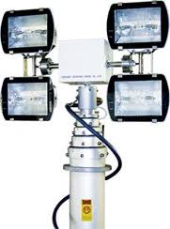
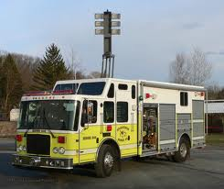
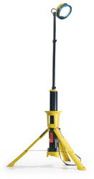
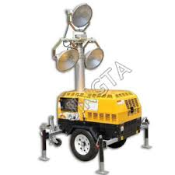
Lighting Systems
Notes:
Instructor Notes:
Many previous rescues from grain storage structures have taken several hours to conduct and in some cases 8-12 hours if a body recovery takes place. The probability of the rescue stretching beyond daylight is high. Consequently, thought should be given to calling in portable lighting systems.
Photo credit:
http://www.wfrfire.com/light_scene/lightindex_tower.asp

Slide 25
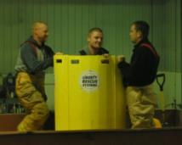
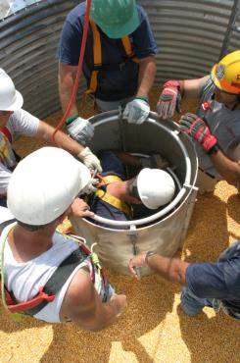
Grain Retaining Devices and
Rescue Tubes
Purpose:
Protect victim from inflowing or avalanching grain
Reduce the inward pressure of the grain
Provide for removal of the grain from directly around the victim to allow for extrication
Notes:
Instructor Notes:
From the earliest records of entrapments and engulfments in free flowing agricultural material, coffer dams or grain retaining devices, usually fabricated on site, have been used to extricate partially buried victims. Rescuers recognized very early that victims could not be simply pulled from the grain and that a means were needed to protect him from inflowing grain caused by the movement of rescuers. Cases have been documented in which victims have been severely injured by forcefully removing them from partial entrapments.
The primary functions of a grain restraining device are:
Protect the victim from additional inflowing or avalanching grain caused by the unstable surface of the grain or first responder activity.
Reduce the inward pressures on the victim caused by the weight of the grain and the weight of first responders in close proximity to the victim.
Provide for removal of the grain from directly around the victim to allow for extrication without further injury to the victim.
The use of grain retaining devices will be discussed in detail in the afternoon hands-on session.

Slide 26
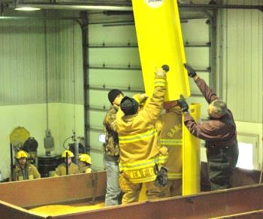
Examples of Grain Retaining Devices and Rescue Tubes
A wide range of items have been used to build coffer dams
Backboard
Plywood sheets (max. of 24” wide strips)
Barrels with ends cut out
Garbage cans
Metal roofing
Commercially available grain rescue tubes
Notes:
Instructor Notes:
A wide range of items have been used to build coffer dams:
Backboards and plywood sheets (max. of 24” wide strips and 60” tall)
Barrels with ends cut out, garbage cans, metal roofing, etc. Think outside the box for any items that can stop the flow of grain in on the victim
Commercially available grain rescue tubes
Whatever configuration is selected it needs to be transported to the top access hatch of the bin and fit through the hatch, generally about 24” in diameter.

Slide 27
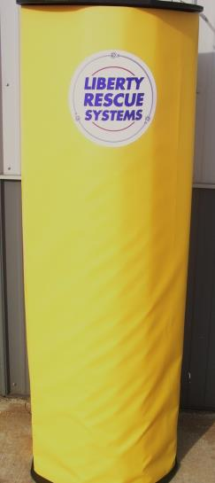
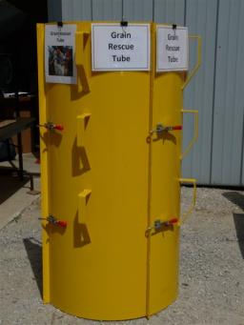
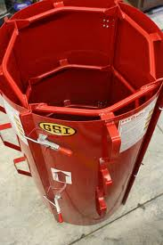
Commercial Grain Rescue Tubes
Notes:
Instructor Notes:
These are several different types of grain rescue tubes currently available commercially. Contact information is available in the Instructor Guide as Attachment 19. Most commercially available rescue tubes consist of panels that can be assembled together around a partially buried victim.
The use of rescue tubes has been documented in several successful extrications from grain entrapments. Over the past few years hundreds of these devices have been purchased by fire/rescue agencies and commercial grain storage and handling operations across the country.
Participants will have the opportunity to practice with different types of rescue tubes during the demonstrations and hands-on training.

Slide 28

Questions?
Notes:
Instructor Notes:
Answer questions anyone may have concerning this unit before moving on

