Slide 1
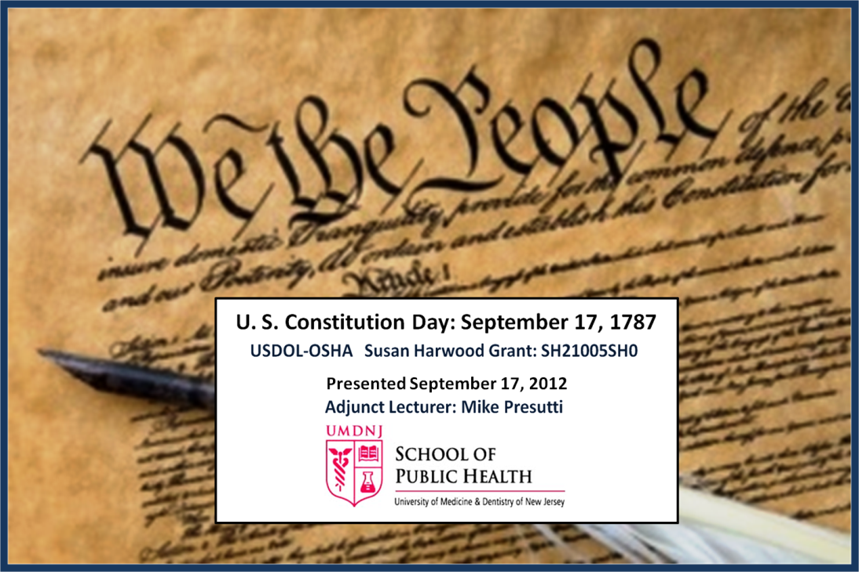

United States Constitution Day
September 17, 1787
This material was produced under grant number SH-23527-12-60-F-34 from the Occupational Safety and Health Administration, U.S. Department of Labor.

Slide 2
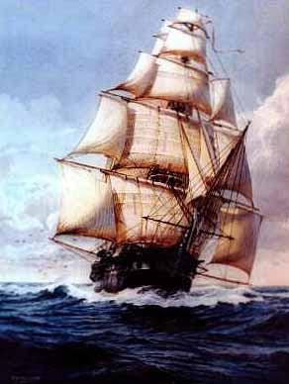
How can we know where we are going if
we know not whence we came?

Slide 3
Constitution Day’s Objectives
Provide a Brief History about our U.S. Constitution
Provide a Brief History of Safety and Health over time.
Constructs and Rights under the Occupational Safety and Health Act of 1970
How our Constitution still lives in the practical application of Occupational Safety and Health today.

Slide 4
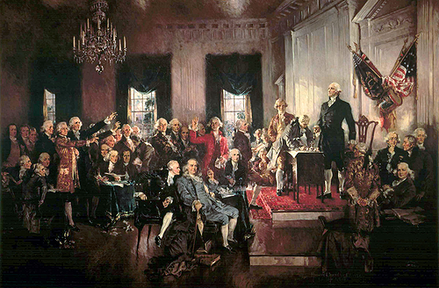
September 17, 1787

Slide 5
Our American Constitution
Constitution was ratified by nine states (New Hampshire the last on, June 21, 1788)
It is the longest lived Constitution (225 years)
It has the least words of any significant Constitution (7,591 words including the 27 amendments)
27 Amendments including the Bill of Rights
Seven different articles which outline our governmental structure.
Checks and balances
3 Branches of Government: Executive, Legislative, Judiciary
5 Bodies: Executive, Senate, House of Representatives,
Judiciary and Electoral College
Amendment Process 2/3 Congress and ratification of states and constitutional convention.
States
People
The U.S. Constitution does not give you your rights it secures your rights by enumerating the permissible and limited rights of government.

Slide 6
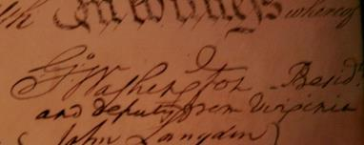
The Philadelphia Constitution Convention of 1787
Purpose to revise Articles of Confederation.
Met from May 14, 1787 – September 17, 1787 from 10 a.m. until 3 p.m. (100 days).
Conducted in secrecy
Fifty-five (55) delegates (deputies) attended
  39 signed
  34 were lawyers,
  Quarter of them large land owners
  half were Revolutionary War veterans.
  8 had signed the Declaration of Independence
  They included planters, educators, ministers, physicians, financiers, judges and merchants.
  39 were former Congressmen and 8 were present or past governors.
  George Washington and James Madison were the only Presidents to sign the Constitution.
  Thomas Jefferson and John Adams were not present.
Constitution was ratified by nine states (New Hampshire the last on, June 21, 1788)

Slide 7
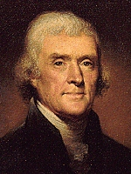
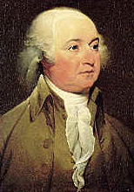
Did Not Attend
Thomas
Jefferson
John
Adams

Slide 8
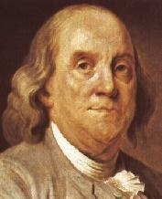
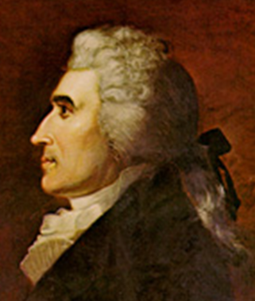
Oldest and Youngest Deputies
Benjamin Franklin
Age 81
Jonathan Dayton
Age 26

Slide 9
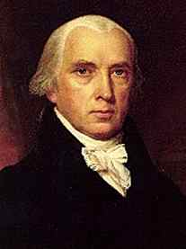
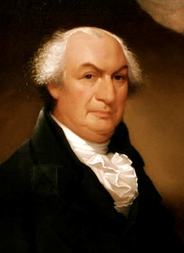
The “Father” & The “Writer” of the Constitution
James Madison
Gouvernuer Morris

Slide 10
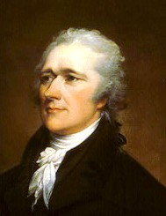

Authors of the Federalist Papers
James
Madison
Alexander
Hamilton
John Jay

Slide 11
In November of 1788 the Congress of the Confederation adjourned and left the United States without a central government until March 4, 1789. On April 1, 1789. That is when the first Congress under the new Constitution convened with its first quorum.
As Benjamin Franklin left the Pennsylvania State House after the final meeting of the Constitutional Convention on September 17, 1787, he was approached by the wife of the mayor of Philadelphia. She was curious as to what the new government would be. Franklin replied, “A republic, madam. If you can keep it.”
The Rest is History

Slide 12
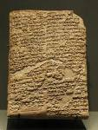
First Written Construction Safety Code circa 1790 - 1700 BCE
Code of Hammurabi
Number 229. If a builder builds a house for someone, and does not construct it properly, and the house which he built falls in and kills its owner, then that builder shall be put to death.

Slide 13
The Law of Moses
Deuteronomy, Chapter 22 Verse 8:
"In case you build a new house, you must also make a parapet for your roof, that you may not place bloodguilt upon your house because someone falling might fall from it."

Slide 14
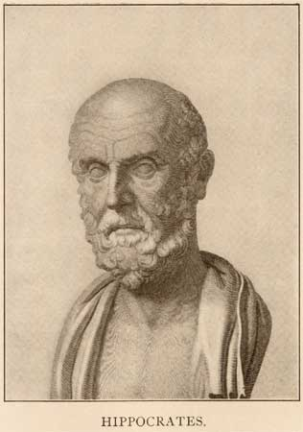
Hippocrates
(460-377 BC)
Described symptoms of
lead poisoning among
miners and metallurgists.

Slide 15
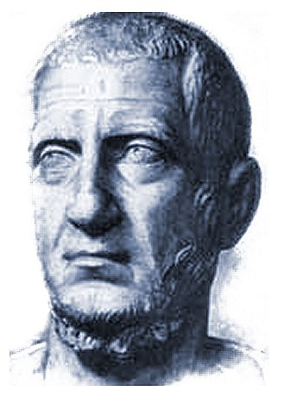
“The desire for safety stands against every great and noble enterprise”
Tacitus
Annals xv
circa 110

Slide 16

Pliny the Elder (23-70 AD)
Roman senator who wrote about workers who protected themselves from dust by tying bladders over their mouths.
He also noted hazards of asbestos and cinnabar
(mercury ore).

Slide 17
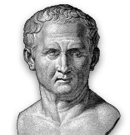
“ Salus populi est suprema lex”
The safety of the people is the supreme law
Cicero 50 BC.

Slide 18
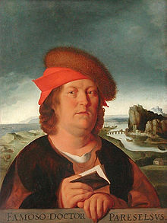
Paracelsus (1493-1541)
Known by several names
Born: Born Phillip von Hohenheim
A Swiss physician, he wrote a
treatise on occupational diseases.
Described lung diseases among
miners and attributed the cause to
vapors and emanation from metals (fumes).
Paracelsus is best known today as the
“Father of Toxicology” because of his
observations of dose and response:
“All substances are poisons; there is
none which is not a poison. The right
dose differentiates a poison and a
remedy.”
Credited with naming the element zinc

Slide 19
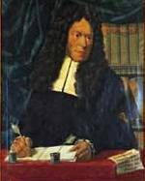
Bernardino Ramazzini (1633-1714)
Italian physician, known as the “patron saint of industrial medicine”.
His book De Morbis Artificium Diatriba
(The Diseases of Workmen) described
the symptoms of mercury and lead poisoning and other occupational diseases.
He wrote about the pathology of silicosis and recommended precautions to avoid hazards.

Slide 20
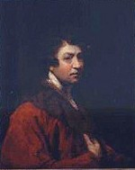
Sir George Baker (1722-1809)
Discovered that “Devonshire colic” was caused by lead contamination in cider.”

Slide 21
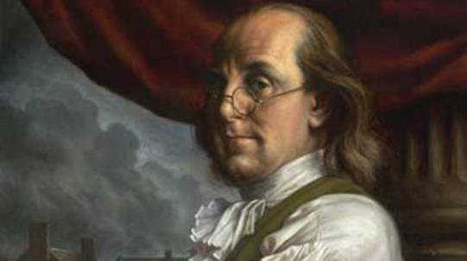
Benjamin Franklin
In 1736, Franklin, with a group of like-minded individuals, formed the Union Fire Company in Philadelphia, Pennsylvania, the first organized fire company in the colonies.
“About this time I wrote a paper… on the different accidents and carelessness by which houses were set on fire, with cautions against them, and means purposed of avoiding them.”

Slide 22
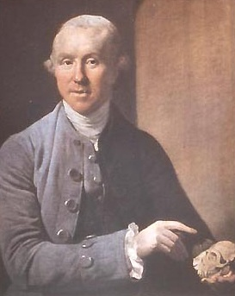
Percival Pott (1714-1788)
A London physician, he was the first to link occupational exposure to cancer.
Scrotal cancer among chimney sweeps, caused by soot
"My lamp is almost extinguished: I hope it has burned for the benefit of others."
-upon deathbed-

Slide 23
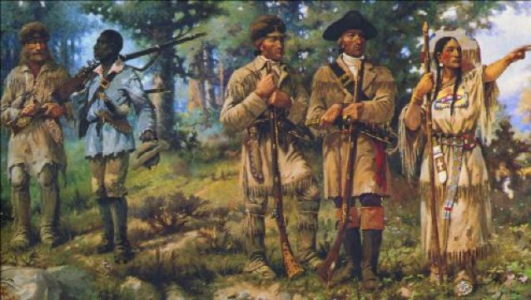
The byproducts of our resourcefulness have often marked prehistory and history….
Lewis and Clark Expedition (1803-1806)

Slide 24
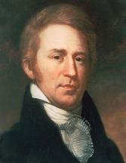
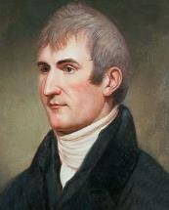
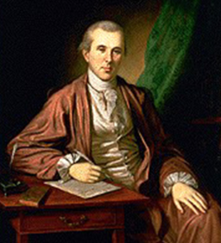
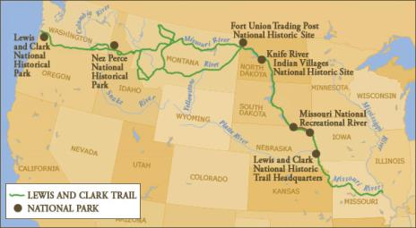
Thomas Jefferson sent Meriwether Lewis to Philadelphia in the spring of 1803 to solicit medical advice from founding father and physician Benjamin Rush. Rush prescribed pills known as “Thunder-clappers” and fifty dozen were included in the medical pharmacy taken on the expedition. Among other ingredients, the pills combined a mixture of six parts mercury to one part chlorine. Lewis and Clark used the pills to treat malaria, an accidental arsenic poisoning, pleurisy, and dysentery. Deposits of mercury can still be found in encampments along their trail.
William Clark
(1770 –1838)
Meriwether Lewis
(1774 –1809)
Benjamin Rush
(1745 -1813)

Slide 25
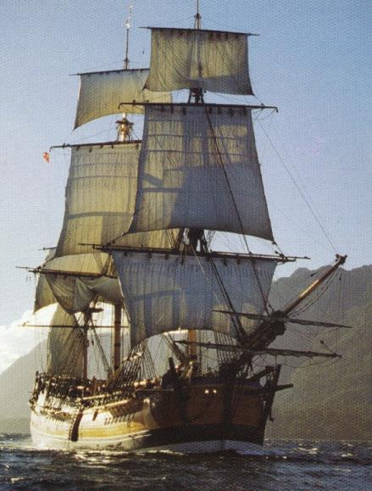
1790 The U.S. Federal Government, the First Congress passes an ineffective Merchant Seaman's Act which gave the crew of a ship at sea the right to order the vessel into the nearest port if a majority of the seamen plus the first mate believed it was unseaworthy
* Henry W. Farnam, Chapters in the History of Social Legislation in the United States to 1860 (Washington, Carnegie Institution, 1938), pp. 242-46.

Slide 26
Fight Hazards with INSURANCE!
Throughout the Antebellum era and especially after the Civil War, life and accident insurance companies expanded, and some workers purchased insurance or set aside savings to offset the income risks from death or injury.
Some unions and fraternal organizations also offered their members insurance.
Railroads and some mines also developed hospital and insurance plans to care for injured workers while many carriers provided jobs for all their injured men.

Slide 27
1872, Massachusetts report describes some particularly grisly accidents and the industrial statistics
1877, Massachusetts passes the Nation's first factory inspection law. It required guarding of belts, shafts, and gears, protection on elevators, and adequate fire exits.
1878, The first recorded call by a labor organization for federal occupational safety and health law is heard.
1887, Congress creates the Interstate Commerce Commission partly because of the large numbers of railroad workers killed or injured in train wrecks
1890, nine States provided for factory inspectors, 13 required machine guarding, and 21 made limited provision for health hazards.
1893, At the urging of the Interstate Commerce Commission and the railroad unions, Congress passes the "coupler bill" which banned the notoriously dangerous link-and-pin method of coupling cars

Slide 28
Railroad Safety Appliance Act (1893)
(Railroads were second only to coalminers)
Provided a uniform standard.
Controlled speeds of the train without requiring brakemen to use a hand brake for that purpose.
Coupler safety
Applied to all trains and cars used on any railroad engaged in interstate
Required safety checks on locomotive and a sufficient number of cars.
Required secure grab irons or handholds in the ends and sides of each car
Violation paid in a penalty of $100 for every violation,
If someone working for a non-compliant train is injured. If employee injured in a train that is not in compliance with this act will not need to bear the risk occasioned even if he knew that it was unlawful to do things that way and still continued working for the employer.

Slide 29
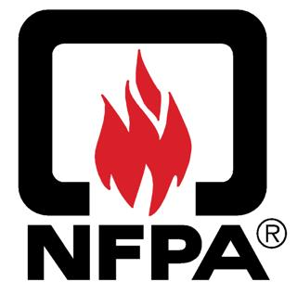
1896, an association to prevent fires and write codes and standards, the National Fire Protection Association (NFPA), was founded.

Slide 30
Lochner vs. New York (1905)
(Joseph Lochner, owner of Lochner's Home Bakery)
Lochner vs. New York, (1905), In response to a New York State Bakeshop Act,
  Regulated sanitary conditions
  Prohibited individuals from working in bakeries for more than ten hours per day or sixty hours per week.
  Could not sleep in bakery
  Supreme Court ruled was a landmark United States Supreme Court case that held a "liberty of contract" was implicit in the due process clause of the Fourteenth Amendment. The case involved a New York law that limited the number of hours that a baker could work each day to ten, and limited the number of hours that a baker could work each week to 60. By a 5-4 vote, the Supreme Court rejected the argument that the law was necessary to protect the health of bakers, deciding it was a labor law attempting to regulate the terms of employment, and calling it an "unreasonable, unnecessary and arbitrary interference with the right and liberty of the individual to contract.”

Slide 31
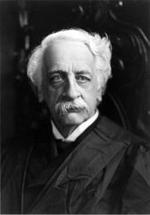
“The Great Dissenter”
Oliver Wendell Holmes Jr.
Lochner vs. New York, (Dissenting Opinion)
I think that the word 'liberty,' in the 14th Amendment, is perverted when it is held to prevent the natural outcome of a dominant opinion…. It does not need research to show that no such sweeping condemnation can be passed upon the statute before us. A reasonable man might think it a proper measure on the score of health. Men whom I certainly could not pronounce unreasonable would uphold it as a first installment of a general regulation of the hours of work. Whether in the latter aspect it would be open to the charge of inequality I think it unnecessary to discuss.
”
Oliver Wendell Holmes Jr.

Slide 32
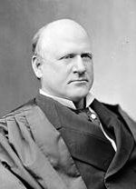
Mr. Justice John Marshall Harlan’s
Dissent
“ The power of the courts to review legislative action in respect of a matter affecting the general welfare exists only when that which the legislature has done comes within the rule that, if a statute purporting to have been enacted to protect the public health, the public morals or the public safety, has no real or substantial relation to those objects, or is, beyond all question, a plain, palpable invasion of rights secured by the fundamental law."
John Marshall Harlan

Slide 33
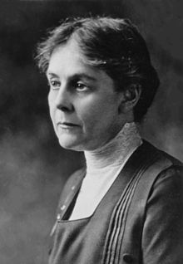
By chance, U.S. Commissioner of Labor Charles Neill met Dr. Alice Hamilton, now considered the founder of industrial medicine, at a European conference on occupational accidents and diseases. She was studying lead trades as director of the Illinois Occupational Disease Commission.
  Neill invited her to work as a special investigator for the Bureau of Labor. She accepted and until 1921 traveled around the country visiting lead smelters, storage battery plants, and other hazardous workplaces.
  In 1911, she published a study of the white lead industry that was the first of a series of Bureau of Labor reports known as the "Federal survey."
Dr. Alice Hamilton

Slide 34
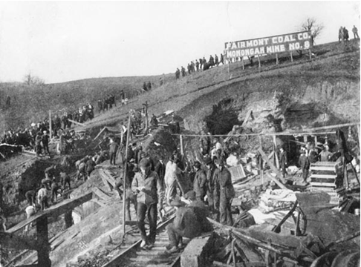
1907, 362 coal miners were killed at Monongah, W. Va., in the worst U.S. mine disaster. This widely publicized tragedy shocked the Nation and led to the creation in 1910 of the U.S. Bureau of Mines to promote mine safety.

Slide 36
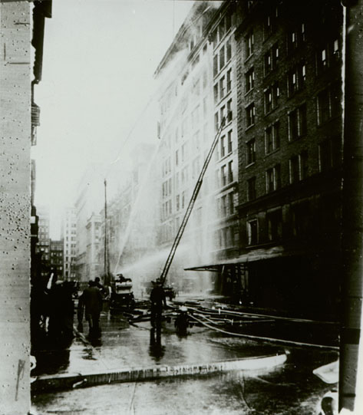

Slide 37
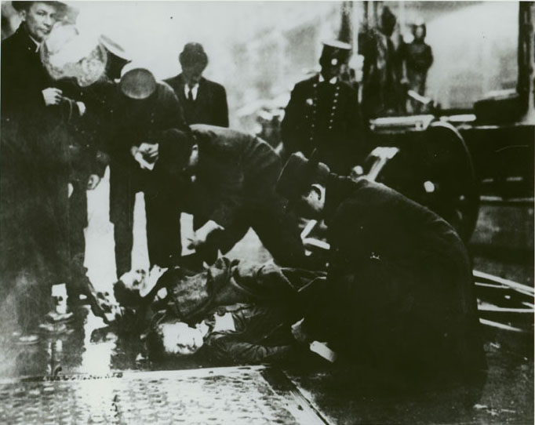
Notes:
This photo only shows two bodies but the streets were strewn with bodies….141 died.

Slide 38
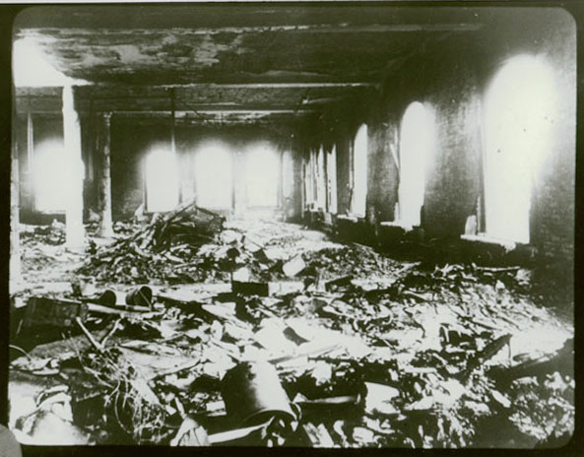

Slide 39
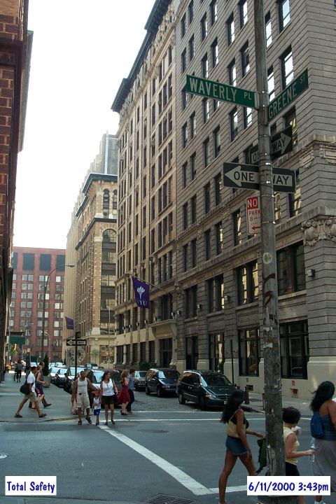

Slide 40
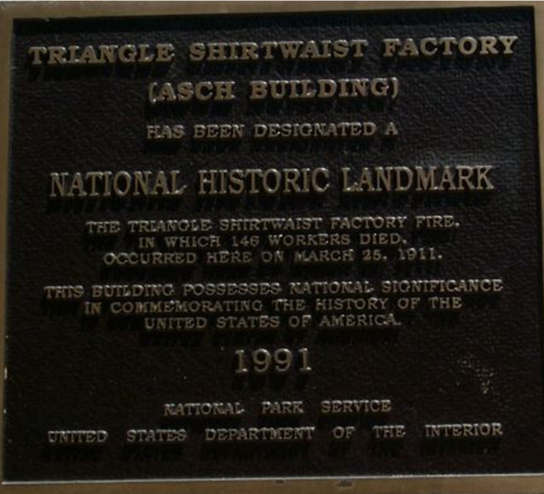

Slide 41

American Society of Safety Engineers
1911

Slide 42
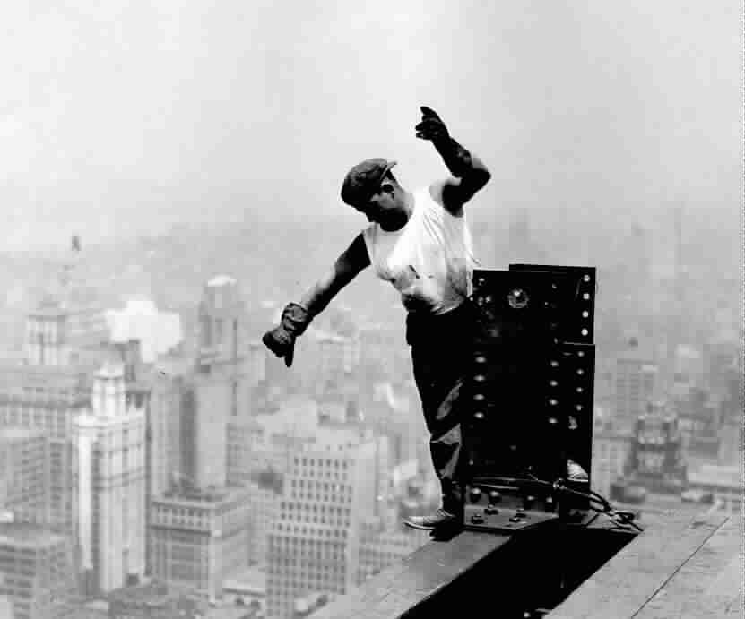

Slide 43
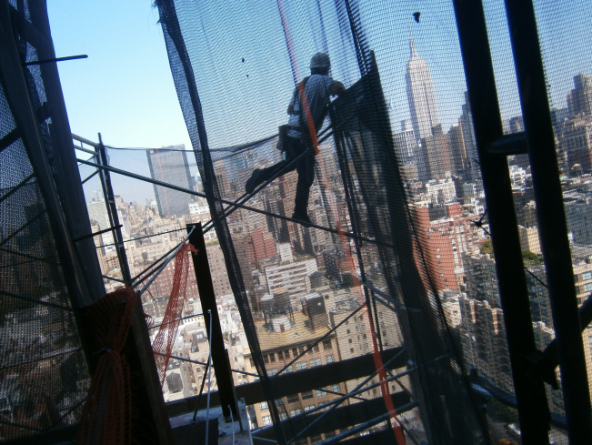

Slide 44
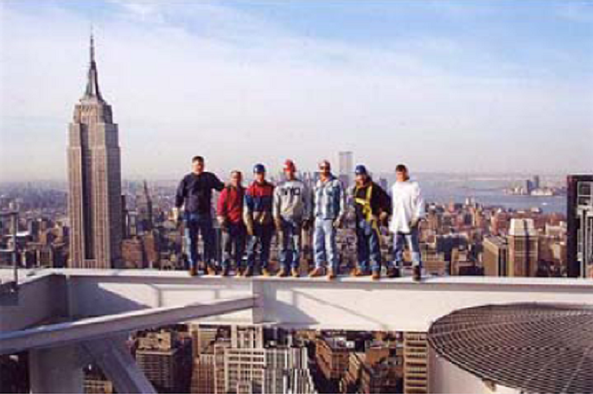

Slide 45
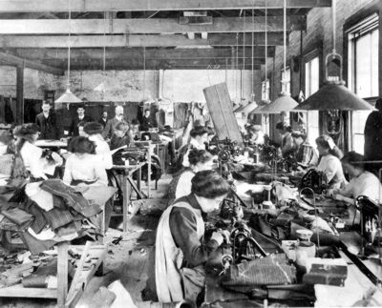
1914 - Studies in New York City and
Youngstown, Ohio
Revealed unsanitary conditions and tuberculosis among workers, leading to the abolishment of “sweat shops.”
1923 - Studies of the “dusty trades”
Led to the development of industrial hygiene sampling equipment.

Slide 46
1930: Gauley West Virginia Bridge Disaster, also known as the Hawks Nest tragedy, this was America’s worst industrial disaster killed at least 476 men and disabled1500 by silicosis. Economic factors of the Great Depression forced the men to work in unhealthy conditions

Slide 47
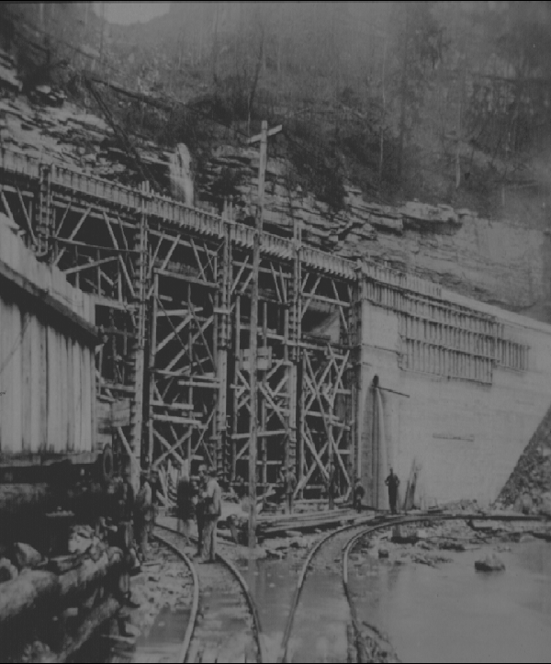

Slide 48
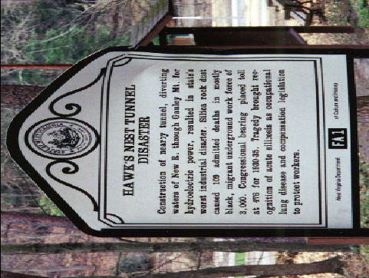

Slide 49
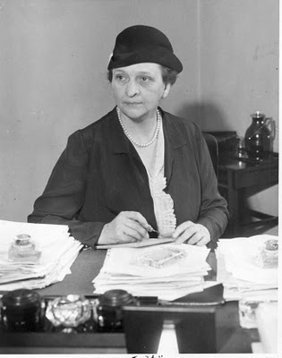
Francis Perkins
Witnessed Triangle Shirtwaist “pivotal event in her life”
New York State Industrial Commission
Expanded factory investigations for safety and health issues.
Called for a federal occupational safety and health law.
Created the Bureau of Labor Standards in 1934.
1936 Instrumental in the drafting of the Walsh-Healey (Public Contracts) Act passed. This law required that all federal contracts be fulfilled in a healthful and safe working environment.

Slide 50
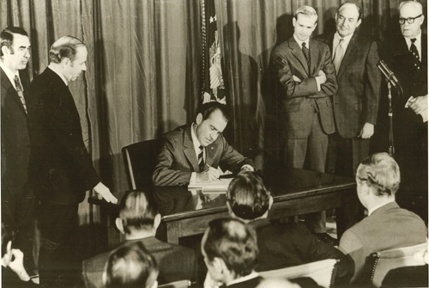
Occupational Safety and Health Act of 1970
(Williams-Steiger Occupational Safety and Health Act)
U.S. Congressman William "Bill" Steiger R-Wisconsin
U.S. Senator Harrison "Pete" Williams, Jr D-New Jersey
On December 29, 1970, President Richard Nixon signed into law the

Slide 51
Title 29 CFR 1975.2 Basis of Authority
Coverage of Employees under the Williams-Steiger OSHA 1970 The power of Congress to regulate employment conditions under the Williams-Steiger Occupational Safety and Health Act of 1970, is derived mainly from the Commerce Clause of the Constitution. (Sec. 2(b), Public Law 91-596; U.S. Constitution, Art. I, Sec. 8, Cl. 3; "United States v. Darby," 312 U.S. 100.) The reach of the Commerce Clause extends beyond Federal regulation of the channels and instrumentalities of interstate commerce so as to empower Congress to regulate conditions or activities which affect commerce even though the activity or condition may itself not be commerce and may be purely intrastate in character. ("Gibbons v. Ogden," 9 Wheat. 1, 195; "United States v. Darby," supra; "Wickard v. Filburn, 317 U.S. 111, 117; and "Perez v. United States," 91 S. Ct. 1357 (1971).) And it is not necessary to prove that any particular intrastate activity affects commerce, if the activity is included in a class of activities which Congress intended to regulate because the class affects commerce. ("Heart of Atlanta Motel, Inc. v. United States," 379 U.S. 241; "Katzenbach v. McClung," 379 U.S. 294; and "Perez v. United States," supra.) Generally speaking, the class of activities which Congress may regulate under the commerce power may be as broad and as inclusive as Congress intends, since the commerce power is plenary and has no restrictions placed on it except specific constitutional prohibitions and those restrictions Congress, itself, places on it. ("United States v. Wrightwood Dairy Co.," 315 U.S. 110; and "United States v. Darby," supra.) Since there are no specific constitutional prohibitions involved, the issue is reduced to the question: How inclusive did Congress intend the class of activities to be under the Williams-Steiger Act?

Slide 52

Article I, Section 8, Clause 3:
“ The Congress shall have Power] To regulate Commerce with foreign Nations, and among the several States, and with the Indian tribes

Slide 53
Commerce Clause Cases
Gibbons v. Ogden (1824)
Slaughterhouse Cases 83 (1872)
Standard Oil Co. of New Jersey v. United States 221 (1911)
National Labor Relations Board v. Jones & Laughlin Steel Corp. (1937)
Heart of Atlanta Motel, Inc. v. United States 379 (1964)

Slide 54
Constitutional Issues Live On
Multiple Employer Citation
Can you think of any?

Slide 55
Occupational Safety and Health Act of 1970
SECTION. 5. Duties (a) Each employer (1) shall furnish … a place of employment which are free from recognized hazards that are causing or are likely to cause death or serious physical harm to his employees;
(b) Each employee shall comply with occupational safety and health standards and all rules, regulations, and orders issued pursuant to this Act which are applicable to his own actions and conduct.
SECTION. 12. The Occupational Safety and Health Review Commission
SECTION. 19. Federal Agency Safety Programs and Responsibilities (POHSA, PESH)
SECTION. 20 & 22 Research and Related Activities The Secretary of Health and Human Services, National Institute of Occupational Safety and Health
SECTION. 21. Training and Employee Education Outreach
SECTION. 24. Statistics (a) … the Secretary… shall develop and maintain an effective program of collection, compilation, and analysis of occupational safety and health statistics.

Slide 56
What You Should Know About OSHA
Laws and Codes “Standards” Federal Registers, Federal Regulations.
Incorporated Reference: Consensus Standards, and Recommendations Professional Organizations: i.e. ANSI, NFPA WHO, World Health Organization, ACGIH American Conference of Governmental Industrial Hygienists.
Directives (Instructions to OSHA staff on how to enforce codes)
OSHA Enforcement Standard Interpretations
Letters of interpretations
Publications are documents published by OSHA that have not gone through the OSHA rulemaking process, such as Ergonomics Program Management Guidelines for Meatpacking Plants and Guidelines for Preventing Workplace Violence for Health Care and Social Workers. Not enforceable as OSHA standards but in some cases may be used in conjunction with the General Duty Clause to cite an employer for an unsafe work practice
OSHA Review Commission Decisions

Slide 57


Slide 58










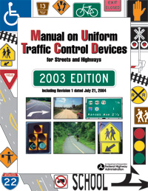

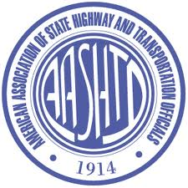



Slide 59
Are there common threads that run through history and safety and health?

Slide 60
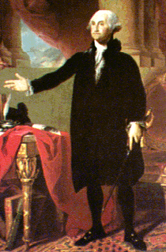
A proclamation by President George Washington and a congressional resolution established the first national Thanksgiving Day on November 26, 1789. The reason for the holiday was to give “thanks” for the new Constitution.

Slide 61
A Proclamation by the
President of the United States of America
Whereas it is the duty of all Nations to acknowledge the providence of Almighty God, to obey his will, to be grateful for his benefits, and humbly to implore his protection and favor-- and whereas both Houses of Congress have by their joint Committee requested me to recommend to the People of the United States, a day of public thanksgiving and prayer to be observed by acknowledging with grateful hearts the many signal favors of Almighty God, especially by affording them an opportunity peaceably to establish a form of government for their safety and happiness….
Given under my hand at the City of New York the third day of October in the year of our Lord 1789
Go: Washington

