Slide 1
Indoor air quality
“This material was produced under the grant SH-20839-SHO from the Occupational Safety and Health Administration, U.S. Department of Labor. It does not necessarily reflect the views or policies of the U.S. Department of Labor, nor does mention of trade names, commercial products, or organizations imply endorsement by the U.S. Government.”

Slide 2
Objectives
Know the difference between sick building syndrome and building-related illness.
Identify building conditions as well as contaminants associated with symptoms or illnesses
Learn some of the preliminary steps to an effective IAQ investigation
Be familiar with a few model IAQ policies and practices

Slide 3
Sick Building Syndrome
Sick building syndrome (SBS) - a term for symptoms which may be triggered by poor indoor air quality including:
    Headaches
    Fatigue
    Nausea
    Difficulty in concentrating
    Irritation of the eyes, nose, throat and skin
Notes:
The US EPA long ago made two categories of health effects associated with indoor air quality.
The first, known as Sick building syndrome (SBS) is a term for symptoms which may be triggered by poor indoor air quality.
These include some symptoms you mentioned, such as: headaches, fatigue, nausea, difficulty in concentrating and irritation of the eyes, nose, throat and skin.
They don’t fit the pattern of any particular illness and usually can’t be traced to any specific exposure source.
In a problem building, the majority of workers will experience some of these symptoms, but will most likely feel better after they leave the building.
Image: Power point clipart

Slide 4
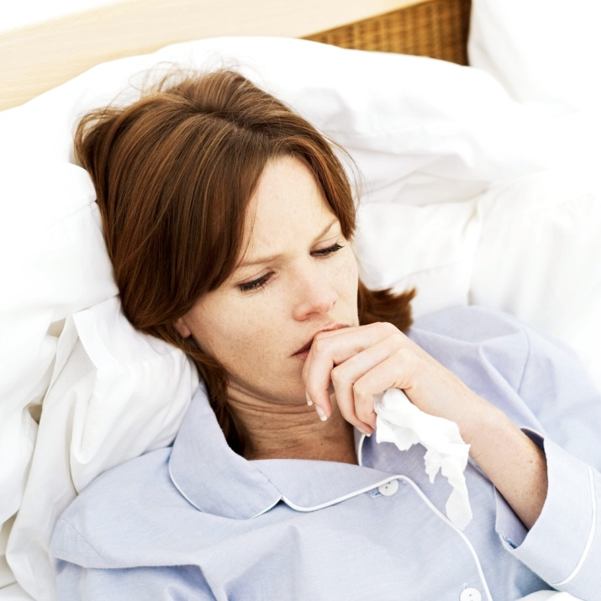
Building Related Illness
But sometimes people don’t get better, they get sick.
EPA placed these illnesses in a second category called building-related illness (BRI)
  Symptoms include coughing, chest tightness, fever, chills and muscle aches, and they don’t clear up after you leave the building.
  BRI is a diagnosed illness which can be linked directly to exposure to contaminants in a building’s air.
Notes:
But sometimes people don’t get better, they get sick and EPA put these illnesses in a second category called building-related illness (BRI).
BRI is a diagnosed illness which can be linked directly to exposure to contaminants in a building’s air.
These illnesses can be severe and are flu-like in nature. Symptoms include coughing, chest tightness, fever, chills and muscle aches, and they don’t clear up after you leave the building. Examples include Legionnaire’s Disease and Restrictive Airways Disease.
Image: Power point clipart

Slide 5
And there’s asthma……..
  Asthma rates are high in damp buildings and newly-acquired cases of asthma are on the rise.
  Asthma rates appear to be going up for custodians and others who are over exposed to common disinfectants such as bleach and Lysol spray.
  In education, employees have higher rates of work-related asthma compared to the general working population.
Notes:
Asthma rates go up in damp buildings (high humidity and leaks) – conditions that are ripe for mold, bacteria and viruses
Newly-Acquired cases of asthma are on the rise in these damp buildings – i.e. asthma contracted as an adult in the bad building
Asthma rates appear to be going up for cleaners and others who are over exposed to common disinfectants such as bleach and Lysol spray
In education, school employees have high rates of work-related asthma
Image: Power point clipart

Slide 6
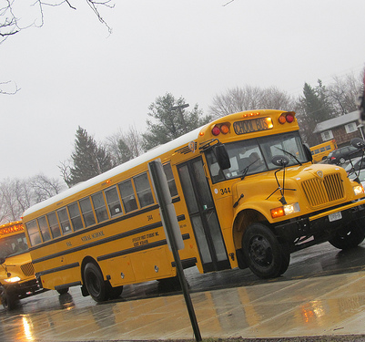
Outside Sources
Where a building is sited determines what is being brought into the building from the outside.
Common outside contaminants include:
    Pollen, dust,
    Industrial pollution
    Vehicle exhaust
    DUMPSTER odors!!
Image: ThoseGuys119's photostream
Notes:
When we’re thinking about pollution sources, we also have to think about where the building is sited. That can determine what is being brought into the building from the outside.
This may include nasty contaminants, such as pollen, dust, industrial pollution, vehicle exhaust and even dumpster odors which add to the mix already in the building!
Images from: Creative Commons:
You are free:
to Share — to copy, distribute and transmit the work
to Remix — to adapt the work
Under the following conditions:
Attribution — You must attribute the work in the manner specified by the author or licensor (but not in any way that suggests that they endorse you or your use of the work).
Image: ThoseGuys119's photostream

Slide 7
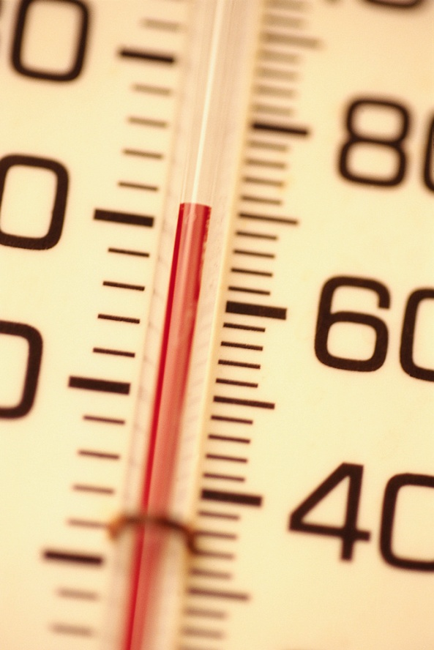
Temperature/Humidity
High temperature + High humidity =
  Lethargy
  Fatigue
  Reduced productivity (less learning etc.)
High temperature + Low humidity =
  Dry skin, eyes
  Dry throat
  Prone to more colds, infections
Notes:
Temperature and humidity are more than comfort issues, they can cause symptoms.
When temperatures are high and the relative humidity goes above 60%, people will feel very uncomfortable and sweaty, and will be less productive.
On the other hand, if room temperature is high in winter and the relative humidity goes below 40%, then workers will start to complain of dry skin, eyes, nose and throat. This drying effect on the throat and nose puts people at risk for more colds and infections.
So, it’s about more than comfort, it’s about health.
Image: Power point clipart

Slide 8
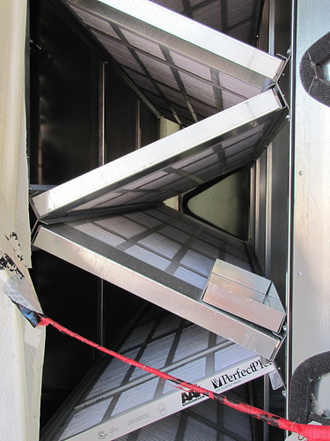
Building Sources: Ventilation/Air Conditioning
If the ventilation system is not:
  Delivering enough fresh air
  Filtering out dust particles and contaminants
………… It becomes a major contributor of bad indoor air quality
Image: Assembled Chemical Weapons Alternatives’ Photostream
Notes:
As you know, our workplaces are filled to the brim with a variety of contaminants. If the ventilation system is not doing its job and not flushing them out, or isn’t being maintained in good working order, we have an indoor air quality problem.
Image: Assembled Chemical Weapons Alternatives’ Photostream

Slide 9
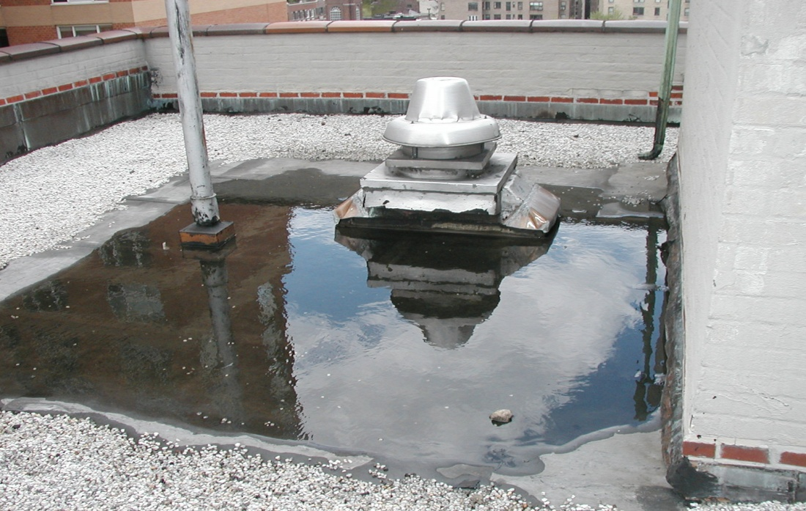
Building sources: that mold you’re smelling……..
Roofs that leak
Windows, doors that leak
Poor drainage that let’s water in the basement or walls
Damp buildings = potential for mold and bacterial growth = miserable occupants with increased allergies and asthma!
Notes:
In the building itself the roof, walls and poorly fitted windows and doors and poor drainage can contribute to the problems. Anytime you have the potential for water intrusion you’ve set yourself up for damp, wet conditions and possible mold growth.
Mold can be found anywhere there is moisture – it thrives on moist, organic matter. It can grow on ceiling tiles, on and behind walls, on floors, books and paper and even inside air ducts.
Image: AFT/UFT

Slide 10
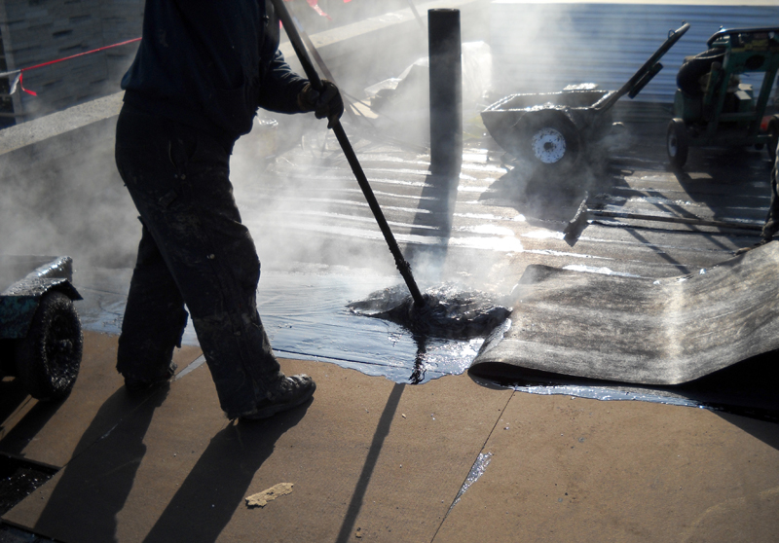
Renovations
Renovations taking place in occupied buildings can lead to exposures to the by-products of construction such as paint fumes, glues and dust.
Renovations not properly conducted can lead to additional health complaints from occupants.
Image: jen_kels' photostream
Notes:
Renovations occurring at the same time as people are in place at work can lead to exposures to the by-products of construction such as paint fumes, glues and dust.
If renovations are not properly conducted it can lead to additional health complaints of occupants.
Image: jen_kels' photostream

Slide 11
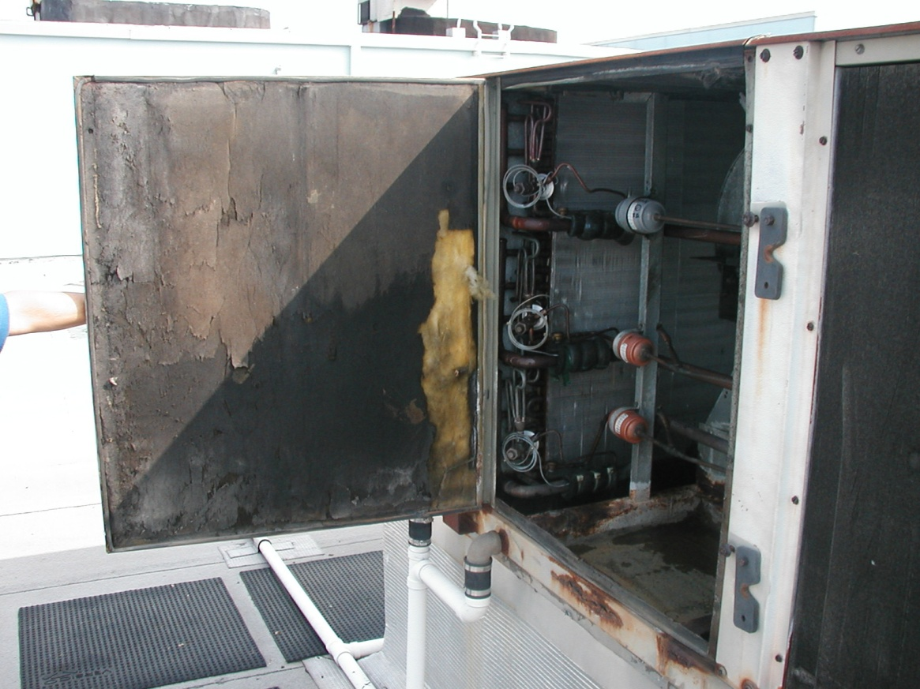
Chronic Fiscal Problems =
Neglected Buildings
Hard –pressed schools, colleges, universities and public agencies often defer maintenance
Damaged fibrous glass insulation
inside the air handler
Notes:
Another big problem is deferred maintenance.
Hard –pressed schools, colleges, universities and public agencies often defer maintenance out of necessity due to chronic fiscal problems and underfunding of public services.
Example: Fibrous glass insulation lines the inside of many air handlers and supply ducts. When damaged it releases glass fibers , which are irritating to the respiratory system.
Image: AFT/UFT

Slide 12
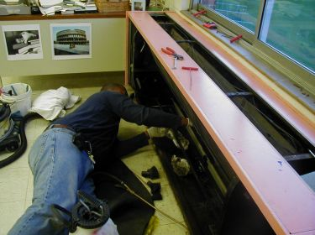

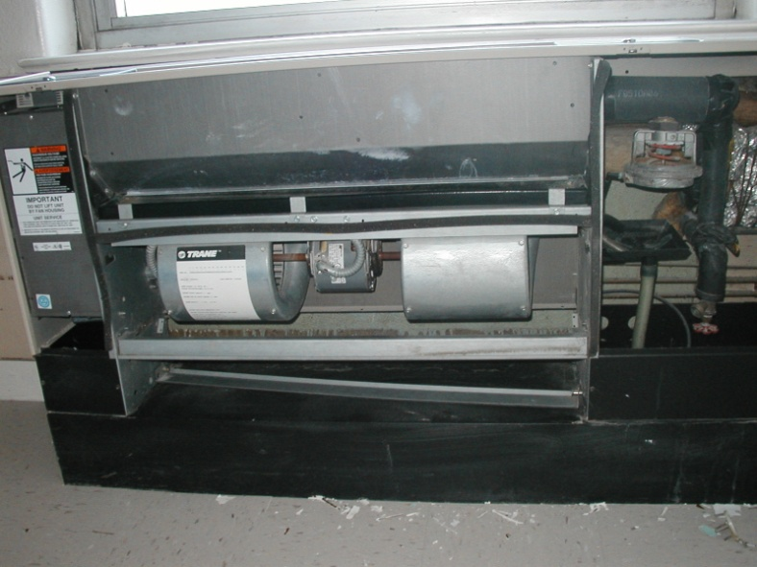
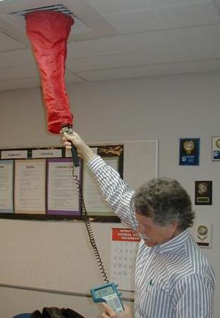
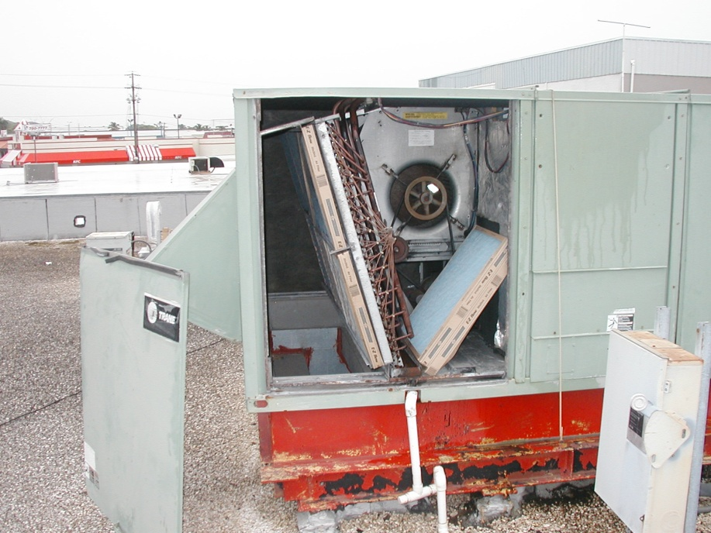
So How Does a Local Union Address an IAQ Issue?
Unit ventilator
HVAC Unit
Notes:
Picture Images: AFT/UFT
Graphics: Power point clipart

Slide 13
Helpful Tests
Carbon Dioxide C0₂
Temperature and Humidity
Exhaled breath
Indicator Gas
Let’s us know other contaminants are building up if levels increase
Will result in symptoms and complaints increasing
Use to track daily patterns
Can help to create a picture of what’s going on in different parts of the building
Notes:
There are two tests that can be helpful:
Carbon dioxide levels – Carbon dioxide is a non-hazardous gas given off when we exhale. However, it’s a good measure of what’s going on within a building. Normal outside air has anywhere from 350 to 450 parts per million (ppm) of CO₂ . When CO₂ levels increase in a building to over 1000 ppm, it means either air supply vents are not bringing in enough outside air to dilute the contaminants or the system is shut down completely. We call CO₂ an indicator gas. High levels of CO₂ isn’t necessarily dangerous, it just tells us that the concentration of all other contaminants are also going up as well. As a result, symptoms and complaints go up. It’s no wonder that by the end of the day everyone is drooping.
Temperature and humidity - Take regular temperature and humidity readings. The equipment for all these tests is inexpensive and samples don’t have to be taken to a lab. Workers can learn to use this equipment and interpret the readings . Your local may want to purchase some of this equipment.

Slide 14
Detective Work is Key
What’s the complaint?: Temperature? Odors? Moisture/humidity? Stale Air? Different complaints? Any patterns?
Who is affected?: Some people and not others? Do symptoms clear up soon after leaving the building?
Where’s the problem?: Are symptoms present all over the building or in just a certain area?
Notes:
If you think about it, that’s just what you’ve just done. You know the complaint, you’re the one affected, you’ve identified potential problems or sources and thought about when and why the problem is happening!
Image: Power point clipart

Slide 15

Detective Work is Key
When does it occur?: Every day? Late afternoon? After a rainstorm? Seasonally? With certain building activities? Anything happen recently at the workplace that could affect the air quality?
Why is it happening? Roof leak? Pesticide spraying? Vocational classes? Buses idling?
Notes:
Image: Power point clipart

Slide 16
New Jersey PEOSH
Indoor Air Quality Standard
Requires public employers to:
  Identify a designated person responsible for complying with standard
  Develop a written plan describing how they will achieve compliance with standard
  Establish and follow a preventative maintenance schedule as per manufacturer’s recommendations
  Promptly investigate employee complaints

Slide 17
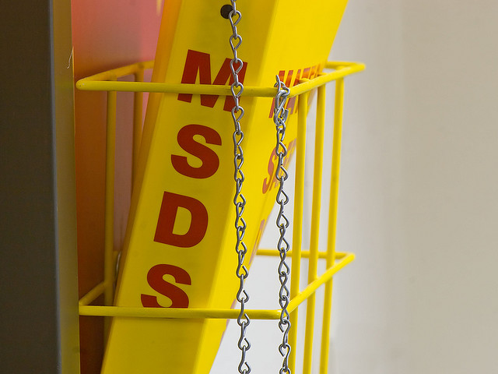
Laws and Regulations that may Help Reduce IAQ Exposures
OSHA Hazard Communication Standard
  Labeling of all containers
  Material Safety Data Sheets (MSDS)
Pesticide application laws for schools
Image: nebarnix's photostream
Notes:
Image: nebarnix's photostream

Slide 18
Use Your Union Structure!
Form a health & safety committee
Survey the membership
Educate members on hazards
Figure out your allies in this struggle
Come up with an action plan
Develop contract language and/or advocate for necessary policies
Notes:
Organize a H&S Committee – if not already established, recommend and/or volunteer to participate in a union H&S committee.
Surveys – both of the members and of the workplace – to find out more information about what issues are a concern and current conditions within the building.
Reporting – is there a reporting process for recording accidents, injuries and illnesses? If yes, is it used by the membership? If not, why not? How can having a reporting system help improve health and safety in the workplace?
Policy – what policies currently exist regarding the safety and health of the employees? What policies are needed? How can the union push the administration to adopt necessary policies?
Contract – What language does the contract have on health and safety issues? What might be suggested for next round of negotiations? Emphasize how getting language like health and safety might be achievable in tough economic times when monetary improvements are unlikely.

