Slide 1
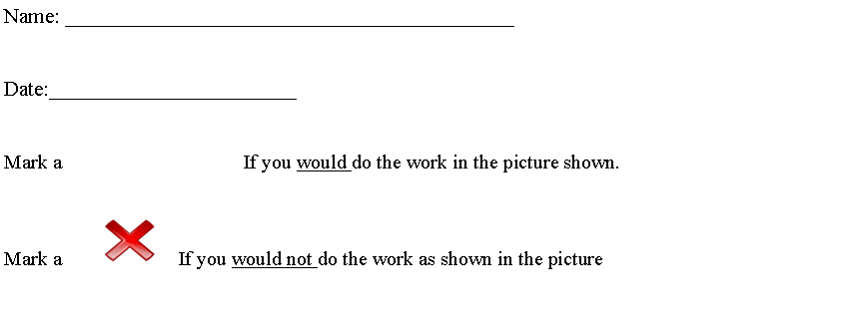
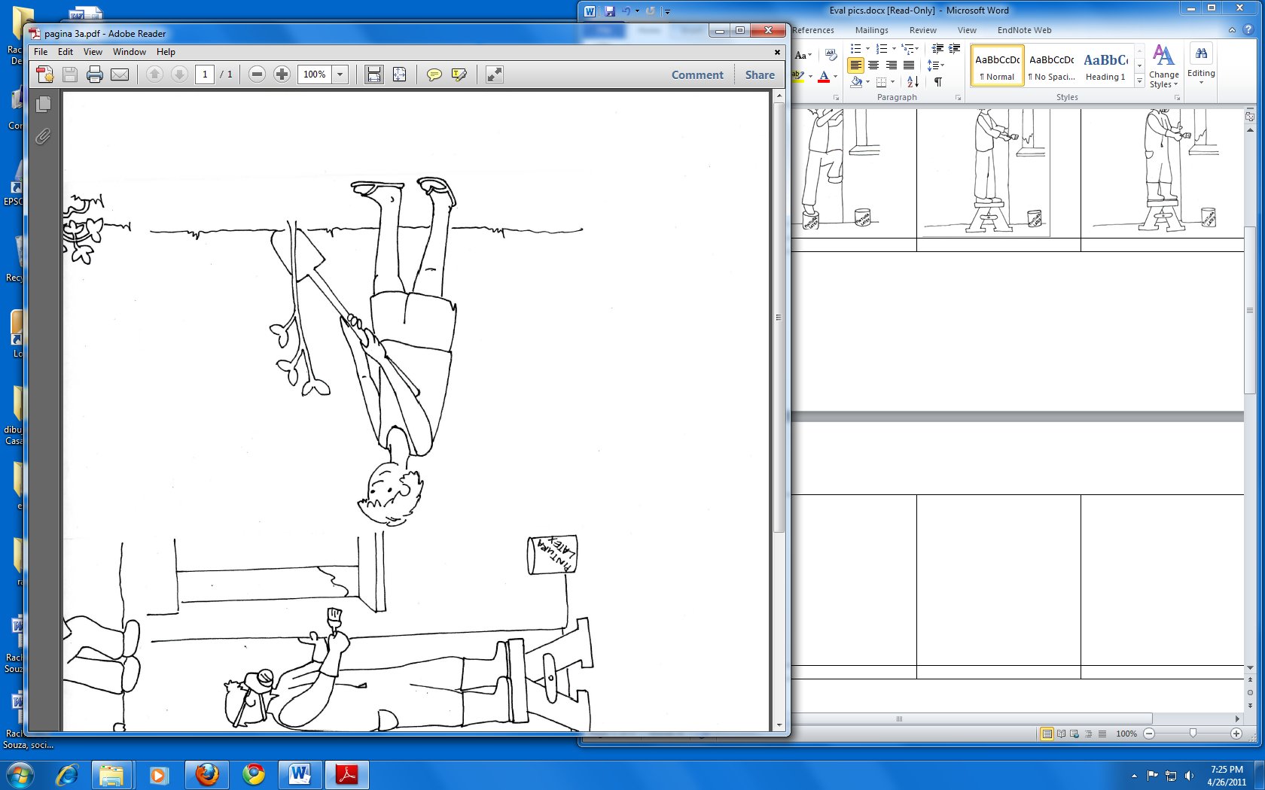
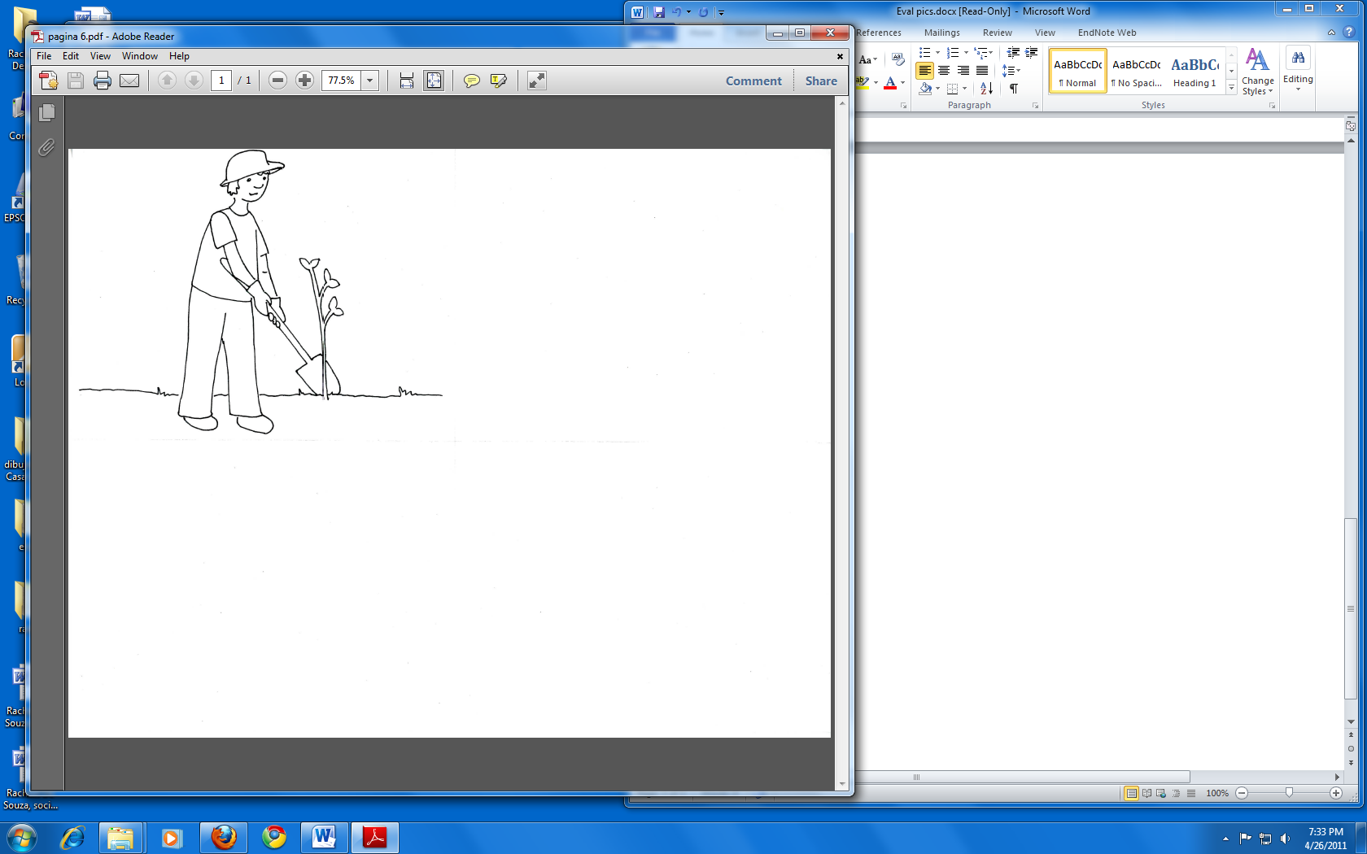
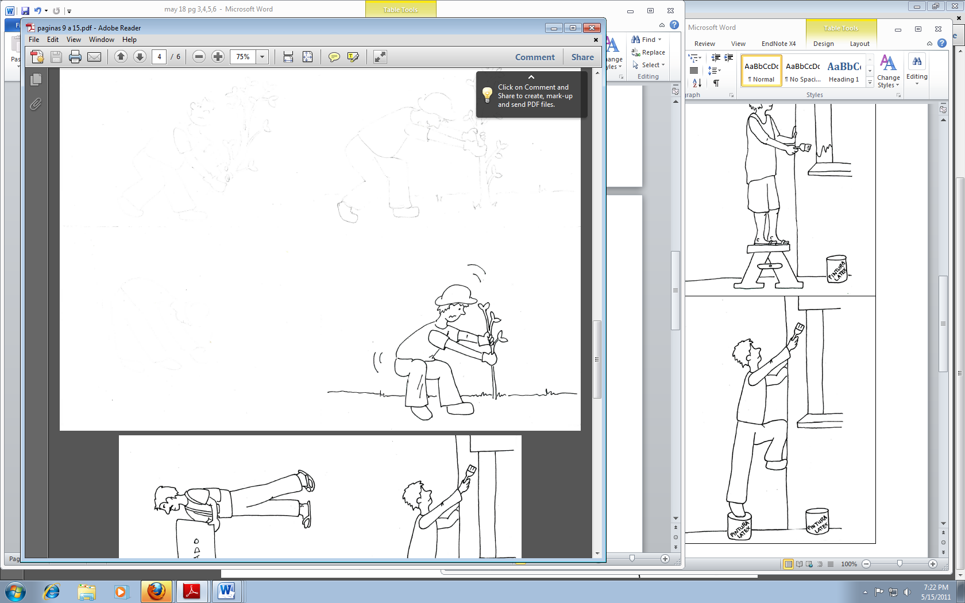
Funded by: Susan Hardwood Grant SH20824SHO
Before the workshop

Slide 2
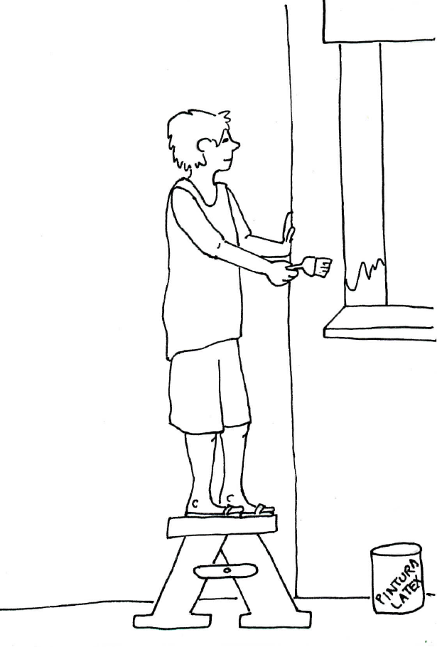
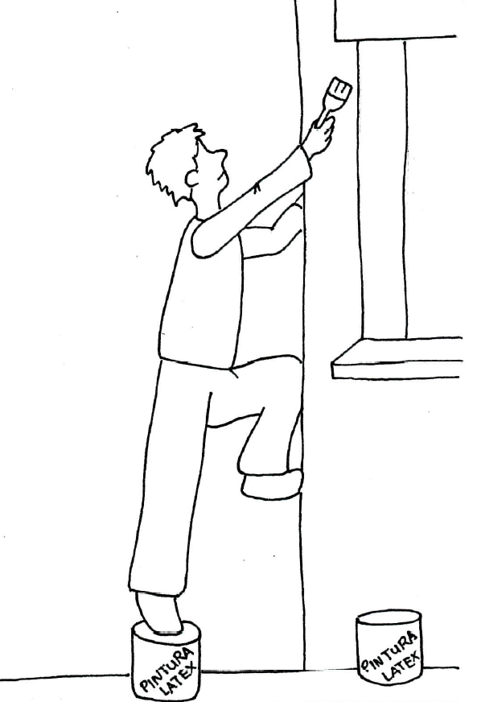
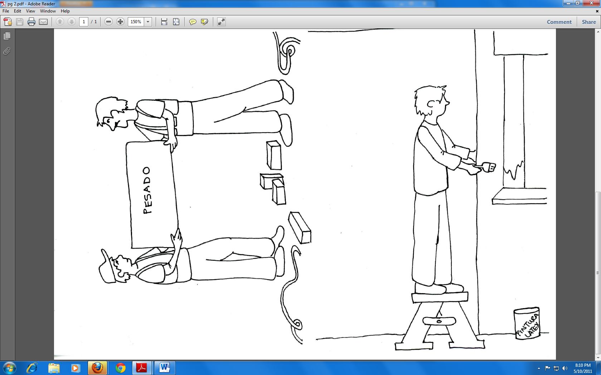
Funded by: Susan Hardwood Grant SH20824SHO
Before the workshop

Slide 3
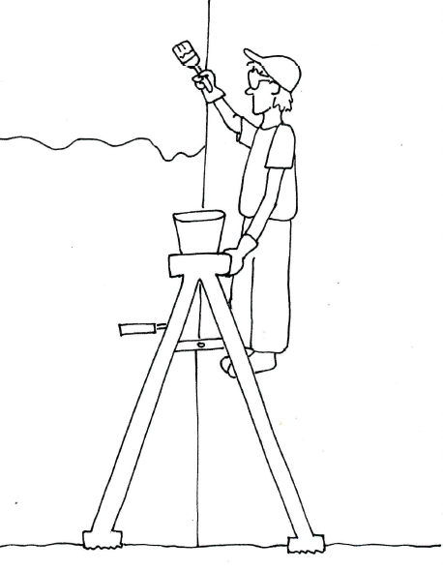
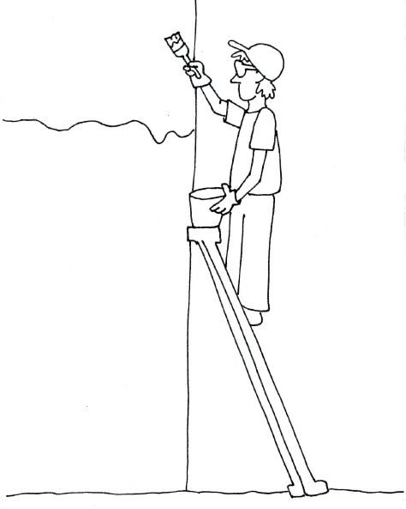
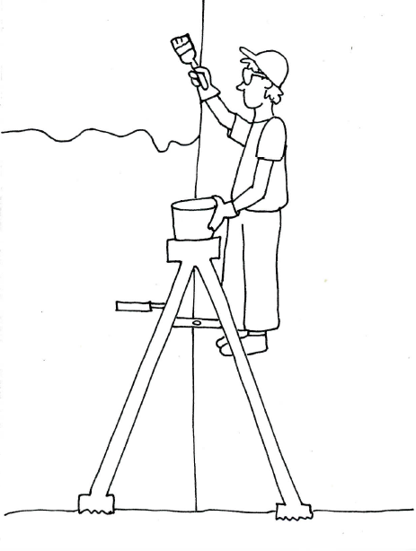
Funded by: Susan Hardwood Grant SH20824SHO
Before the workshop

Slide 4
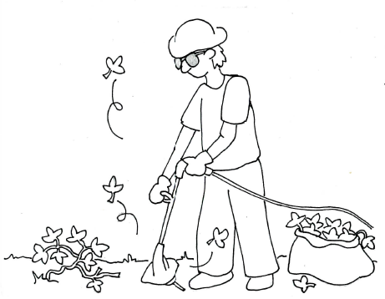
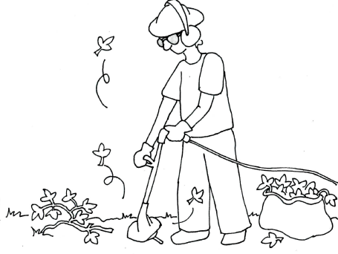
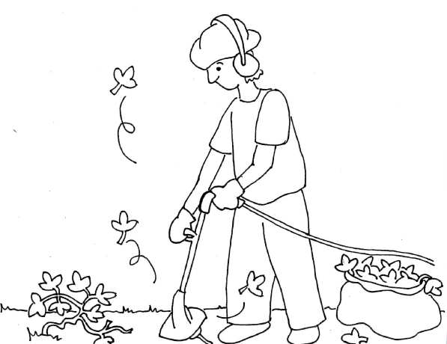
Funded by: Susan Hardwood Grant SH20824SHO
Before the workshop

Slide 5
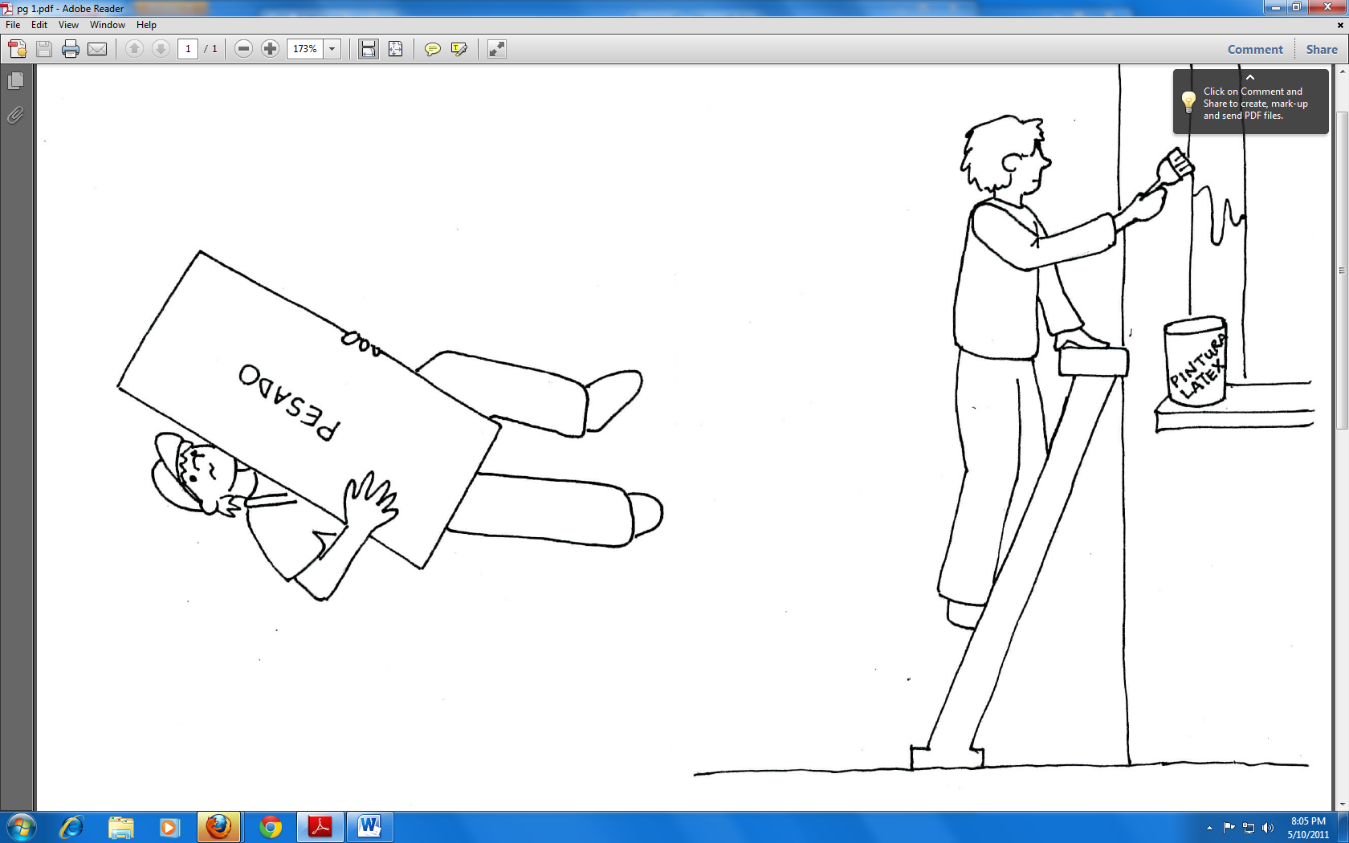
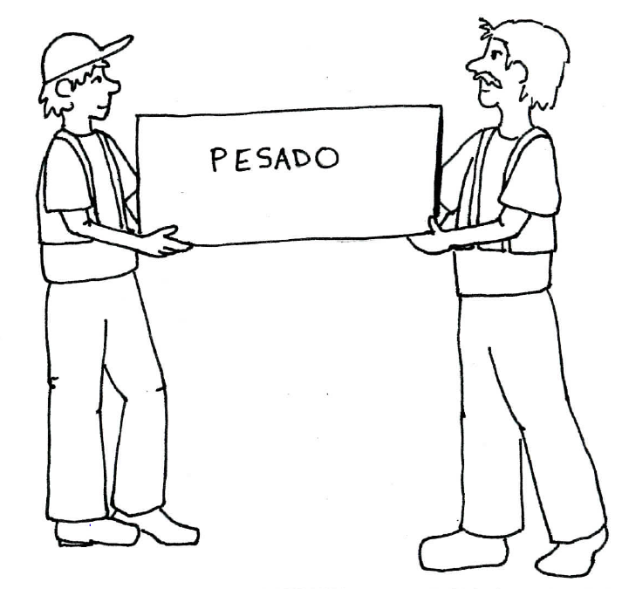
Before the workshop
Funded by: Susan Hardwood Grant SH20824SHO

Slide 6
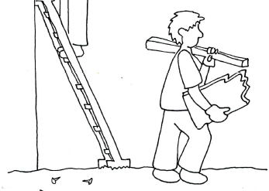
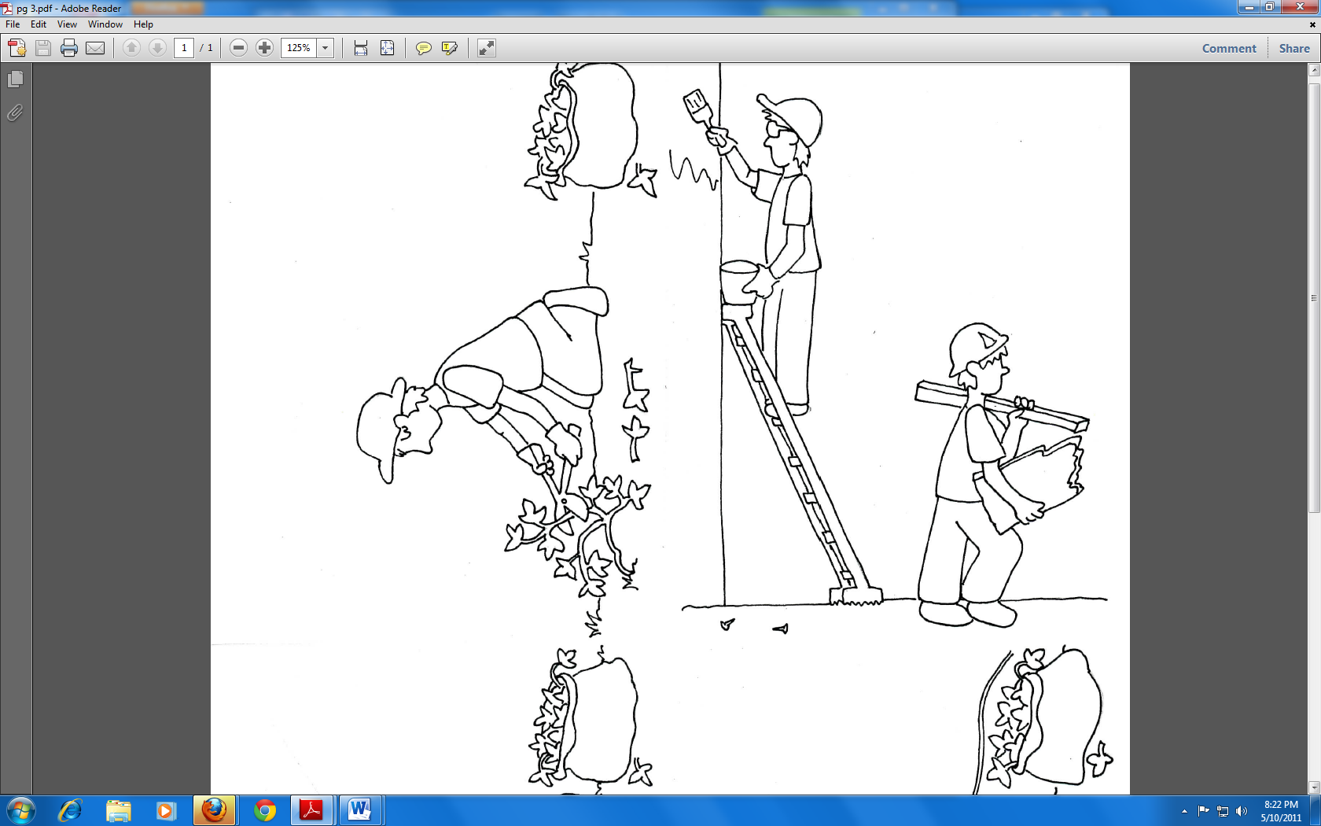
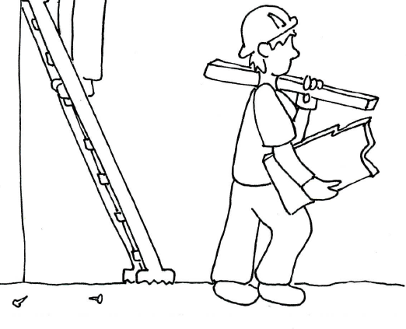
Before the workshop
Funded by: Susan Hardwood Grant SH20824SHO

Slide 7
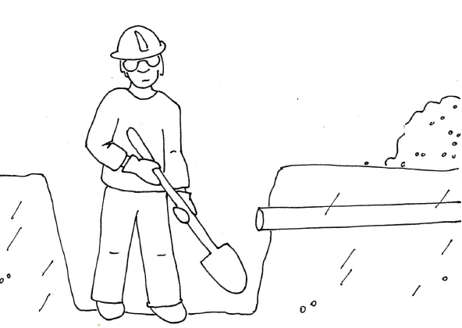
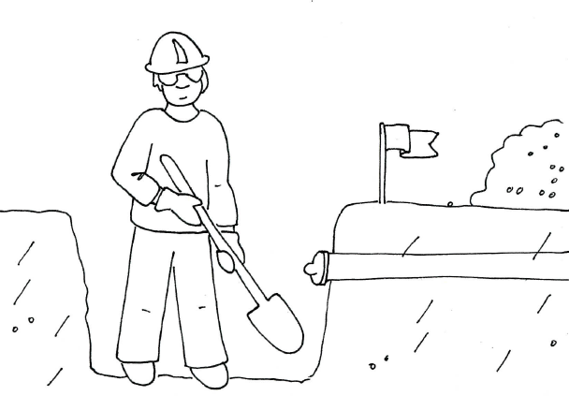
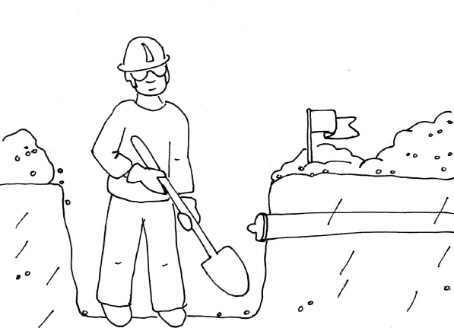
Funded by: Susan Hardwood Grant SH20824SHO
Before the workshop

Slide 9
Funded by: Susan Hardwood Grant SH20824SHO
Before the workshop

Slide 10
Funded by: Susan Hardwood Grant SH20824SHO
Before the workshop

Slide 11
Funded by: Susan Hardwood Grant SH20824SHO
Before the workshop

Slide 12
Funded by: Susan Hardwood Grant SH20824SHO
Before the workshop

Slide 13
Before the workshop
Funded by: Susan Hardwood Grant SH20824SHO

Slide 14
Before the workshop
Funded by: Susan Hardwood Grant SH20824SHO

Slide 15
Funded by: Susan Hardwood Grant SH20824SHO
Before the workshop

